Slide 1


Slide 3
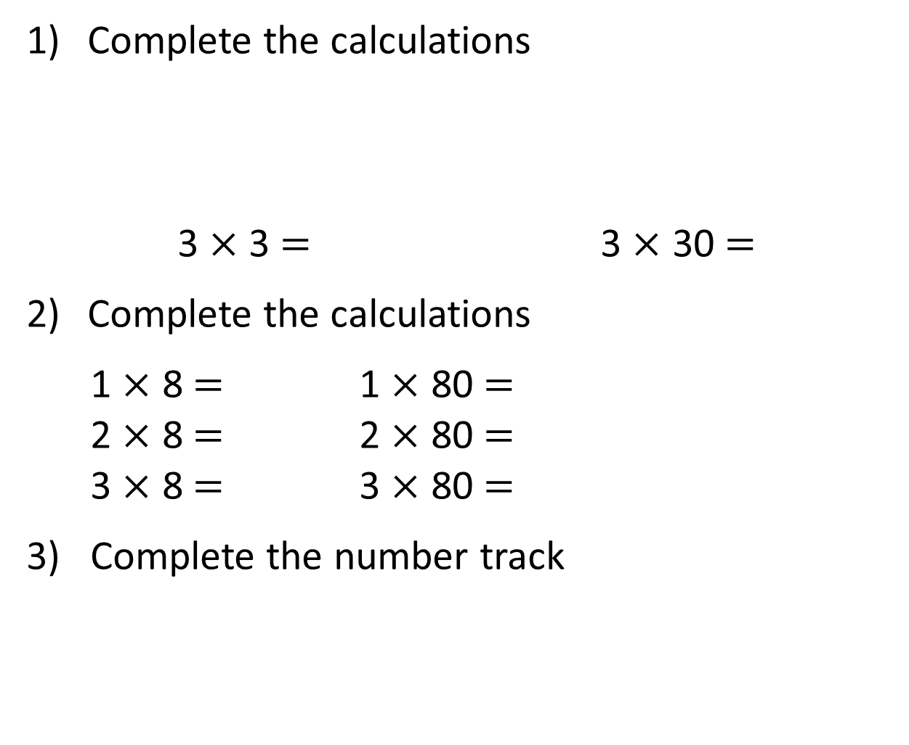
Complete the calculations
3 $×$ 3 $=$ 3 $×$ 30 $=$
Complete the calculations
1 $×$ 8 $=$ 1 $×$ 80 $=$
2 $×$ 8 $=$ 2 $×$ 80 $=$
3 $×$ 8 $=$ 3 $×$ 80 $=$
3) Complete the number track
20 | 40 | 60 |  | 100 |  | 140 | 160

Slide 4
Complete the calculations
3 $×$ 3 $=$ 3 $×$ 30 $=$
Complete the calculations
1 $×$ 8 $=$ 1 $×$ 80 $=$
2 $×$ 8 $=$ 2 $×$ 80 $=$
3 $×$ 8 $=$ 3 $×$ 80 $=$
3) Complete the number track
9
90
8
80
16
160
24
240
20 | 40 | 60 |  | 100 |  | 140 | 160
80
120
180
200

Slide 6

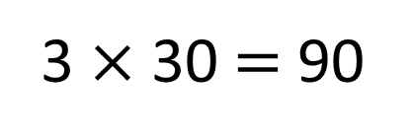
Each class has 30 pears.
How many pears are there in total?
Class 1
Class 2
Class 3
3 $×$ 30 $=$ 90
There are 90 pears in total.

Slide 7
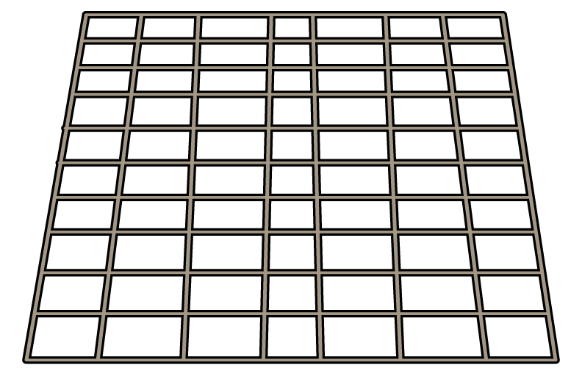



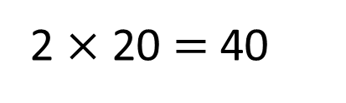
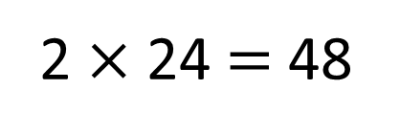
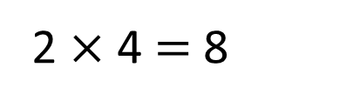
Each tray has 24 rolls.
How many rolls are there in total?
2 $×$ 20 $=$ 40
2 $×$ 4 $=$ 8
T O
2 $×$ 24 $=$ 48
2
4
There are 48 rolls in total.
2
$×$
4
8

Slide 8

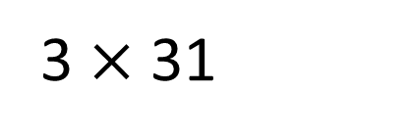
3 $×$ 31
T | O
T O
3
1
$×$
3
9
3

Slide 9

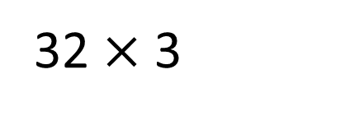
32 $×$ 3
Have a think
T | O
T O
3
2
$×$
3
9
6

Slide 10



Write a short multiplication to match the counters.
T | O
T O
2
1
$×$
4
8
4
Have a think

Slide 11
Have a go at questions 1-6 on the worksheet

Slide 12
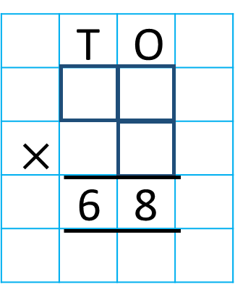
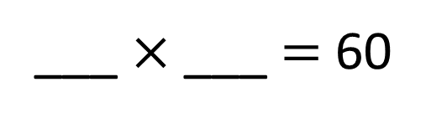
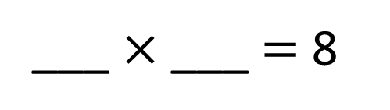
Complete the short multiplication.
4
2
___ $×$ ___ $=$ 8
3
2
4
2
30
___ $×$ ___ $=$ 60
4
Have a think

Slide 13
Have a go at the rest of the questions on the worksheet

