Slide 1
English Week 3 Week Commencing 18.01.2021

Slide 2
Monday

Slide 3
Monday – Lesson 1 OLI: to write a postcard.
During last week’s live session we read the book Dragon Post by Emma Yarlett.
Today’s work will be based on that. You can listen to the story again here (on YouTube).
At the end of the story the Dragon sent Alex some post. Your task is to pretend to be the dragon and write a postcard to your friend Alex to tell him all about your new home.
Think about where you now live and what you have been doing.
Have you been on interesting flights? Try and ask Alex a question, making sure you use a question mark.

Slide 4
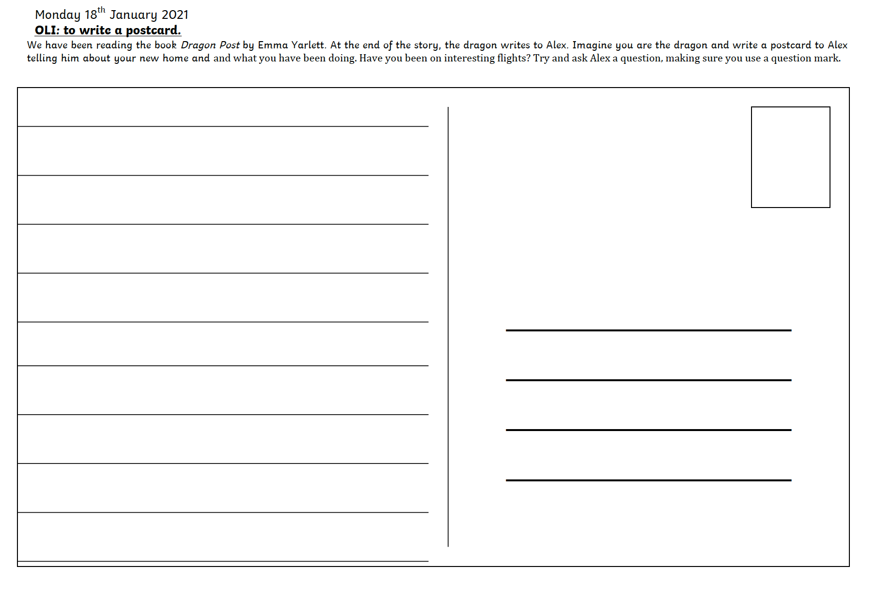

Slide 5
Tuesday

Slide 6
Story writing
This week we will be planning and then writing our own dragon story, a step at a time!
Tuesday: Think about Characters and setting.
Wednesday: Plan the story using a story mountain.
Thursday: Write the first part of the story.
Friday: Write the second part of the story.
A Year 1 target is ‘sequencing sentences to form short narratives.’
Spring term is partially about building the children’s stamina in writing.

Slide 7
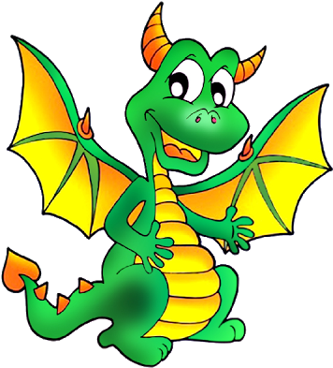
Story writing
We are going to write our own story about a dragon!
When we write a story we need to think about:
The Beginning
The Middle
The End
A year one target is ‘to sequence sentences to form short narratives’. So over the next few weeks we are going to try really hard to write longer stories and pieces of work.

Slide 8
Planning a story
Planning our story before we write it, is the easiest way to make the BEST story.
First we need to think about the characters in our story.
Then we think about the setting. That means where does the story take place.
Then can use a story mountain to help us.

Slide 9
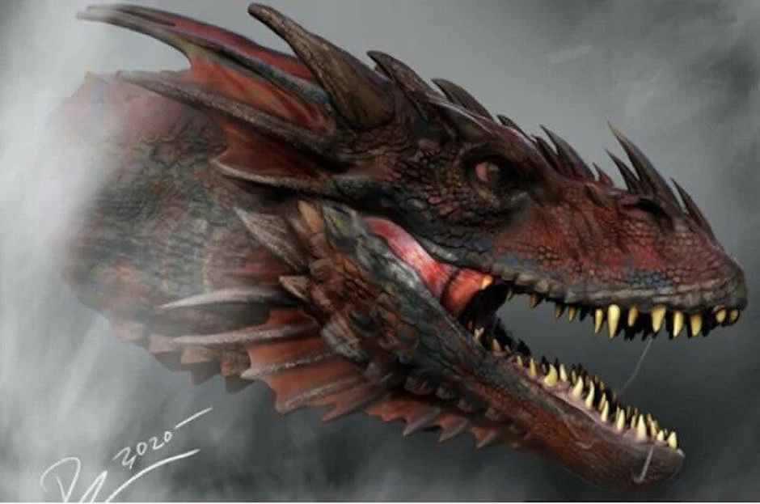
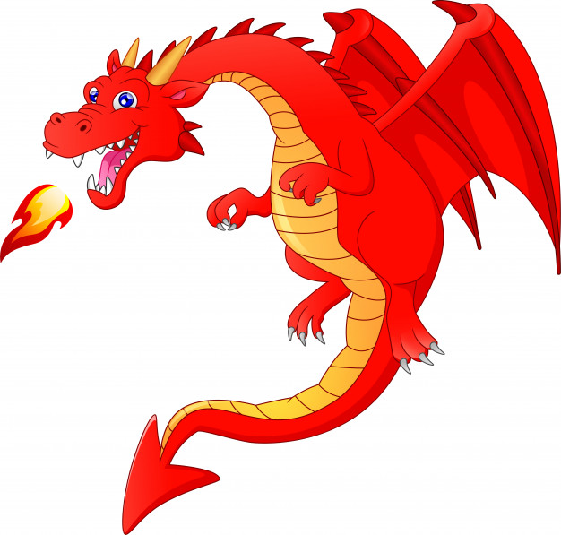
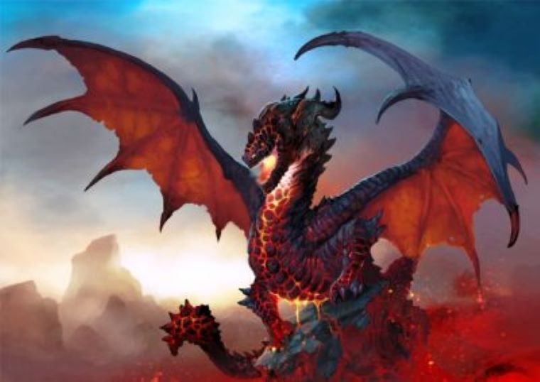
Characters – Who is in your story?
Can you use adjectives to describe your dragon and the other characters?
The dragon has shiny and smooth scales.
Challenge: use a simile.
The dragon has teeth as sharp as a knife.

Slide 10
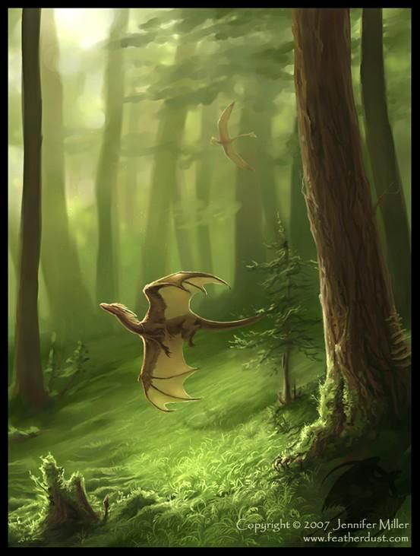
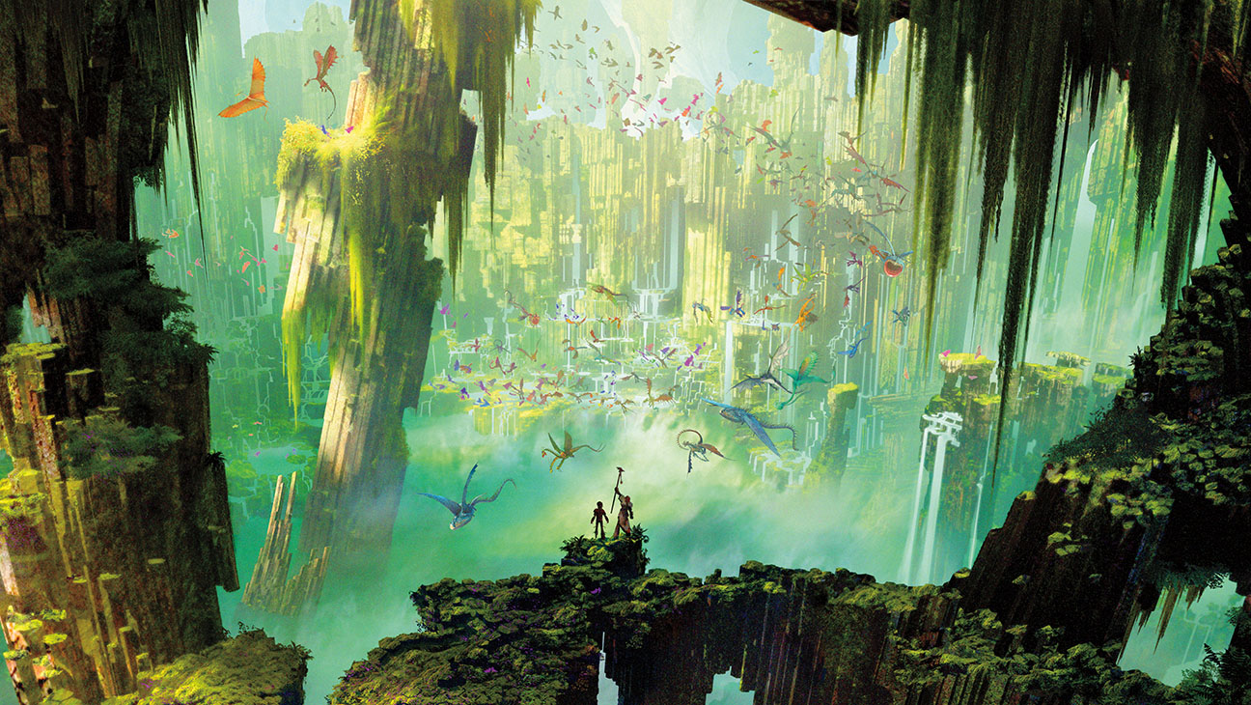
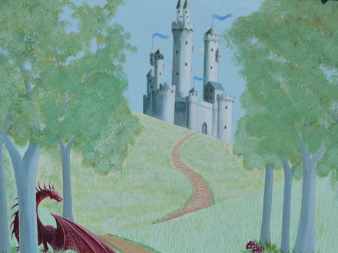
Setting – Where does the story take place?
Can you use adjectives to describe it?
The dragon lives far, far away on top of an enormous mountain.
He lives among the tall, gigantic trees.
Challenge: use a simile.
The dragon lives in a dungeon as dark as the night.

Slide 11
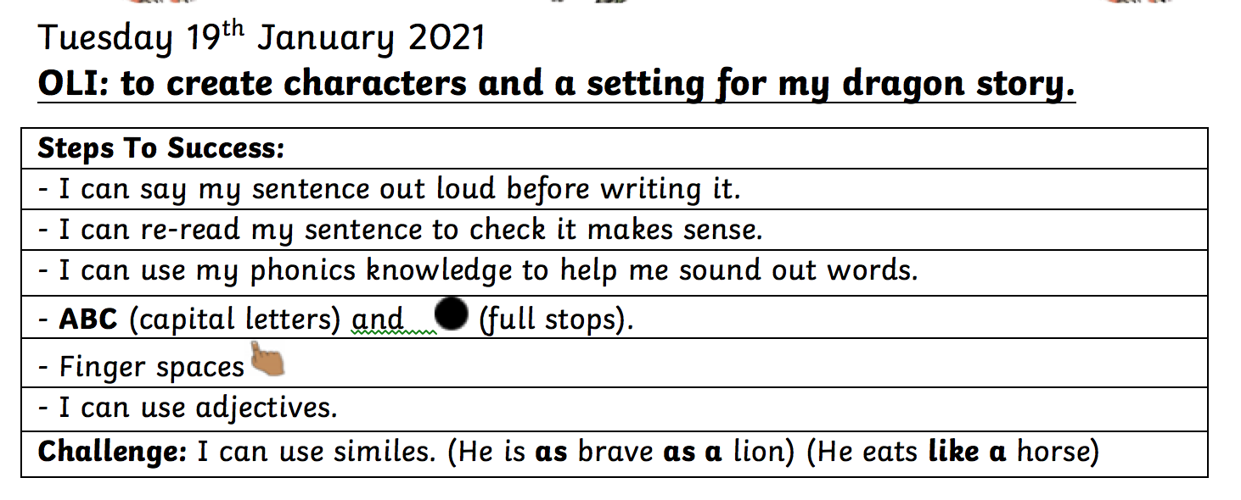
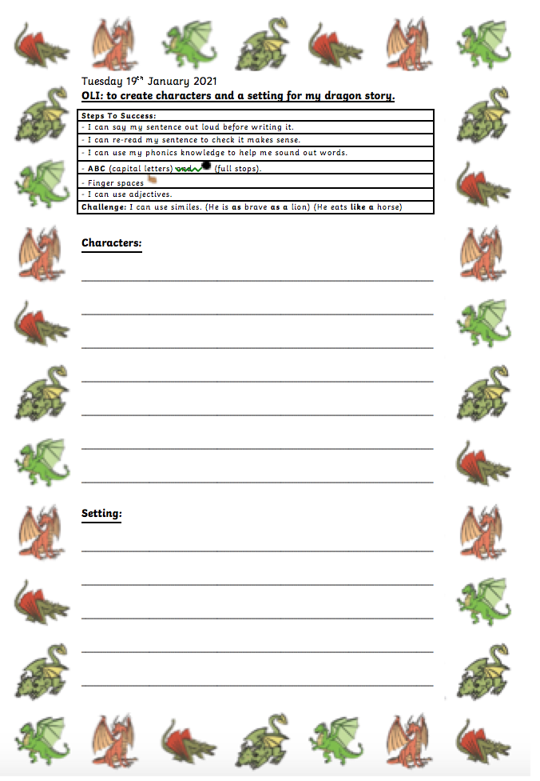
Your turn!

Slide 12
Wednesday

Slide 13
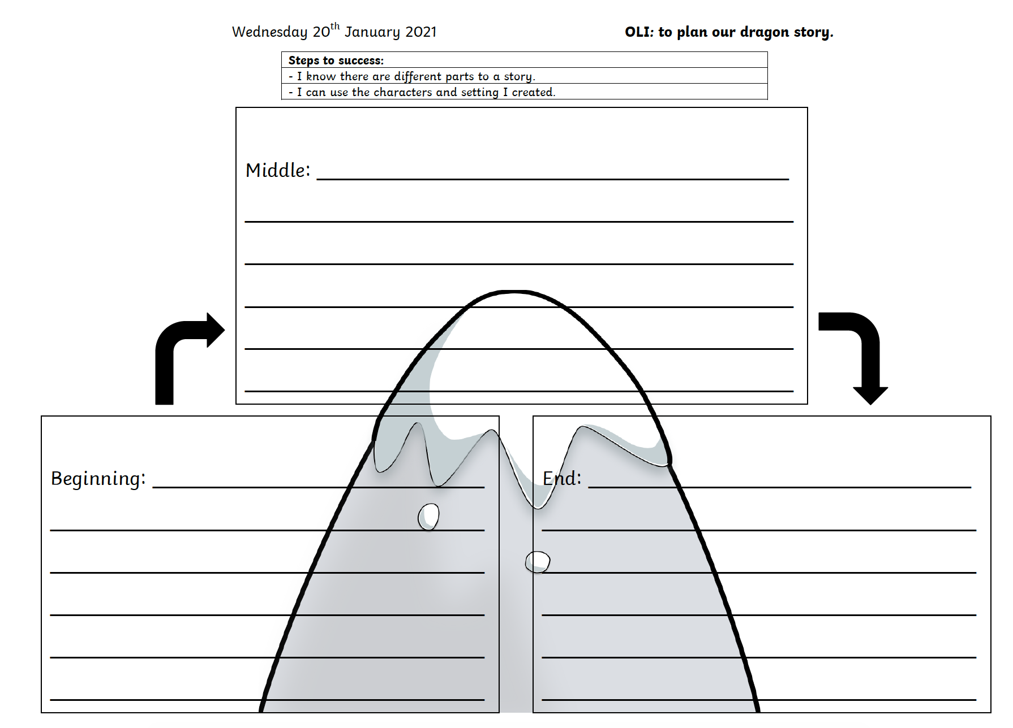

Slide 14
Thursday and Friday

Slide 15
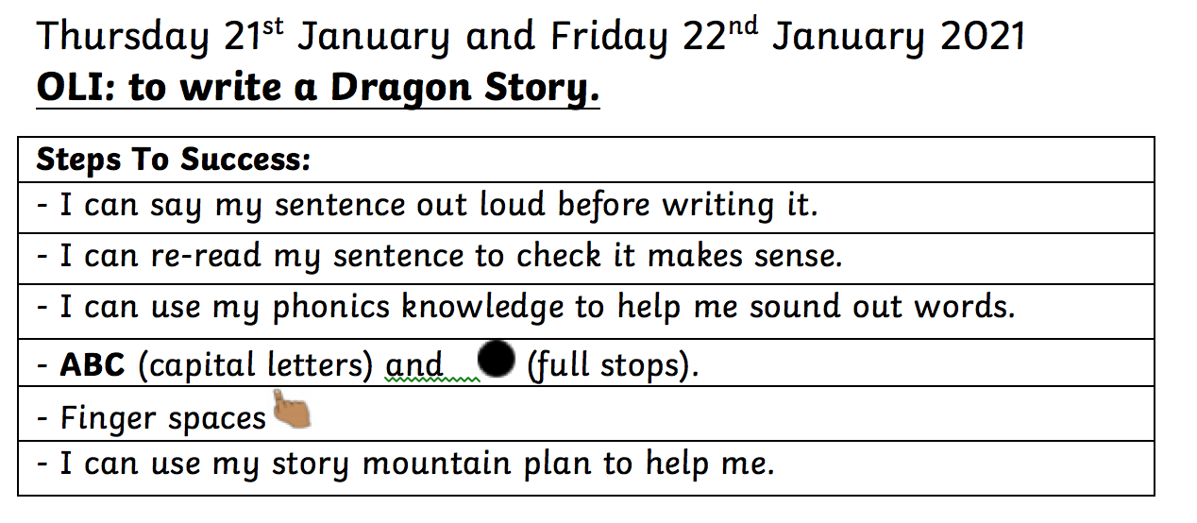
Try and expand on your story mountain plan to make the story eve juicer and more detailed!

Slide 16
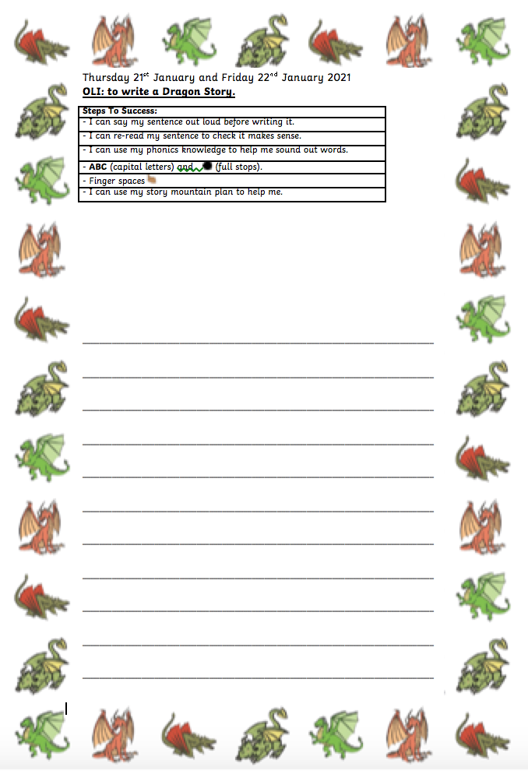

Slide 17
Well done!

