Slide 1
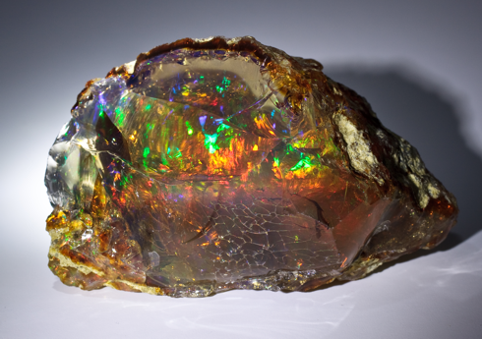
Rocks and Minerals

Slide 2
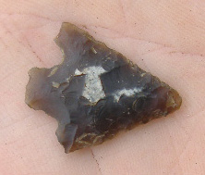
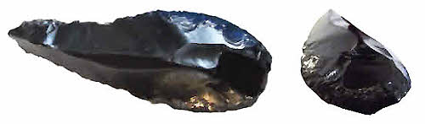
Humans have been using rocks as tools for 3 and a half million years!
During the stone age, we used boulders to sit on, river rocks to break things with, and obsidian and flint for knives and spears.

Slide 3
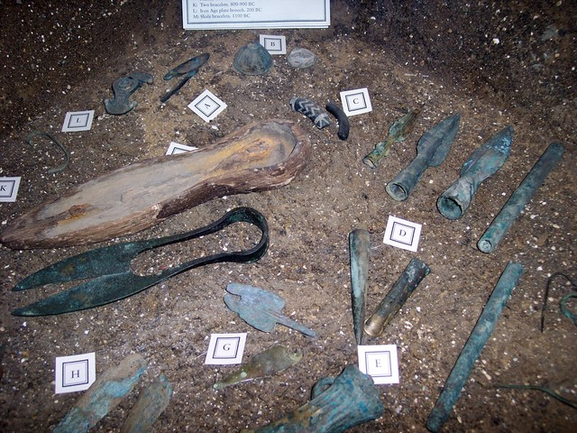
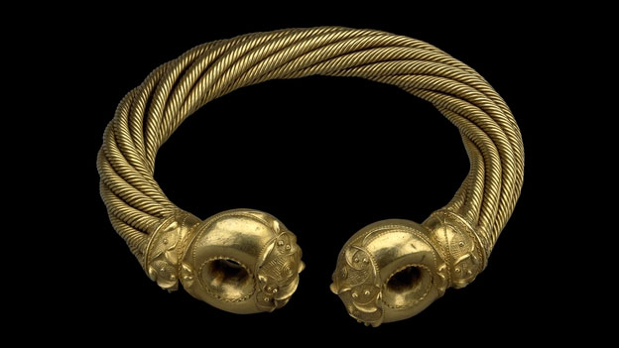
Then we learned to use copper, bronze (a mixture of copper and tin), iron and other metals to make tools, and jewellery.

Slide 4
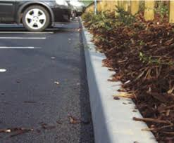


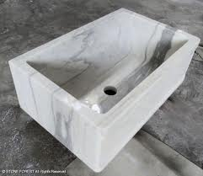
Now we use rocks and minerals everyday, in so many ways that it would be impossible to list them all!
Can you think of anywhere else we see rocks in our everyday lives?

Slide 5
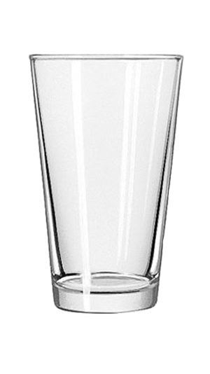
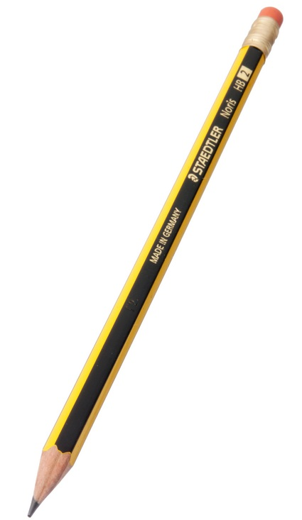

Here are some ways that we use rocks and minerals in our everyday lives that might surprise you!
We use sand to make glass
We use graphite to make pencils
Fluorite, limestone and calcium carbonate are used in toothpaste

