Slide 1
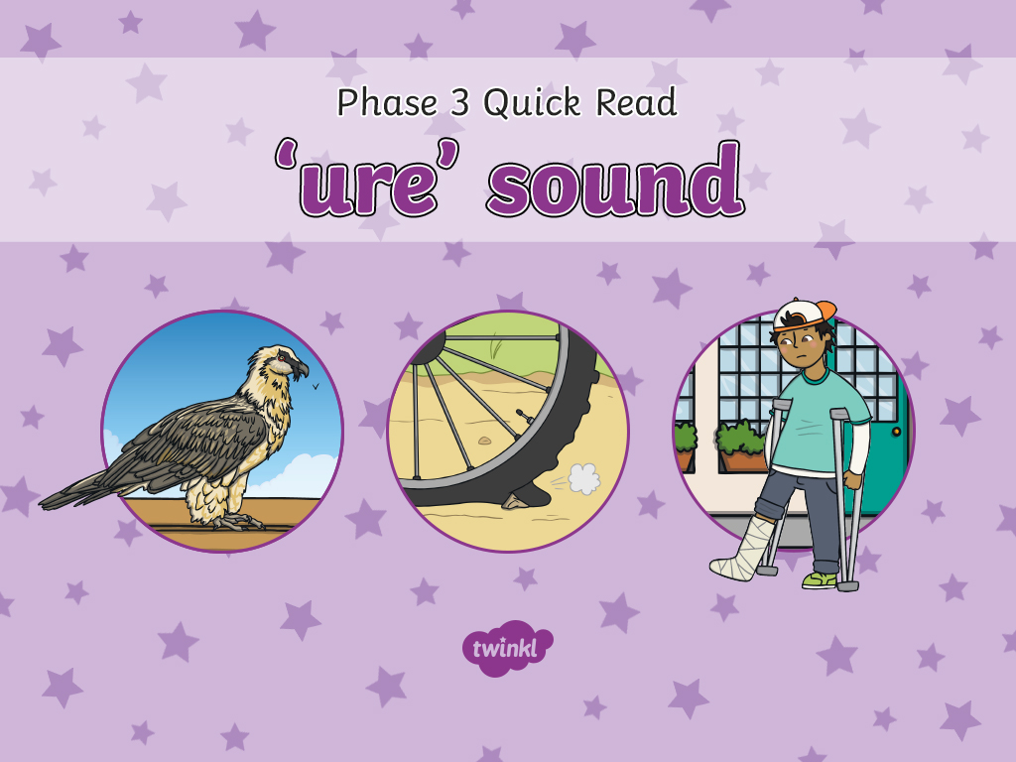

Slide 2
pure
pure

Slide 3
cure
cure

Slide 4
injure
injure

Slide 5
manure
manure

Slide 6
mixture
mixture

Slide 7
vulture
vulture

Slide 8
picture
picture

Slide 9
capture
capture

Slide 10
puncture
puncture

