Slide 2
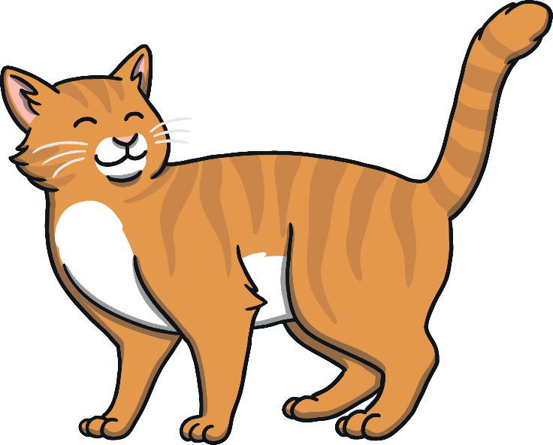
c
a
t

Slide 3
d
o
g

Slide 4
h
a
t

Slide 5
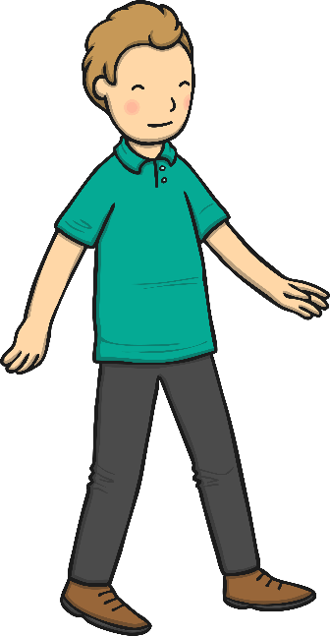
m
a
n

Slide 6
p
i
n

Slide 7
l
e
g

Slide 8
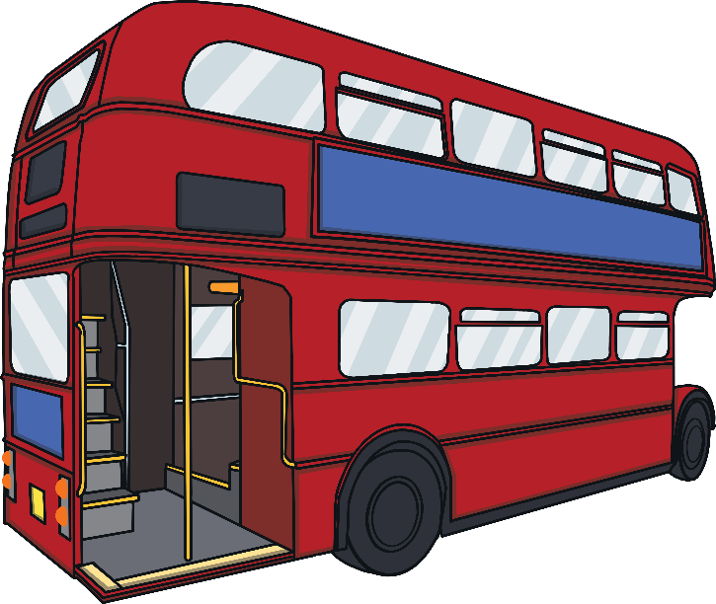
b
u
s

Slide 9
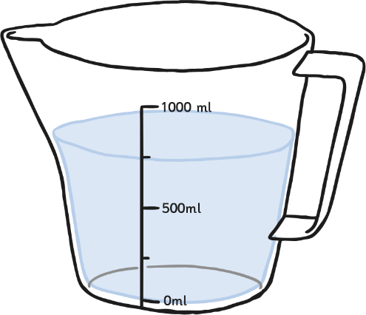
j
u
g

