Slide 1
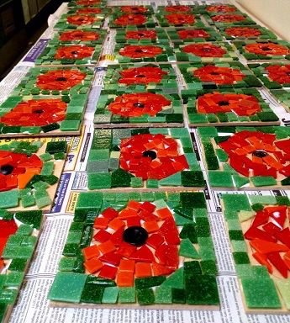
Poppies with tissue paper or felt

Slide 2
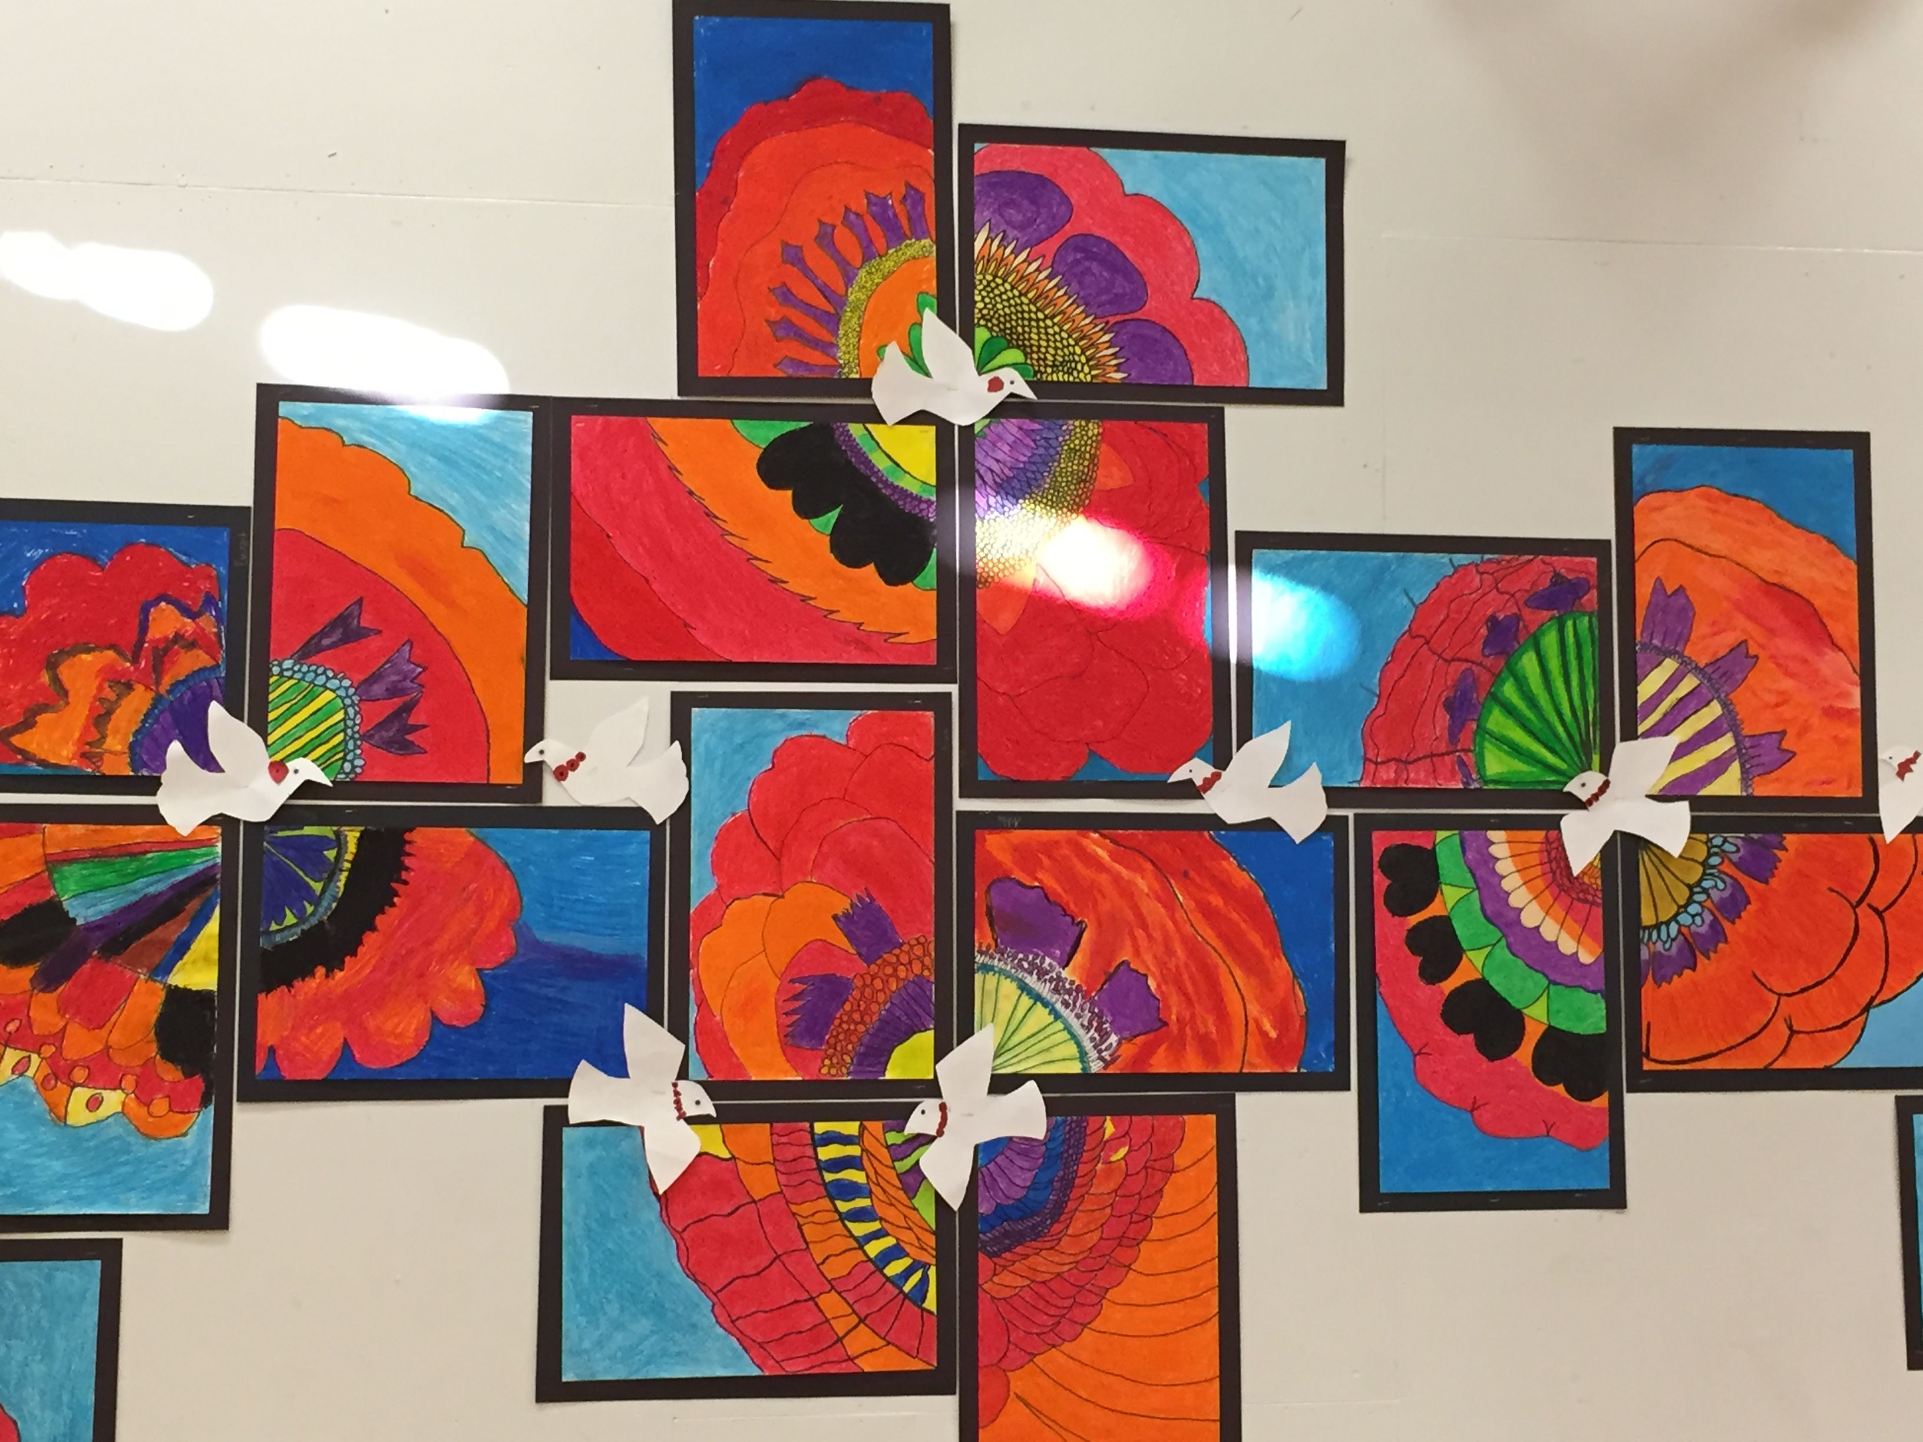

Slide 3
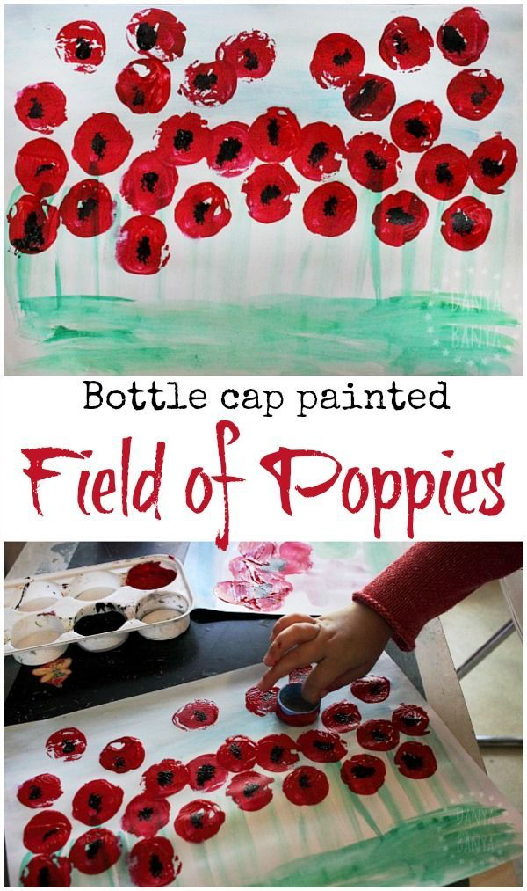

Slide 4
Poppies with cupcake cases

Slide 5
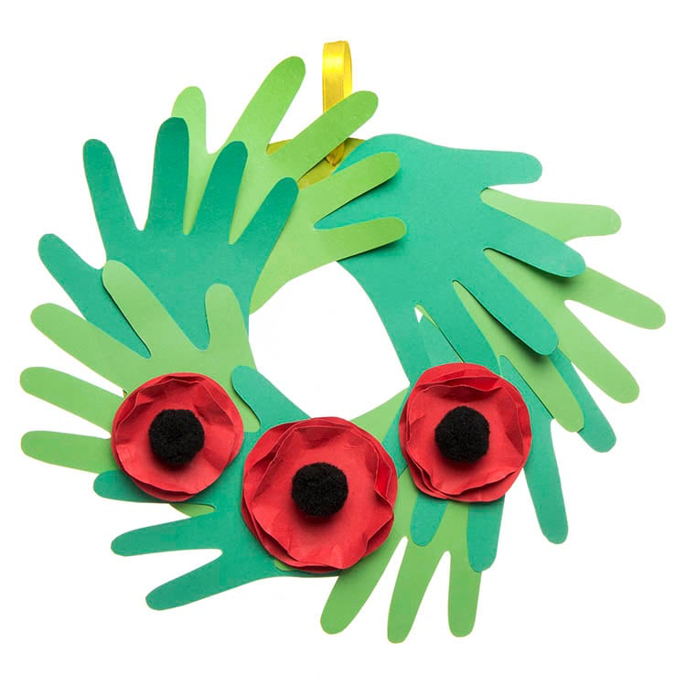

Slide 6
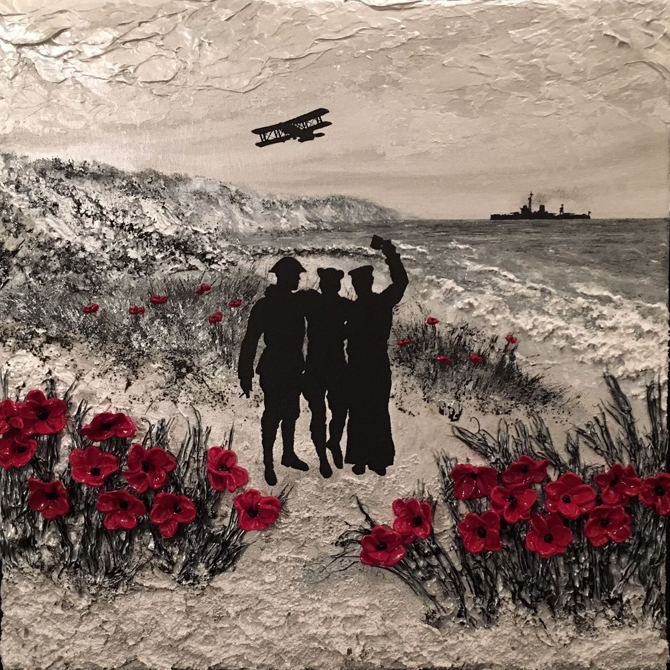
Using charcoal or pencil to sketch with only the poppies providing colour

Slide 7
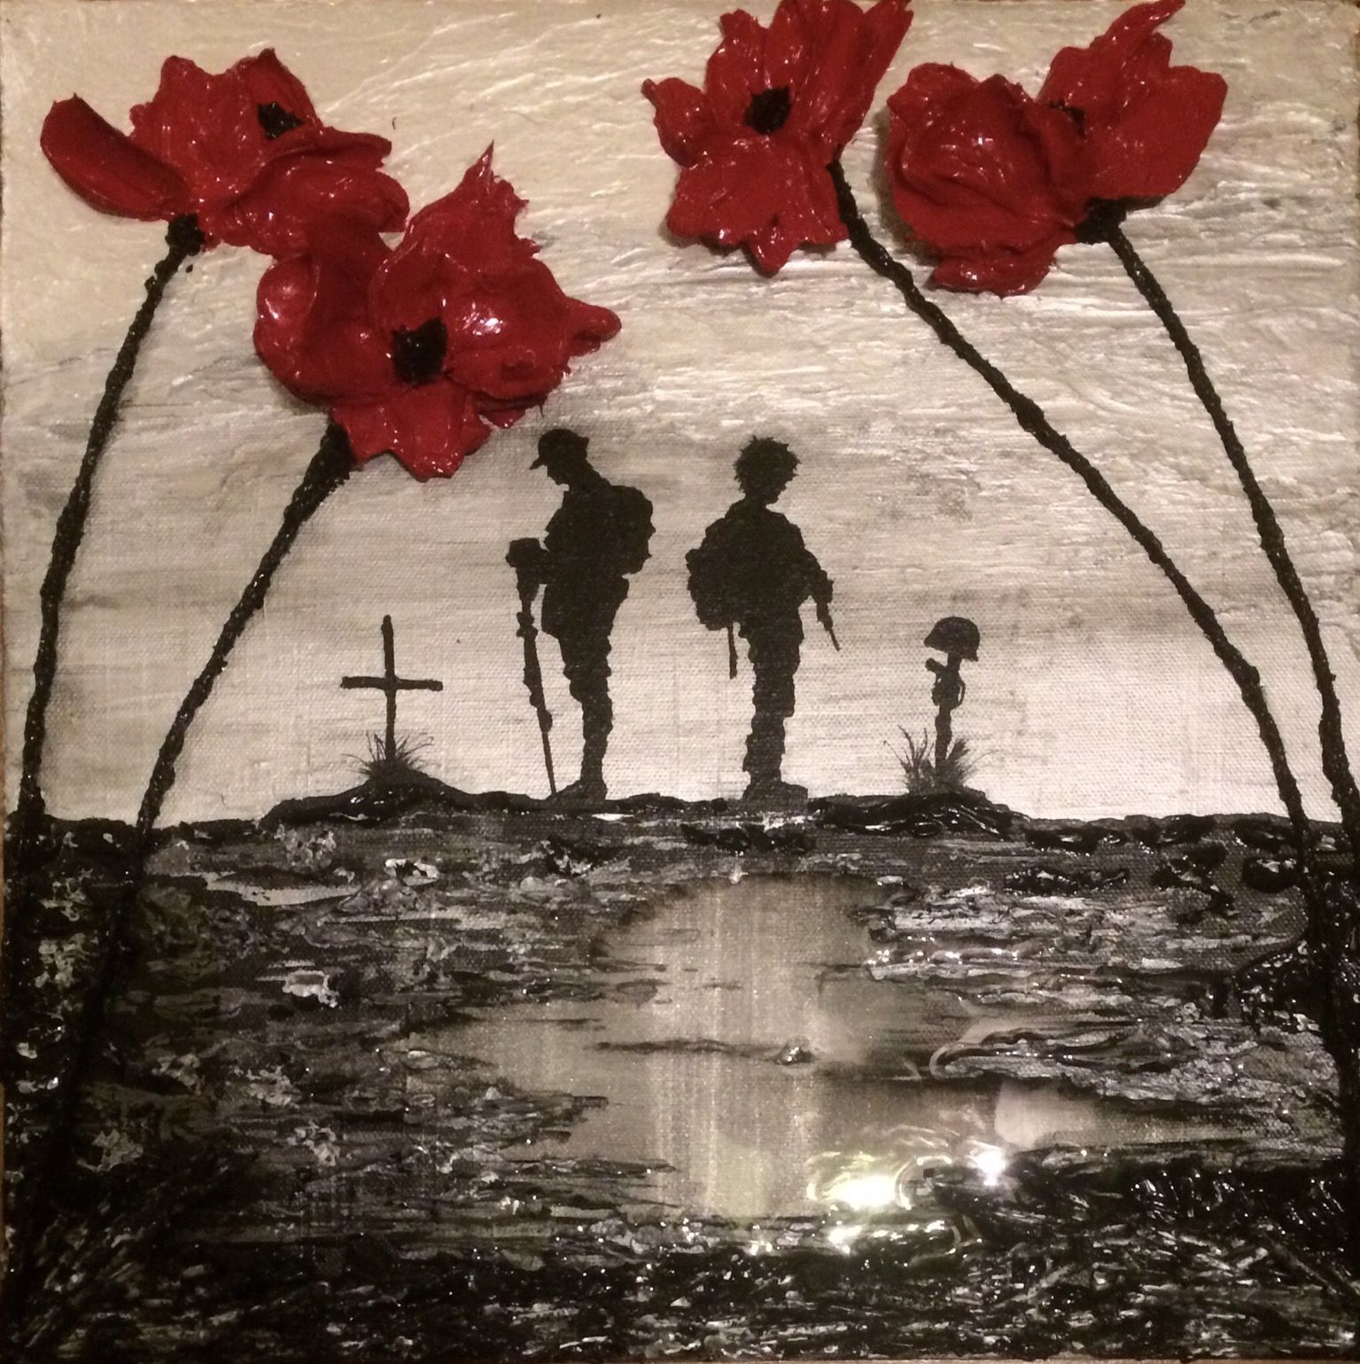

Slide 8
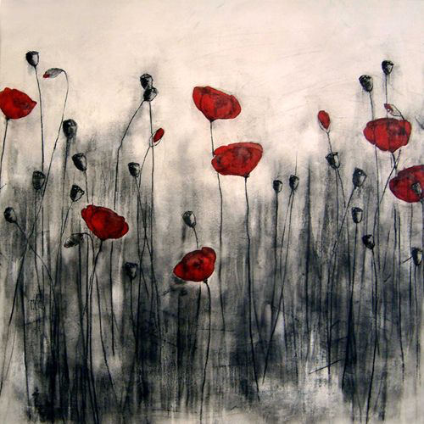

Slide 10
Painted sunset background with black card silhouette cut outs then added poppies

