Slide 2
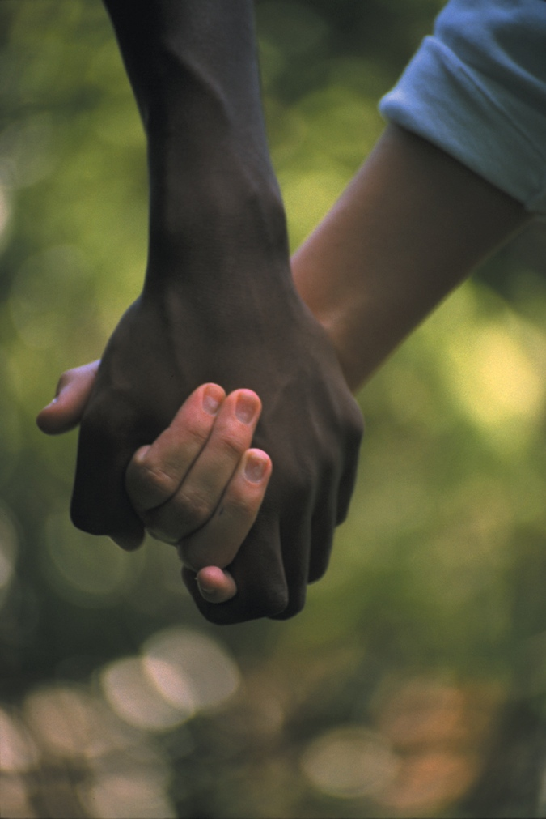
Be Real About Loving
Be whole-hearted and enthusiastic in all you do.
Dear Friends
We all have been given lovely gifts.
When you give, give with a loving heart.
If you have a job to do, do it really well.
If you are helping someone, do it happily.
Be real in your love for each other.
Do not just pretend to be good.
Love and care for each other as good brothers and sisters.
Be joyful.
When things get hard, keep on going.
Pray regularly.
Share what you have with people in need.
Always make people feel welcome.
Based on Romans 12: 8-11
God’s Story 3

