Slide 1
Jesus’ prayer for Unity
Friday 5th February

Slide 2
Jesus often spoke to his disciples about the importance of unity among them. He gave them the model of the unity between himself and God the Father.
In the text from John’s Gospel, part of his prayer for his disciples just before his arrest, he makes it clear how they would be more effective witnesses of his love if there was unity among them.
Read this passage on the next two slides
John 17: 11, 20-23

Slide 3
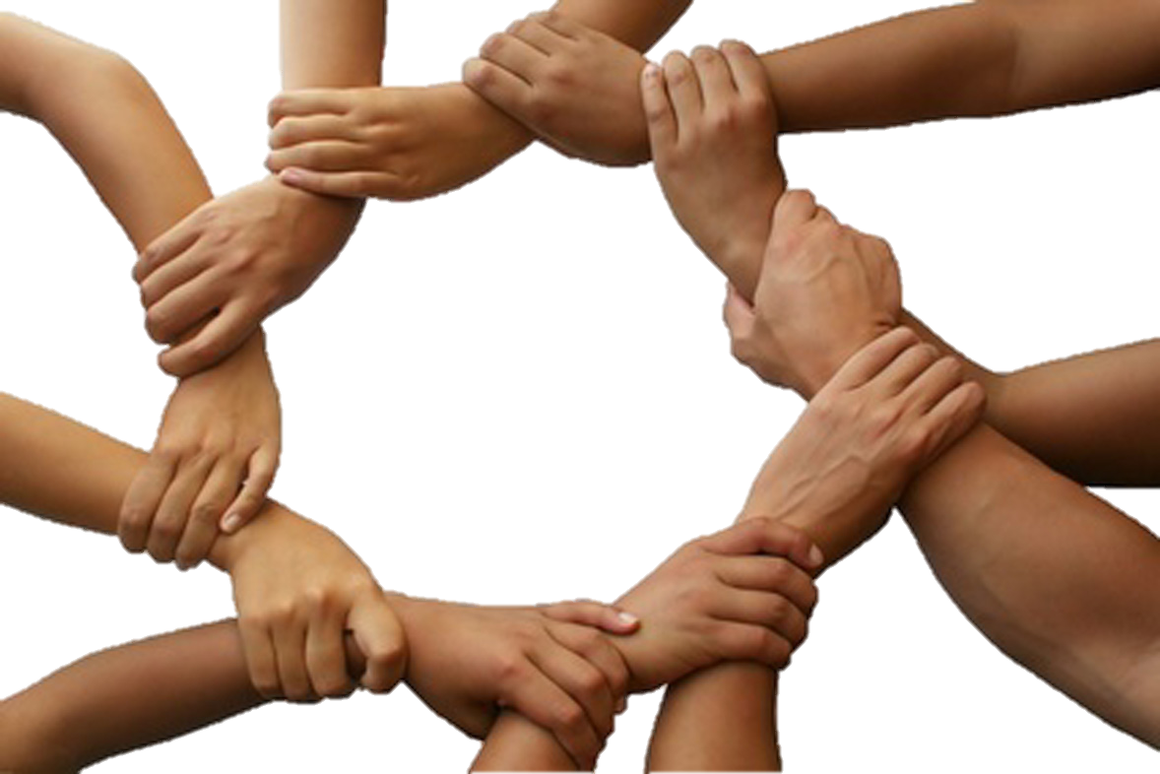
Keep them safe by the power of your name, the name you gave me, so that they may be one just as you and I are one.
Father! May they be in us, just as you are in me and I am in you.
I pray not only for them, but also for those who believe in me because of their message. I pray that they may all be one.
May they be one, so that the world will believe that you sent me

Slide 4
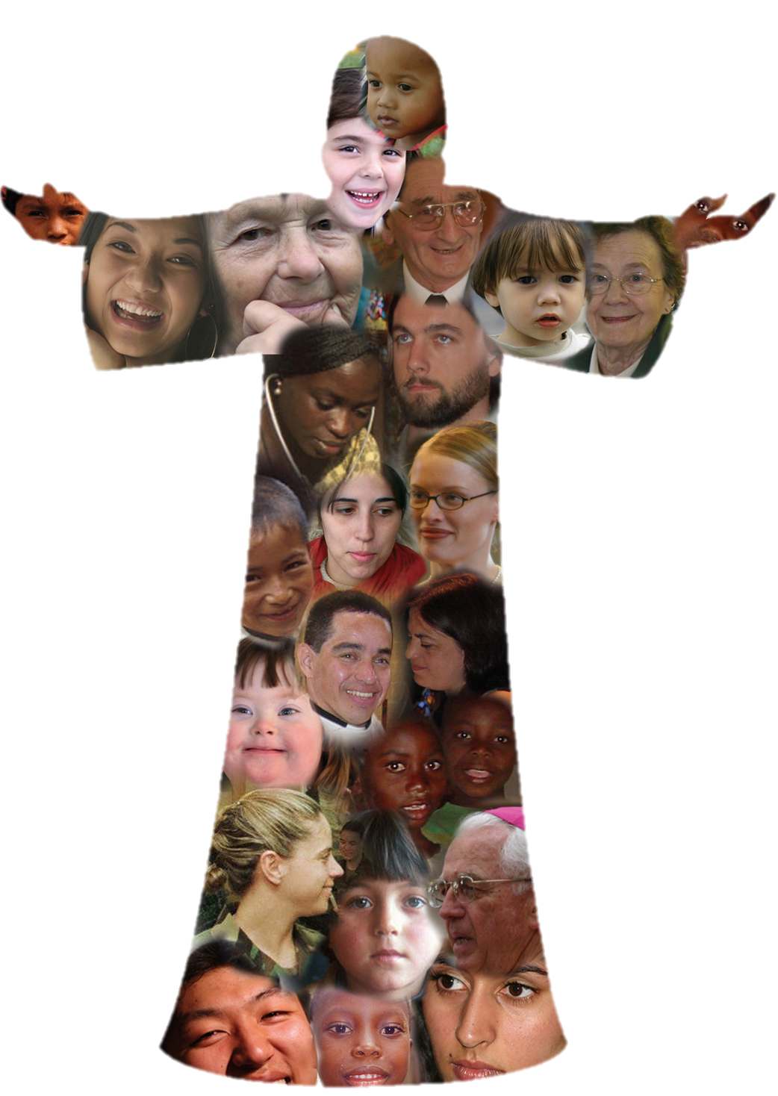
I gave them the same glory you gave me, so that they may be one, just as you and I are one I in them and you in me, so that they may be completely one, in order that the world may know that you sent me and that you love them as you love me.
Based on John 17: 11, 20-23
(Come and See)

Slide 5
Your task
Use the text from John on the previous slides to help you compose a prayer for unity.
Think about: what unity means?
Why is unity important?
You may wish to relate your prayer to the importance of unity in difficult times.
You can illustrate the prayer if you wish.
Remember this is a prayer, so you are praying for guidance and help from God.

