Slide 1
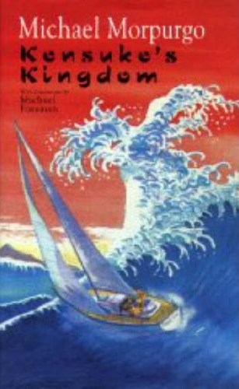
Tuesday 23rd February
Learning Objective: Finish reading novel and discuss certain aspects of the final two chapters.
Success Criteria: I have read Michal Morpurgo’s novel: Kensuke’s Kingdom, am able to summarise it and discuss the main points.

Slide 2
Your task
Finish reading the last two chapters of Kensuke’s Kingdom and answer the questions on the following slides.
We will discuss the answers in this afternoon’s session!

Slide 3
Chapter 9 - Questions
1. Describe the atmosphere between Michael and Kensuke at the beginning of the chapter.
2. What is it that makes Kensuke change his mind about Michael staying on the island?
3. What developments in the world does Michael describe to Kensuke?

Slide 4
Chapter 10 -
1. Describe the rain on the island, and the effect it has on Michael and Kensuke.
2. What happened to the binoculars?
3. How do Michael and Kensuke save the orang-utans from the
poachers?
4. What do the poachers do on the island?
5. What were they doing when Kensuke spotted the sail?
6. What does Michael see that makes him realise it’s the Peggy Sue?
7. What are Kensuke’s reasons for staying behind?
8. Do you think that Kensuke has made the right decision? Explain
your views.

