Slide 1
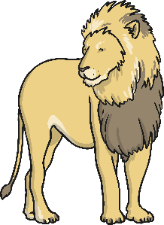
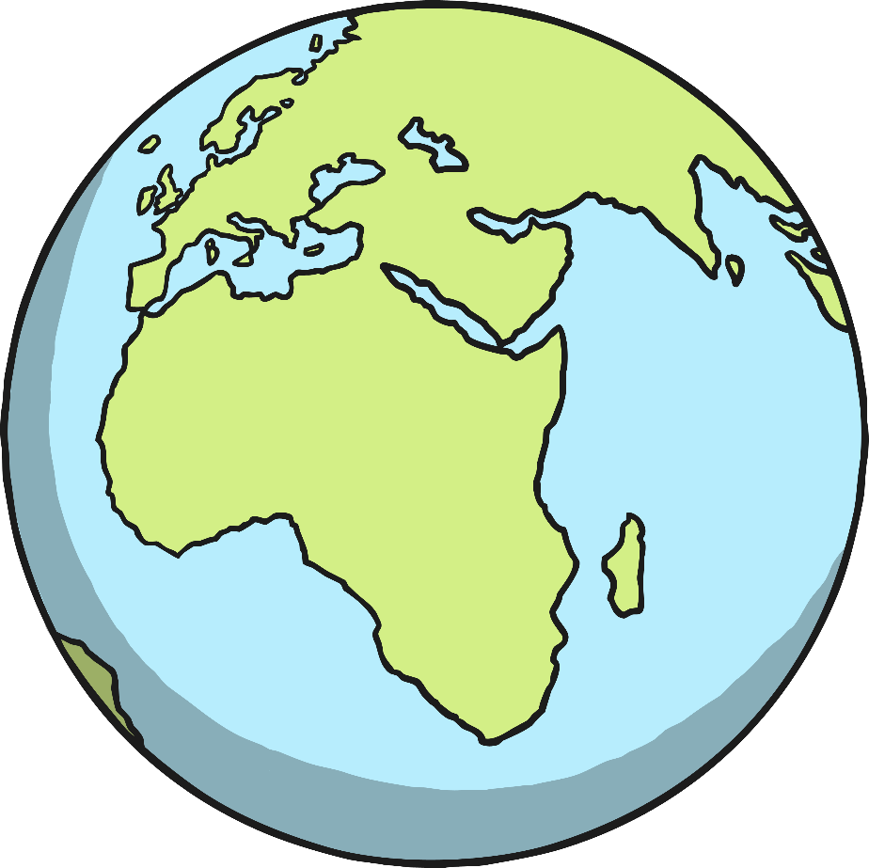
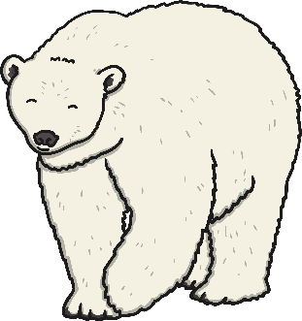
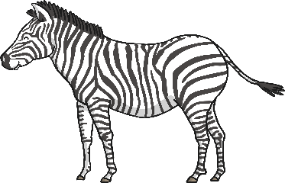
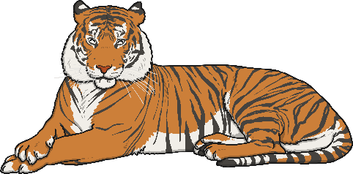
Year 1 Term 2
Geography
Animals around the World
(Our journey around the world)

Slide 2
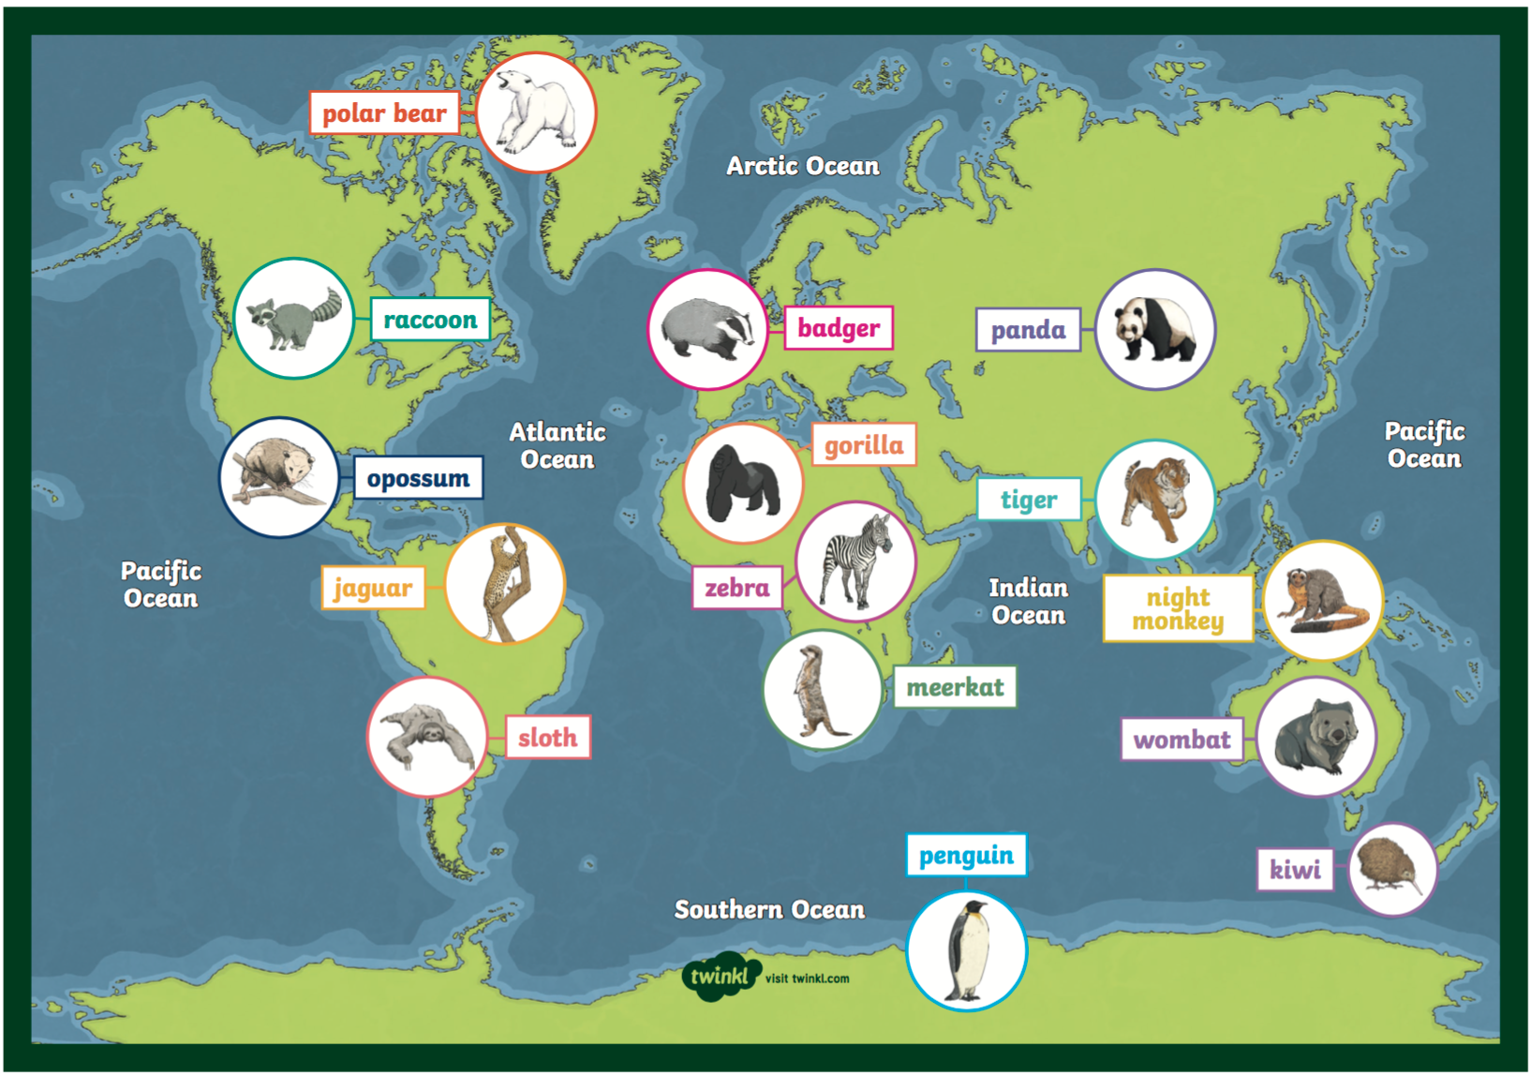
Over the next few weeks we are going to look at different animals living around the world, especially in their native countries and continents.

Slide 3
Week 7
Lesson 1
Maps of the world.
Let’s label the 7 continent and the 5 oceans

Slide 4
Lesson 1
OLI: To name and locate the continents and oceans of the world.
Success Criteria
I can say the names of the 7 continents of the world.
I can begin to name the 5 oceans in the world.
I can use an atlas, map or globe to locate the continents and oceans of the world.
I can label a world map accurately.

Slide 5
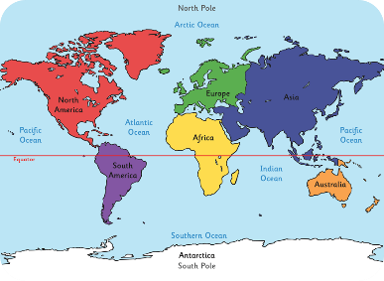
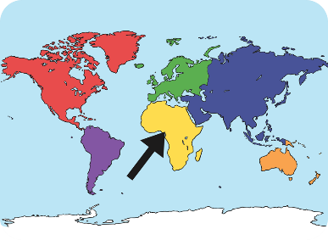
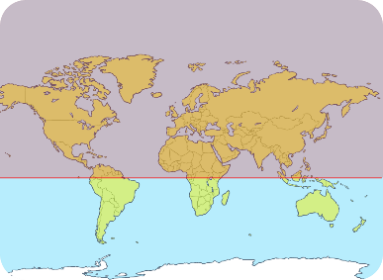
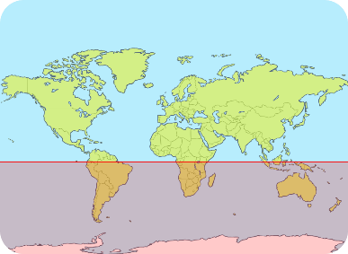
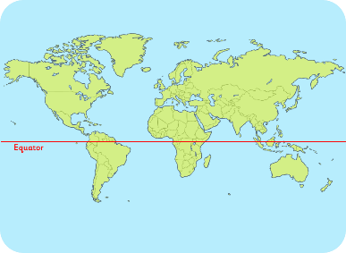
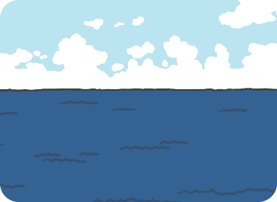
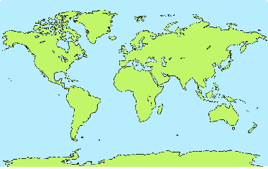
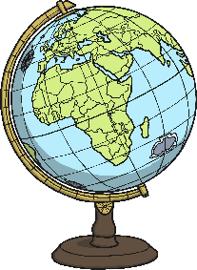
Key Words
world map
continent
Northern Hemisphere
Southern Hemisphere
equator
ocean / sea
land
sphere (round)

Slide 6
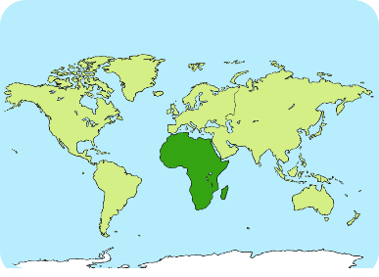
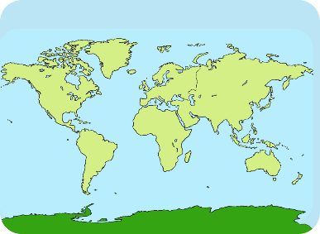
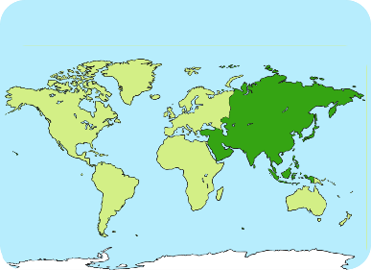
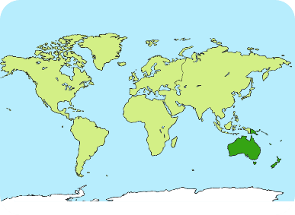
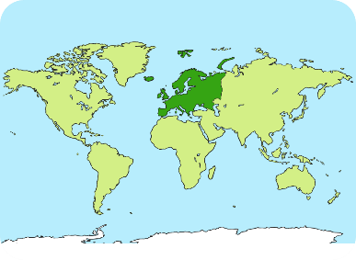
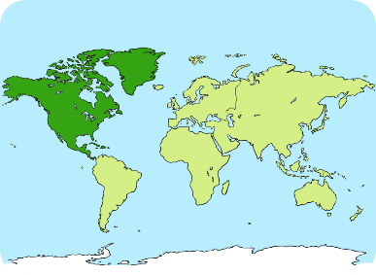
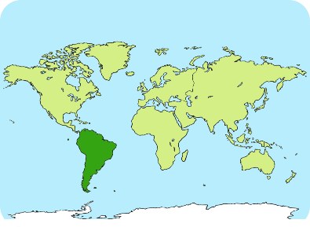
Key Words - Continents
Africa
Antarctica
Asia
Australia
Europe
North America
South America

Slide 7
Key Words - Oceans
Why does it say Pacific Ocean twice?
Think about the 3D shape of the world.

Slide 8
What Do I Already Know?
What is a continent?
1
Can you name any continents of the world?
2
We live in the UK – What continent is the UK in?
3
Can you name any of the main oceans of the world?
4
Countries are hotter that are near the _____?
5

Slide 9
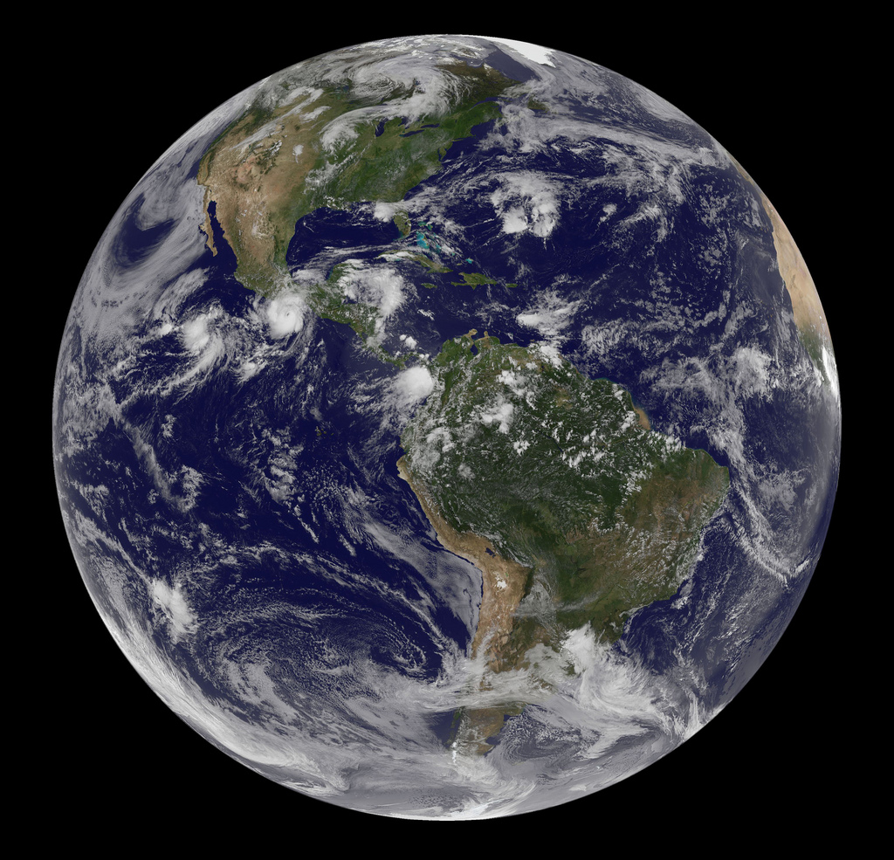
The Earth from Space
Photo courtesy of NASA Goddard Photo and Video @flickr.com) - granted under creative commons licence – attribution

Slide 10
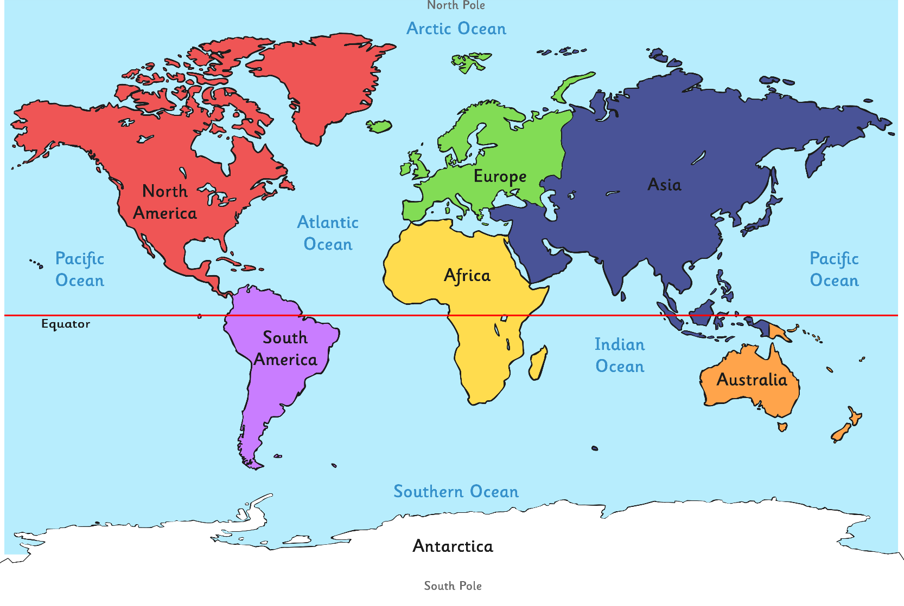
Our Wonderful World

Slide 11
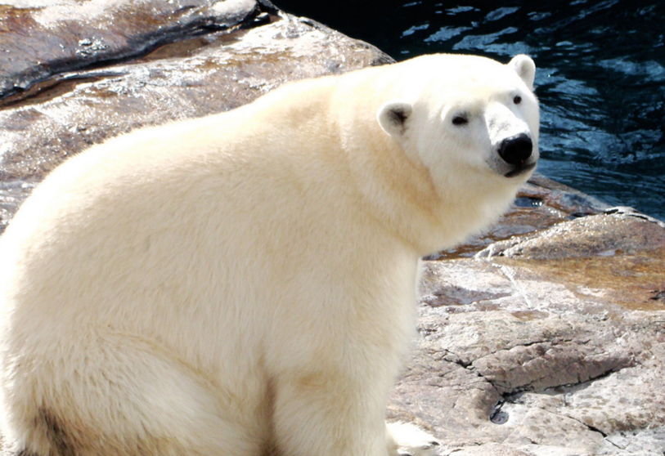
But what about the Arctic?
We have studied the Arctic before in Reception. Where is it?
It is the North Pole!
What continent is the Arctic in?
The Arctic in actually part of 3 different continents; North America, Europe and Asia.
North America (including Alaska, Canada and Greenland)
Europe (including Iceland, Finland, Norway and Sweden)
Asia (Including Russia)

Slide 12
Make a Mnemonic
Can you think of a rhyme (mnemonic) to remember the continents of the world?
E.G Eat An Apple After A Night-time Snack
Europe, Antarctica, Asia, Africa, Australasia, North America and South America

Slide 13
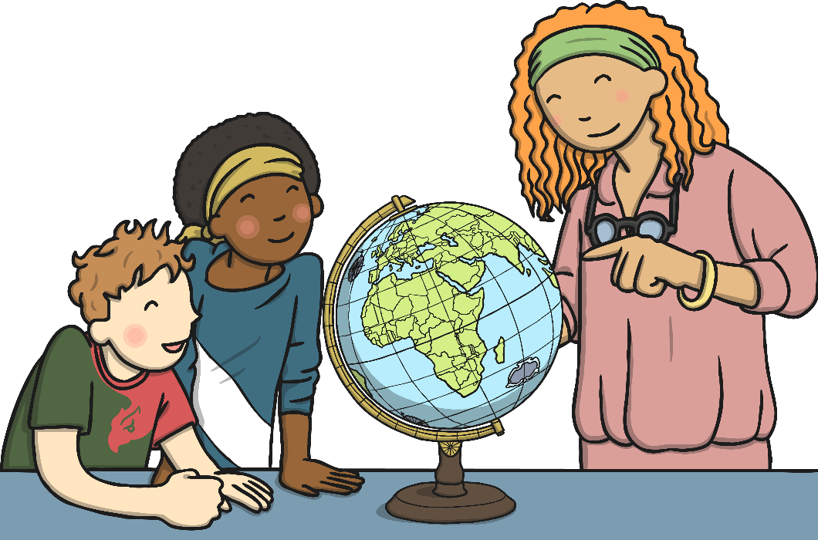
Round and Round
Work with someone to explore a globe, a map, an atlas or the map on the previous slide.
Can you find:
an area of land
seas or oceans
the equator
where you live
an island
A continent
a capital city
Challenge: What are the differences between a globe and a map?

Slide 14
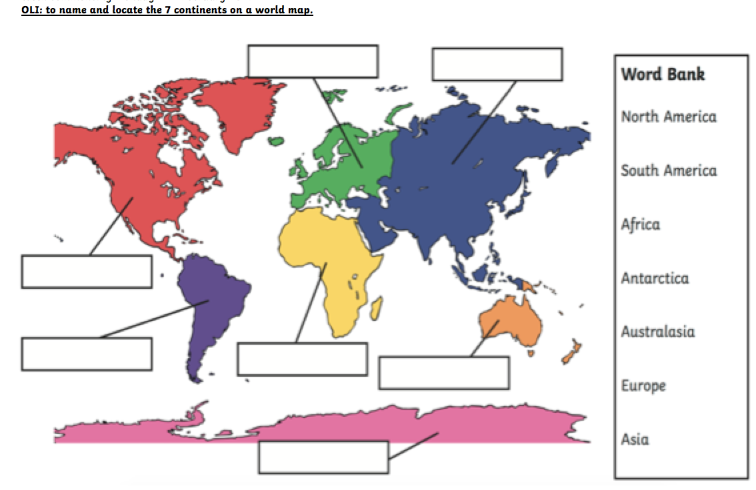
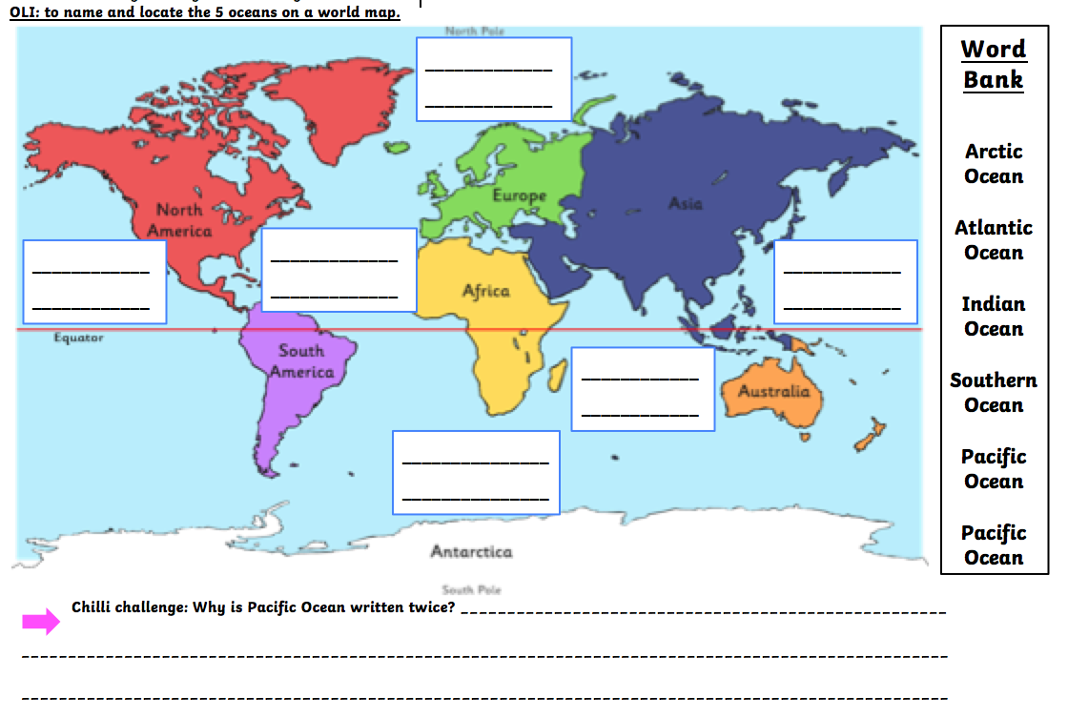
Lesson 1: Mapping the World
Using an atlas, can you find, colour and label: *The seven main continents *The five oceans of the world 1st map Chilli Challenge: Can you find the North and South Pole and The Equator?
2nd Map Chilli challenge: Why is the Pacific Ocean written twice?

Slide 15
Week 7
Lesson 2
Animals in North America
Let’s look at 4 different animals you would find in North America, then we will make a fact file!

Slide 16
Lesson 2
Animals in North America

Slide 17
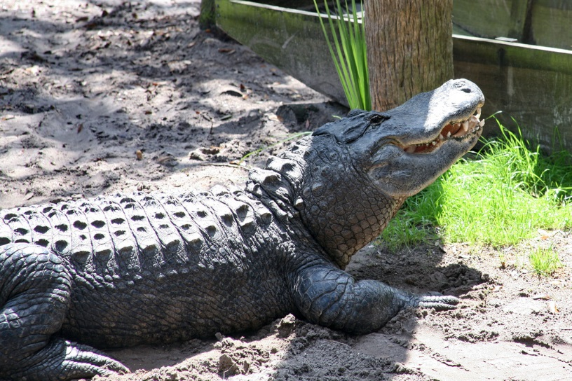
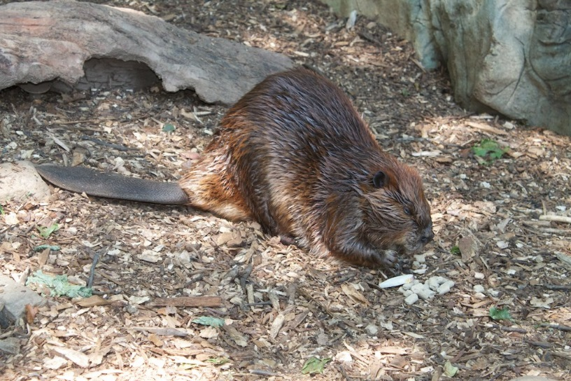
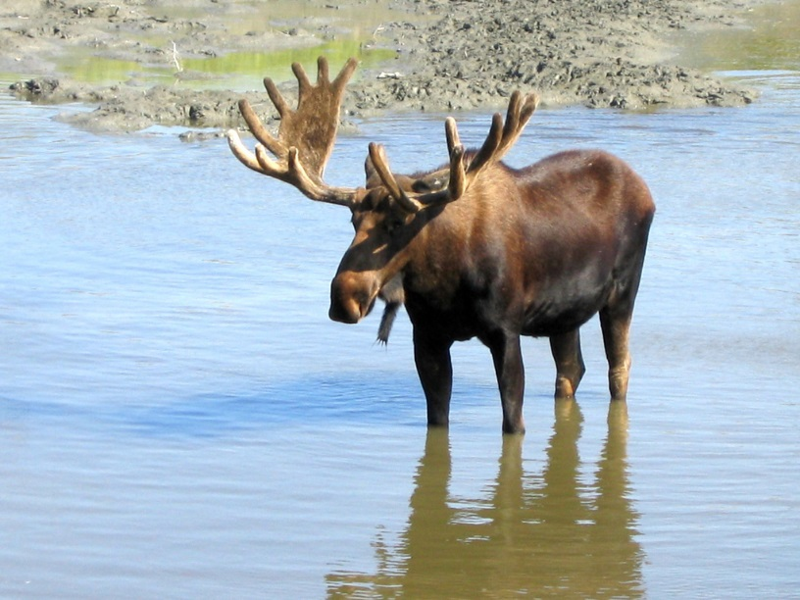
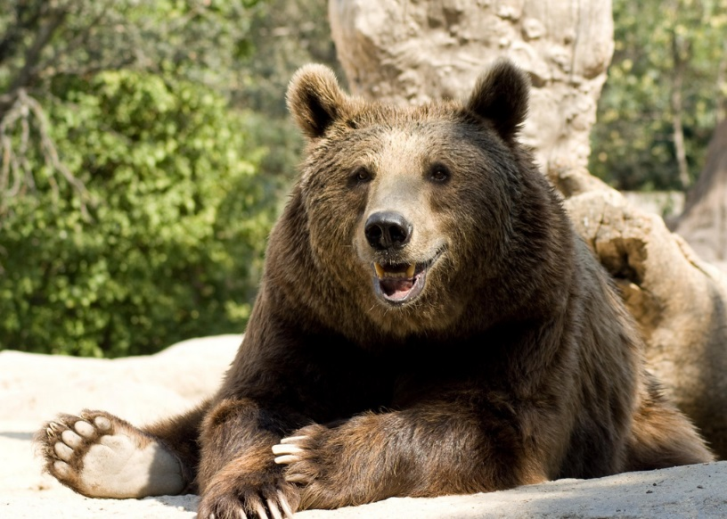
North America
alligator
beaver
moose
brown bear

Slide 18
Alligator
Alligators are reptiles.
They lay eggs.
Alligators eat any meat but mostly fish, birds and turtles.
They have lived on earth for millions of years.
They live in the southern parts of North America such as Louisiana and Florida.
They have a powerful bite but their jaw muscles are very weak. An adult human can hold open an alligator's jaw.
Adult males can be over 3 metres long.
They were once an endangered species.

Slide 19
Beaver
Beavers are found by streams, ponds, rivers and lakes.
They feed on trees and tree bark.
They live in colonies with their families.
Beavers build dams and lodges.
Dams and lodges are built for protection against predators.
They can stay underwater for up to 15 minutes.
Their feet and tails help them to swim really well.
They are nocturnal and work at night.
Young beavers are called kits.

Slide 20
Brown Bear
Brown bears are also known as grizzly bears.
They eat grass, fruit, insects, roots and bulbs of plants and when hungry enough they will eat small animals.
They live in forested mountain areas and near rivers.
In autumn they eat huge amounts of food so they can hibernate through the winter.
Adult males can be over two metres tall.
They hibernate in dens which are like a 'bedroom' at the end of a tunnel..

Slide 21
Moose
Moose are the largest member of the deer family.
Male moose are called bull moose.
Bull moose shed their antlers during the winter and grow new ones every year.
Female moose are called cows.
Moose have a piece of hairy skin that hangs under the throat. This is called a bell.
Moose have a hump.
They are around 7 feet tall.
Moose are great swimmers.

Slide 22
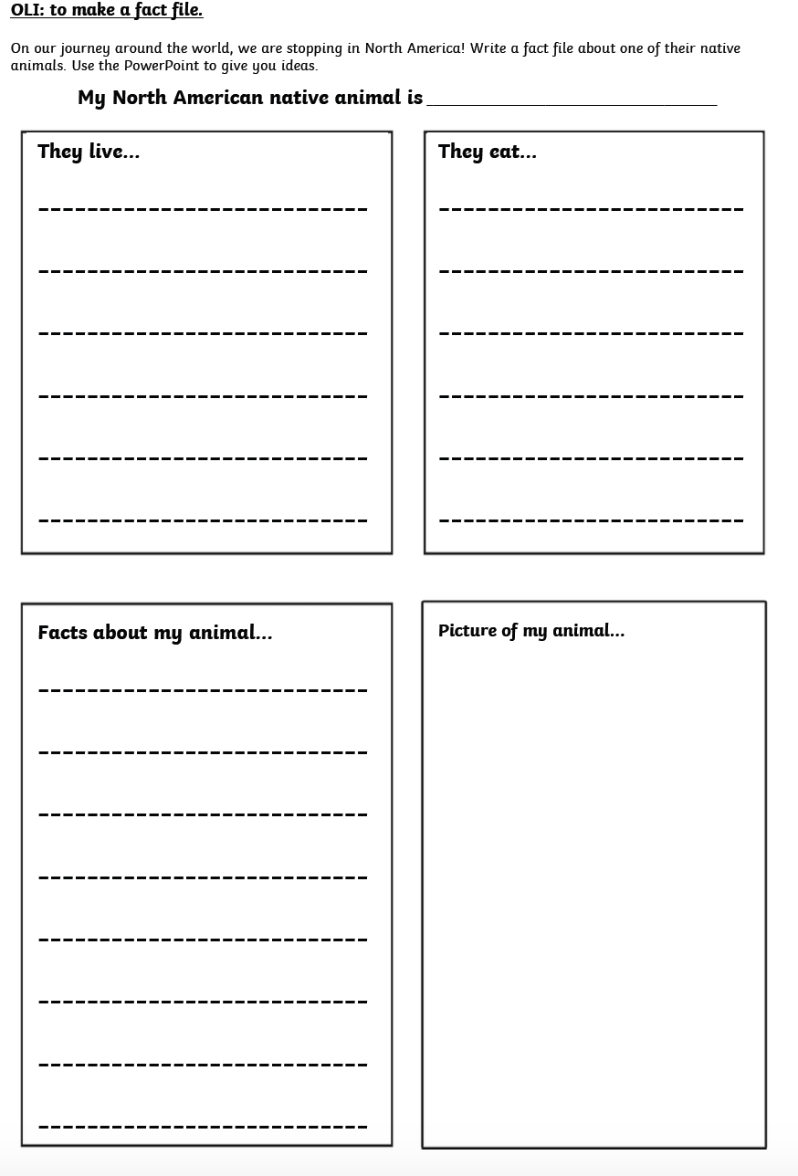
Your task:

