Slide 1
Science
Forces
Year One
Science | Year 5 | Forces | Air Resistance | Lesson 3

Slide 3
Aim
To investigate the effects of air resistance.
Success Criteria
I can explain how air resistance affects moving objects.
I can plan and conduct an investigation into the effects of air resistance.

Slide 4
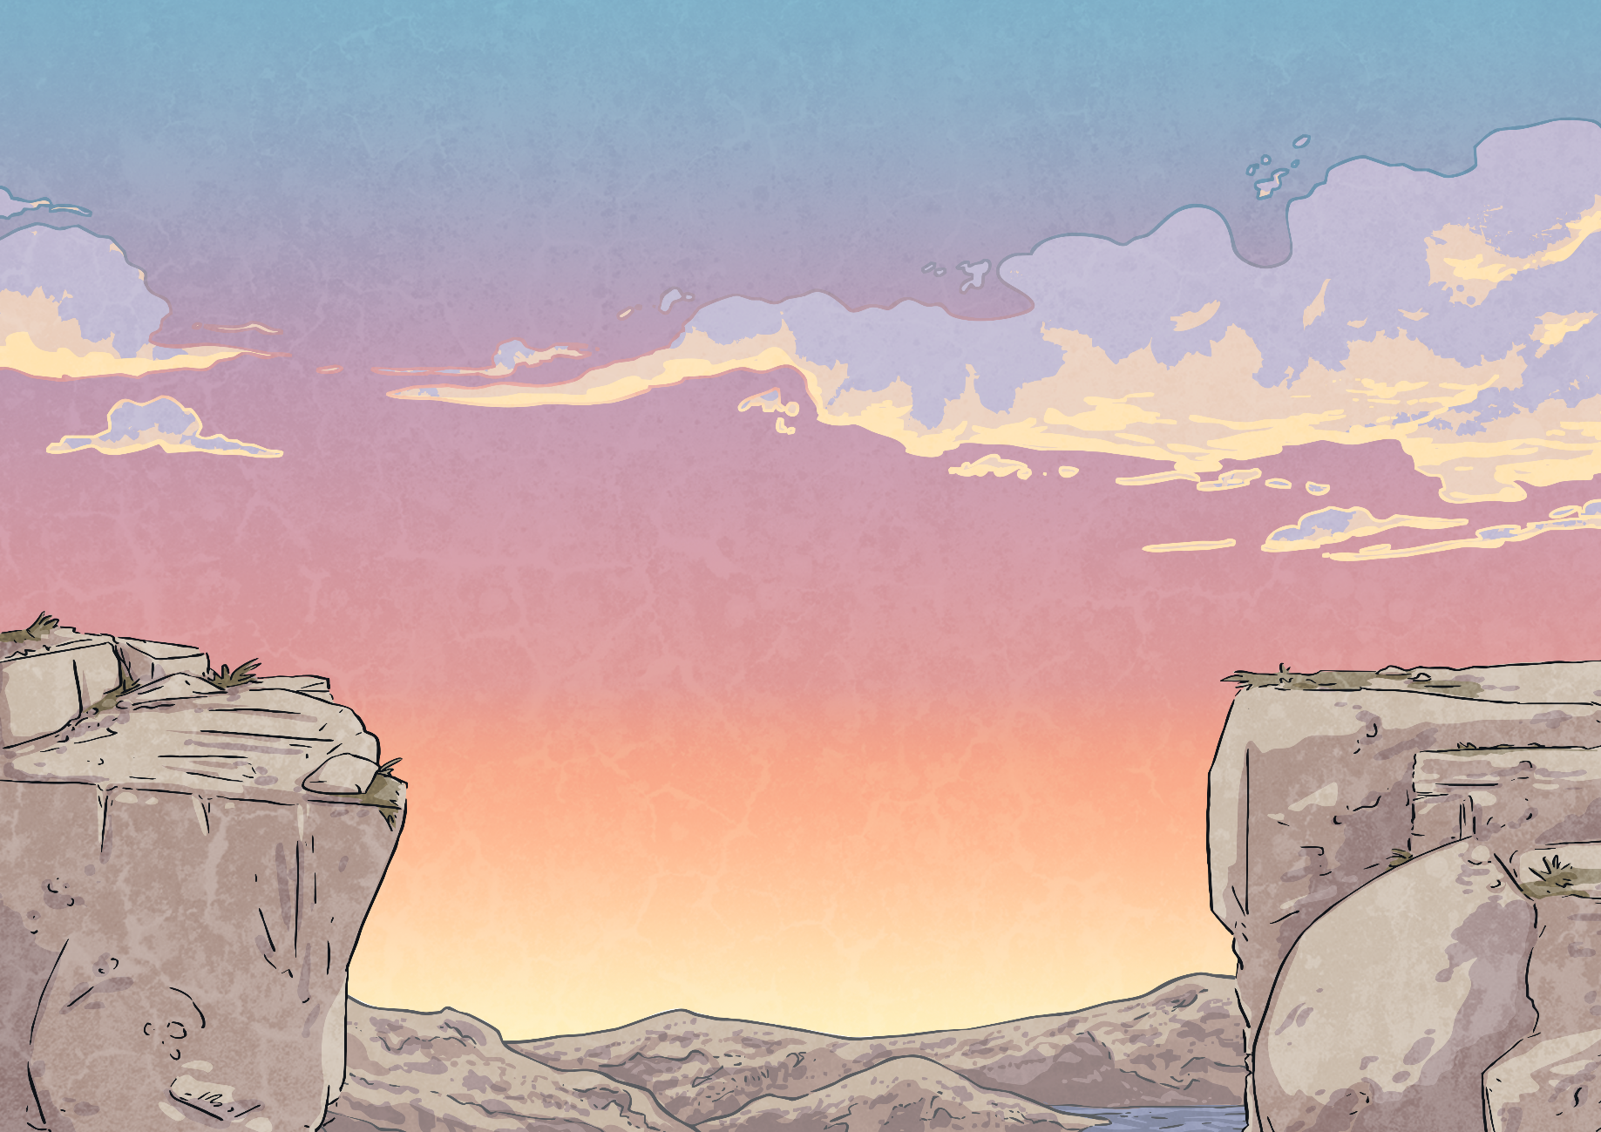
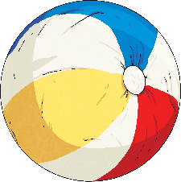
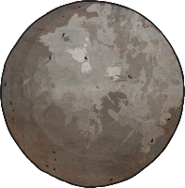
Gravity and Falling
You have learnt that gravity pulls objects towards the centre of the Earth.
But do you think all objects are pulled as fast as each other?
These two balls are the same size, but one has a much greater mass.
Do you think they will hit the ground at the same time when dropped from a height?

Slide 5
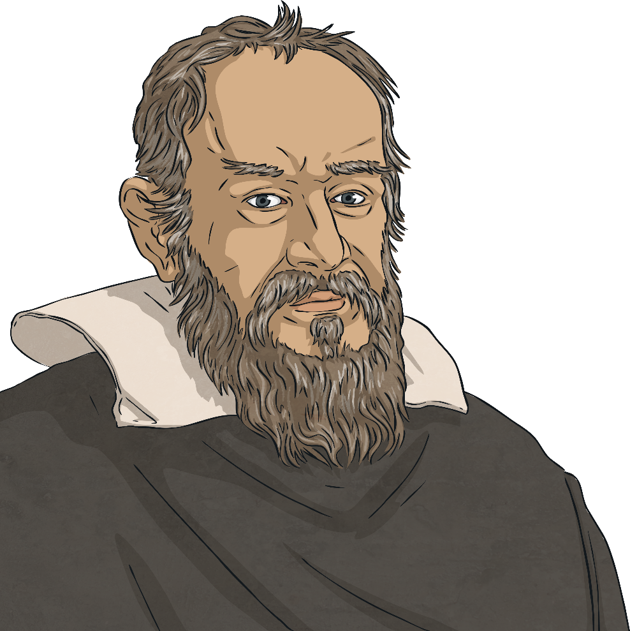
Gravity and Falling
Galileo Galilei (1564-1642) was an Italian scientist and mathematician who wondered about this.
In 1590, he decided to carry out an investigation to find the answer.
He climbed to the top of the Leaning Tower of Pisa with two balls of similar shape and size, but with different masses.
He dropped both of the balls from the top of the tower at the same time. Both balls hit the ground at the same time.

Slide 6
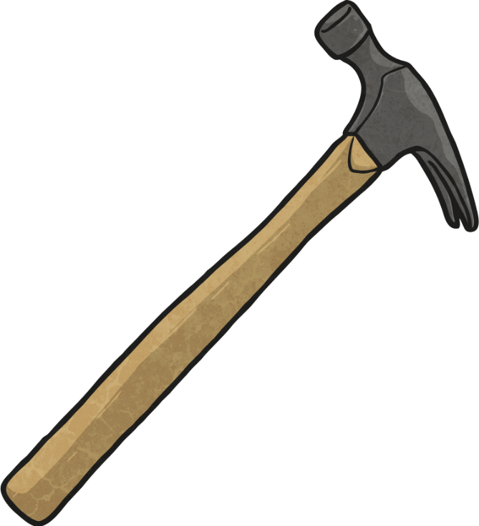
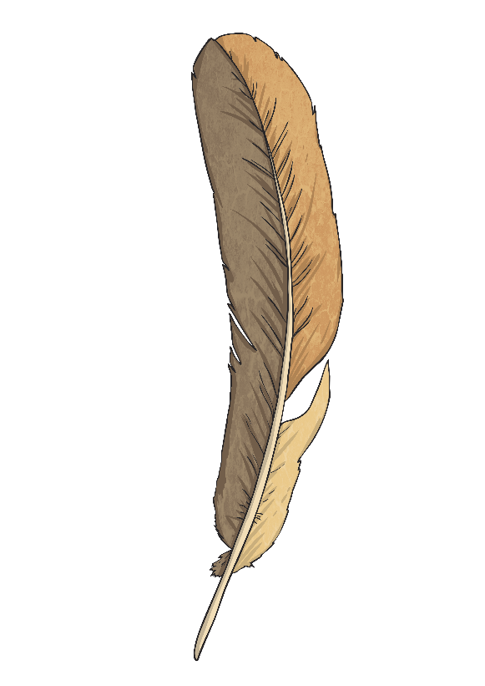
Gravity and Falling
Galileo's experiment proved that all objects fall at the same rate, no matter what their mass is.
But this can seem hard to believe!
Think about a feather and a hammer. If you dropped both objects at the same time, would they hit the ground at the same time?

Slide 7
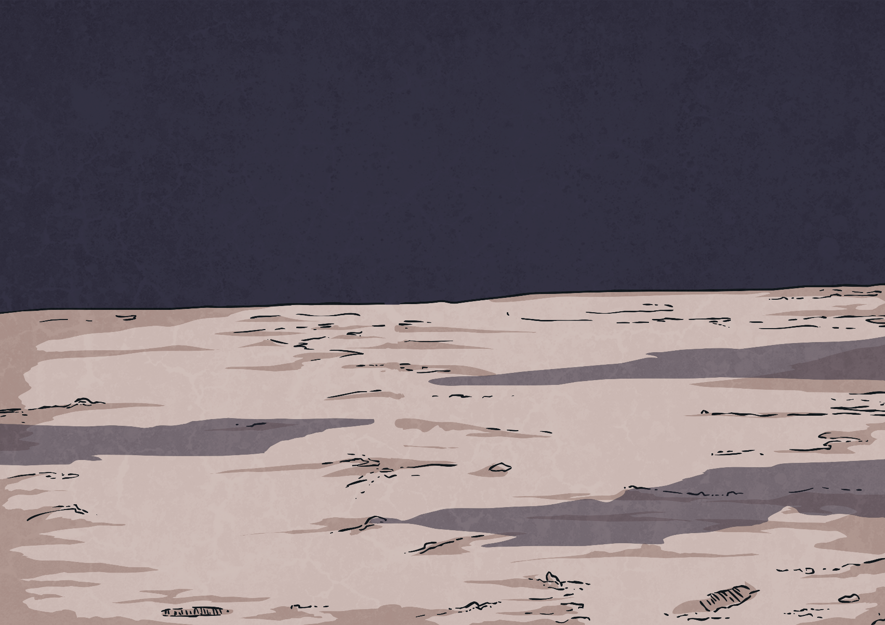
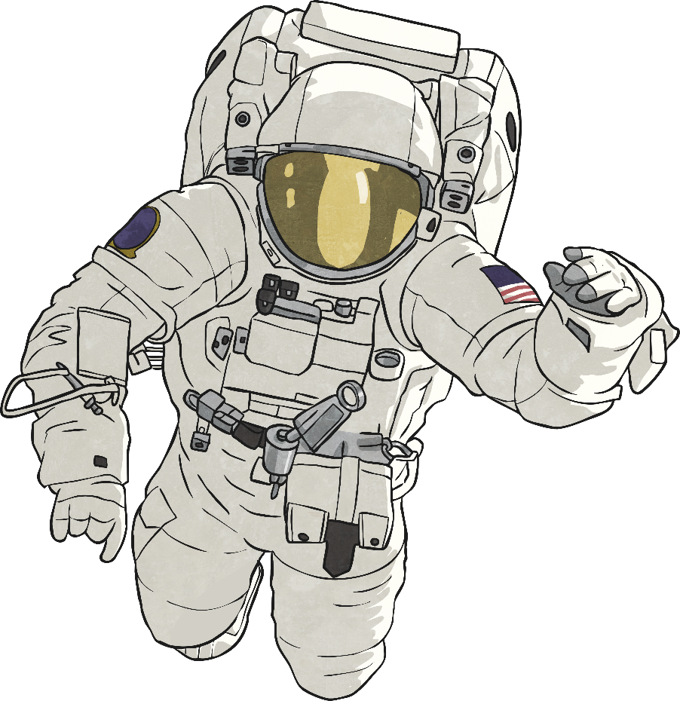
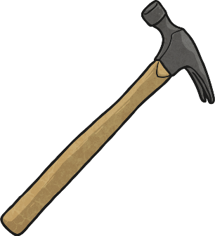
Gravity and Falling
What do you think happened when astronauts stood on the Moon and dropped these two items at the same time?

Slide 8
Gravity and Falling
The feather and the hammer hit the surface of the Moon at the same time!
This proves that Galileo’s findings are correct.
Can you think why the two objects might fall at the same speed on the Moon but the feather falls so much more slowly on Earth?
What is different about the Moon and the Earth that could cause this to happen?

Slide 9
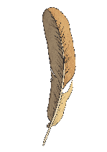
Air Resistance
There is no air on the Moon.
Air pushes against any object moving through it. This is known as air resistance.
On Earth, air resistance acts on both objects. The feather has a large surface area in comparison to its mass. The hammer has a small surface area in comparison to its mass. Air resistance therefore has a greater upwards force on the feather.
Since there is no air on the Moon, there is no air resistance to push against the feather, so the two objects fall at the same speed.

Slide 10
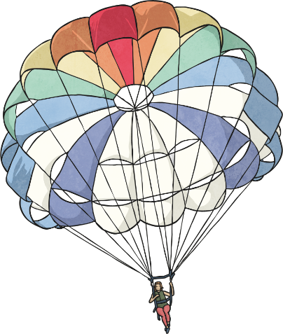
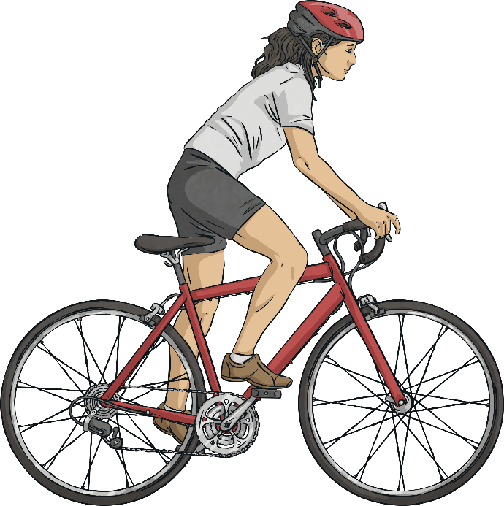
Air Resistance
gravity
Air resistance can be a useful force, but it can also be unhelpful in certain situations.
air resistance
air resistance
Look at the two diagrams below. Which one shows a useful effect of air resistance, and which one shows an unhelpful effect of air resistance?
driving force

Slide 11
Air Resistance
Air resistance pushes up on the parachute, opposing the force of gravity and making the parachute and the person fall more slowly. This is a useful effect.
gravity
air resistance
air resistance
But air resistance pushes the cyclist back, opposing the cyclist’s force from them pedalling the bicycle and making the bicycle travel more slowly. This is an unhelpful effect.
driving force

Slide 12
Aim
To investigate the effects of air resistance.
Success Criteria
I can explain how air resistance affects moving objects.
I can plan and conduct an investigation into the effects of air resistance.

