Slide 1


Year 6 – Spring Block 2 – Percentages
Step 2: Equivalent FDP
© Classroom Secrets Limited 2018

Slide 2
Introduction
Match the fraction to its equivalent percentage and decimal.
3 |  | 60% |  | 0.25
5
3 |  | 25% |  | 0.6
4
2 |  | 75% |  | 0.4
8
20 |  | 40% |  | 0.75
50
© Classroom Secrets Limited 2018

Slide 3
Introduction
Match the fraction to its equivalent percentage and decimal.
3 |  | 60% |  | 0.25
5
3 |  | 25% |  | 0.6
4
2 |  | 75% |  | 0.4
8
20 |  | 40% |  | 0.75
50
© Classroom Secrets Limited 2018

Slide 4
Varied Fluency 1
Use the shaded part of the 100 square to write an equivalent fraction, decimal and percentage.
© Classroom Secrets Limited 2018

Slide 5
Varied Fluency 1
Use the shaded part of the 100 square to write an equivalent fraction, decimal and percentage.
Fraction:
Decimal: 0.08
Percentage: 8%
8
100
© Classroom Secrets Limited 2018

Slide 6
Varied Fluency 2
Which numbers are missing?
= |  | = | 80%
5
© Classroom Secrets Limited 2018

Slide 7
Varied Fluency 2
Which numbers are missing?
= |  | = | 80%
 | 0.8
4
5
© Classroom Secrets Limited 2018

Slide 8
Varied Fluency 3
Convert the following decimals to their equivalent percentages and fractions.
Display each fraction in its simplest form.
A) 0.625
B) 0.01
C) 0.1
© Classroom Secrets Limited 2018

Slide 9
Varied Fluency 3
Convert the following decimals to their equivalent percentages and fractions.
Display each fraction in its simplest form.
A) 0.625 = 62.5% =
B) 0.01 = 1% =
C) 0.1 = 10% =
5
8
1
100
1
10
© Classroom Secrets Limited 2018

Slide 10
Varied Fluency 4
Which conversion is incorrect?
A. = 1%
B. 0.6 = 60%
C. 80% =
1
10
4
5
© Classroom Secrets Limited 2018

Slide 11
Varied Fluency 4
Which conversion is incorrect?
A. = 1%
B. 0.6 = 60%
C. 80% =
A is the odd one out because the conversion is incorrect. should
be converted to 10%, not 1%.
1
10
4
5
1
10
© Classroom Secrets Limited 2018

Slide 12
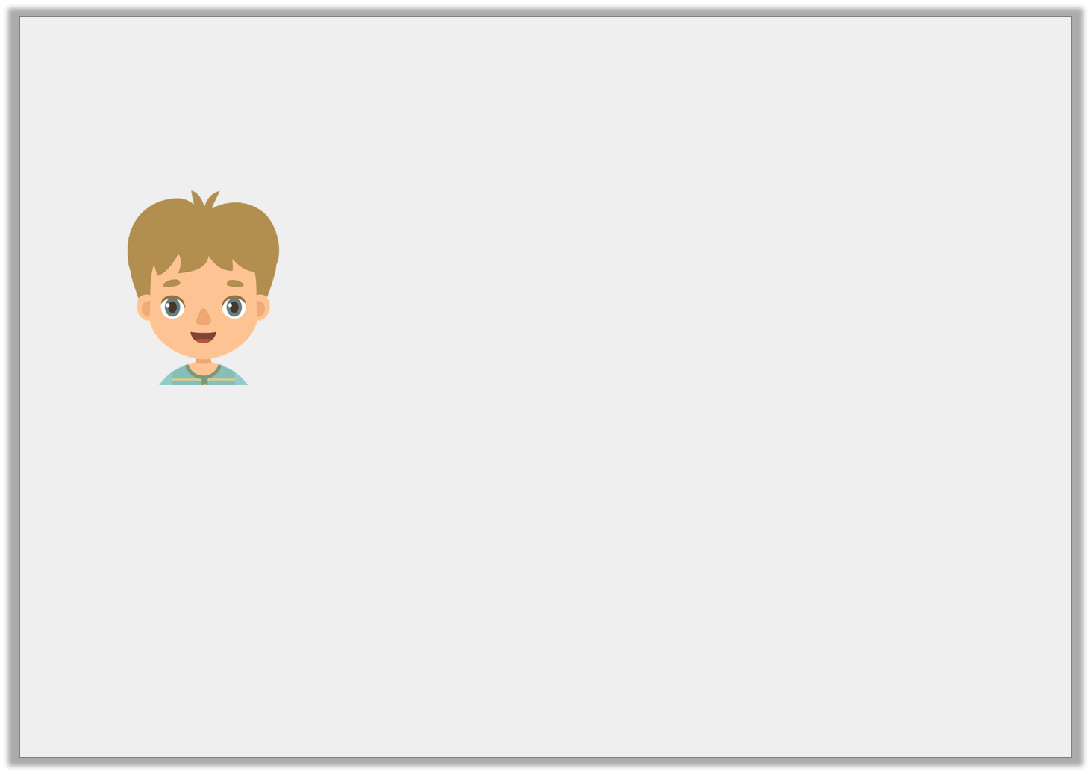
Reasoning 1
Jaxon says,
Do you agree? Prove it.
If I eat seven eighths of my birthday cake, there will be 0.25, or 25% left.
© Classroom Secrets Limited 2018

Slide 13
Reasoning 1
Jaxon says,
Do you agree? Prove it.
No, because…
If I eat seven eighths of my birthday cake, there will be 0.25, or 25% left.
© Classroom Secrets Limited 2018

Slide 14
Reasoning 1
Jaxon says,
Do you agree? Prove it.
No, because if Jaxon eats seven eighths there will be one eighth left. One eighth is equivalent to 0.125 and 12.5%.
If I eat seven eighths of my birthday cake, there will be 0.25, or 25% left.
© Classroom Secrets Limited 2018

Slide 15
Problem Solving 1
Ethan scored 62.5% on his Science test.
Felix got of his answers correct.
Jaiden expresses her result as a decimal, which is 0.75.
Who scored the highest?
Show your working.
7
8
© Classroom Secrets Limited 2018

Slide 16
Problem Solving 1
Ethan scored 62.5% on his Science test.
Felix got of his answers correct.
Jaiden expresses her result as a decimal, which is 0.75.
Who scored the highest?
Show your working.
Ethan: 62.5% = 0.625 =
Felix: = 0.875 = 87.5%
Jaiden: 0.75 = 75% =
Felix scored the highest.
7
8
5
8
7
8
3
4
© Classroom Secrets Limited 2018

