Slide 1
Science
Electricity
Year One
Science | Year 4 | Electricity | Everyday Electrical Appliances | Lesson 2

Slide 3
Aim
I can identify electrical appliances and the types of electricity they use.
Success Criteria
I can identify electrical appliances and non-electrical appliances.
I can sort appliances based on whether they use mains or battery power.

Slide 4
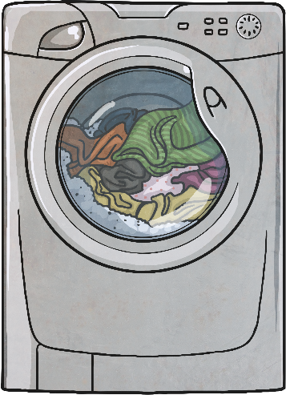
What is an Appliance?
Definition:
An Appliance is a device, piece of equipment or an instrument designed to perform a task.
Examples:
A washing machine is an appliance which performs the task of washing clothes.
A thermometer is an appliance which performs the task of checking the temperature.

Slide 5
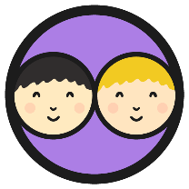
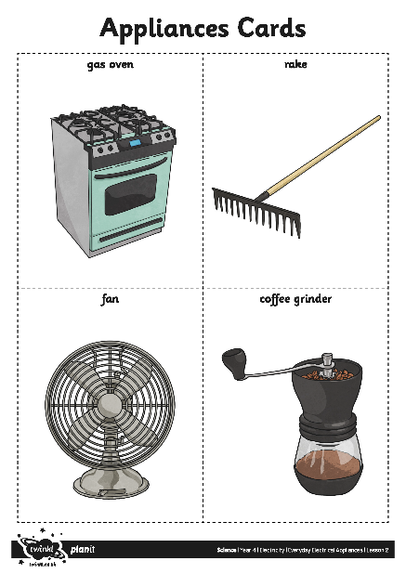
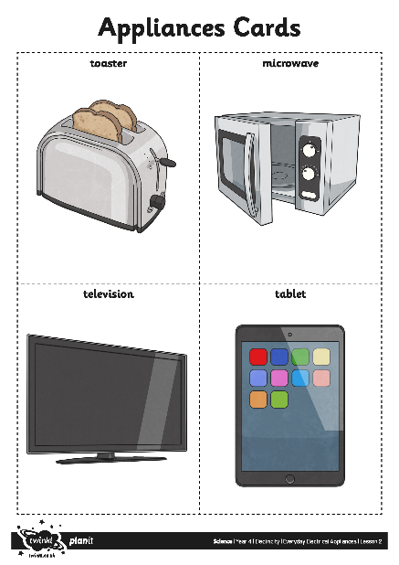
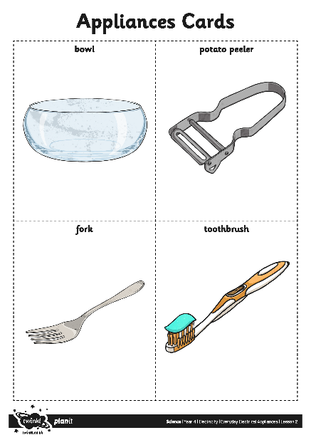
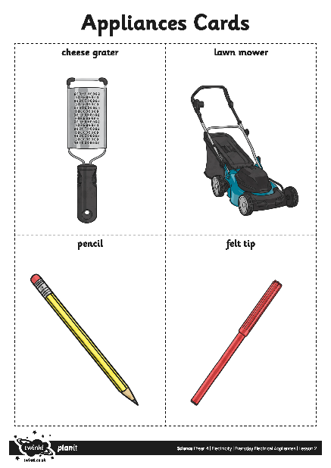
Electrical Appliances
Look at the appliances cards. Which of these items use electrical power and which are these don’t use any power? Write a list with electrical/ Non – electrical items.

Slide 6
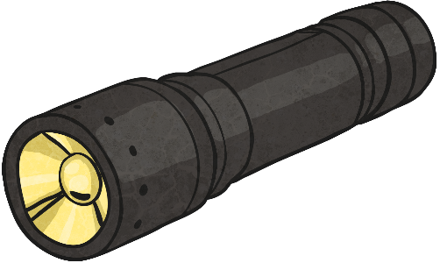
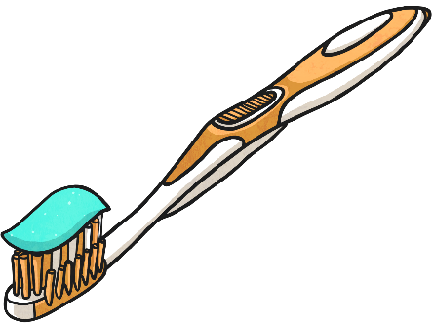
Electrical Appliances Answers
Electrical Appliances | Non-electrical Appliances
washing machine mobile phone lawn mower toaster microwave television tablet fan sewing machine torch iron hairdryer | thermometer saucepan cheese grater pencil felt tip bowl potato peeler fork toothbrush gas oven rake coffee grinder candle hammer sponge
Questions
Which appliances did you think used electricity?
Which did you think did not use electricity?
Can you explain why?

Slide 7
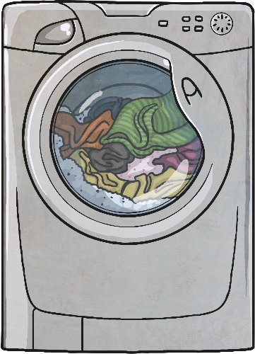
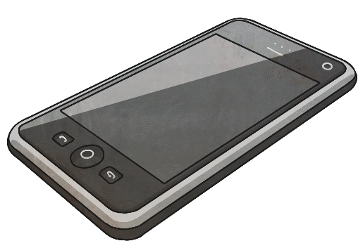
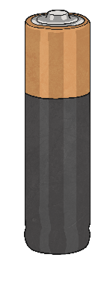
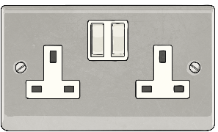
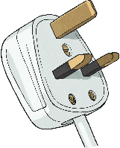
Types of Electricity
There are two types of electricity:
Mains Electricity
Battery Electricity
To use this type of electricity, you need to plug the appliance into a socket.
To use this type of electricity, you need to insert a battery into the appliance.

Slide 8
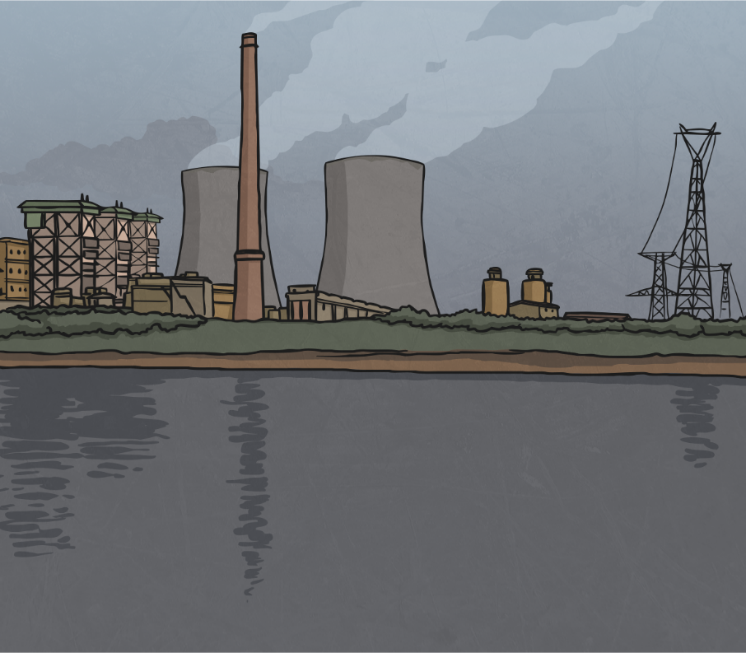
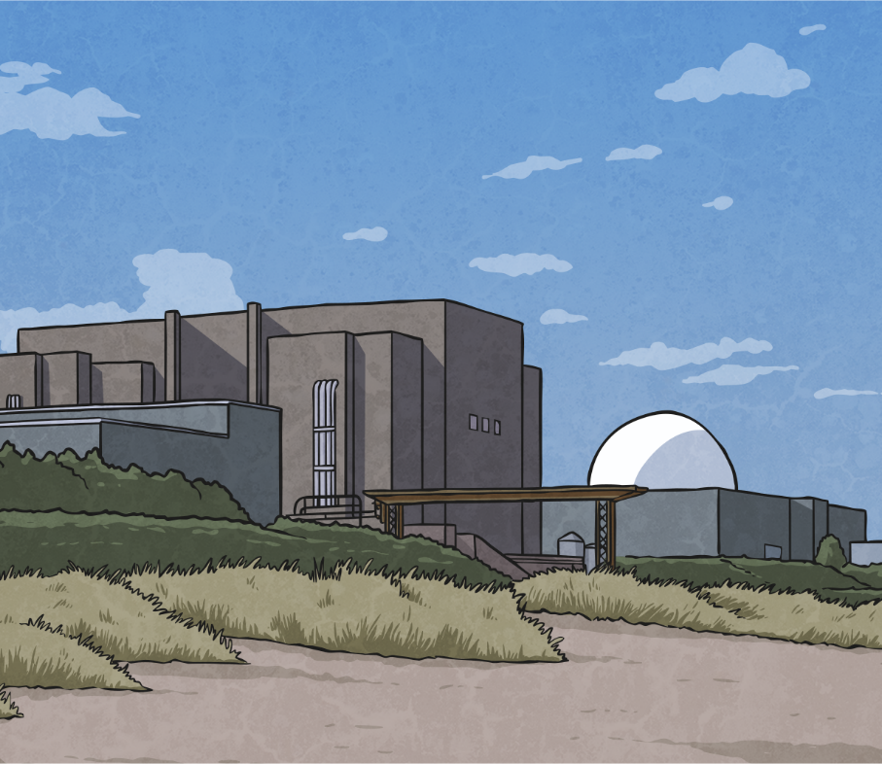
Types of Electricity
In the UK, mains electricity is produced mainly by gas, coal or nuclear power stations.
gas power station
nuclear power station

Slide 9
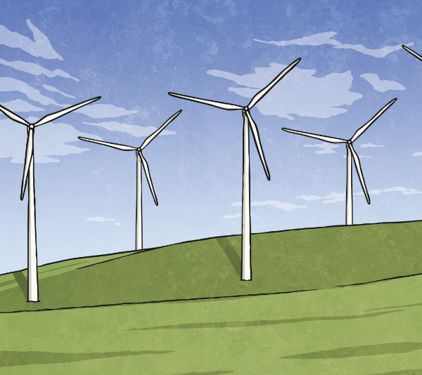
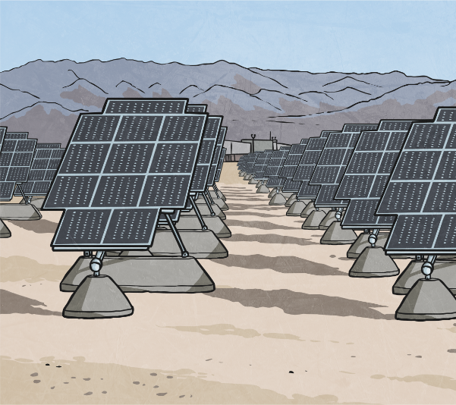
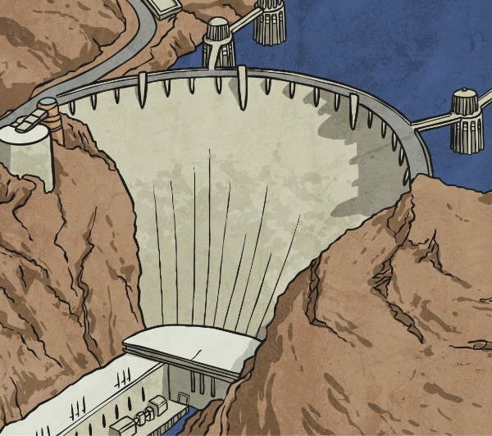
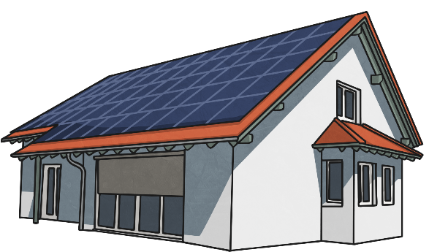
Types of Electricity
Wind turbines, hydroelectric and solar panel power stations are also used to generate electricity, but to a lesser extent.
wind turbines
solar panels
hydroelectric power
A small number of homes have solar panels attached to their roofs to provide mains electricity.

Slide 10
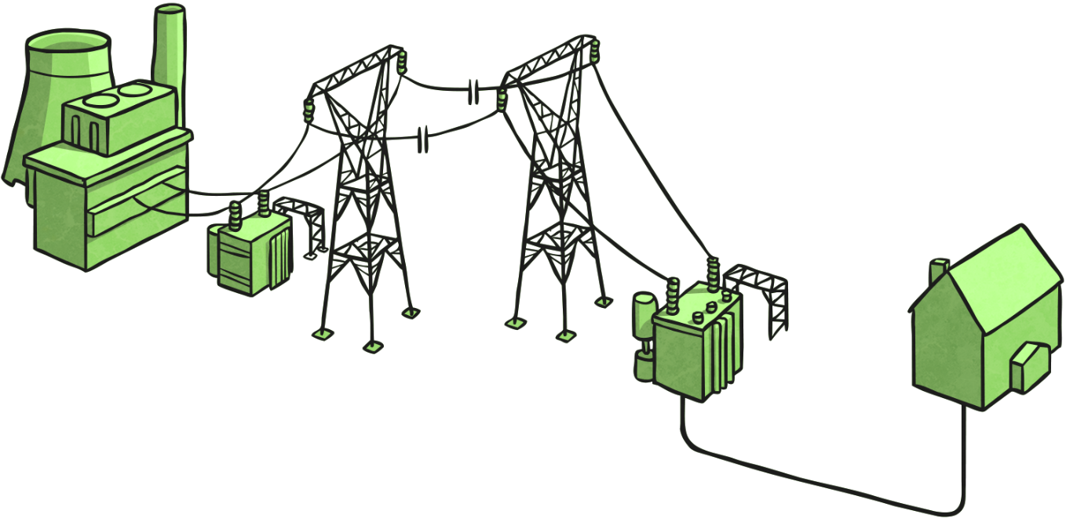
Types of Electricity
Power stations generate a continuous electric current.
Power Station
An electric current is generated and then sent through wires to a transformer.
Transformer
The second transformer connects to the wires from the pylons and in most cases, these wires are then placed underground.
Home
The wires are taken and then distributed throughout the home. The reason why you don’t see them is because they are in the walls! You only see the socket attached to the wires in the walls.
Transformer
The current is sent from transformers along wires that are attached to pylons to cities, towns and villages.
Pylons
Pylons connect the first transformer to the transformers near cities. You see pylons in the countryside.
Underground Wires
The underground wires connect the transformer to buildings, including homes.

Slide 11
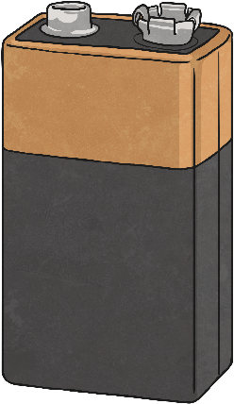
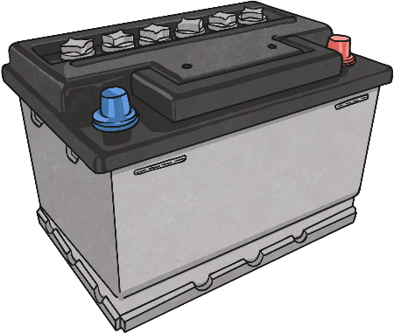
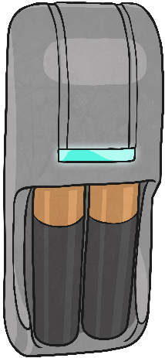
Types of Electricity
Batteries store chemicals which produce an electric current. They eventually stop working as the chemicals stop being able to produce an electric current.
battery
square battery
car battery
Rechargeable batteries are ones where the chemical reaction can be reversed so that the battery is able to create an electric current again. However, even rechargeable batteries will eventually stop producing an electric current.

Slide 12
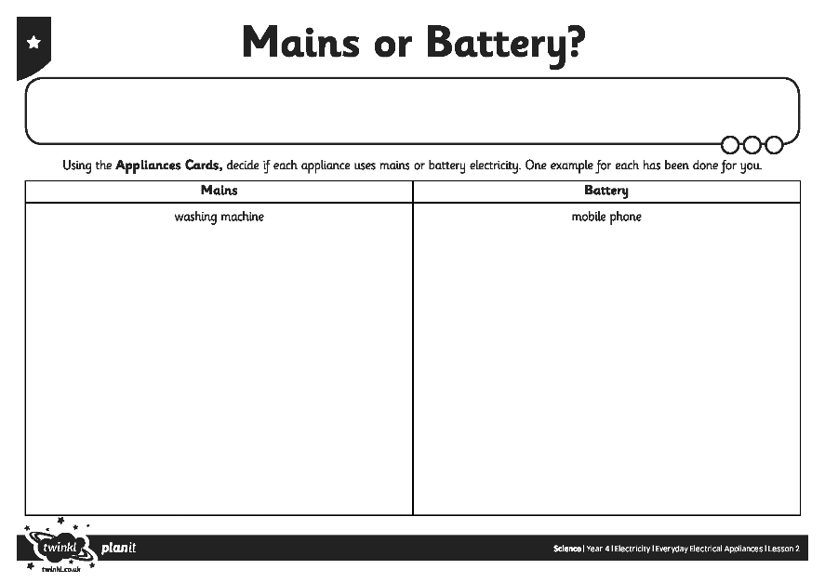
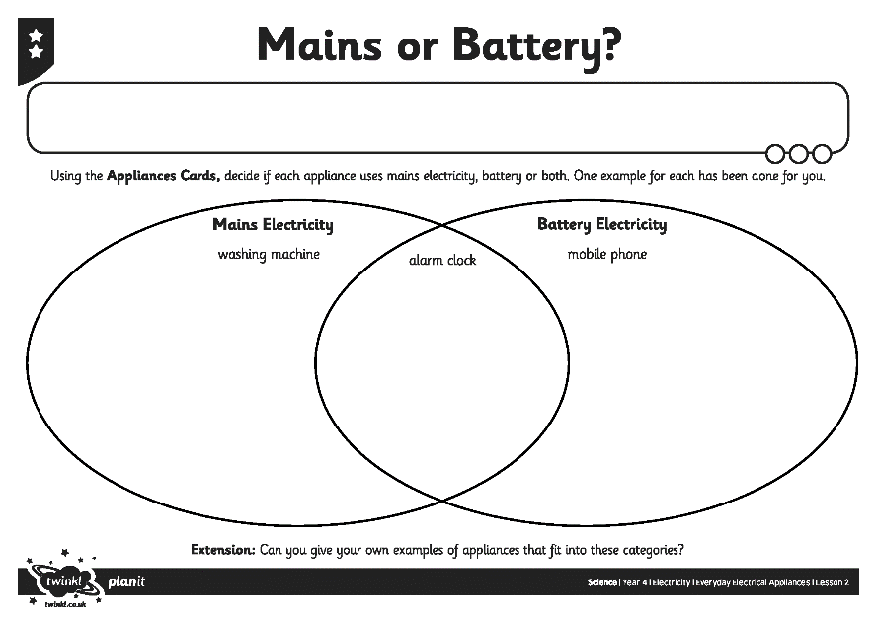
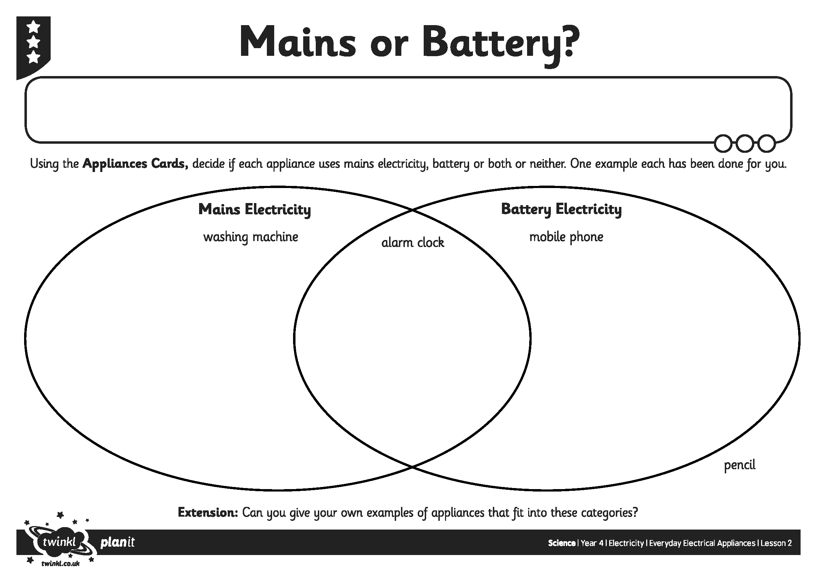
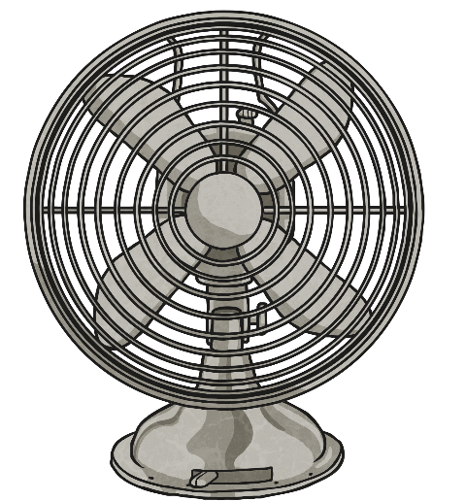
Mains or Battery?

Slide 13
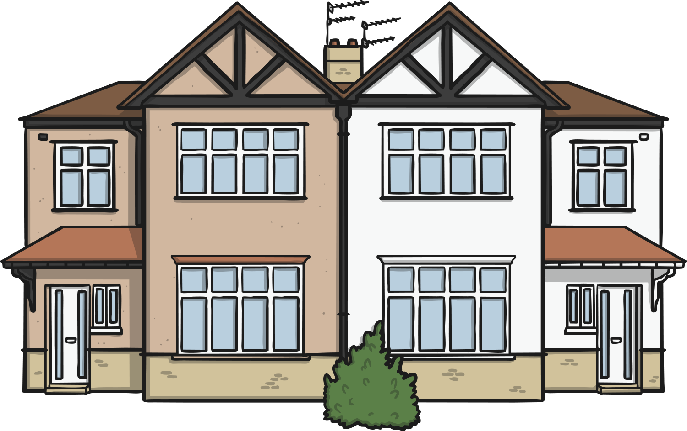
Staying Safe
Mains electricity can be dangerous, causing anything from a minor electric shock, to serious burns and even death!
Do you know how to stay safe in your home?
Click on the house below and let’s see.

Slide 14
Aim
I can identify electrical appliances and the types of electricity they use.
Success Criteria
I can identify electrical appliances and non-electrical appliances.
I can sort appliances based on whether they use mains or battery power.

