Slide 1
Percentages recap

Slide 2
OLI:
I can recognise and write percentages.
Success Criteria
I can recognise the per cent symbol.
I can write the percentage that a diagram represents.
I can represent a percentage with a diagram.

Slide 3
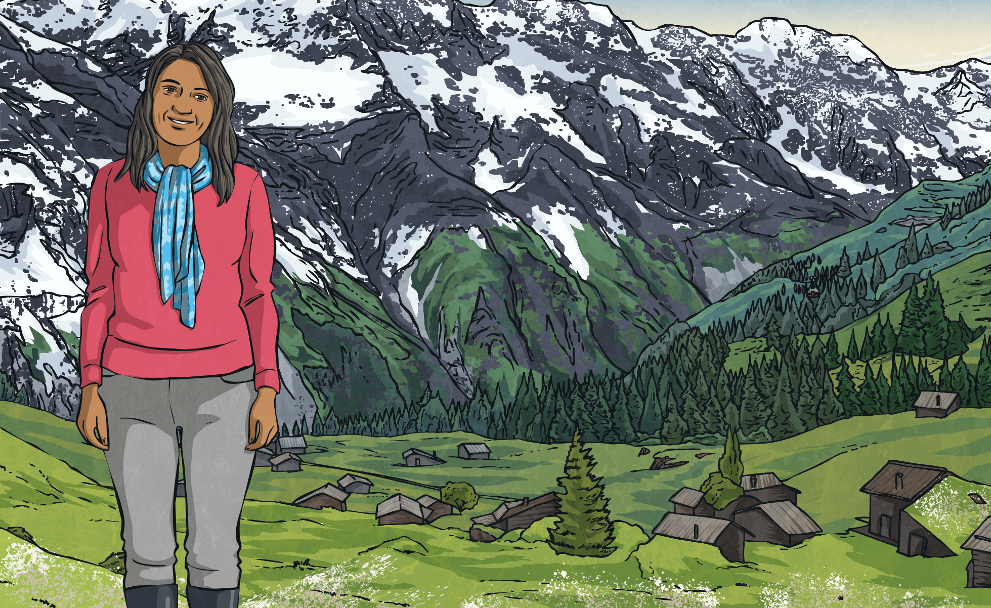
Fraction Action!
1
3
1
9
0.25
=
0.5
>
<
>
<
Write down a fraction that fits this statement:
=
5
4
4
10

Slide 4
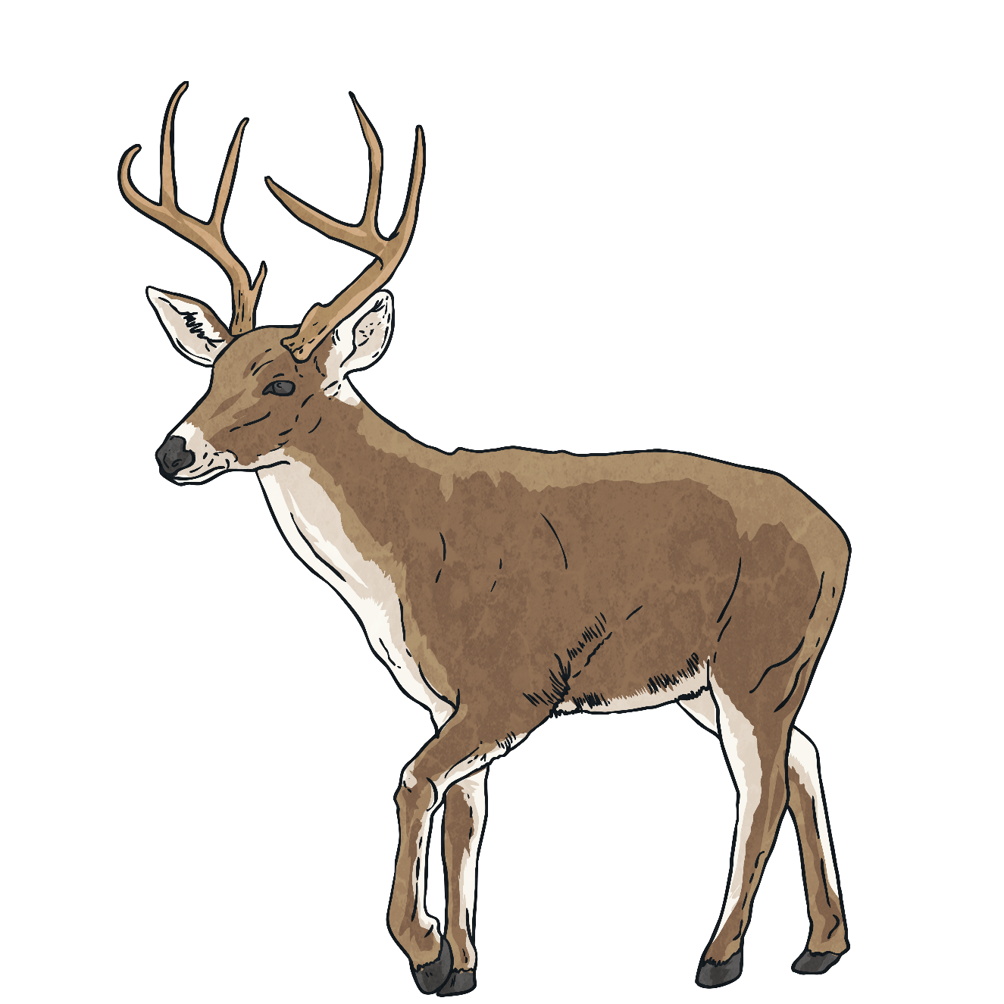
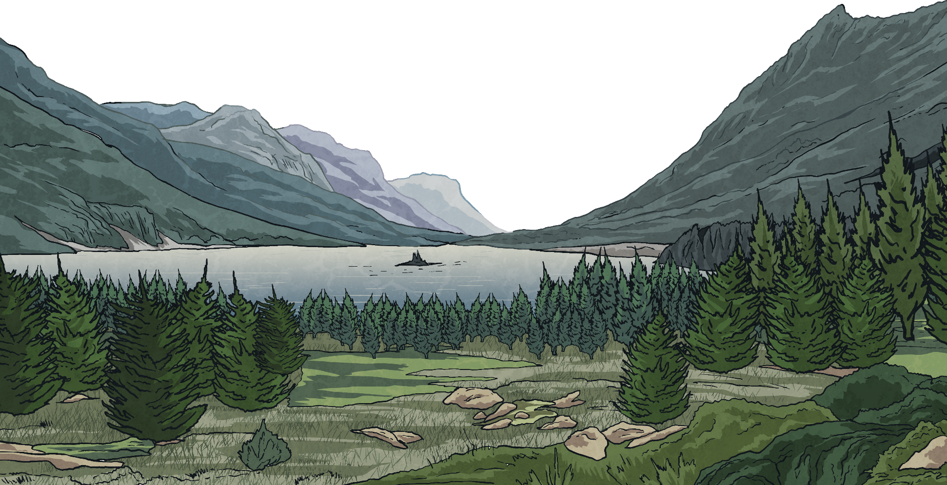
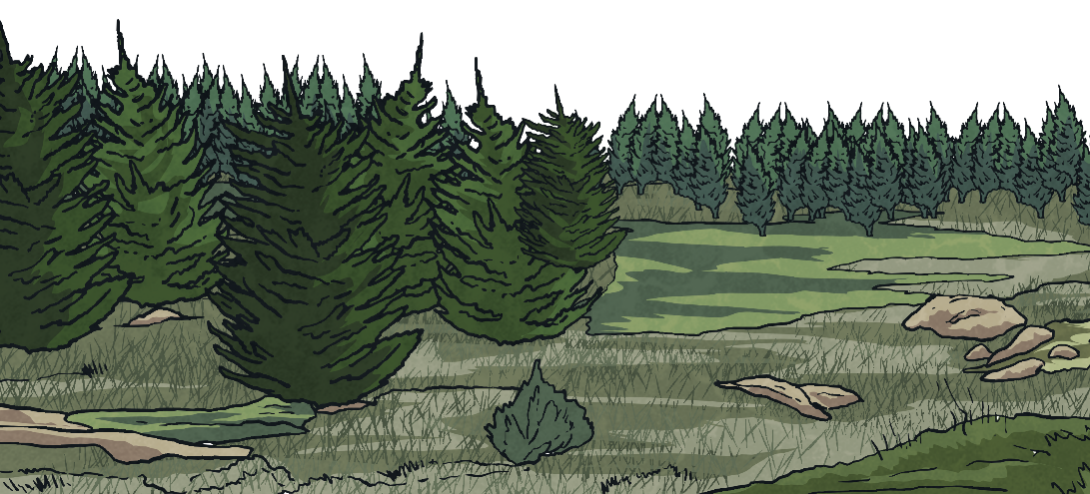
Tell Me
What can you tell me about this symbol?
‘Per cent’ relates to ‘number of parts per hundred’.
%

Slide 5
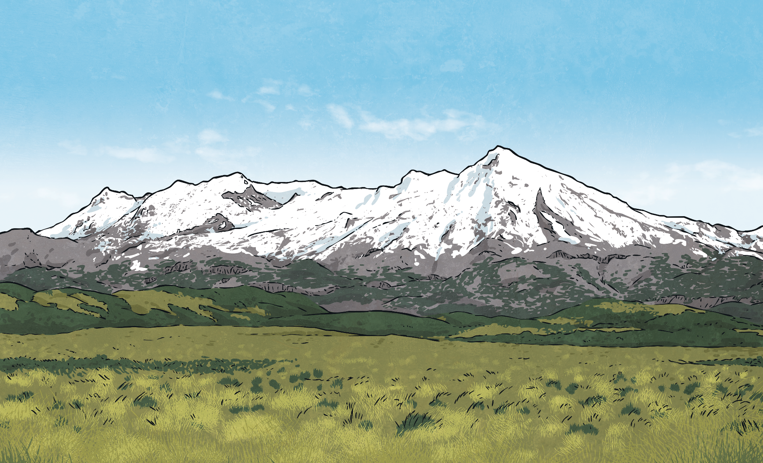
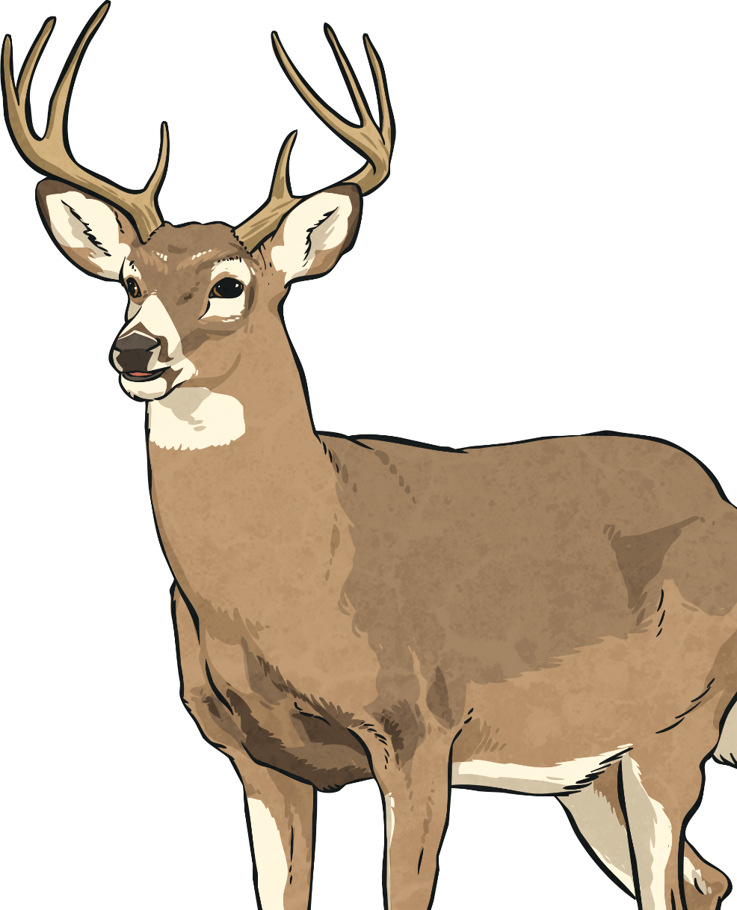
Percentage Diagrams
Here is a 10 by 10 grid made of 100 small, equal squares. What is the number of parts per hundred shaded? What percentage does each square represent?
1 part per hundred is shaded = 1%
90 parts per hundred is shaded = 90%
55 parts per hundred is shaded = 55%
74 parts per hundred is shaded = 74%
30 parts per hundred is shaded = 30%
20 parts per hundred is shaded = 20%

Slide 6
Percentage Diagrams
Use your Blank Hundred Squares.
Shade in a grid to show:
90%
3%
48%
17%

Slide 7
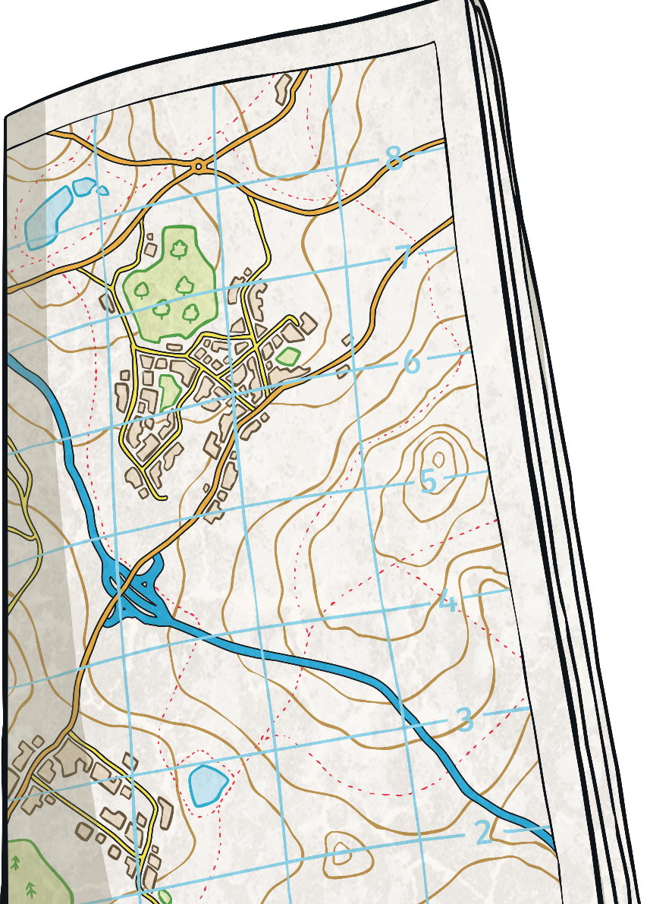
Percentage Diagrams
Here is a grid made of 10 equal rectangles.
What percentage of the grid does each rectangle represent?
Here is a grid made of two equal rectangles.
What percentage of the grid does each rectangle represent?
Here is a grid made of four equal squares.
What percentage of the grid does each square represent?
There are 10 parts per hundred shaded, which is equivalent to 10%
There are 25 parts per hundred shaded, which is equivalent to 25%
There are 50 parts per hundred shaded, which is equivalent to 50%
10%
50%
25%

Slide 8
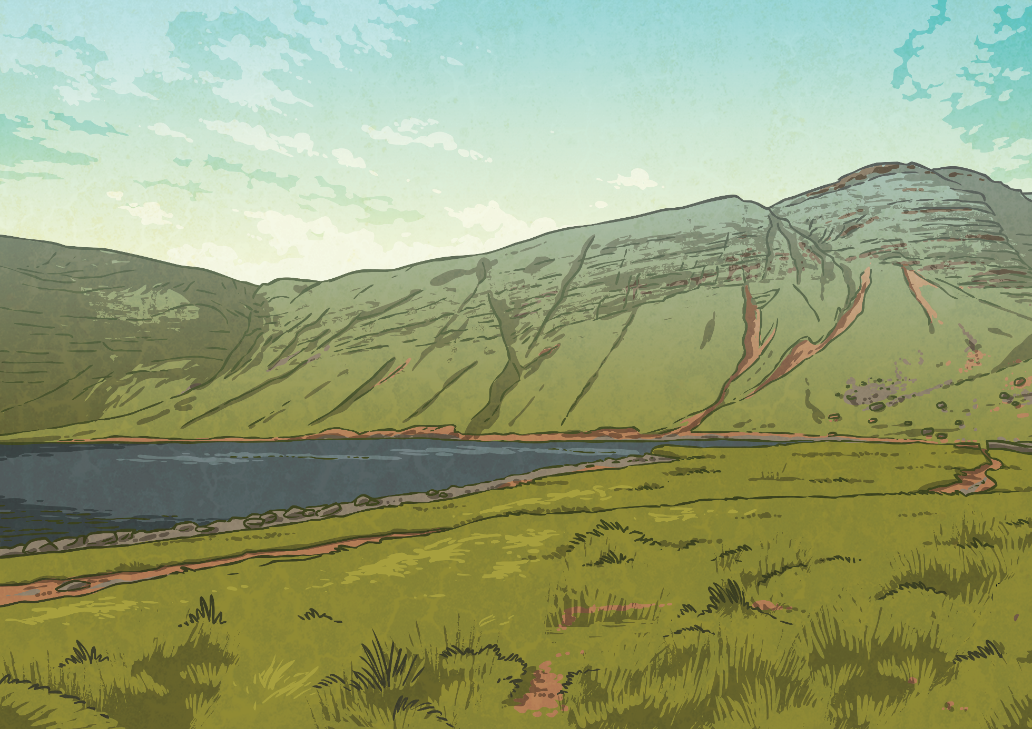
Matching Hundredths
Match up these equivalent percentages and fractions.
For any fractions or percentages that don’t have a match, can you write down their equivalent match?
13%
11%
33%
31%
30%
10%
3%
31
100
31%
33
11
10
30
100
100
100
100
33%
11%
10%
30%
13
1
3
100
100
100
13%
1%
3%

Slide 9
Matching Hundredths
Match up these equivalent percentages and fractions.
For any fractions or percentages that don’t have a match, can you write down their equivalent match?
13%
11%
33%
31%
30%
10%
3%
31
100
31%
33
11
10
30
100
100
100
100
33%
11%
10%
30%
13
1
3
100
100
100
13%
1%
3%

