Slide 1
Tuesday 23rd February 2021
OLI: To explore the Liturgy of the Eucharist

Slide 2
At the end of the Liturgy of the Word, the priest and people together say the Creed, which is a statement of what they believe. It starts with the words ‘I believe in one God’.
The second part of the Mass now begins. It is called the Liturgy of the Eucharist.

Slide 4
The cup is called a chalice. The dish, which contains the hosts, is called a paten.

Slide 5
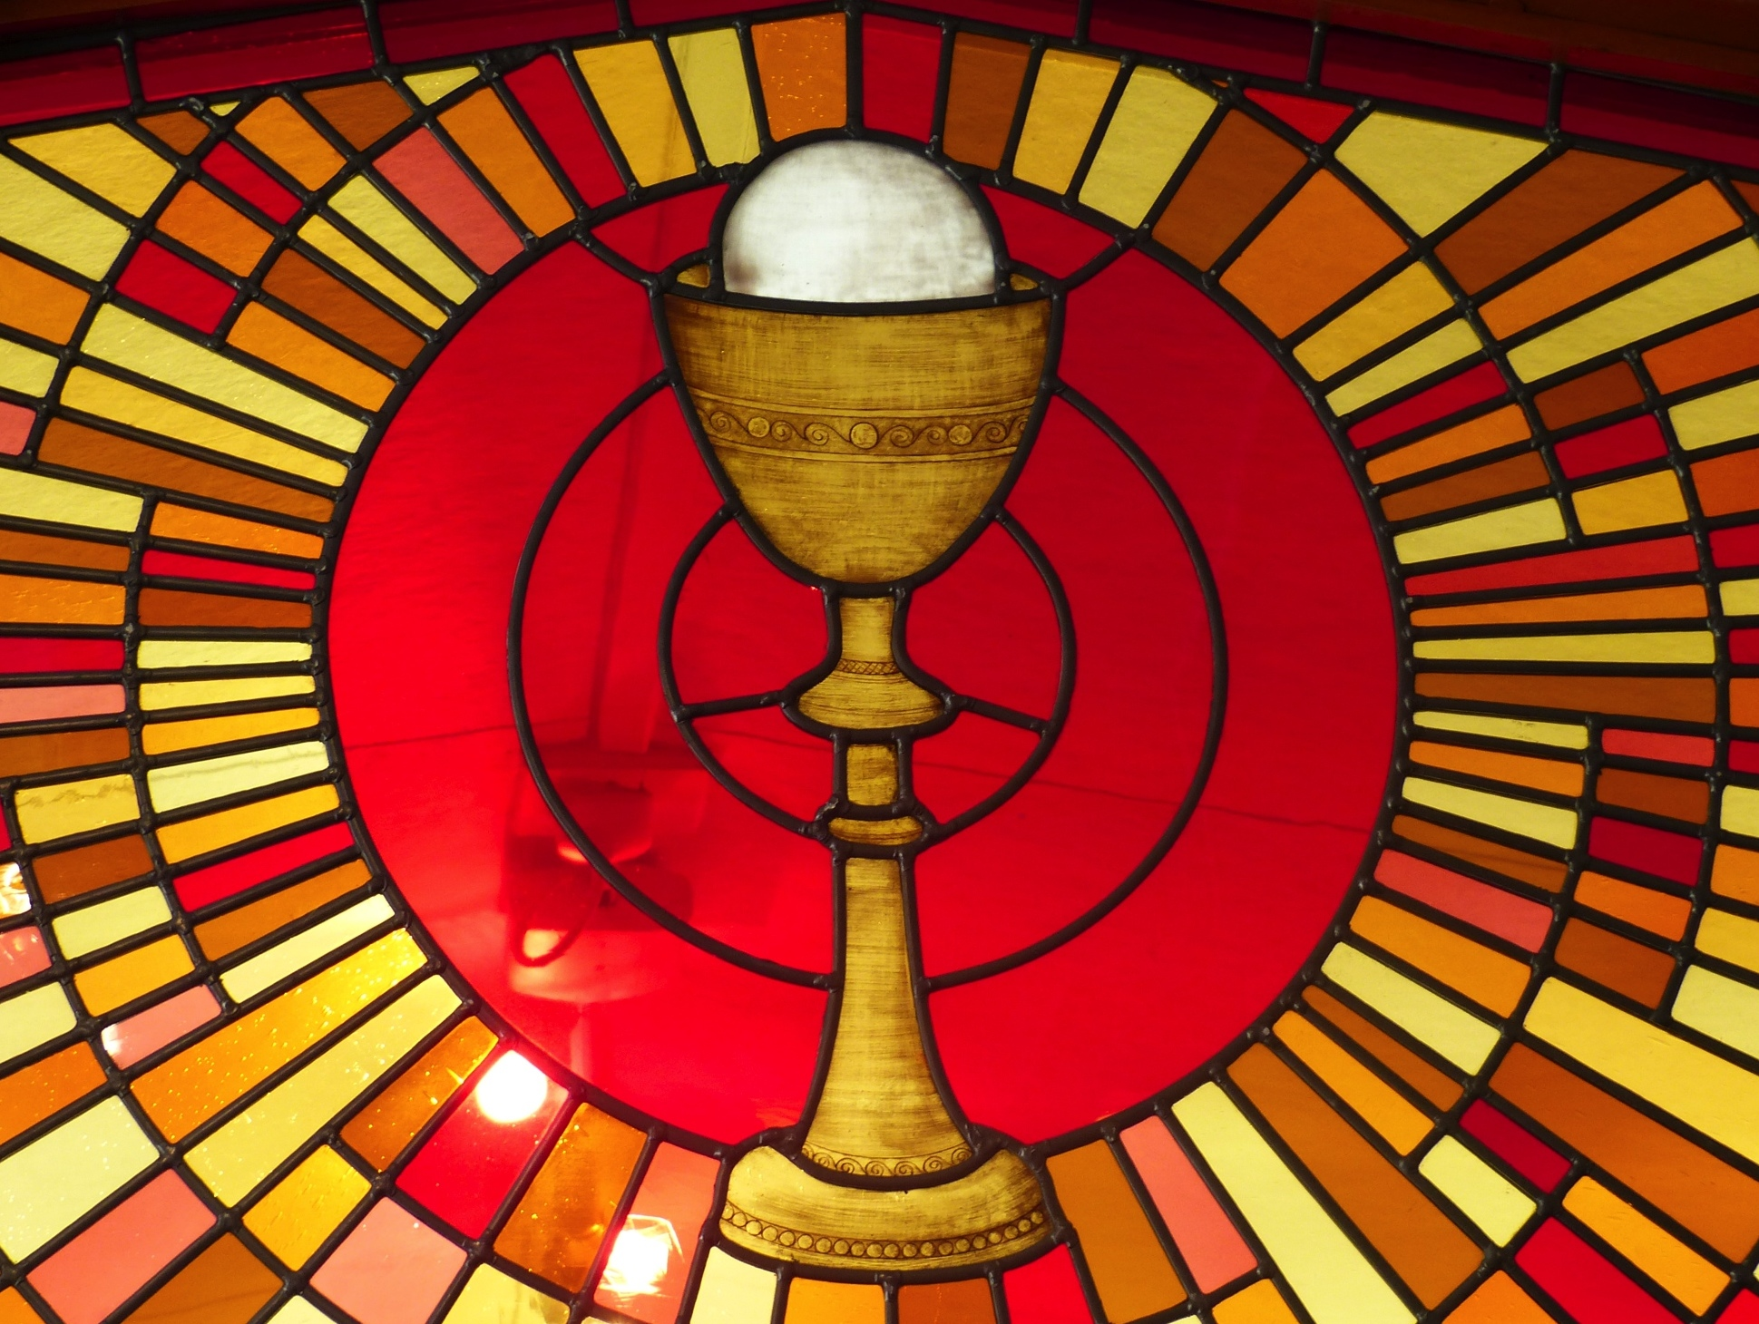
Eucharist
Preparation of the Gifts

Slide 6
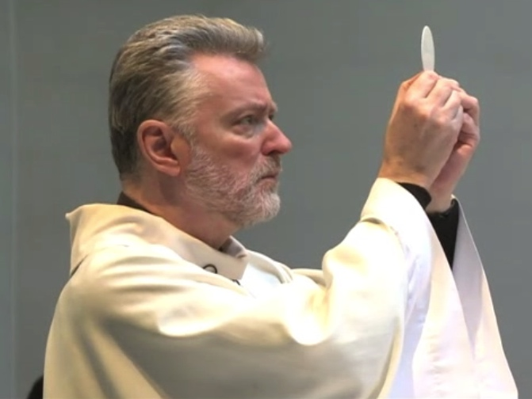
Blessed are you, Lord, God of all creation for through your goodness we have received the bread we offer you: fruit of the earth and work of human hands. It will become for us the bread of life.

Slide 7
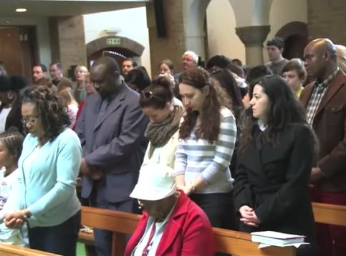
Blessed be God for ever

Slide 8
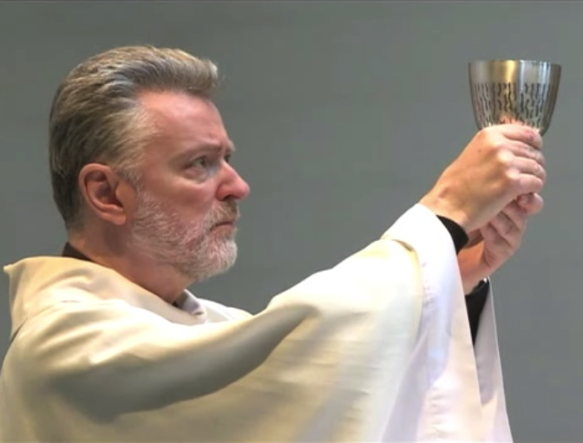
Blessed are you, Lord, God of all creation for through your goodness we have received the wine we offer you: fruit of the vine and work of human hands.
It will become our spiritual drink.

Slide 9
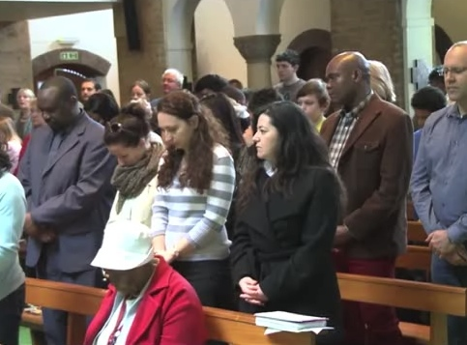
Blessed be God for ever

Slide 10
SOME KEY QUESTIONS
What gifts are brought in procession to the altar?
Who brings the gifts to the altar?
Who receives the gifts?
What does the priest do with the gifts?
What do the gifts of bread and wine represent?

Slide 11
The Eucharistic Prayer gives thanks for all God’s goodness. The greatest of all gifts is Jesus and in this prayer the Church remembers the special meal of the Last Supper. This is a time when the priest speaks the words of the prayer and the parish family listen carefully and pray quietly in their hearts. Holding the host, the priest says the words Jesus used at the Last Supper:
“Take this, all of you and eat of it; for this is my Body, which will be given up for you.”
(Jesus’ words mean ‘This is my living presence today, this is myself, this is me’.)
Holding the chalice, the priest says,
“Take this, all of you and drink from it;
For this is the chalice of my Blood,
the Blood of the new and eternal covenant.
which will be poured out for you and for many
for the forgiveness of sins,
Do this in memory of me.”
By the power of the Holy Spirit the bread and wine have now become the Body and Blood of Jesus.
At the very end of the Eucharist Prayer everyone says ‘Amen!’, which is a Hebrew word. It means ‘let it be so’, ‘we agree’.

Slide 13
SOME KEY QUESTIONS
What kind of prayer is the Eucharistic Prayer?
When we celebrate the Eucharist, what are we thanking God for?
What links the Eucharistic Prayer to the Last Supper?
What did Jesus mean when he said, “This is my body”?
Why do you think Jesus chose bread and wine as symbols to remember him by?

