Slide 2
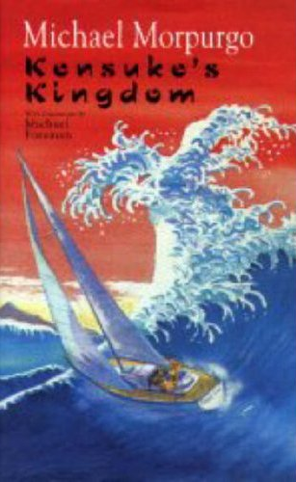
Thursday 4th February
OLI: Describing characters using evidence from the text.
Success Criteria: I can describe a character from Kensuke’s Kingdom using evidence from the text.

Slide 3
Abunai
DANGER

Slide 4
Gomenasai
SORRY

Slide 5
Yamero
STOP

Slide 6
Oyasumi nasai
GOOD NIGHT

Slide 7
What sort of person do you think Michael is? Choose SIX of the words in the box below, and write a sentence for each. You can use different words if you wish!
brave, cowardly, lonely, determined, happy, sad
confused, clever, sensible, angry, foolish, naughty
6 sentences:
I think Michael is.................... because......................................................

Slide 8
Task
Use these sentences to write a 2-3 paragraph description of Michael.
Remember to include ambitious vocabulary
Use evidence from the text to back up your ideas!

