Slide 1


Slide 3
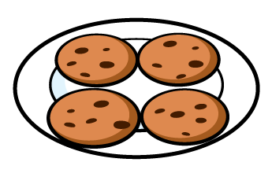
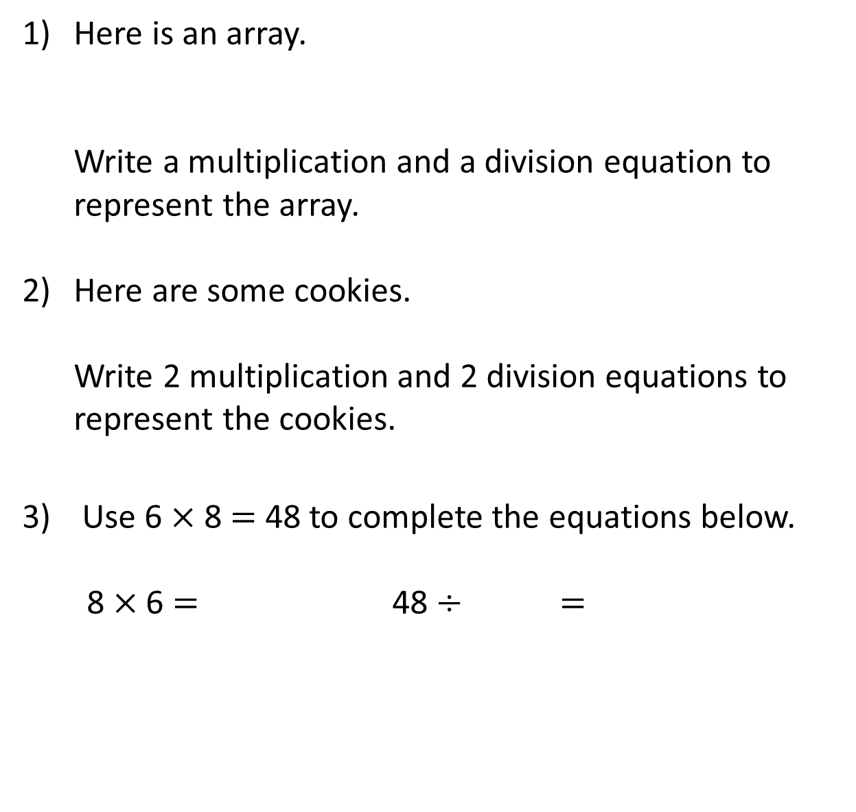
1) Here is an array.
Write a multiplication and a division equation to represent the array.
Here are some cookies.
Write 2 multiplication and 2 division equations to represent the cookies.
3) Use 6 $×$ 8 $=$ 48 to complete the equations below.
8 $×$ 6 $=$ 48 $÷$ $=$

Slide 4
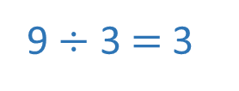
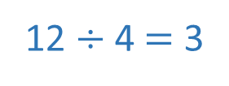
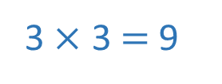
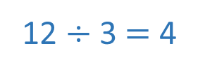
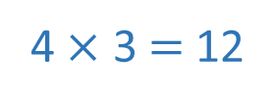
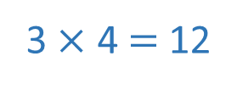
1) Here is an array.
Write a multiplication and a division equation to represent the array.
Here are some cookies.
Write 2 multiplication and 2 division equations to represent the cookies.
3) Use 6 $×$ 8 $=$ 48 to complete the equations below.
8 $×$ 6 $=$ 48 $÷$ $=$
3 $×$ 3 $=$ 9
9 $÷$ 3 $=$ 3
3 $×$ 4 $=$ 12
4 $×$ 3 $=$ 12
12 $÷$ 3 $=$ 4
12 $÷$ 4 $=$ 3
6
8
48
8
6

Slide 6
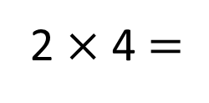
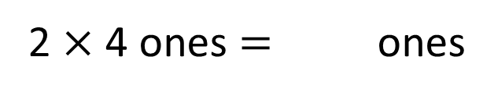
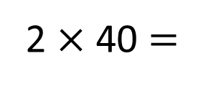

Complete the multiplications.
8
2 $×$ 4 ones $=$ ones
2 $×$ 4 $=$
8
8
2 $×$ 4 tens $=$ tens
2 $×$ 40 $=$
80

Slide 7
4
8
12
16
20
24
28
40
80
120
160
200
240
280

Slide 8
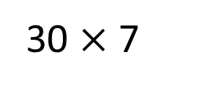
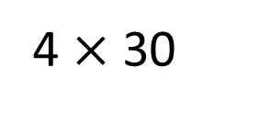
3
6
9
12
15
18
21
4 $×$ 30
30 $×$ 7
30
60
90
120
150
180
210

Slide 9



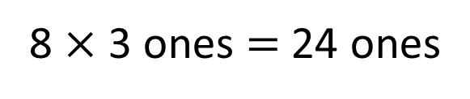
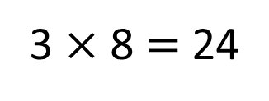
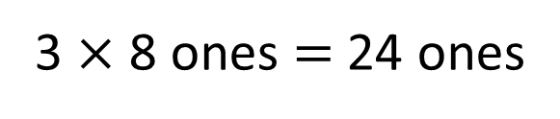
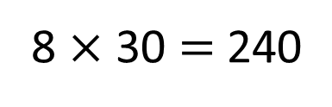
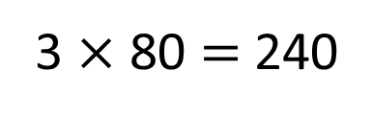

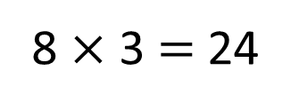

Have a think
8 $×$ 3 ones $=$ 24 ones
8 $×$ 3 $=$ 24
3 $×$ 8 ones $=$ 24 ones
3 $×$ 8 $=$ 24
8 $×$ 3 tens $=$ 24 tens
8 $×$ 30 $=$ 240
3 $×$ 8 tens $=$ 24 tens
3 $×$ 80 $=$ 240

Slide 10
Have a go at questions
1 – 4 on the worksheet

Slide 11
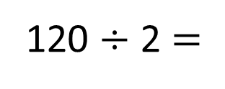
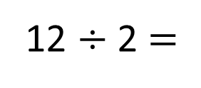
Complete the divisions.
12 $÷$ 2 $=$
6
120 $÷$ 2 $=$
60

Slide 12
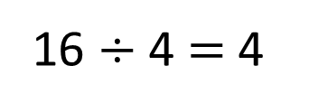
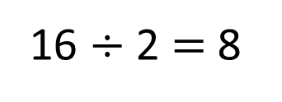
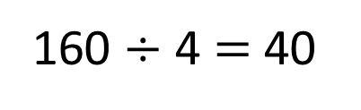
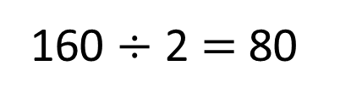
16 $÷$ 2 $=$ 8
16 $÷$ 4 $=$ 4
160 $÷$ 2 $=$ 80
160 $÷$ 4 $=$ 40

Slide 13
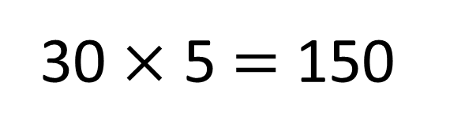
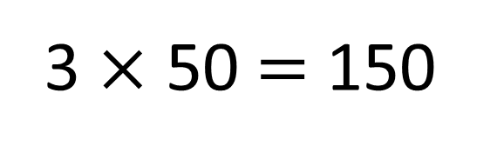
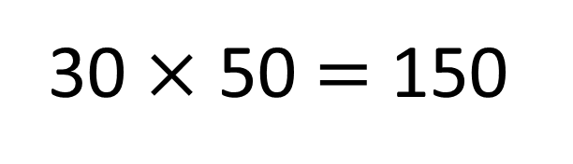
True
False
3 $×$ 50 $=$ 150
30 $×$ 5 $=$ 150
30 $×$ 50 $=$ 150

Slide 14
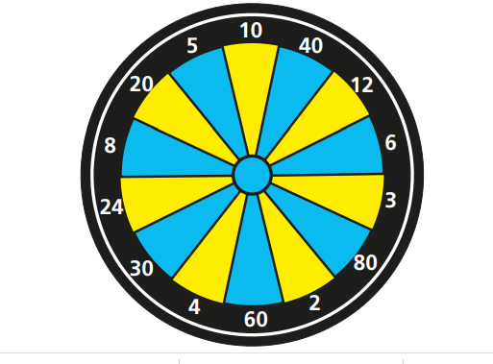


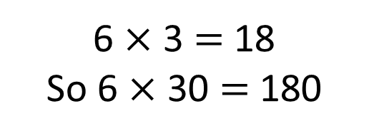
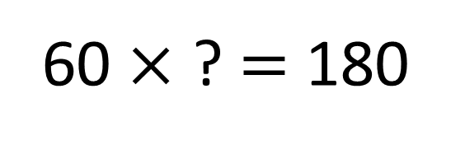
Where does Whitney’s counter need to land?
What was Annie’s score?
Have a think
180
60 $×$ ? $=$ 180
6 $×$ 3 $=$ 18
So 6 $×$ 30 $=$ 180
I wonder if I can score the same?

Slide 15
Have a go at the rest of the questions on the worksheet

