Slide 2
Diving into Mastery Guidance for Educators
Each activity sheet is split into three sections, diving, deeper and deepest, which are represented by the following icons:
These carefully designed activities take your children through a learning journey, initially ensuring they are fluent with the key concept being taught; then applying this to a range of reasoning and problem-solving activities.
These sheets might not necessarily be used in a linear way. Some children might begin at the ‘Deeper’ section and in fact, others may ‘dive straight in’ to the ‘Deepest’ section if they have already mastered the skill and are applying this to show their depth of understanding.
Diving
Deeper
Deepest

Slide 3
Aim
Recognise and show, using diagrams, families of common equivalent fractions.

Slide 4
Equivalent Fractions (1)
Diving
Label the fractions and identify the equivalents for a third.
One third is equivalent to two sixths.
= $\frac{\text{2}}{\text{6}}$
1
3
1
3
1
3
One third is equivalent to .
= $\frac{\text{2}}{\text{6}}$
1
3
1
3
1
3
1
6
1
6
1
6
1
6
1
6
1
6
1
3
1
3
2
6
One third is equivalent to .
= $\frac{\text{4}}{\text{12}}$
1
3
1
3
1
3
One third is equivalent to four twelfths.
= $\frac{\text{4}}{\text{12}}$
1
3
1
3
1
3
1
12
1
12
1
12
1
12
1
12
1
12
1
12
1
12
1
12
1
12
1
12
1
12
1
3
1
3
4
12

Slide 5
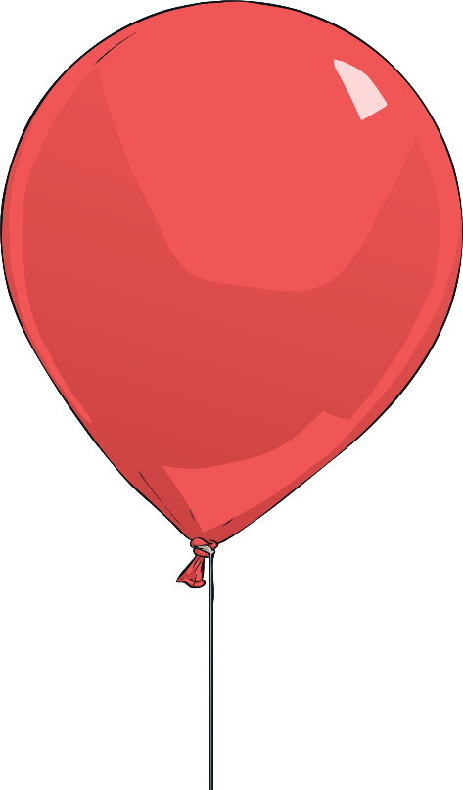
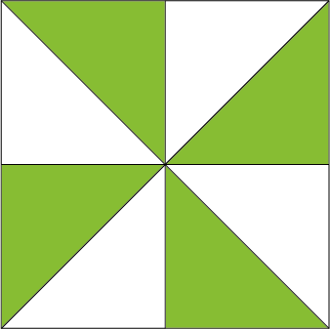
Equivalent Fractions (1)
Diving
Is the fraction equivalent to $?$
Complete the table.
1
2
Fraction | Is it equivalent to $\frac{\text{1}}{\text{2}}$ ? ✓ or ✗
1
2
✓ $\frac{\text{8}}{\text{16}}$ = $\frac{\text{1}}{\text{2}}$
8
16
1
2
✗
✓ $\frac{\text{8}}{\text{16}}$ = $\frac{\text{1}}{\text{2}}$
4
8
1
2

Slide 6
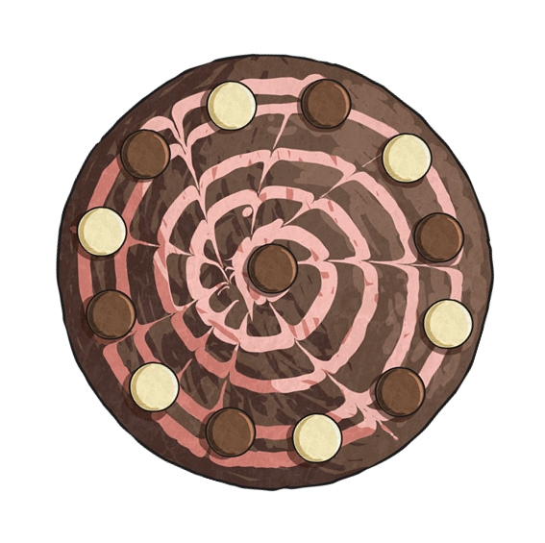
Equivalent Fractions (1)
Diving
Mrs Venn baked a cake.
Who ate the most?
Khem ate $\frac{\text{6}}{\text{12}}$ of the cake.
6
12
Carly ate $\frac{\text{1}}{\text{4}}$ .
Khem ate the most because $\frac{\text{6}}{\text{12}}$ is equivalent to $\frac{\text{1}}{\text{2}}$ or $\frac{\text{2}}{\text{4}}$ . Carly and Anya both ate the equivalent of $\frac{\text{1}}{\text{4}}$ each.
1
4
6
12
1
2
2
4
Anya ate $\frac{\text{3}}{\text{12}}$ of the cake.
3
12
1
4

Slide 7
Equivalent Fractions (1)
Deeper
Which one is the odd one out and why?
A
B
A shows $\frac{\text{3}}{\text{9}}$ , B shows $\frac{\text{1}}{\text{3}}$ and D shows $\frac{\text{6}}{\text{18}}$.
All of these fractions are equivalent to $\frac{\text{1}}{\text{3}}$ . C is the odd one out because it shows $\frac{\text{6}}{\text{12}}$ which is equivalent to $\frac{\text{1}}{\text{2}}$ and greater than the rest.
3
9
1
3
6
18
1
3
C
D
6
12
1
2

Slide 8
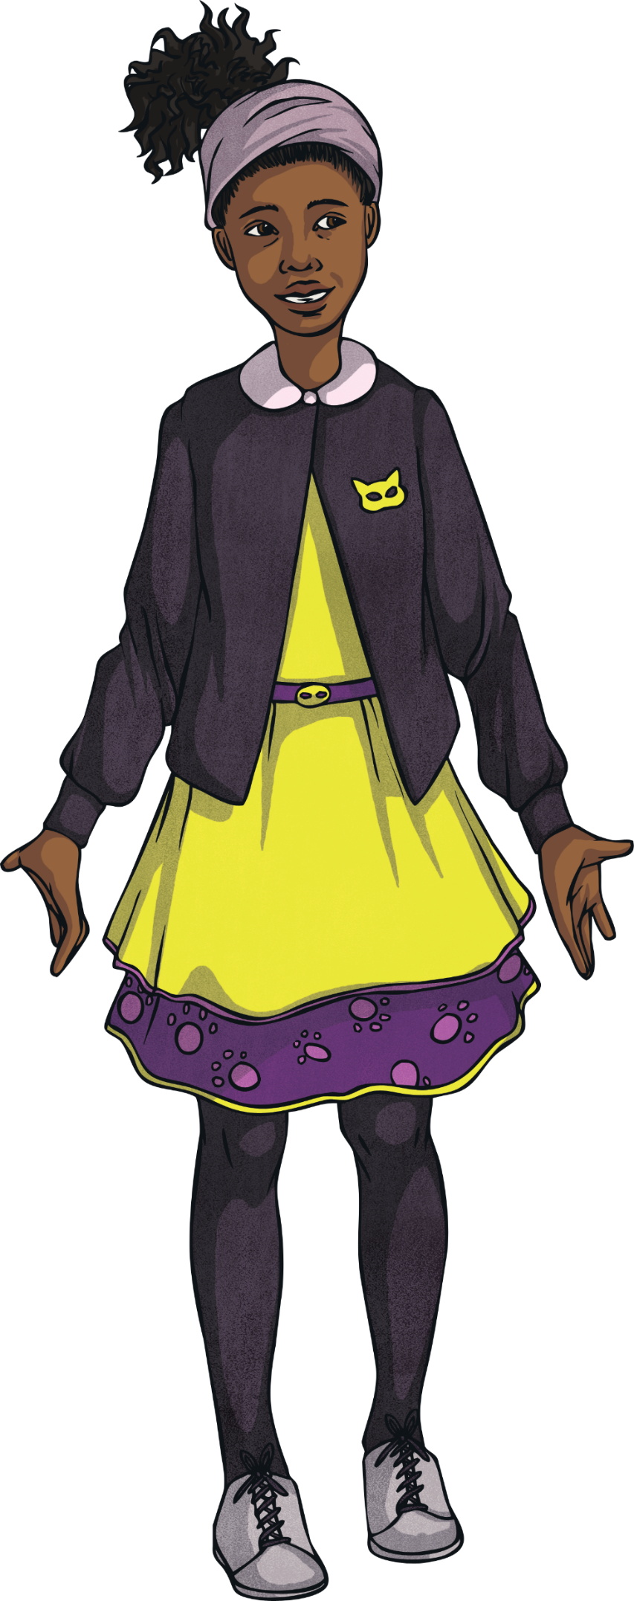
Equivalent Fractions (1)
Deeper
Is this statement true or false? 'Prove it and explain your reasoning.
Equivalent fractions can be made by splitting the original fraction into smaller parts.
1
6
1
6
1
6
1
6
1
6
1
6
1
3
1
3
1
3
1
3
1
3
1
3
1
6
1
6
1
6
1
6
1
6
1
6
True. Thirds can become sixths by cutting each third into 2 equal parts. It is easy to then see that one third is equivalent to two sixths.

Slide 9
Equivalent Fractions (1)
Deeper
Natalie says:
Four tenths is the same as a half.
Do you agree or disagree?
Explain and prove your answer.
Disagree because $\frac{\text{4}}{\text{10}}$ is less than $\frac{\text{1}}{\text{2}}$ . We know this because $\frac{\text{5}}{\text{10}}$ is equivalent to $\frac{\text{1}}{\text{2}}$ .
4
10
1
2
5
10
1
2
1
10
1
10
1
10
1
10
1
2
1
2

Slide 10
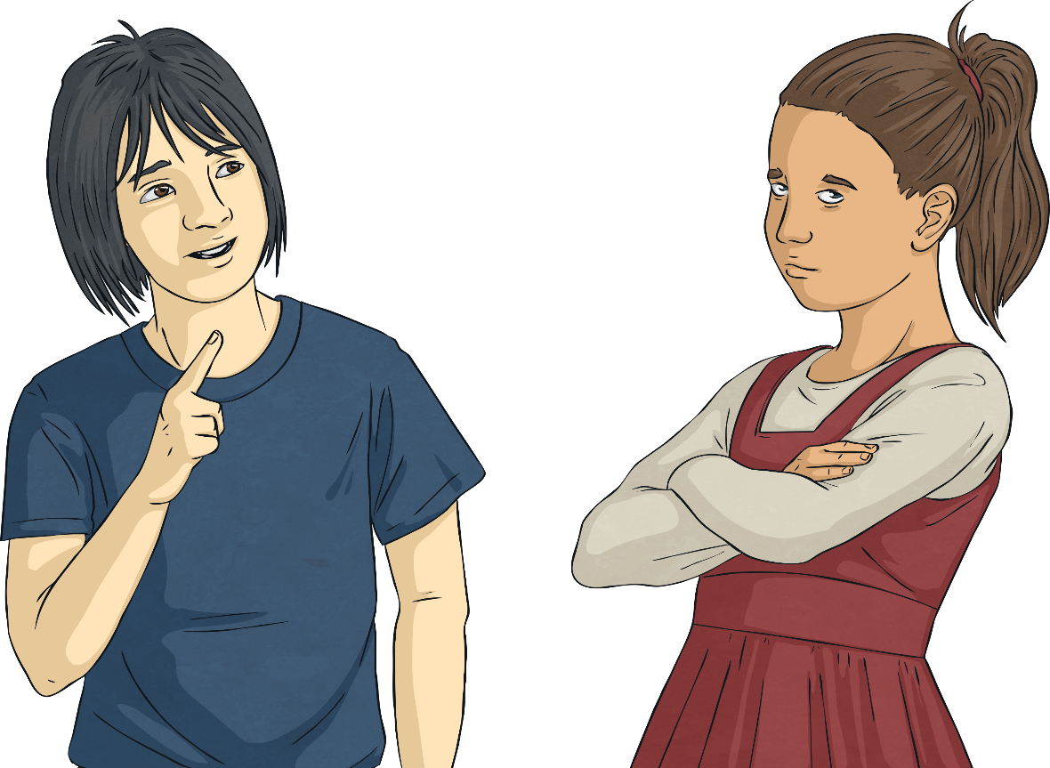
Equivalent Fractions (1)
Deepest
Jim and Ginger are wrapping presents. They are disagreeing. Every time they share out the strips of ribbon, one person always has one more piece of ribbon than the other.
1
3
1
6
1
6
1
6
1
3
1
6
1
6
1
6
1
3
Using your knowledge of equivalent fractions, solve the problem.

Slide 11
Equivalent Fractions (1)
Deepest
This problem is about having the same fractional amounts of ribbon not the same number of parts of ribbon.
Let’s sort the ribbons into the fraction types.
1
6
1
6
1
3
1
6
1
3
1
6
1
6
1
3
1
6

Slide 12
Equivalent Fractions (1)
Deepest
This problem is about having the same fractional amounts of ribbon not the same number of parts of ribbon.
Let’s sort the ribbons into the fraction types.
1
3
1
3
1
6
1
6
1
6
1
3
1
6
1
6
1
6

Slide 13
Equivalent Fractions (1)
Deepest
This problem is about having the same fractional amounts of ribbon not the same number of parts of ribbon.
Now, if we put them together you can make 2 whole ribbons.
1
3
1
3
1
3
1
6
1
6
1
6
1
6
1
6
1
6

Slide 14
Equivalent Fractions (1)
Deepest
Therefore, one person should have 6 sixths of ribbon and the other person should have 3 thirds. This means they will both have one whole ribbon.
1
6
1
6
1
6
1
6
1
6
1
6
1
3
1
3
1
3

Slide 15
Equivalent Fractions (1)
Deepest
Use these digit cards to make fractions that are equivalent to . Find all possibilities with denominators less than 20.
1
3
1
2
3
4
6
9
=
1
3
$$\frac{\text{2}}{\text{6}}$$
$$\frac{\text{3}}{\text{9}}$$
$$\frac{\text{4}}{\text{12}}$$
2
6
3
9
4
12

Slide 16
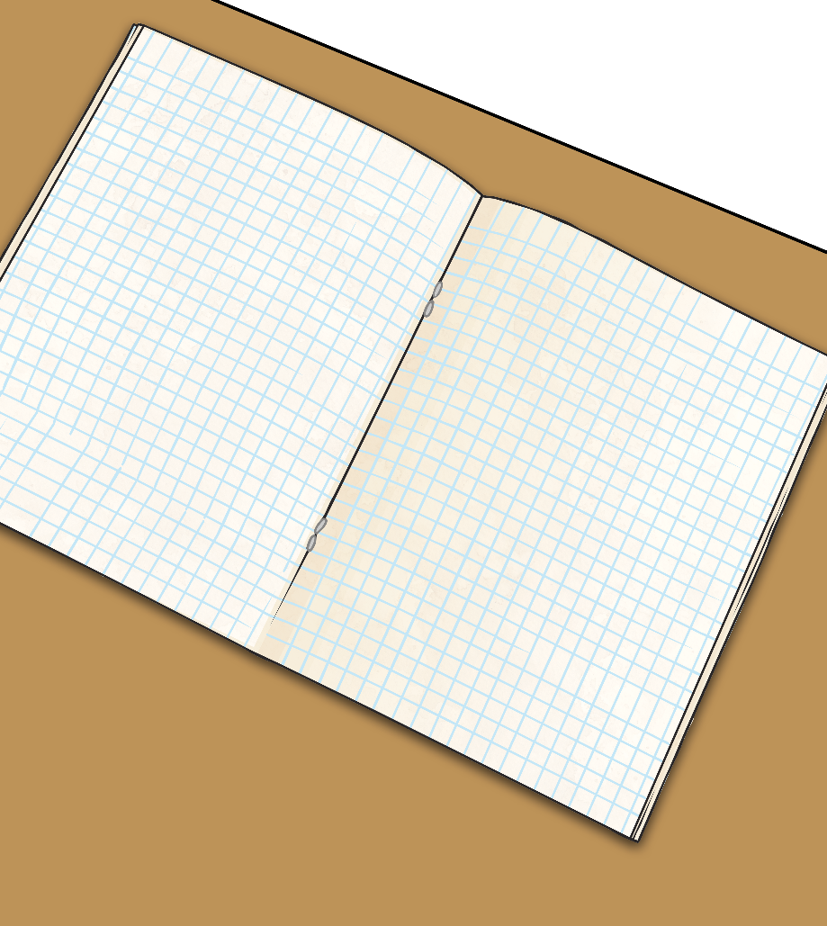
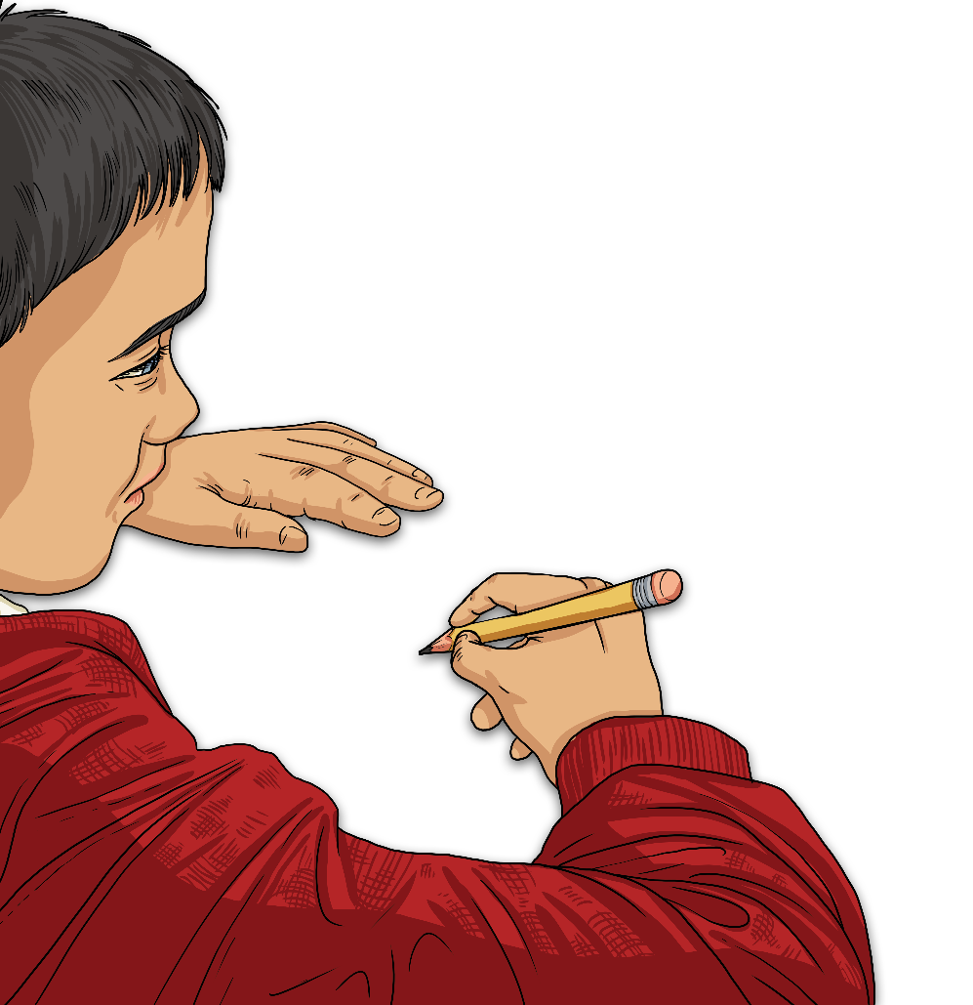
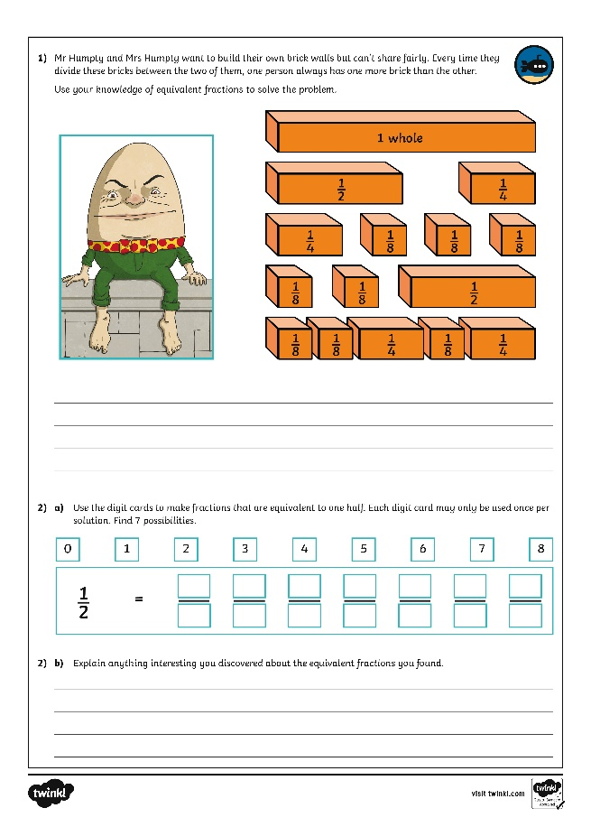
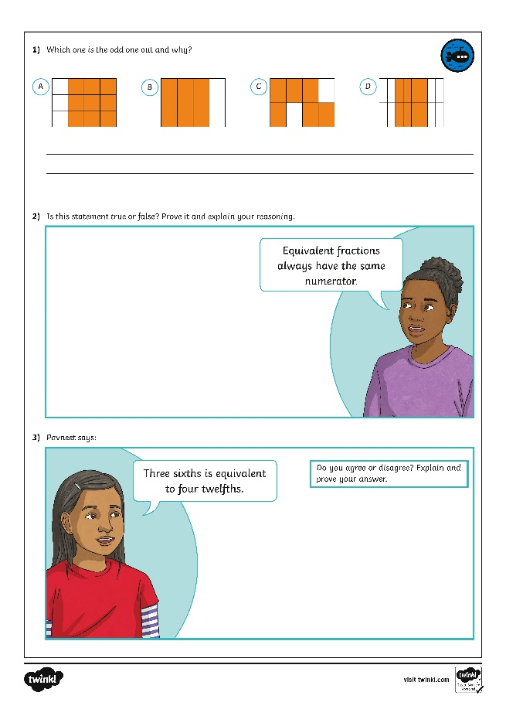
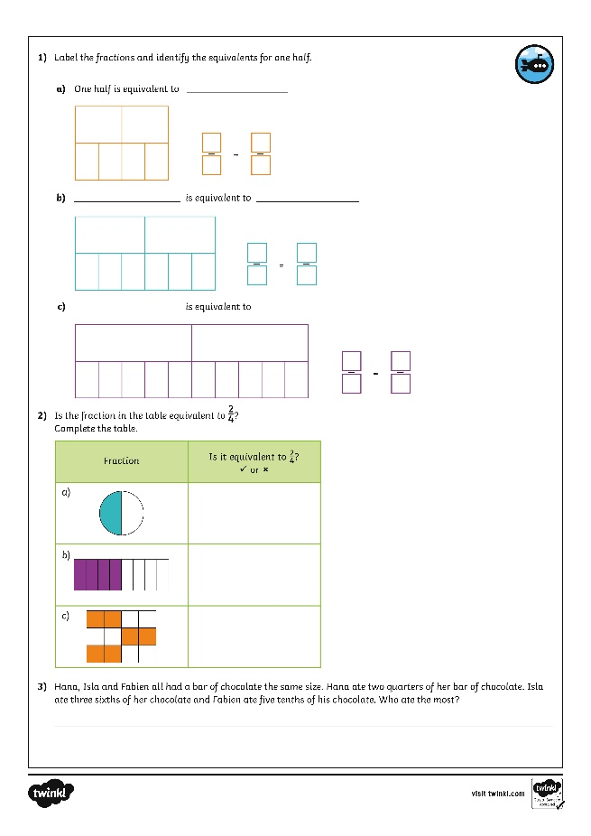
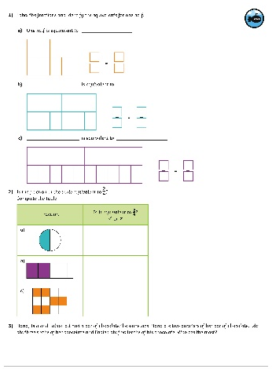
Equivalent Fractions (1)
Dive in by completing your own activity!
Right preview - Right click and replace existing images with horizontal and vertical version jpgs of the activity sheet to keep shadow settings. Left preview - hide the image of the child, drag in your jpgs, crop to just around the black strokes. Width should be 4cm for the horizontal, 2cm for vertical. Drag and rotate into place. Doesn’t have to be too neat as meant to look like the child stuck it in ☺

Slide 17
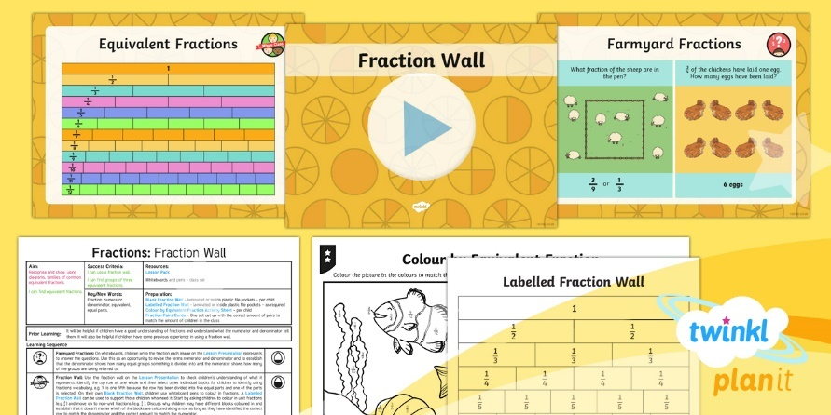
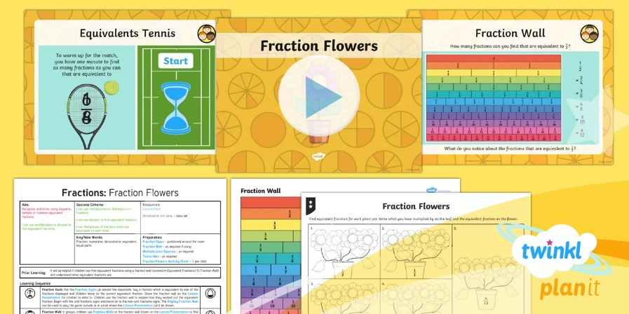
Need Planning to Complement this Resource?
National Curriculum Aim
Recognise and show, using diagrams, families of common equivalent fractions.
For more planning resources to support this aim, click here.
Twinkl PlanIt is our award-winning scheme of work with over 4000 resources.

