Slide 2
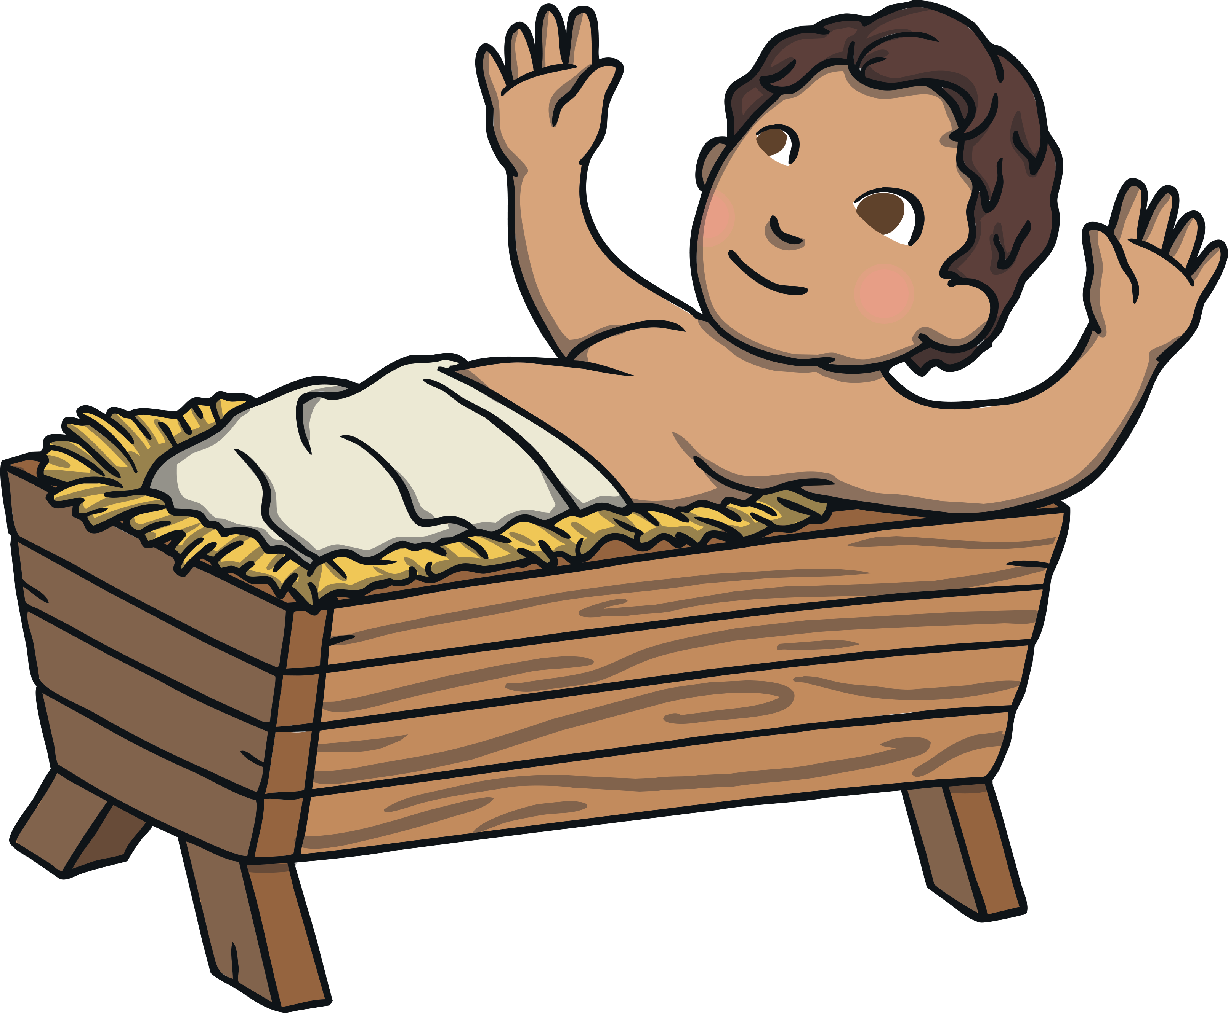
The Meaning
The word ‘epiphany’ comes from the verb ‘to appear’.
The feast of Epiphany is celebrating the Baby Jesus being seen or appearing, to the visitors who had travelled to see him.

Slide 3
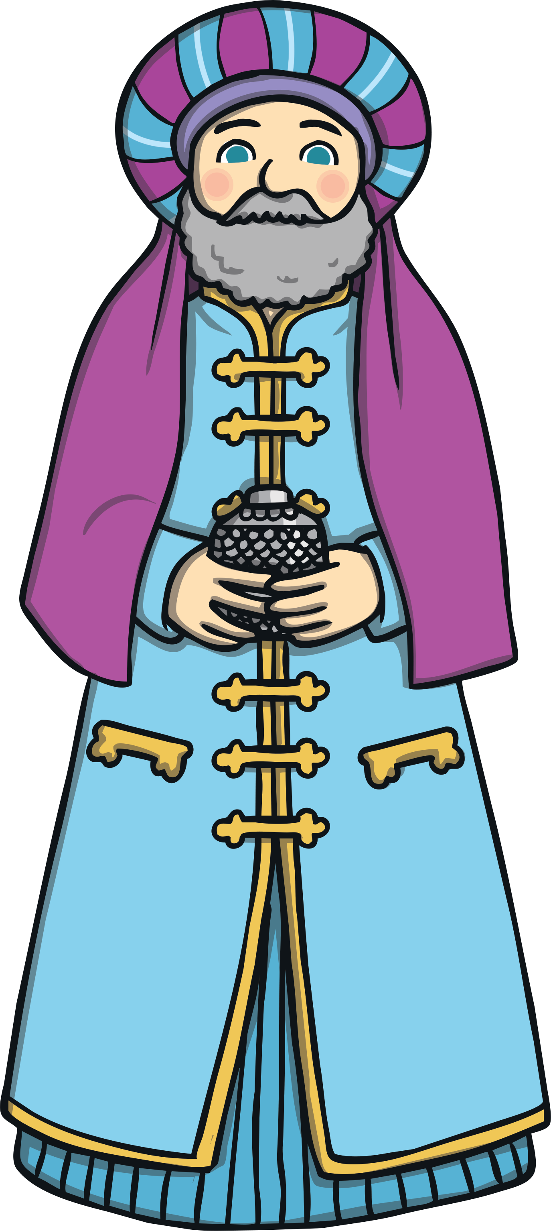
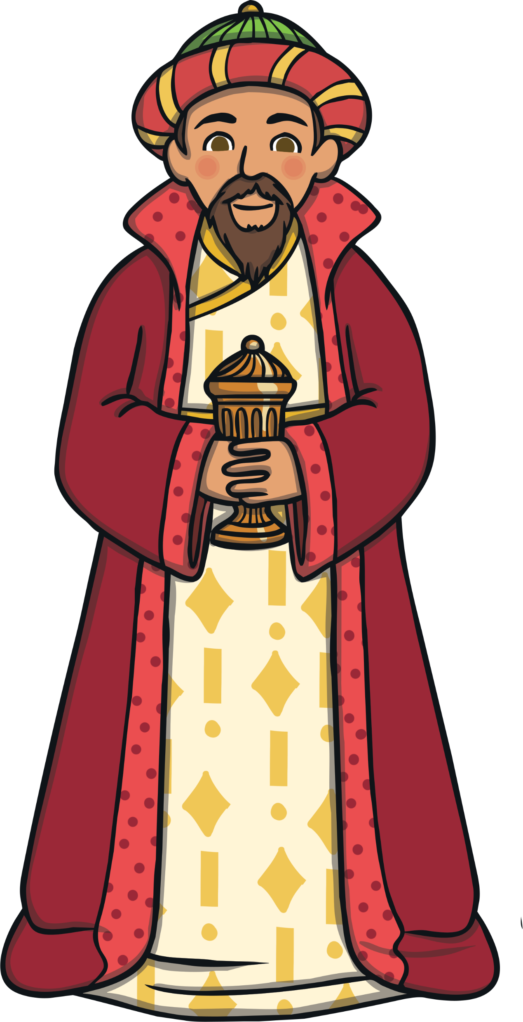
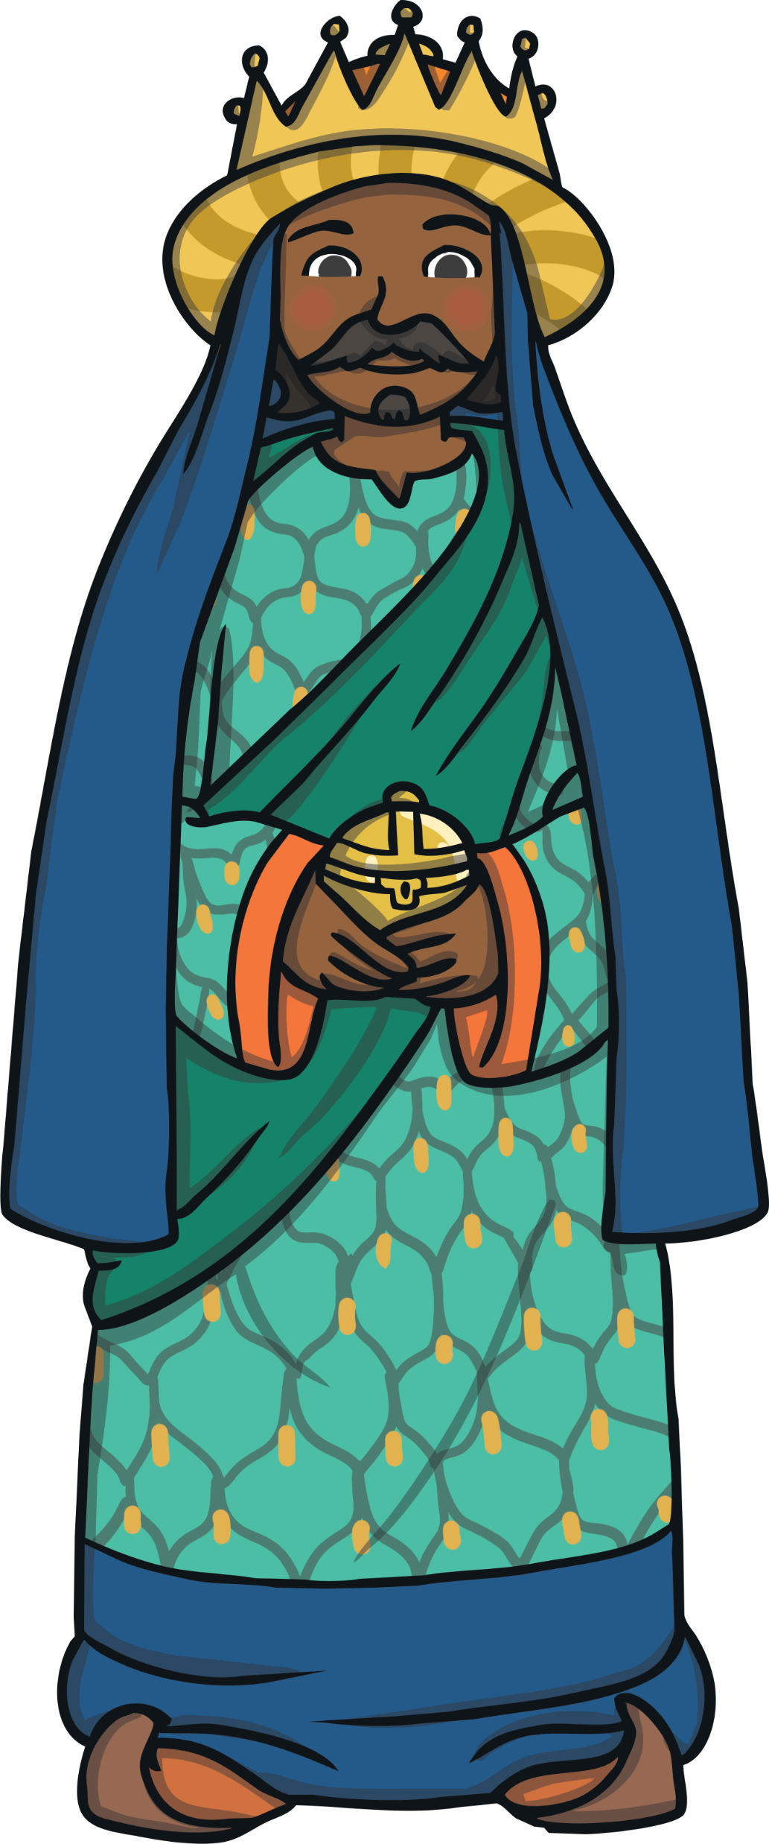
The Visitors
So, who were these visitors?
A long, long way away, there were some wise men studying the stars with their telescopes.
One night, they saw a very interesting star. Very interesting indeed!
These men lived in the east, and were possibly from Persia, which is now called Iran.
Did you know?
The Wise Men are often called Magi, which was a word given to describe priests and clever men.

Slide 4
The Star
The Wise Men were very clever, and understood the religious writings that had been written many years before.
The writings told them that one day there would be a great star and the star would mean that a new king had been born.
So, the men decided to pack up their belongings, and follow the star to wherever it led them.

Slide 5
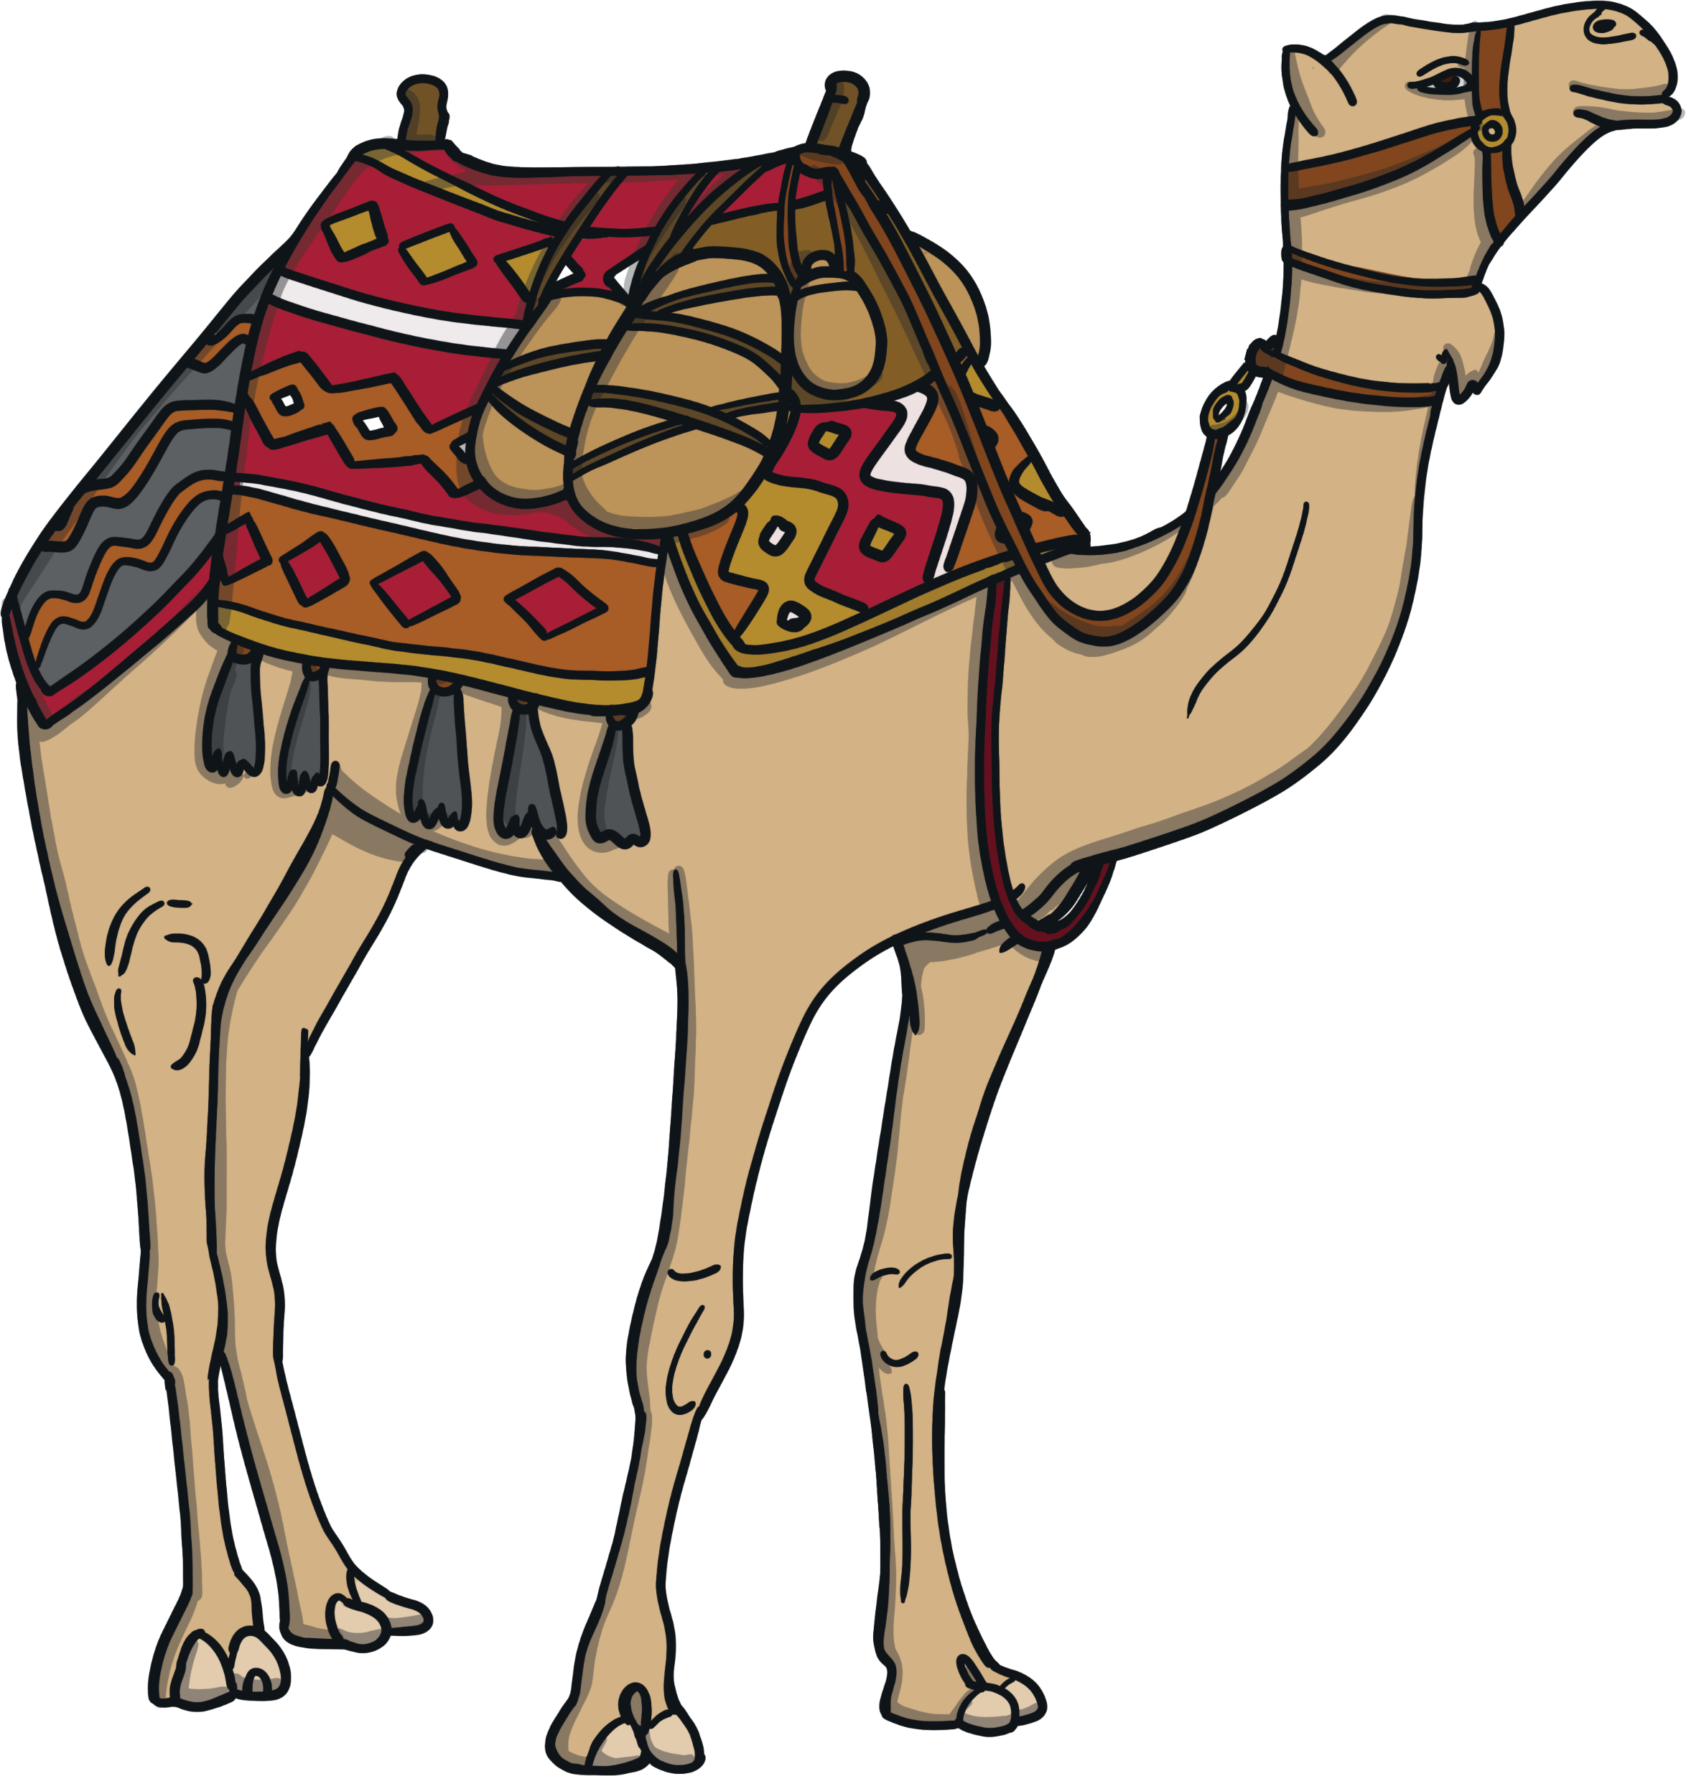
The Journey
The journey would have been very long.
They probably travelled on camels, across deserts and over mountains.
The star led them to the town of Bethlehem in Israel.

Slide 6
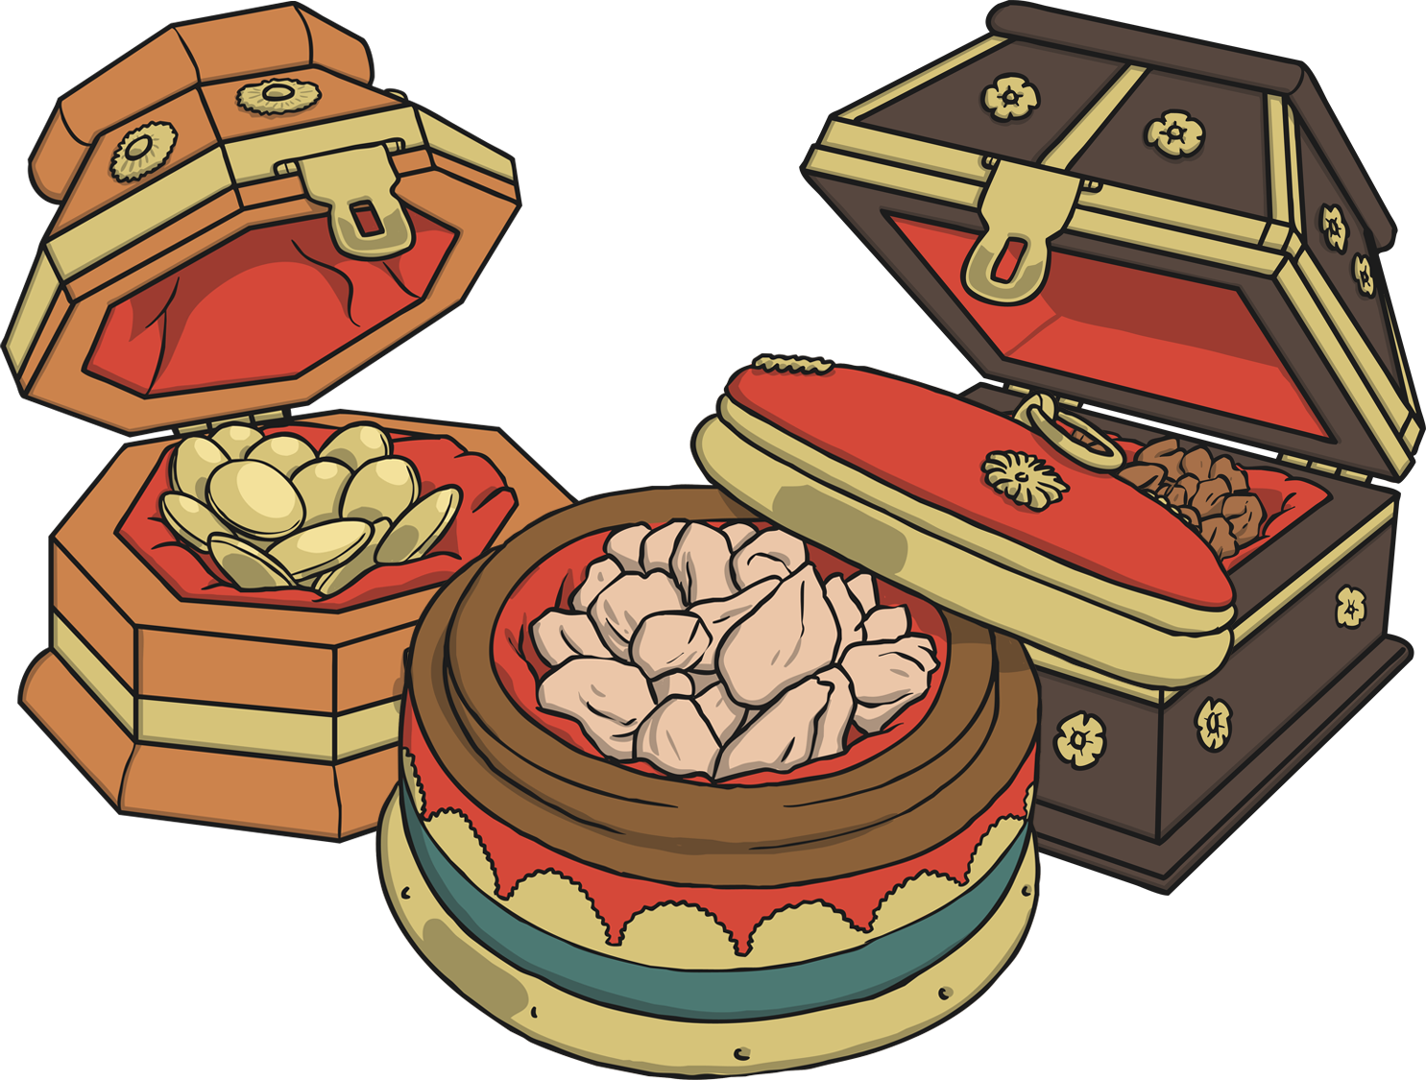
The Gifts
The star came to rest over the place where Jesus was, and the Wise Men brought expensive gifts for him and worshipped the new king.
The Bible never mentions how many wise men there were, but because there were three gifts, people often think there must have been three wise men.
Did you know?
The Wise Men are sometimes called the Three Kings because of the expensive gifts they brought.
The gifts were gold, frankincense and myrrh.

Slide 7
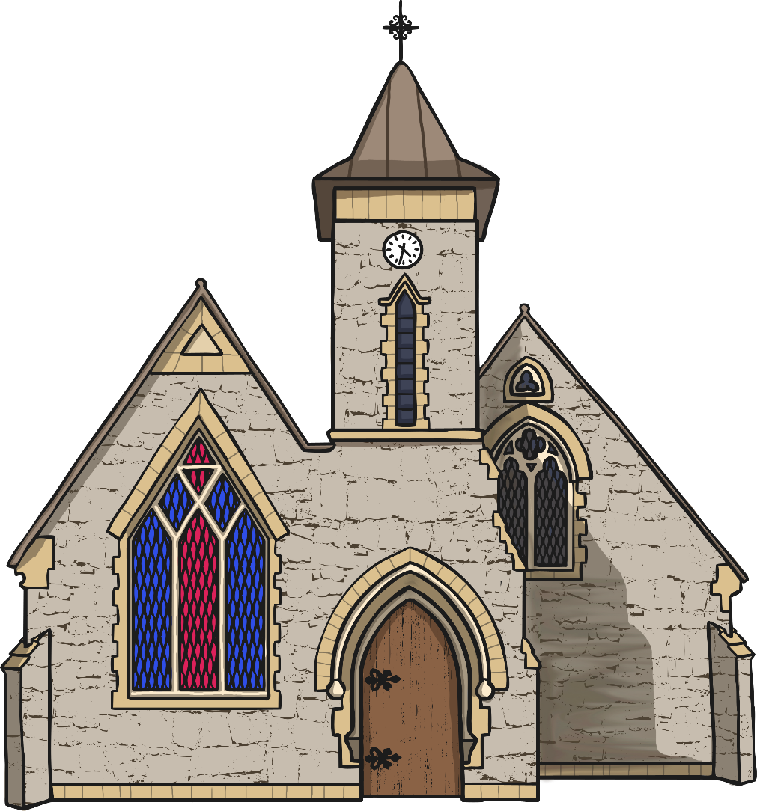
The Feast of Epiphany
The Feast of Epiphany is celebrated in churches, usually on the 6th January.
Epiphany is also known as Three Kings’ Day.

