Slide 1
Year 5 – Spring Block 2 – Fractions – Compare and Order Less than 1
About This Resource:
This PowerPoint has been designed to support your teaching of this small step. It includes a starter activity and an example of each question from the Varied Fluency and Reasoning and Problem Solving resources also provided in this pack. You can choose to work through all examples provided or a selection of them depending on the needs of your class.
National Curriculum Objectives:
Mathematics Year 5: (5F3) Compare and order fractions whose denominators are all multiples of the same number
More Year 5 Fractions resources.
Did you like this resource? Don’t forget to review it on our website.
© Classroom Secrets Limited 2018

Slide 2
Year 5 – Spring Block 2 – Fractions
Step 5: Compare and Order Less than 1
© Classroom Secrets Limited 2018

Slide 3
Introduction
Match the equivalent fractions.
2
3
70
90
1. | A.
2. | B.
3. | C.
4. | D.
5. | E.
8
11
24
33
7
9
15
18
5
6
4
6
3
10
12
40
© Classroom Secrets Limited 2018

Slide 4
Introduction
Match the equivalent fractions.
2
3
70
90
1. | A.
2. | B.
3. | C.
4. | D.
5. | E.
8
11
24
33
7
9
15
18
5
6
4
6
3
10
12
40
© Classroom Secrets Limited 2018

Slide 5
Varied Fluency 1
Finish the model to show and .
Compare using <, > or =.
2
5
5
20
© Classroom Secrets Limited 2018

Slide 6
Varied Fluency 1
Finish the model to show and .
Compare using <, > or =.
2
5
5
20
>
© Classroom Secrets Limited 2018

Slide 7
Varied Fluency 2
Match the fraction with its representation then put them in descending order.
8
9
1. | A.
2. | B.
3. | C.
11
18
2
3
© Classroom Secrets Limited 2018

Slide 8
Varied Fluency 2
Match the fraction with its representation then put them in descending order.
Descending order: 1, 3, 2
8
9
1. | A.
2. | B.
3. | C.
11
18
2
3
© Classroom Secrets Limited 2018

Slide 9
Varied Fluency 3
True or false?
4 | > | 4
7 |  | 9
© Classroom Secrets Limited 2018

Slide 10
Varied Fluency 3
True or false?
True
4 | > | 4
7 |  | 9
© Classroom Secrets Limited 2018

Slide 11
Varied Fluency 4
Circle the largest fraction. Use the models to help you.
7
10
3
5
11
20
© Classroom Secrets Limited 2018

Slide 12
Varied Fluency 4
Circle the largest fraction. Use the models to help you.
7
10
3
5
11
20
© Classroom Secrets Limited 2018

Slide 13
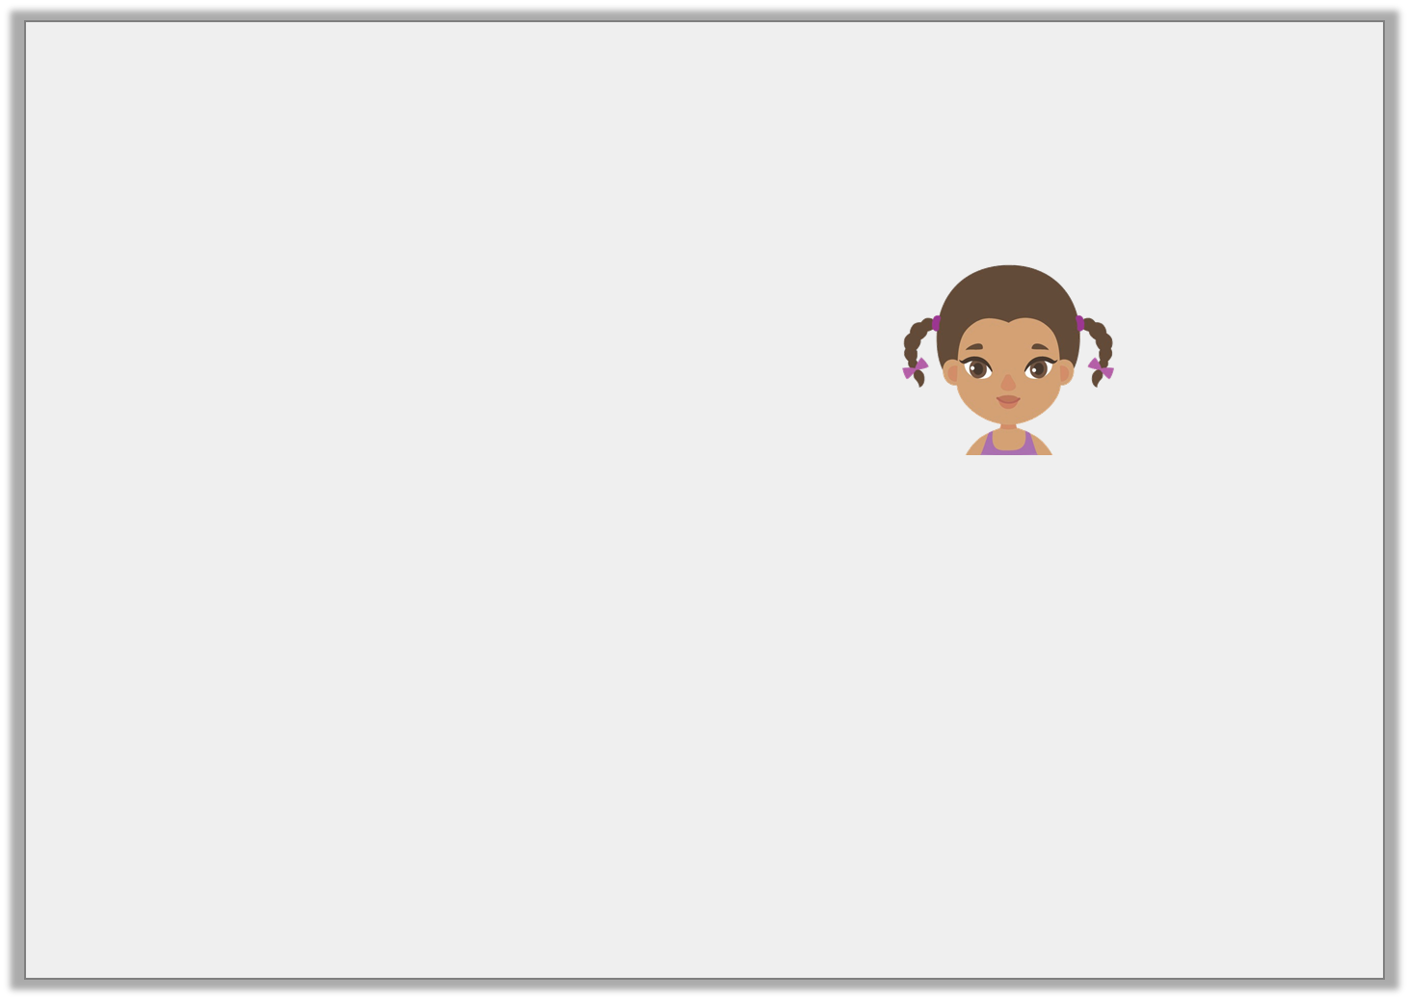
Reasoning 1
Aoife is comparing the fractions and .
Is she correct? Show how she could use a diagram to check her answer.
2
6
4
7
I know that .
Twelfths are double the size of sixths, so is greater than .
2 | equals | 4
6 |  | 12
4 |  | 4
12 |  | 7
© Classroom Secrets Limited 2018

Slide 14
Reasoning 1
Aoife is comparing the fractions and .
Is she correct? Show how she could use a diagram to check her answer.
Aoife is incorrect because…
2
6
4
7
I know that .
Twelfths are double the size of sixths, so is greater than .
2 | equals | 4
6 |  | 12
4 |  | 4
12 |  | 7
© Classroom Secrets Limited 2018

Slide 15
Reasoning 1
Aoife is comparing the fractions and .
Is she correct? Show how she could use a diagram to check her answer.
Aoife is incorrect because twelfths are smaller than sixths.
Therefore, .
2
6
4
7
I know that .
Twelfths are double the size of sixths, so is greater than .
2 | equals | 4
6 |  | 12
4 |  | 4
12 |  | 7
2 | = | 4
6 |  | 12
4
7
4 | < | 4
12 |  | 7
© Classroom Secrets Limited 2018

Slide 16
Problem Solving 1
Use two number cards to complete the equation.
Find two possibilities.
1 | < |  | < | 2
3 |  |  |  | 3
5
9
12
8
15
© Classroom Secrets Limited 2018

Slide 17
Problem Solving 1
Use two number cards to complete the equation.
Find two possibilities.
Possible answers:
1 | < |  | < | 2
3 |  |  |  | 3
5
9
12
8
15
5 | , | 5 | , | 8
9 |  | 12 |  | 15
© Classroom Secrets Limited 2018

Slide 18
Reasoning 2
Tahiba has put these fractions in descending order.
Explain her mistake.
Rewrite the fractions in the correct order with the same denominators.
9 | , | 7 | , | 4 | , | 1
20 |  | 10 |  | 5 |  | 5
© Classroom Secrets Limited 2018

Slide 19
Reasoning 2
Tahiba has put these fractions in descending order.
Explain her mistake.
Rewrite the fractions in the correct order with the same denominators.
Tahiba has ordered the fractions by…
9 | , | 7 | , | 4 | , | 1
20 |  | 10 |  | 5 |  | 5
© Classroom Secrets Limited 2018

Slide 20
Reasoning 2
Tahiba has put these fractions in descending order.
Explain her mistake.
Rewrite the fractions in the correct order with the same denominators.
Tahiba has ordered the fractions by their denominator, but has not found their equivalent fractions.
The correct order is .
9 | , | 7 | , | 4 | , | 1
20 |  | 10 |  | 5 |  | 5
16 | , | 14 | , | 9 | , | 4
20 |  | 20 |  | 20 |  | 20
© Classroom Secrets Limited 2018

