Slide 1
Date: Thursday 12th October 2020
BIDMAS

Slide 2
Let’s look at this question:
5 + 3 x 2 =
We could solve this in different ways and get different answers…
This could be 5 + 3 x 2 = 8 x 2 = 16
OR
5 + 3 x 2 = 5 + 6 = 11

Slide 3
Vocabulary
Brackets
Indices
Division
Multiplication
Addition
Subtraction

Slide 4
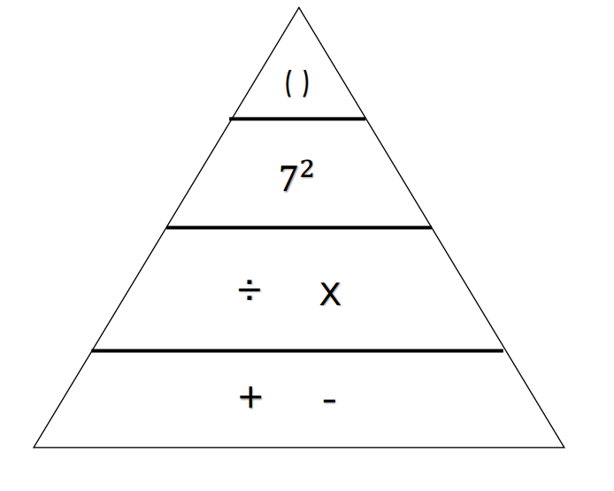
Brackets
Indices
Division
Multiplication
Addition
Subtraction
What does the triangle tell us about the order of operations?

Slide 5
( )
$$7^{2}$$
÷ x
+ -
If we are operating within the same section, then we can just work from left to right.
e.g.
5 + 10 – 7 + 3
5 + 10 = 15 – 7 = 8 + 3 = 11

Slide 6
Brackets
Indices
Division
Multiplication
Addition
Subtraction
( )
$$7^{2}$$
÷ x
+ -
If we are operating within different sections, we work from the higher end downwards.
e.g. 7 + 5 x 5
7 + 25 = 32

Slide 7
Practise
12 x 3 + 7 =
60 – 20 ÷ 5 =
10 x 2 + 4 x 3 =
What mistake might people make on the final question? Why does this matter?
BIDMAS
Use your triangle to support you in the order

Slide 8
Practise answers:
12 x 3 + 7 = 36 + 7 =43
60 – 20 ÷ 5 = 60 – 4 = 56
10 x 2 + 4 x 3 = 20 + 12 = 32
What mistake might people make on the final question? Why does this matter?
BIDMAS
Use your triangle to support you in the order

Slide 9
Practise:
30 – 2 x 6 =
5 x 6 ÷ 2 =
5 x 5 – 12 x 2 =
What mistake might people make on the final question? Why does this matter?
BIDMAS
Use your triangle to support you in the order

Slide 10
Practise Answers:
30 – 2 x 6= 30-12 =18
5 x 6 ÷ 2= 30 ÷ 2 = 15
5 x 5 – 12 x 2 = 25 – 24 = 1
What mistake might people make on the final question? Why does this matter?
BIDMAS
Use your triangle to support you in the order

Slide 11
Practise 2 (slightly harder!):
5 + (10 – 3) x 5 =
16 + (4 + 7) x 3 =
Why is the placement of brackets important?
BIDMAS
Use your triangle to support you in the order

Slide 12
Practice 2 (slightly harder!) Answers:
5 + (10 – 3) x 5 = 5 + 7 x 5 = 5 + 35 = 40
16 + (4 + 7) x 3 = 16 + 11 x 3 = 16 + 33 = 49
Why is the placement of brackets important?
BIDMAS
Use your triangle to support you in the order

Slide 13
Activity- TYM

Slide 14
Practice:
2 x 3 + 4 - 5
27 ÷ (3 + 6)
10 + 2 x 9
John gets the answer 15 for question 2. Explain his mistake.
BIDMAS
Use your triangle to support you in the order

Slide 15
Practice 2:
12 ÷ 2 + 4 x 3
9 + 8 – 7 + 6
Place brackets in question 2 to create the answer 4
BIDMAS
Use your triangle to support you in the order

Slide 16
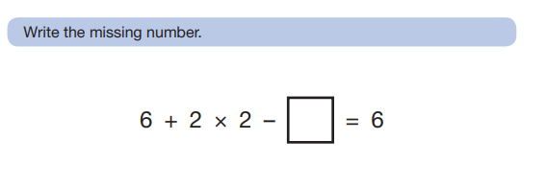
Variation:
Does it make a difference if we change the order of operations? Why/ why not?
BIDMAS
Use your triangle to support you in the order

Slide 17
Activity

