Slide 1
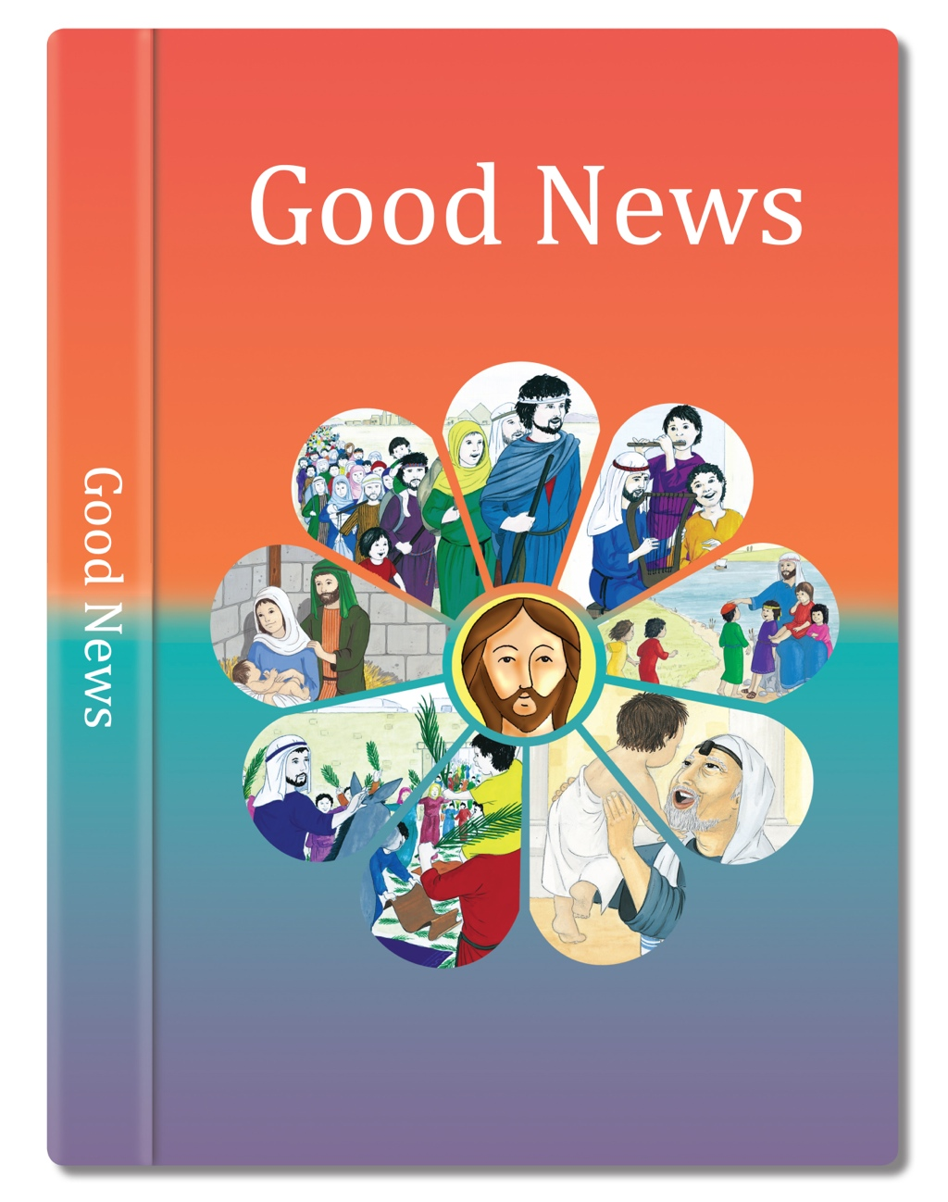

Slide 2
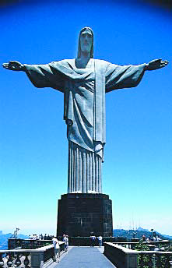
The spirit of God has been given to me.
My heart is filled with joy, with praise and thanks to God. I feel as if God has surrounded me in love, as if God has wrapped me up in a cloak of blessings.
I feel like a bride dressed for her wedding, adorned in jewels.
For just as surely as the earth sends up green shoots. Just as surely as the garden makes seeds grow, so will God bring love and justice and praise to people.
God has sent me to bring good news to the poor, to comfort the broken hearted, to set free those who are imprisoned to proclaim that the time has come when God will shower blessings on his people.
Based on Isaiah 61: 1-2, 10-11
God’s Story 3

