Slide 1
Year One - English
Week 5 (Week commencing Monday 1st February)
https://www.youtube.com/watch?v=qgWk6BmkA3Q

Slide 2
This week is Children’s Mental Health Week. This week’s story is Ruby’s Worry (also called Ruby Finds a Worry) by Tom Percival. Read and listen to the story here. It’s is about dealing with worries, and how talking to someone about them, helps them to go away!

Slide 3
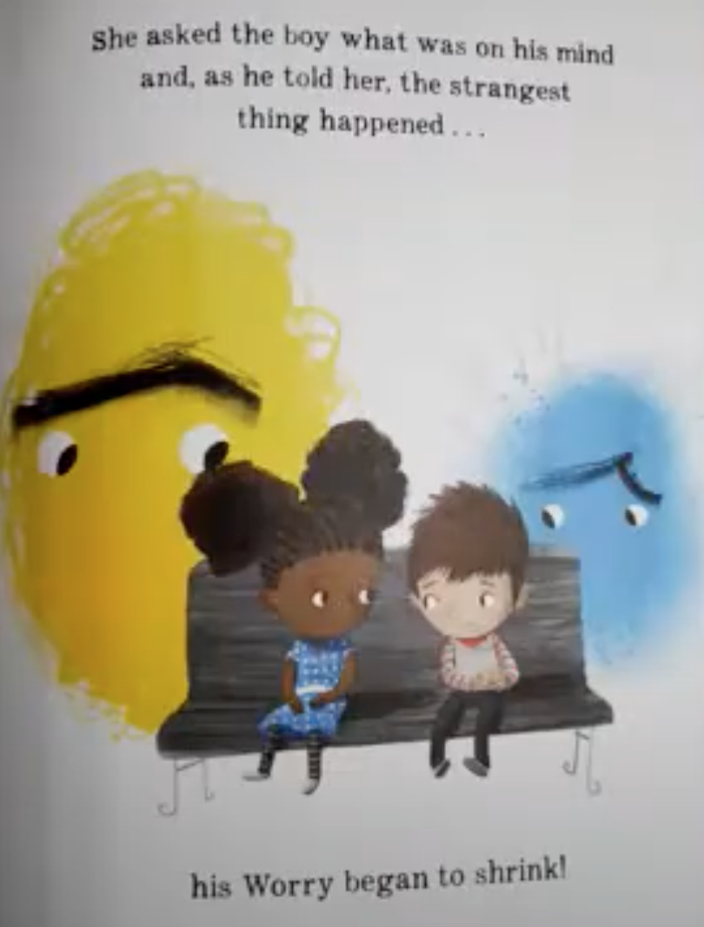
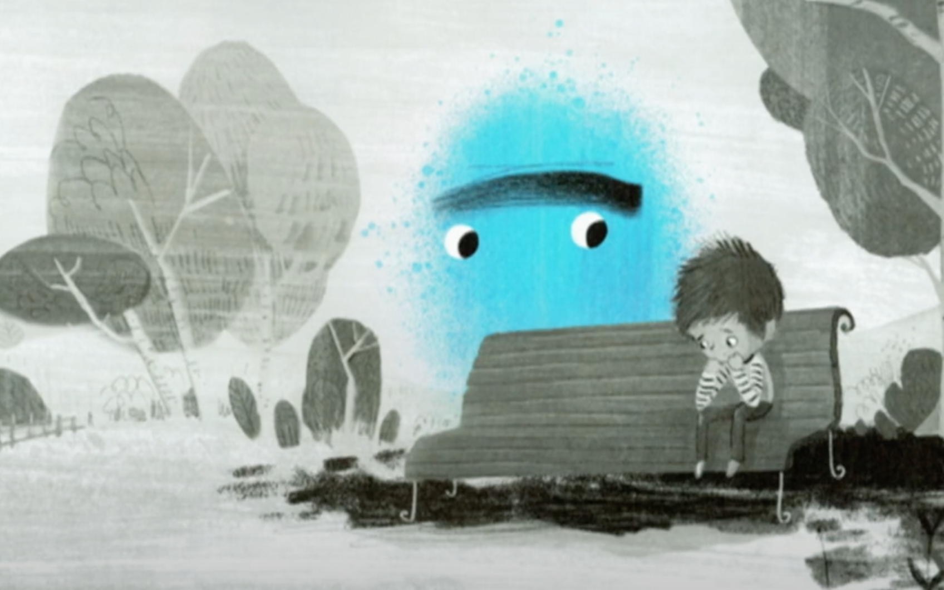
Monday
OLI: to write speech bubbles.
Ruby met a boy who also had a worry and he felt sad. She asked the boy what was on his mind and, as he told her, his worry began to shrink!
Imagine you are Ruby, what would you say to the boy? Fill in the speech bubble, telling me what you would say to help the boy. What do you think the boy says in return?

Slide 4
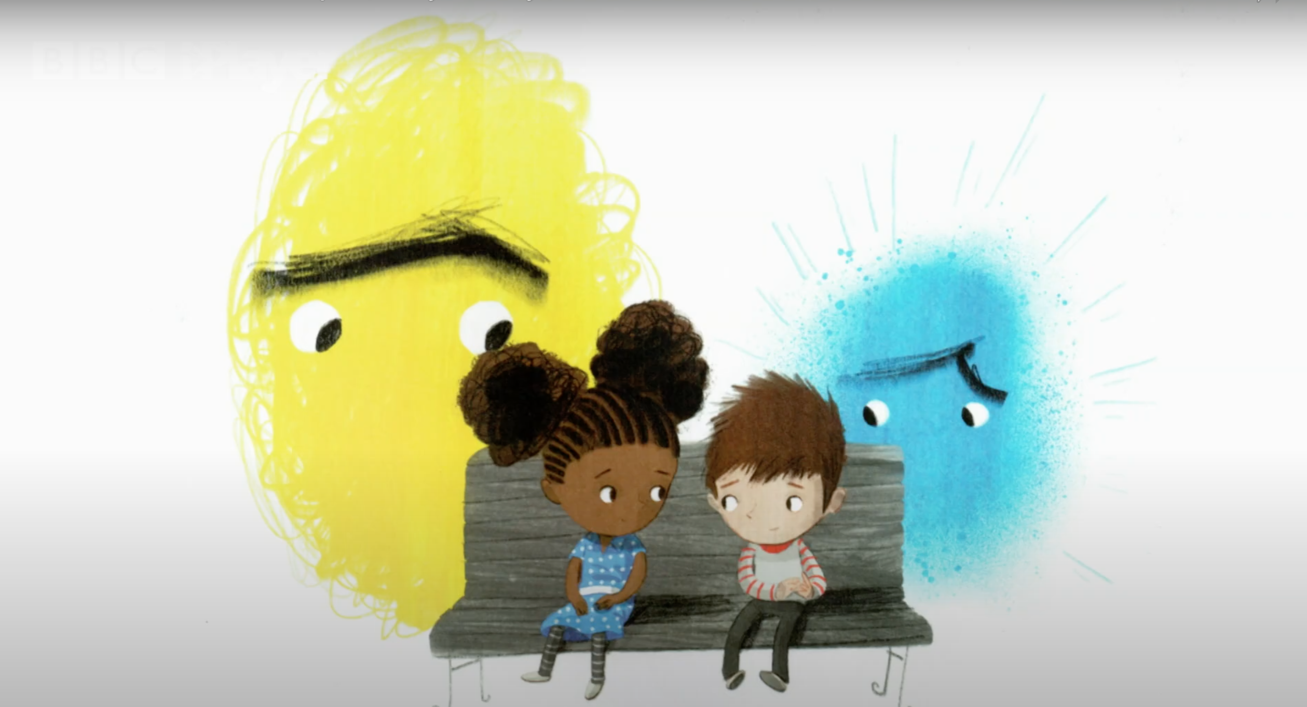
Monday
OLI: to write speech bubbles.

Slide 5
My example!
OLI: to write speech bubbles.
I am sorry to
hear that you
Thank you for
helping me!
are worried. If
you talk about
Talking to someone makes
it, it makes it
better. I want
it much better!
to help you to be happy again!
Don’t forget to use ‘I’. You are imagining you are them.

Slide 6
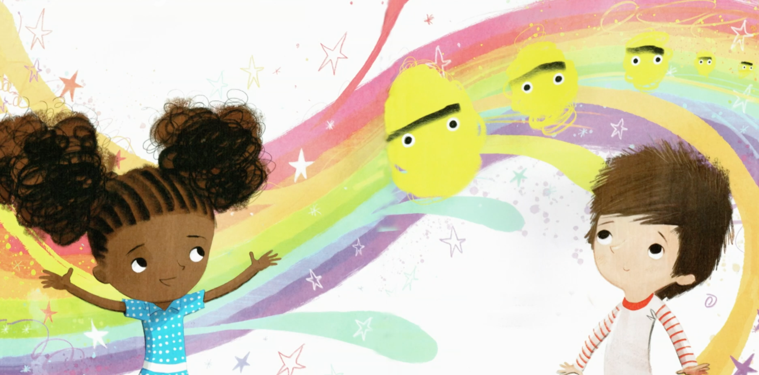
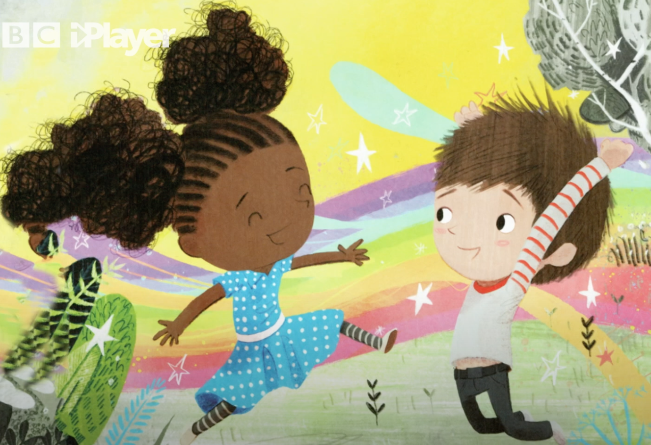
Tuesday
OLI: to explain your worry
The story tells us:
Ruby did the best thing you can ever do if you have a worry … talk about it!
As the words tumbled out, Ruby’s worry began to shrink until it was barely there at all! Soon, both of their worries were gone.

Slide 7
Tuesday
OLI: to explain your worry and how someone could help you.
Ruby did the best thing you can ever do if you have a worry … talk about it!
Today, write a worry you have or have had. Then draw a person who you have told your worry to or would like to tell your worry to. What would they say to make you feel better?

Slide 8
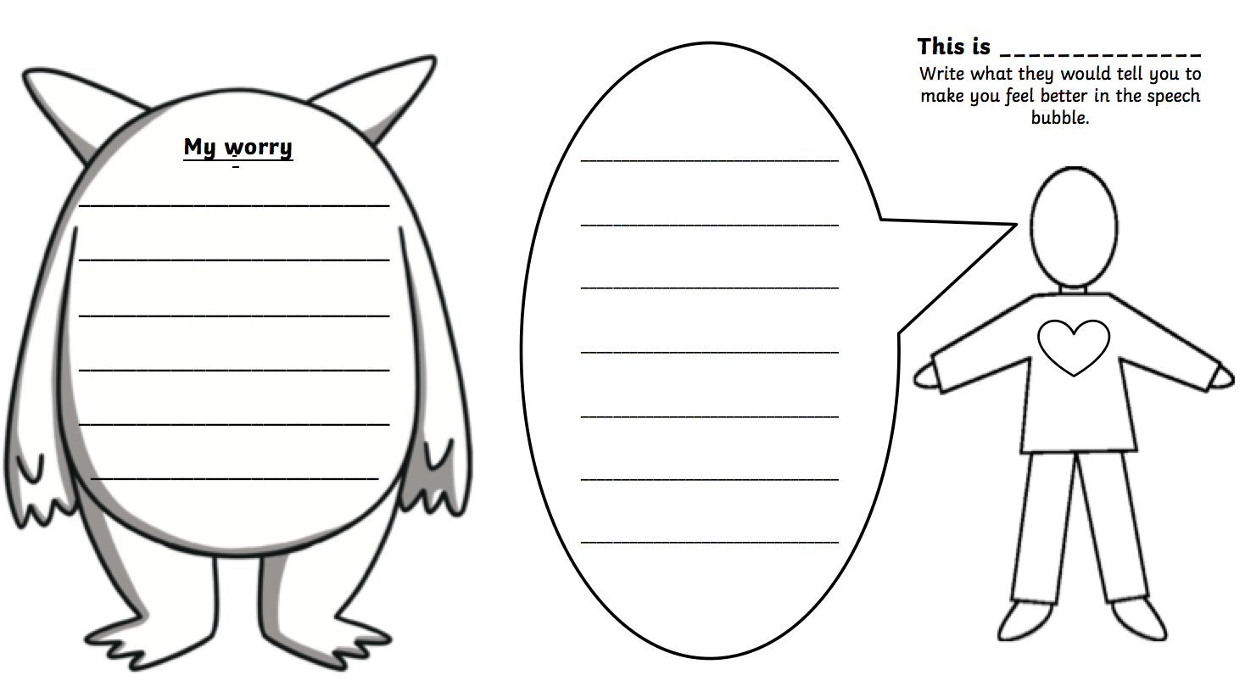
Tuesday
OLI: to explain your worry and how someone could help you.
Ruby did the best thing you can ever do if you have a worry … talk about it!

Slide 9
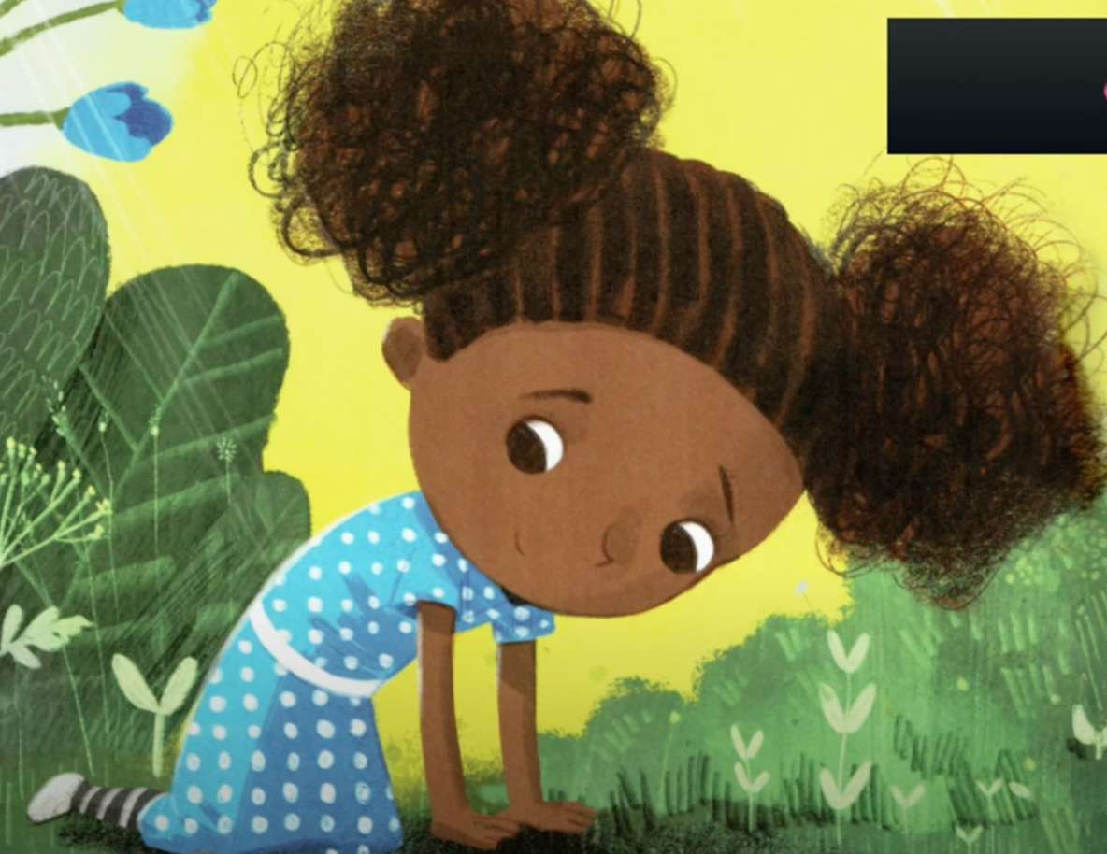
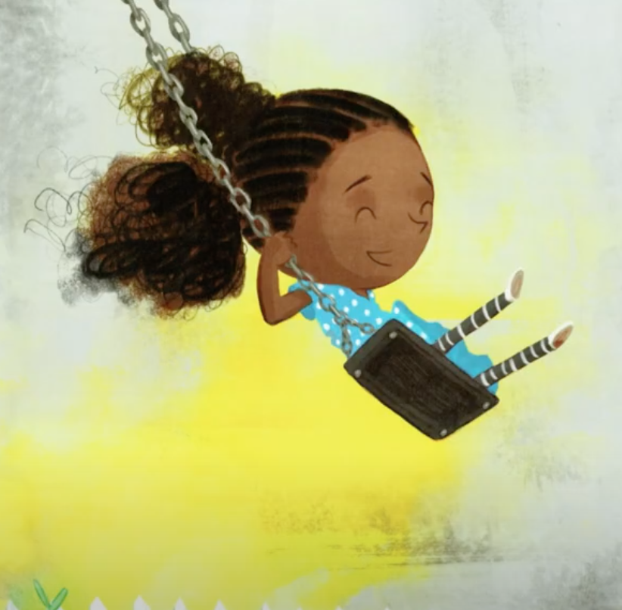
Wednesday
OLI: to write about what makes you happy.
Ruby loved being
Ruby
She loved swinging up high
and she loved to explore wild, faraway places.
Ruby loved being Ruby. The story tells us some of the things that she loved to do and that made her happy. See the pictures above.
What makes you happy? Write them in your jar of happiness!

Slide 10
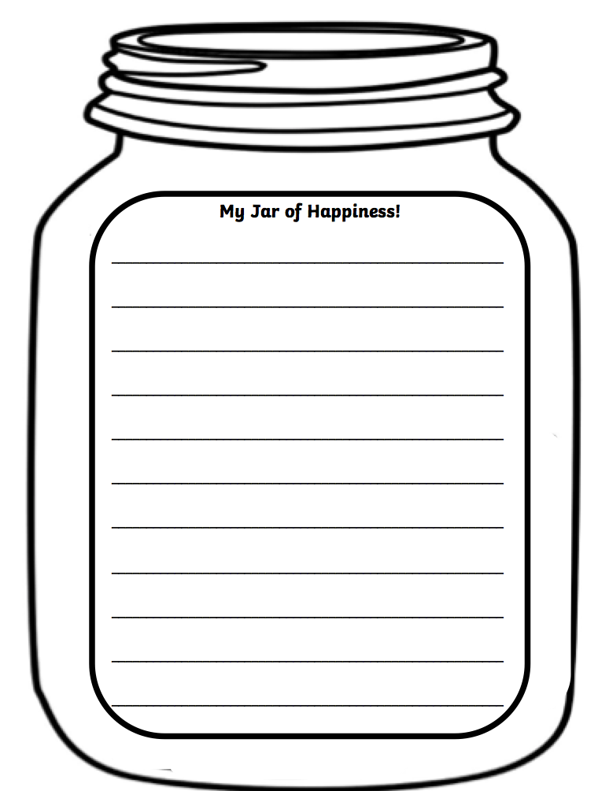
Wednesday
OLI: to write about what makes you happy.

Slide 11
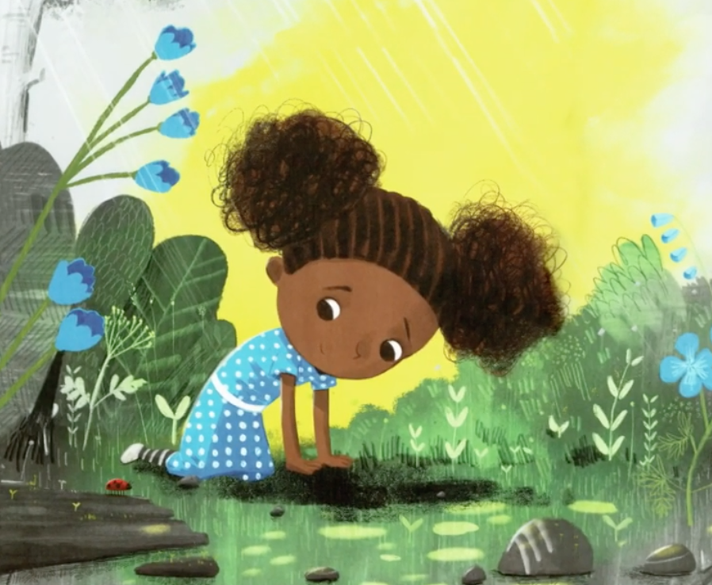
Thursday
OLI: to describe a setting.
The story says: Ruby loved to explore wild, faraway places.
Imagine one of her favourite places and describe it and draw it.
Use adjectives!
Don’t forget capital letters and full stops.
Challenge: use similes.
Look at the next slide for some magical places!

Slide 12
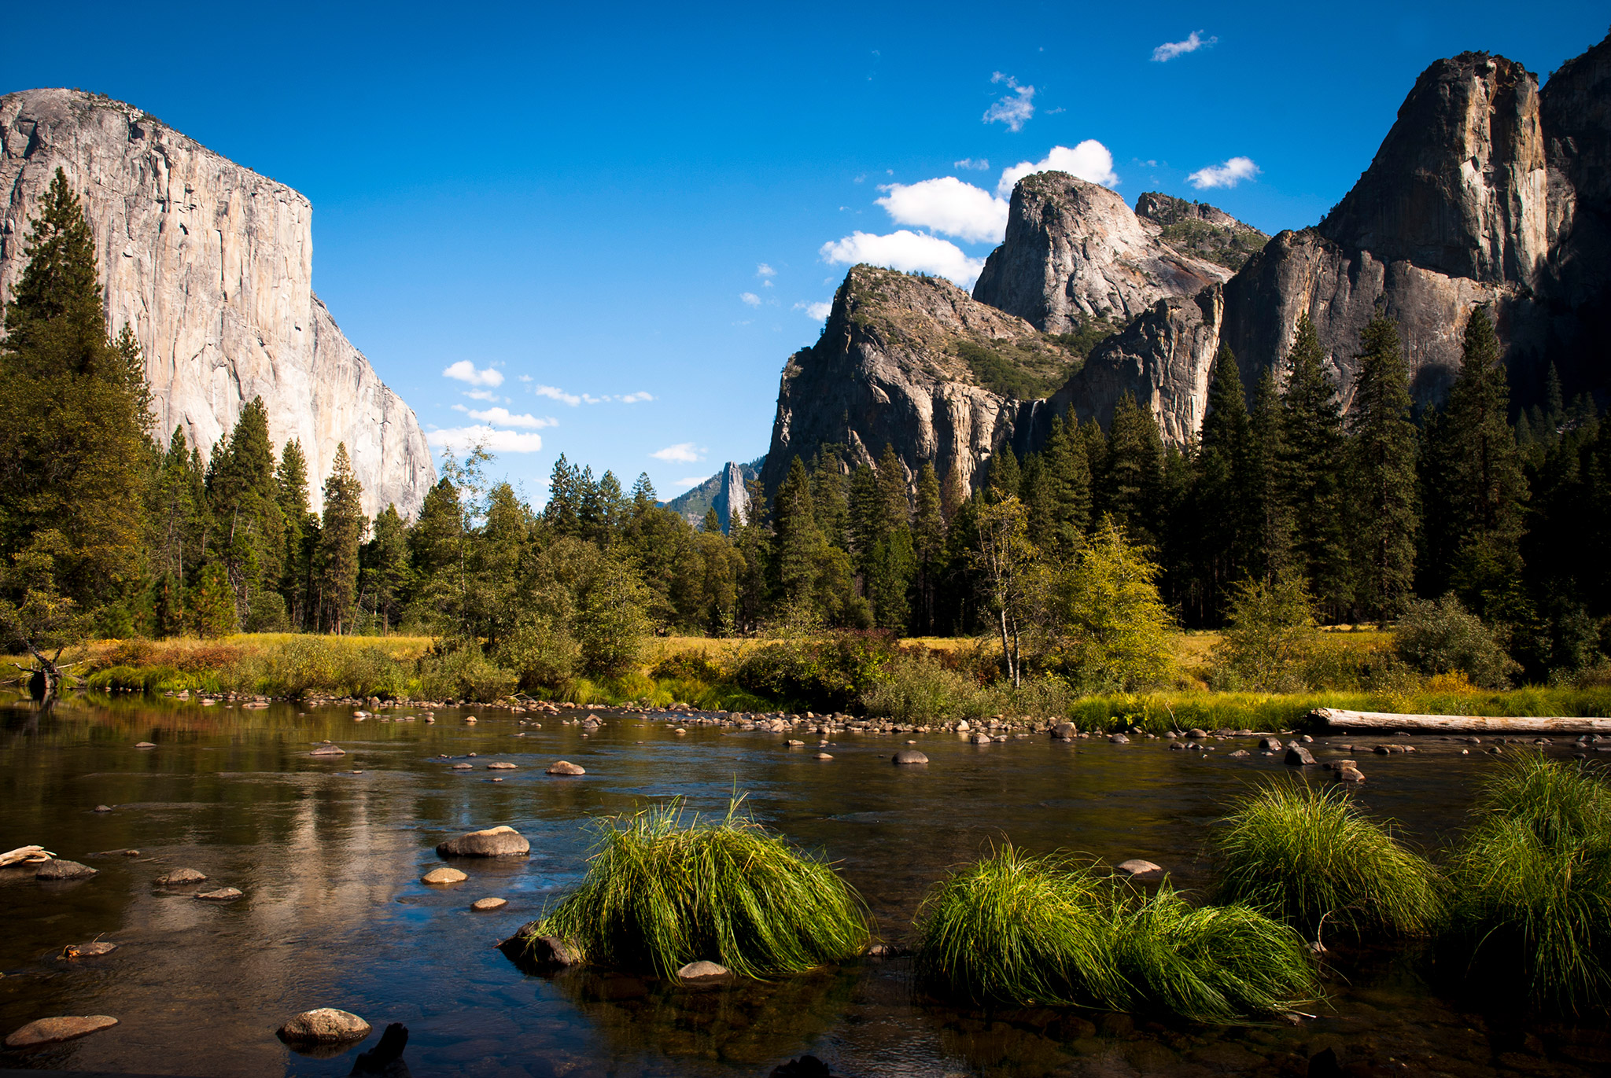
Thursday
OLI: to describe a setting.

Slide 13
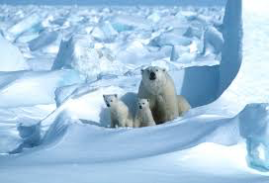
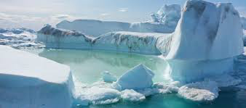
Thursday
OLI: to describe a setting.

Slide 14
Thursday
OLI: to describe a setting.

Slide 15
Thursday
OLI: to describe a setting.
Steps To Success:
- I can say my sentence out loud before writing it.
- I can re-read my sentence to check it makes sense.
- I can use my phonics knowledge to help me sound out words.
- ABC (capital letters) and (full stops).
- Finger spaces
- I can use adjectives.
Challenge: I can use similes. (The trees were as tall as a mountain.)
(The towering trees stood like silent guards.)

Slide 16
My example!
On the damp forest floor a cool stream snaked past the towering trees. The trees stood like silent guards. They were as tall as a mountain. Huge rocks lay sleeping. Moss grew over them like a soft green blanket. The air was warm and filled with the orchestra of a thousand colourful birds and insects. The animals were very loud but they could not be seen. They were hiding under umbrella-like leaves.

Slide 17
Friday
Spelling Test time
You have been learning the sounds:
ay ou

Slide 18
Well done!

