Slide 1
Equivalent Fractions
16th November 2020
Target: To be able to find equivalent fractions.

Slide 2
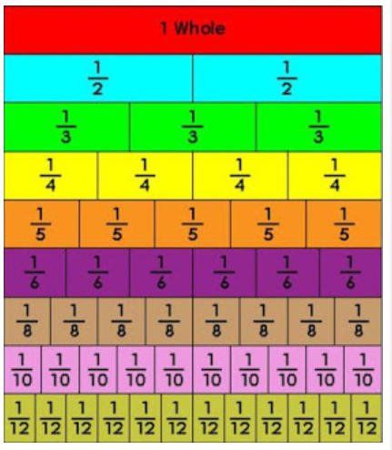

Slide 3
How many equal sections is each square cut into?
2
4
8
16
How many of the sections are blue?
1
2
4
8
What fraction of each square is blue?
x2
x2
x2
Are these fractions equal?
How do you get from one fraction to the next?

Slide 4
How many equal sections is each square cut into?
3
9
36
How many of the sections are blue?
1
3
12
What fraction of each square is blue?
x3
x4
Are these fractions equal?
How do you get from one fraction to the next?

Slide 5
So to find equivalent fractions you multiply the numerator (the top number) and the denominator (the bottom number) by the same number.
E.g. Find 3 equivalent fractions to :
Remember you can multiply by any number!!!
=
=
=
x2
x6
x24
Practice Questions:
Find 3 equivalent fractions for each question
a)
b)
c)
d)
e)
f)
g)
h)
i)
j)
k)
l)

