Slide 2
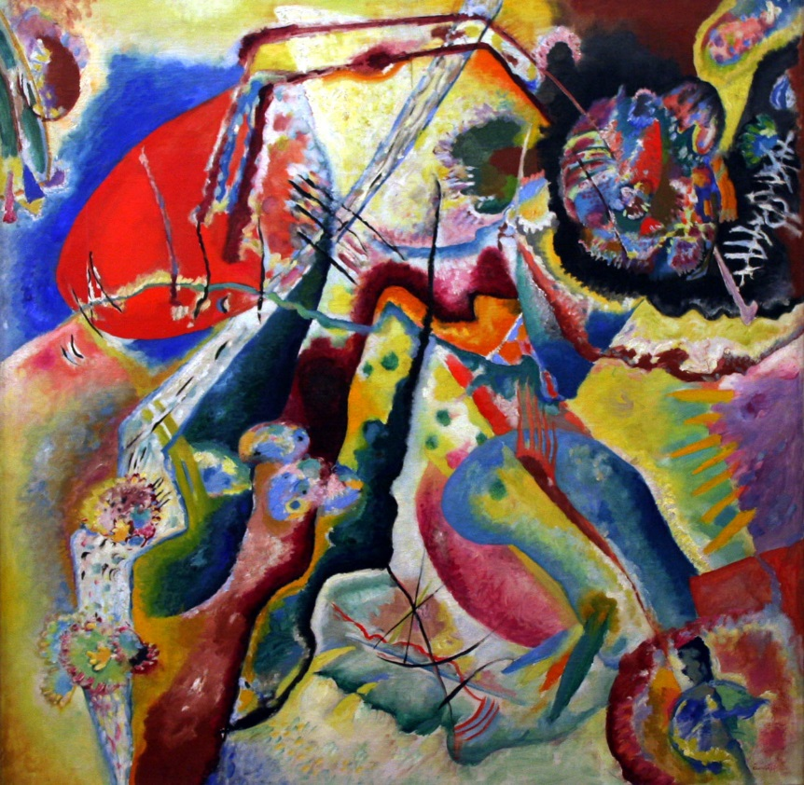
Wassily Kandinsky (1866 - 1944)
Wassily Kandinsky was
a Russian painter.
Many people think he was
the first abstract artist.
Abstract art is a combination of colors, lines, and shapes that are not meant to be realistic.
Abstract Painting
by Wassily Kandinsky
Photo courtesy of Playing Futures: Applied Nomadology (@flickr.com) - granted under creative commons licence – attribution

Slide 3
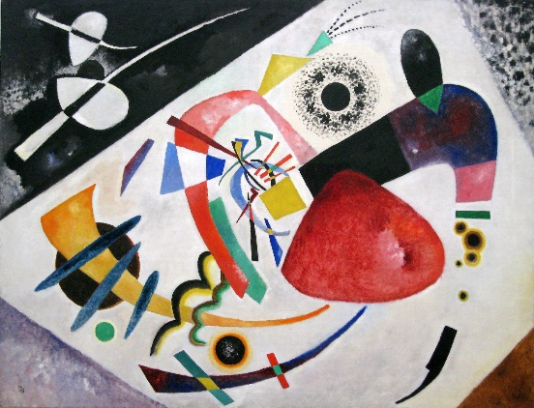
Red Spot II (1921)
by Wassily Kandinsky
Photo courtesy of Sharon Mollerus (@flickr.com) - granted under creative commons licence – attribution

Slide 4
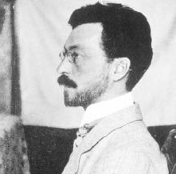
All About Wassily Kandinsky
Wassily Kandinsky was born in Russia in 1866. When he grew up, he worked as a university teacher, but it didn’t make him happy.
When he was 30, he left his job and went to art school. He found art school easy and excelled at his studies.
Kandinsky thought a lot about colors and how they make people feel. He believed that colors had a soul.
Wassily Kandinsky

Slide 5
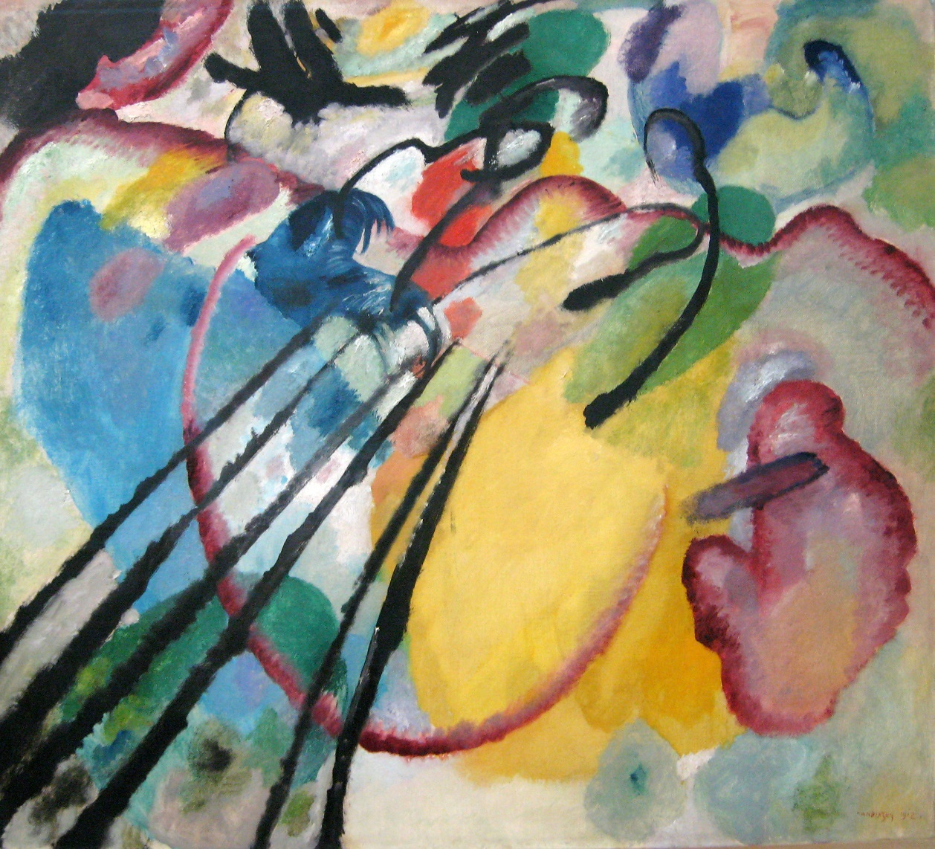
Improvisation 26 (Rowing) (1912)
by Wassily Kandinsky
Photo courtesy of Sharon Mollerus (@flickr.com) - granted under creative commons licence – attribution

Slide 6
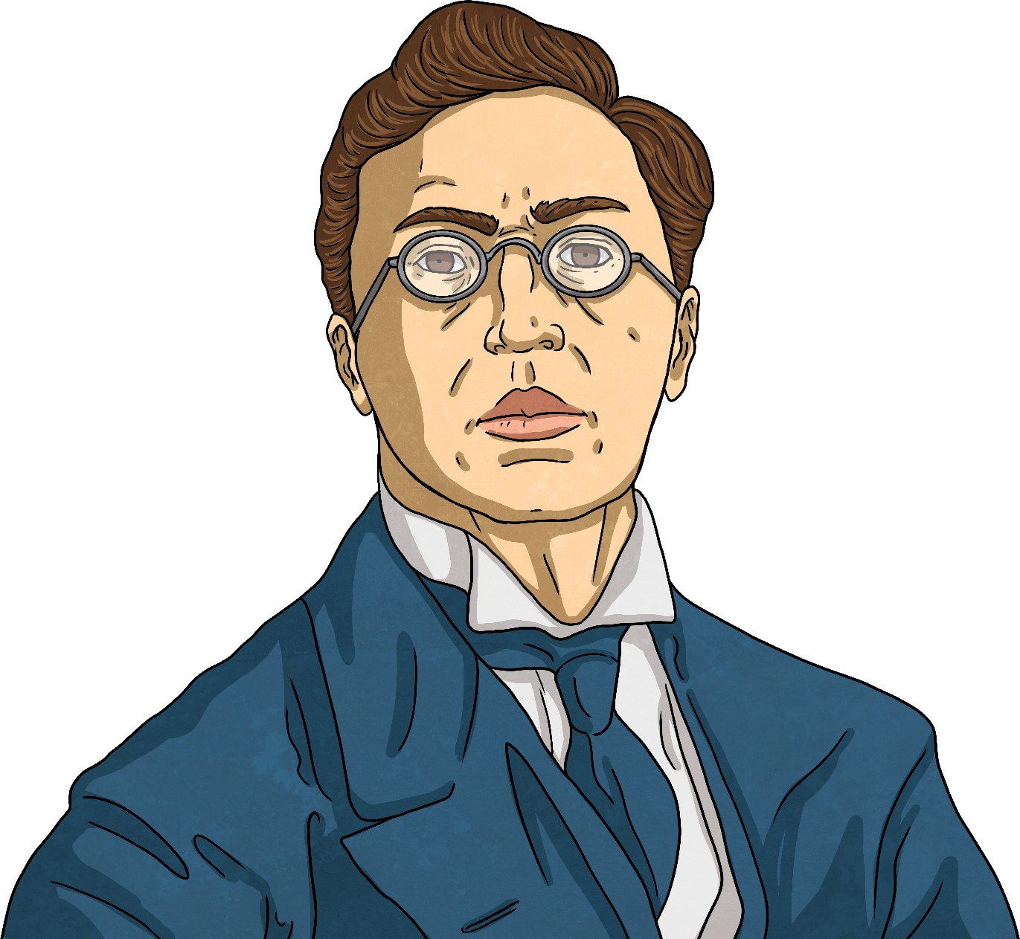
All About Wassily Kandinsky
Kandinsky was the first painter to stop painting pictures of real things and instead paint just using colors and shapes. He believed that this let him paint honestly about his feelings.
Often Kandinsky would listen to music while he painted and try to paint what he heard.
Other painters that came after him learned a lot from Kandinsky’s ideas.

Slide 7
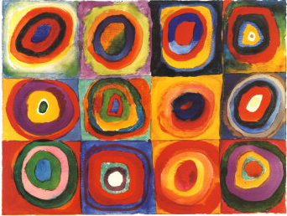
Squares with Concentric Circles (1913)
Let’s Talk!
What do you see when you look
at this painting?
How has the painting been made?
What kind of colors does Kandinsky use?
How would you describe these colors?
What shapes can you see?
What lines can you see?
How do you think Kandinsky was feeling when he painted this?
How does the painting make you feel?
Do you like it? Why?
Photo courtesy of NailsandNoms (@flickr.com) - granted under creative commons licence – attribution

Slide 8

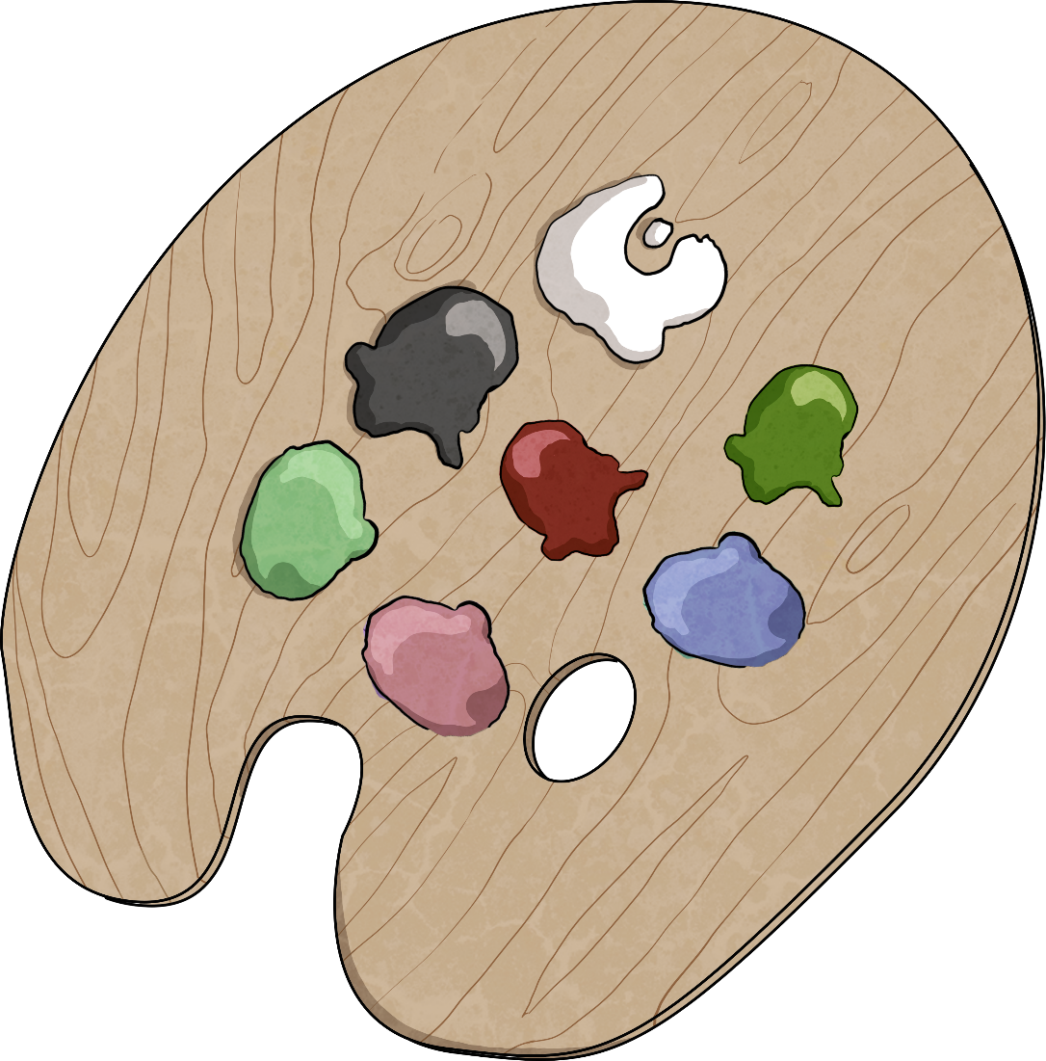
Before we paint, let’s learn about…
Color Mixing

Slide 9
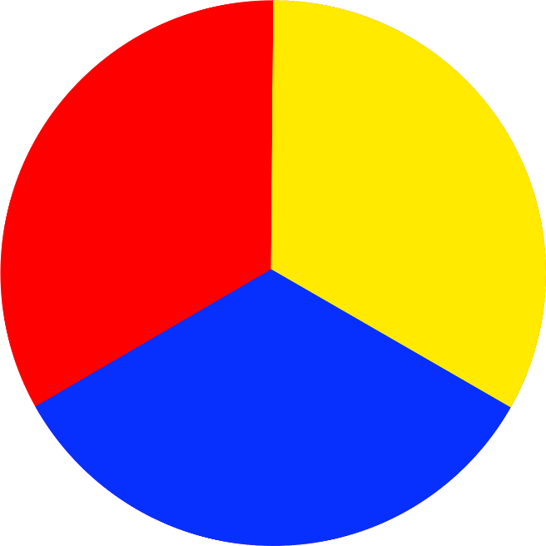
Primary Colors
Primary colors cannot be made by mixing other colors.
The primary colors are red, yellow, and blue.
Primary colors can be mixed together to make other colors.

Slide 10
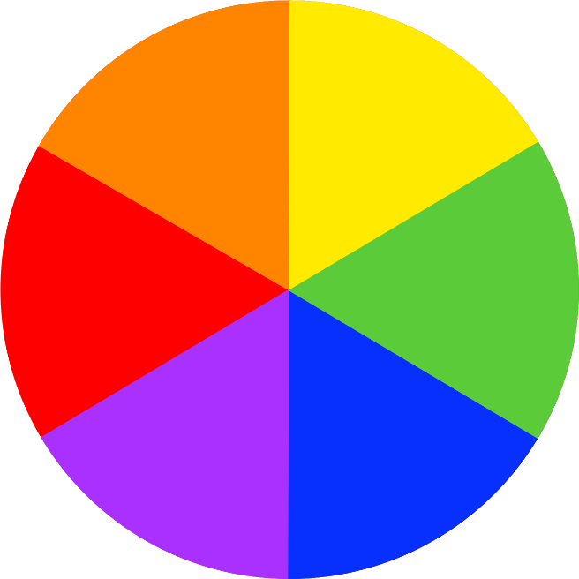
Secondary Colors
You use
primary colors to make secondary colors.

Slide 11



Mixing Secondary Colors

Slide 12
Mixing Tints
If you add white to a color, you can make tints of the original color.
White makes the color lighter.

Slide 13
Mixing Shades
If you add black to a color, you can make shades of the original color.
Black makes the color darker.

Slide 14
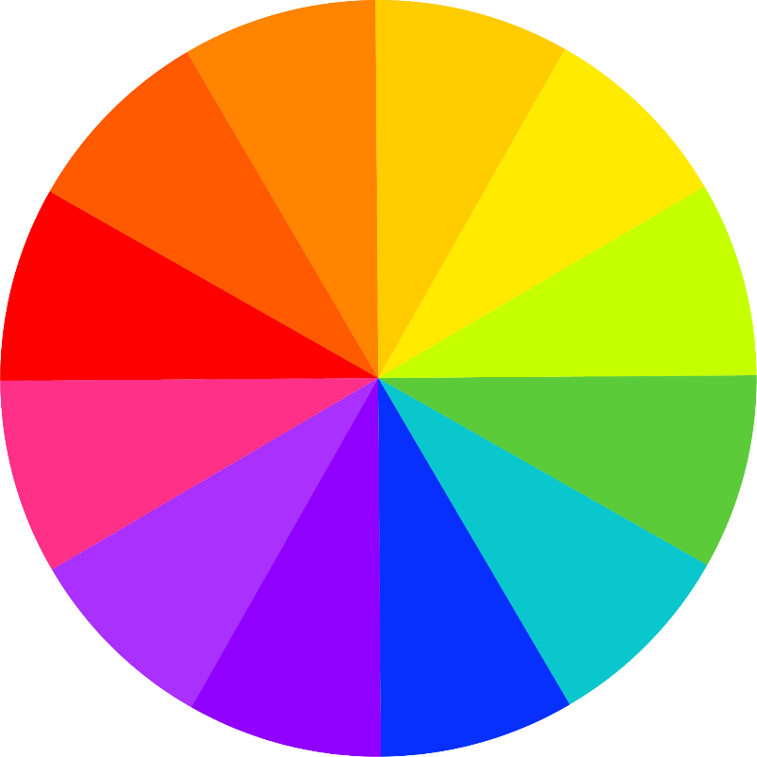
Warm and Cool Colors
warm colors
cool colors
-----------------------------

Slide 15

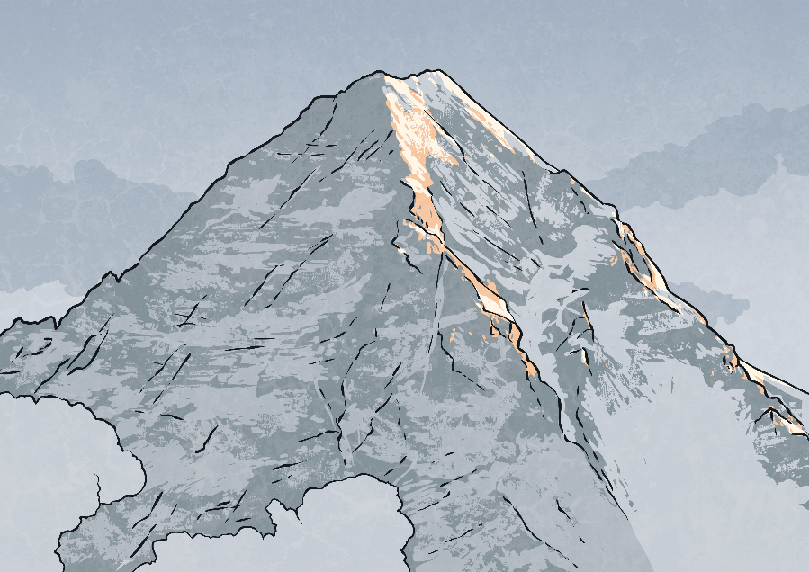
Warm Colors
Cool Colors
Red, orange, and yellow are warm colors. They make us think of sun, warmth, and cozy things.
Green, blue, and purple are cool colors. They make us think of fresh, calm, and chilly things.

Slide 16


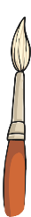




Kandinsky Circle Painting
You will need…
paper folded into four squares
colored paint
brushes
water
Experiment with mixing colors together. Use white to make them lighter and black to make them darker. Make some colors that you like.
In each square of your template, paint a dot. Use a different color for each one.
Around each dot, paint a circle in a different color.
Around each circle, paint a larger circle in a new color.
Finally, fill in any white space you have left in each square in another color.

