Slide 1
OLSJ Music Making Sessions
What will you will need:
Your voice
A creative mind
An instrument
Join in and Jam! Play and sing at home!
Be ready to listen to new music and explore new sounds
Share musical vocab and talk about the music
Research new musical artists, write songs and compose music
Play or sing along to the music at home

Slide 2
Make your own Instrument!
If you don’t have an instrument at home why not make one!
Water Xylophone
Canned Drums
Jazz it up Shaker
Try it yourself tambourine
Superhands guitar
Click here for web link:
https://www.learningliftoff.com/make-homemade-music-with-these-6-diy-instruments/
https://www.youtube.com/watch?v=4m5oWZixca0

Slide 3
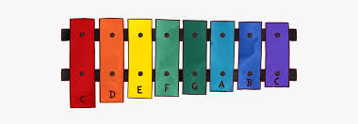
Hey We’re OLSJ!
Can you make a xylophone or glockenspiel that’s sounds just like the one we use in school?
https://www.youtube.com/watch?v=sIO-JhMvu6M
What you need:
4 glasses all the same size
Water
Your musical ear
2 Spoons (Beaters!)

Slide 4
Listening Skills
Listen to the “Hey We’re OLSJ!” Song
Can you sing or hum the notes you need?
CLICK FOR SONG
https://drive.google.com/file/d/166TsWPBwGe_dqXKNVT_JZRGWMTLdIvW1/view?usp=sharing
Which notes? ABCDEFG

Slide 5
DIY Glockenspeil
Here are the notes you need for INTRO & VERSE.
AA E
AAGG
EE B
EE B
: REPEAT

Slide 6
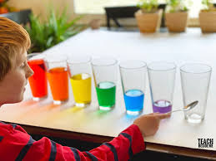
Pitch the notes
Once you have worked out the notes try adjusting the water levels to match the PITCH.
What are the 4 notes we use for this song?
_ _ _ _
but for this song we only need 4 NOTES (4 glasses)
IF YOU LIKE - You can create all the notes CDEFGABC

Slide 7
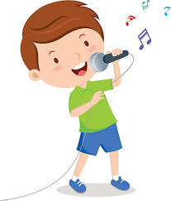
Lyrics
VERSE
Hey We’re OLSJ
Gonna make some music to- day-ay-ay
Can you play along
with me?
Leeeeeeet’s go!
Ready 1 2 3
CHORUS
Join in and jam with me
It’s easy can’t you see
Play 3 notes we know
E A G : (Repeat)
https://drive.google.com/file/d/166TsWPBwGe_dqXKNVT_JZRGWMTLdIvW1/view?usp=sharing

Slide 8
Practise playing the Chorus
Join in and Jam with me
A A
It’s easy can’t you see
A A
Play 3 notes
G G
lets go!
E A G

Slide 9
Listening and Playing
Instruments and sounds
Which instruments can you hear in the track?
What genre of music is this song?
Practice playing the VERSE
Practice playing the CHORUS
TOP TIP
If you find it difficult practice playing the notes SLOWLY

Slide 10
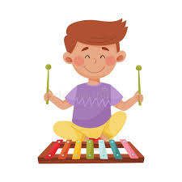
What to expect in live music lessons
Music Box: We will warm up, listen to music, talk about music, sing and play.
Microphone muted
Thumbs up: Let Miss Dyer know that you can hear her music, the keyboard and understand what to do if given a task.
Play solo: You may be invited to share some of your ideas, play the notes or sing.

Slide 11
OLSJ Music Makers
Looking forward to seeing you all soon for some live music making!

