Slide 1
Science
Electricity
Year One
Science | Year 4 | Electricity | Exciting Electricity | Lesson 1

Slide 3
Aim
I can explain ways that electricity is generated.
Success Criteria
I can explain what I know about electricity.
I can explain where electricity comes from.

Slide 4
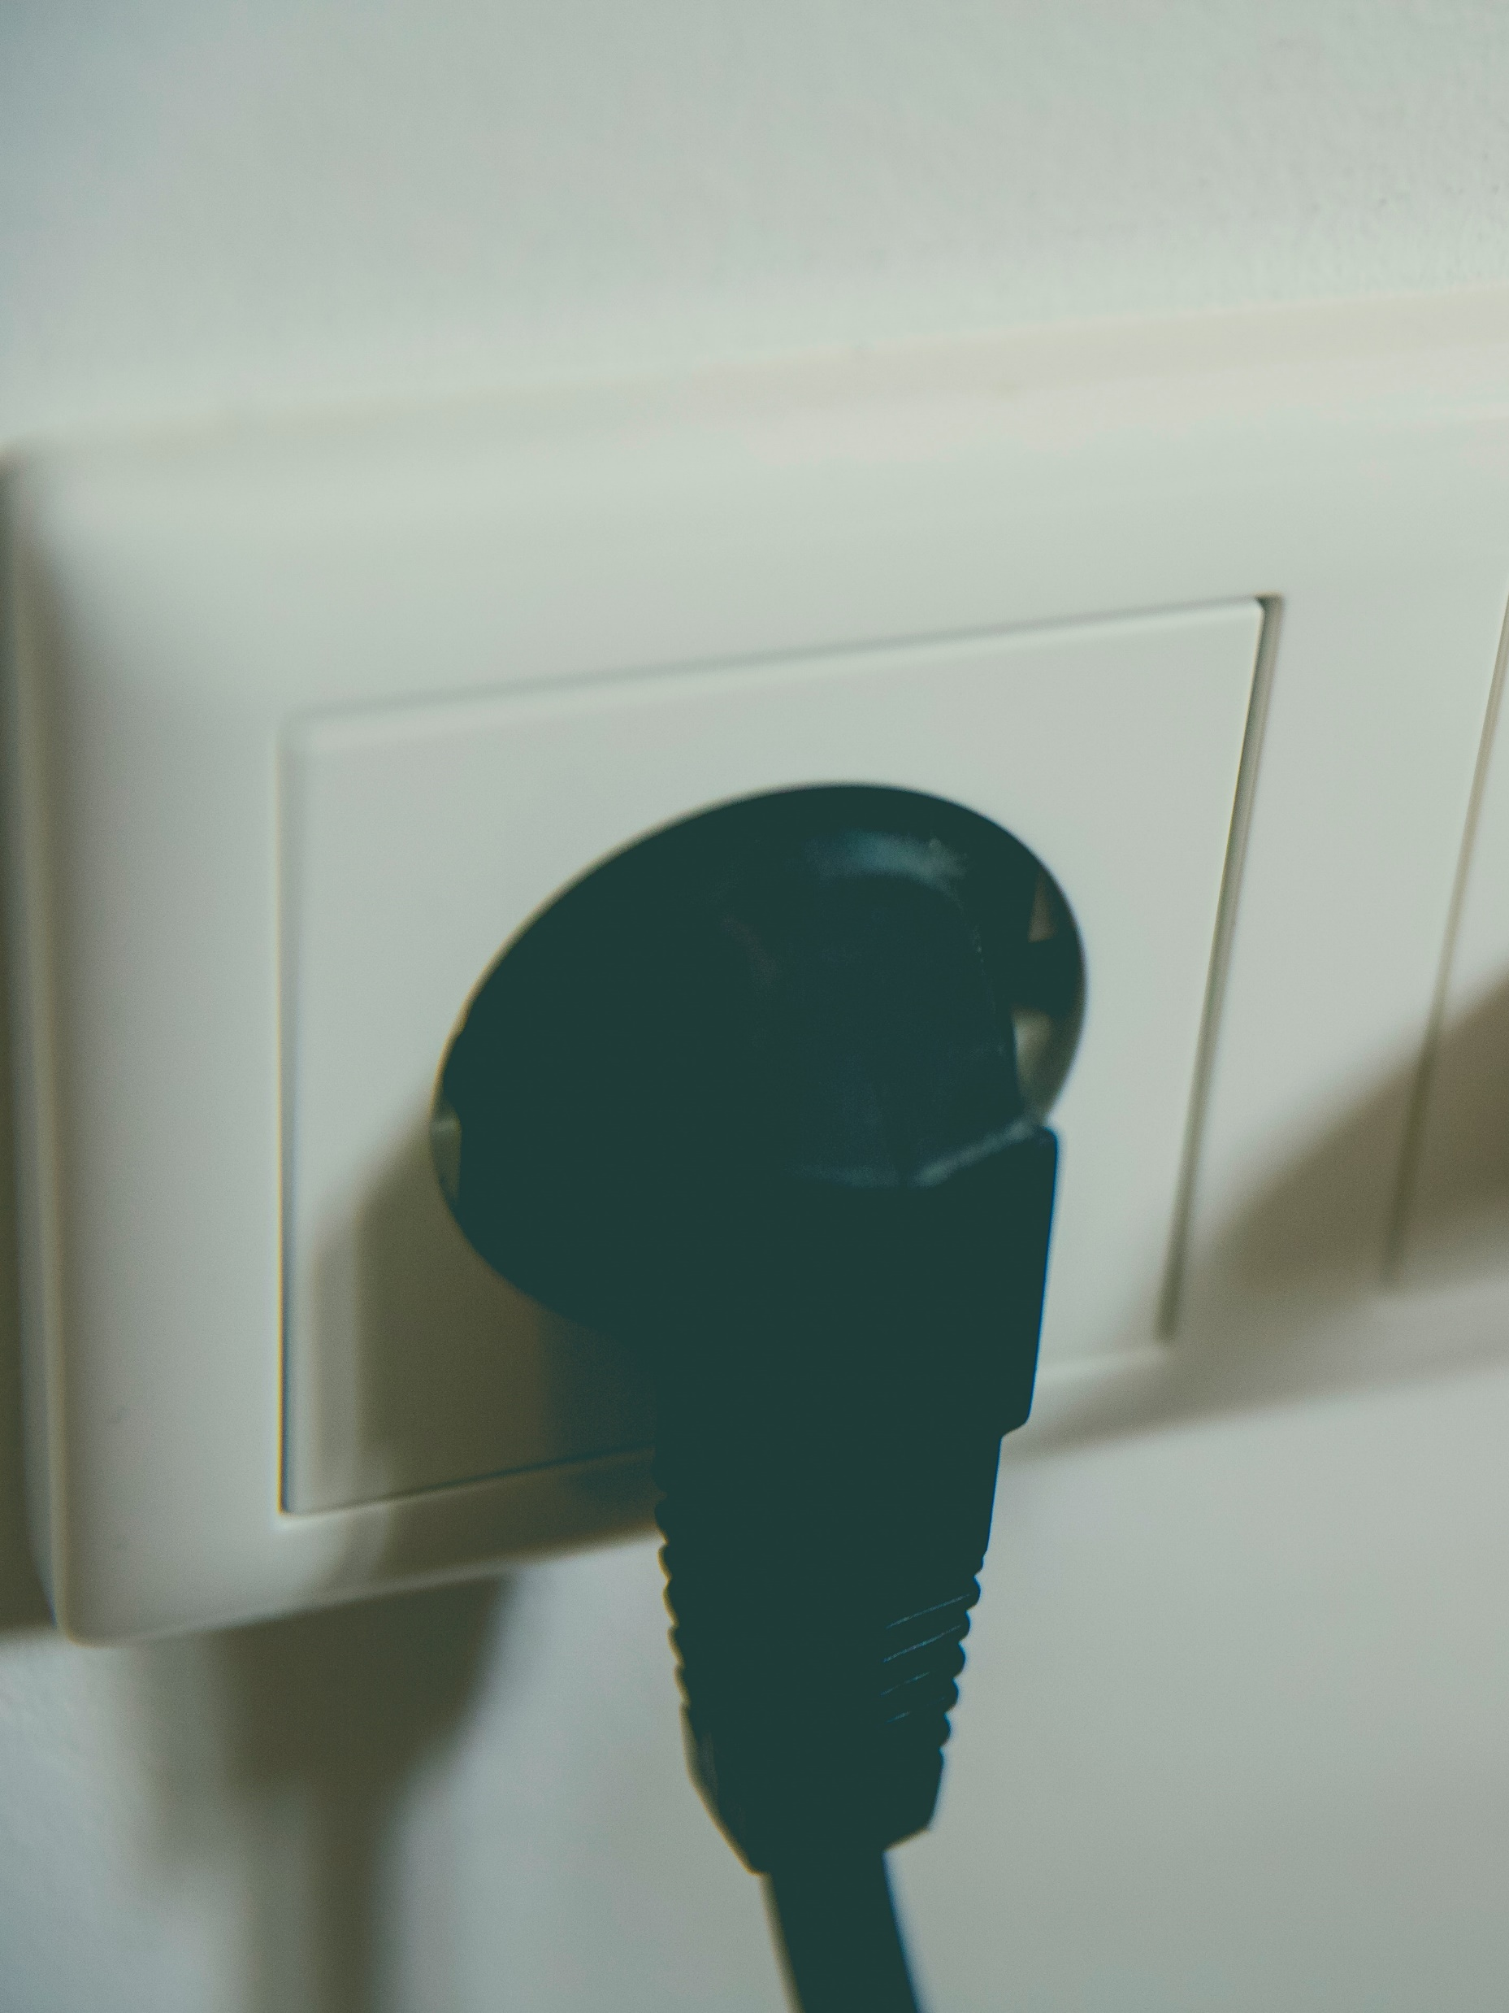
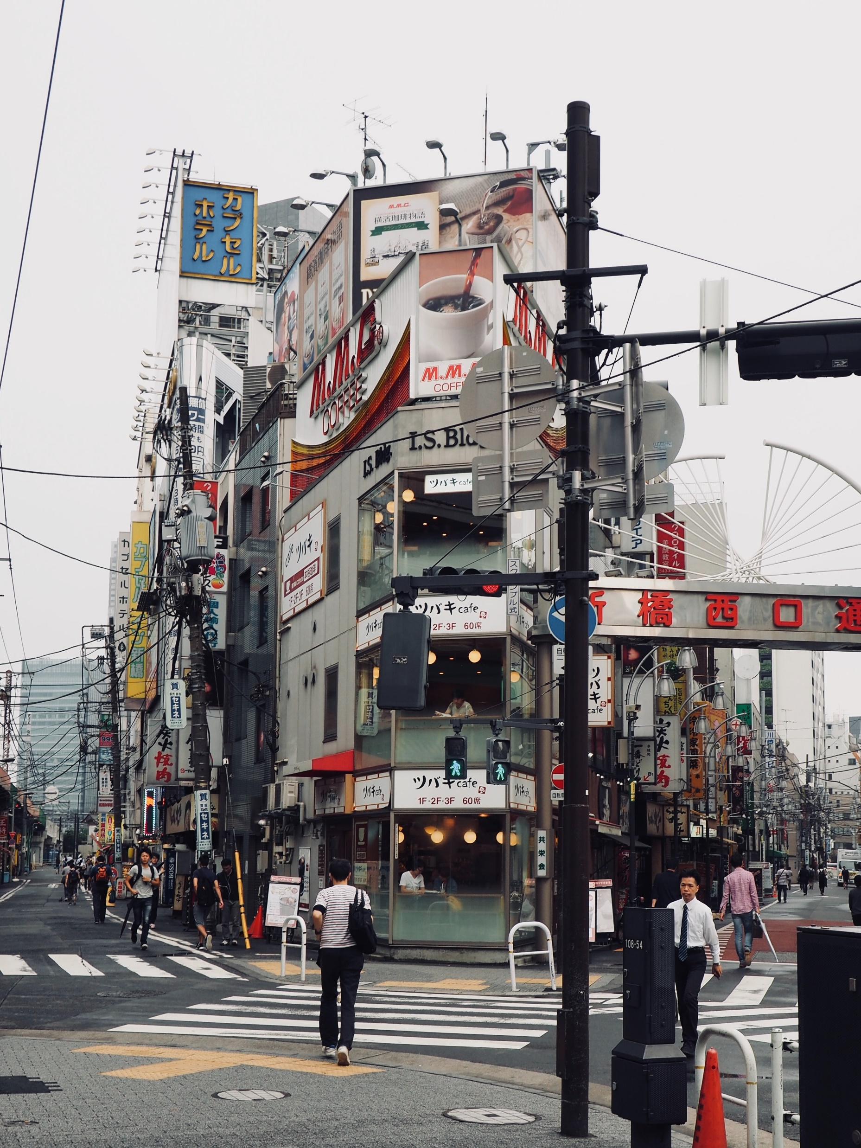
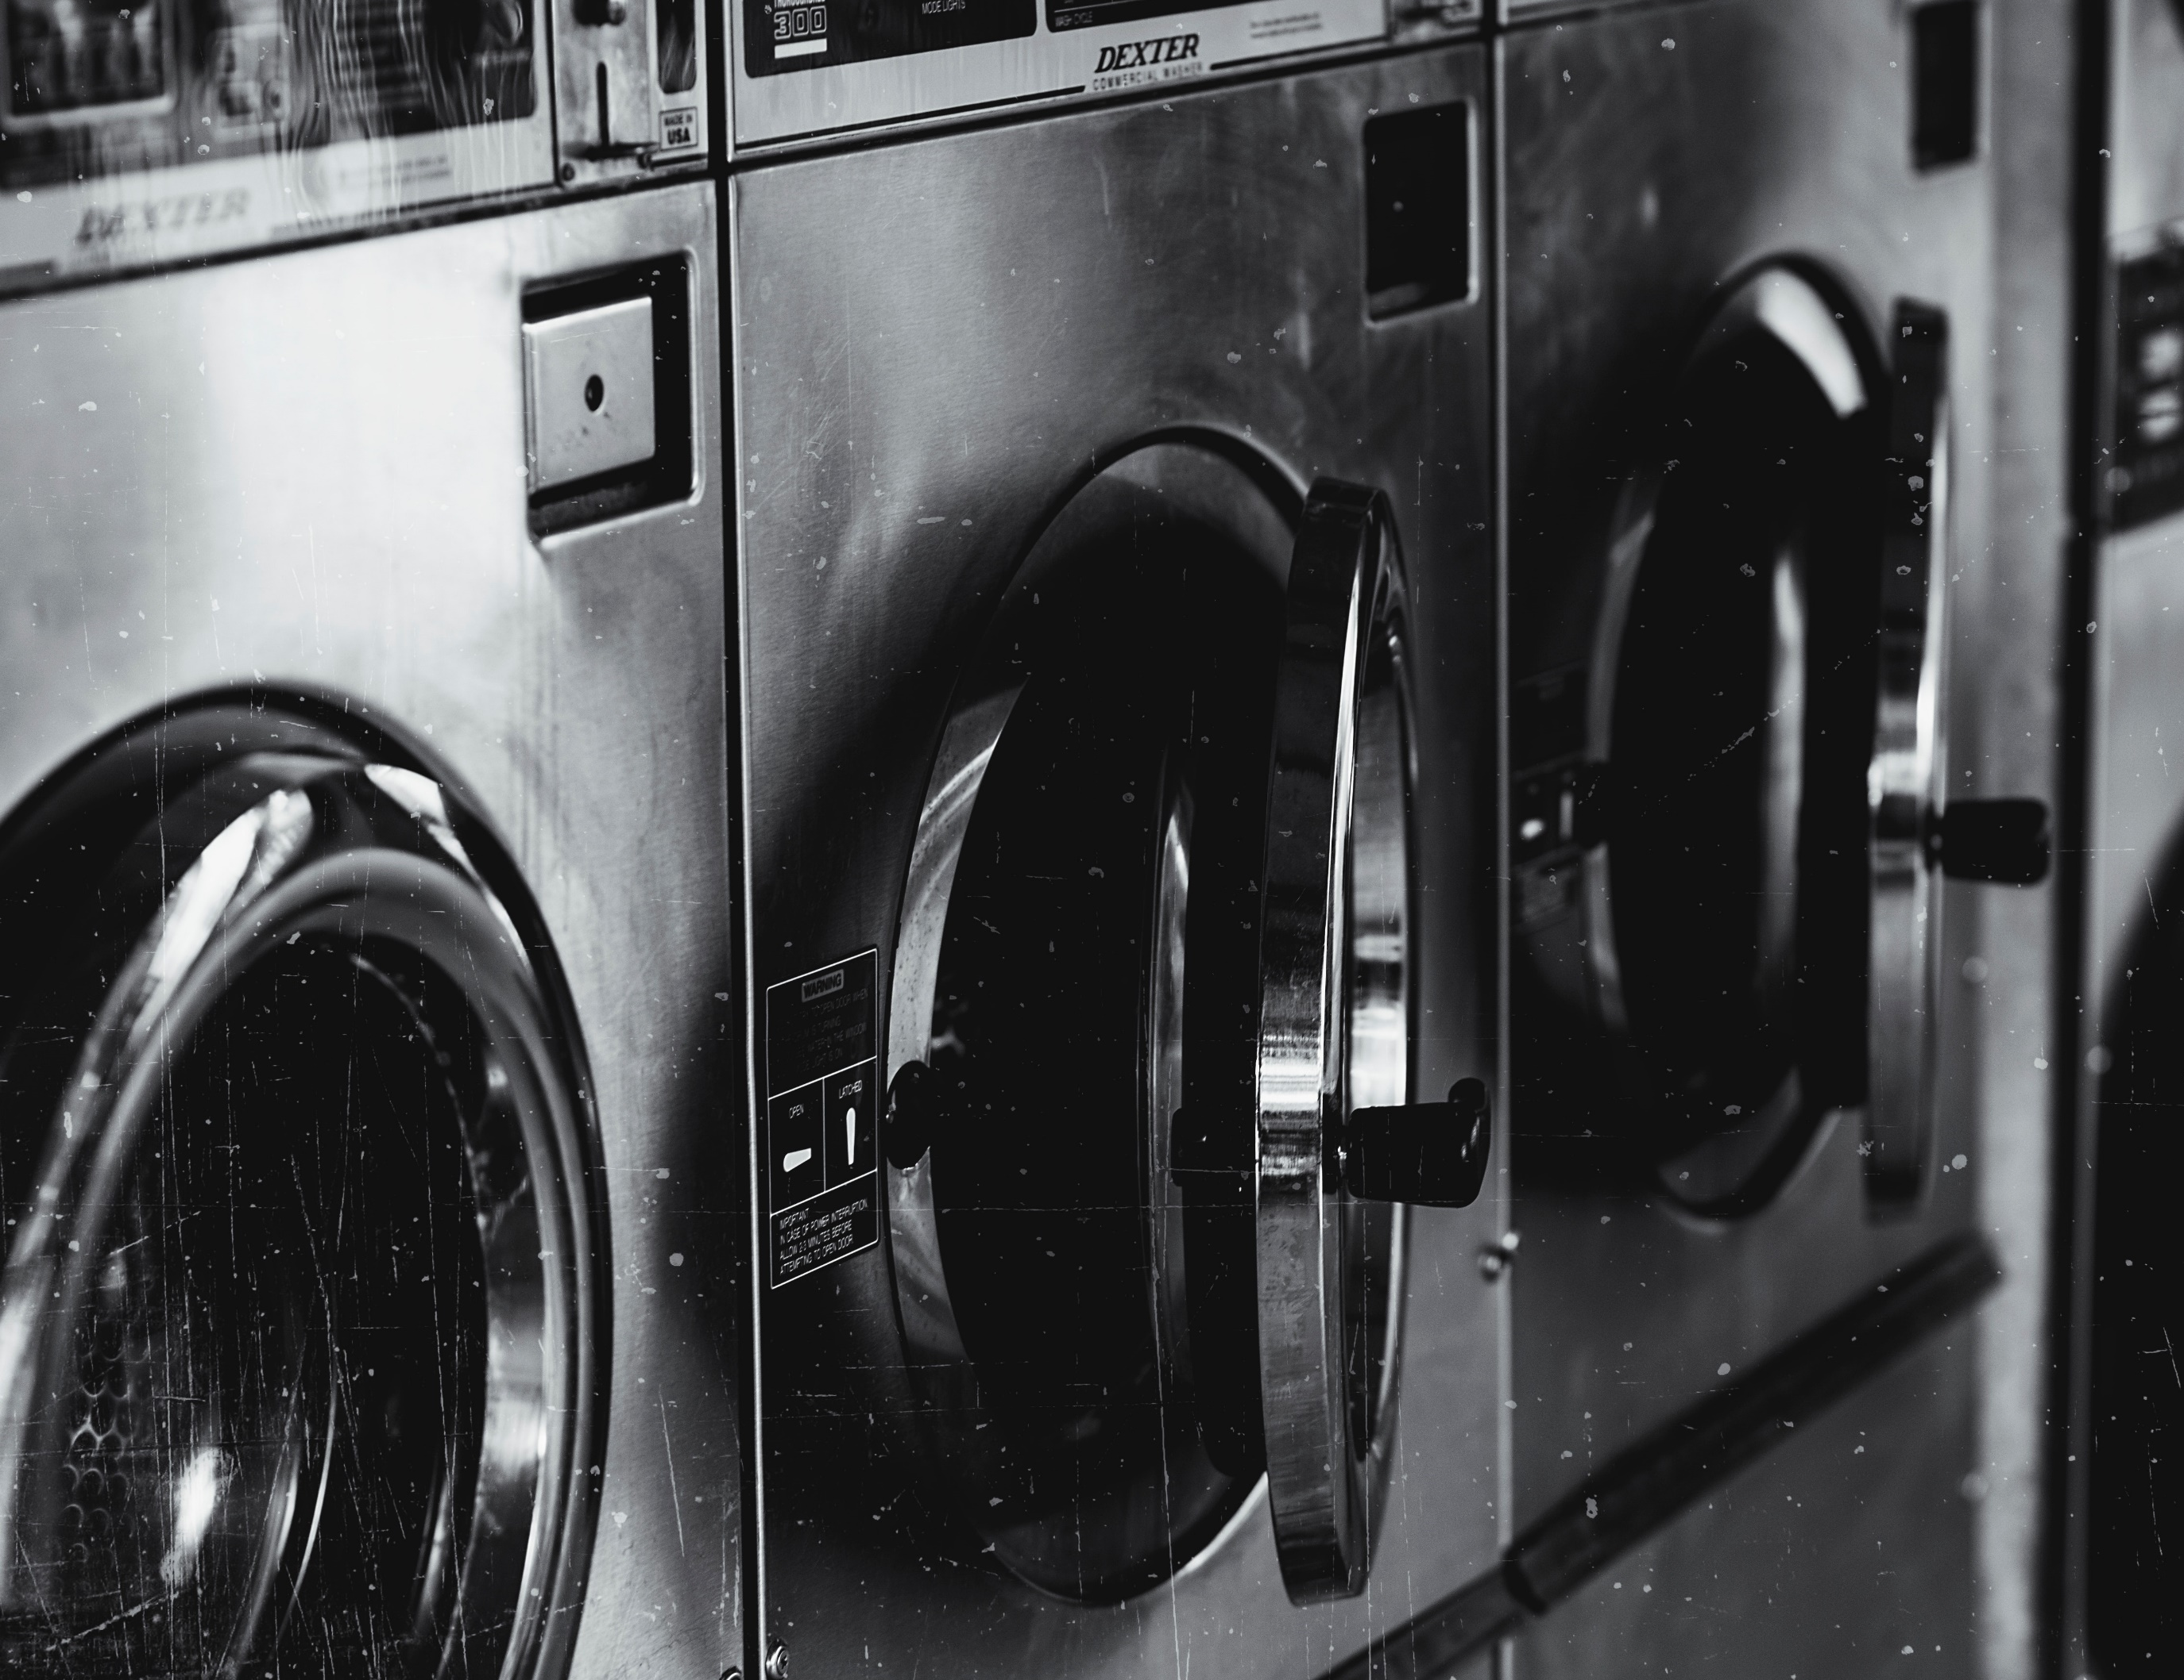
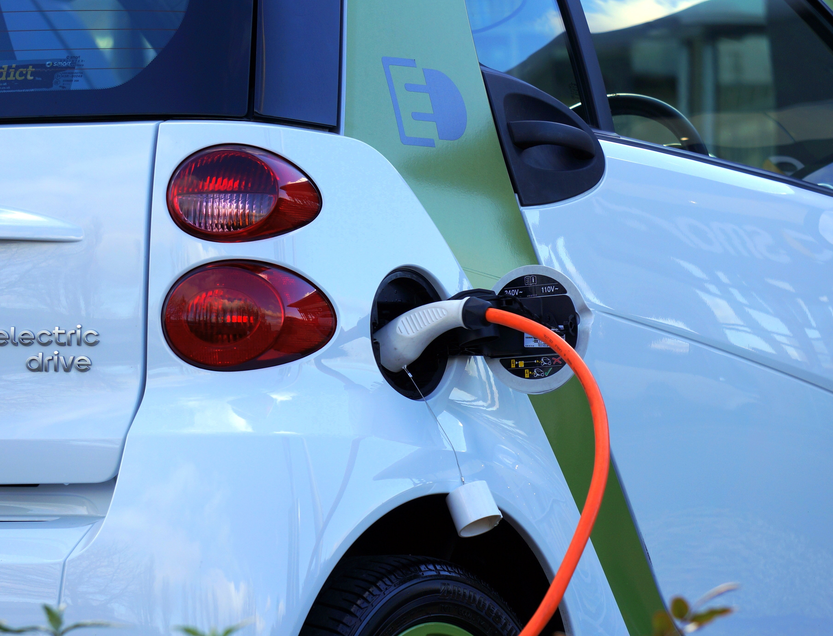
What Makes It Work?
Look at these pictures. Think about what all the items have in common. How do they all work?

Slide 5
Electricity
All of the items shown on the previous slide are powered by electricity. Electricity makes them work.
What do you know about electricity? Create a list to show what you already know about this topic.
Can you think of any questions you would like to find out about electricity?
Think about:
Where electricity comes from;
How switches work;
Which materials allow electricity to flow through them;
Some items that use electricity to work.

Slide 6
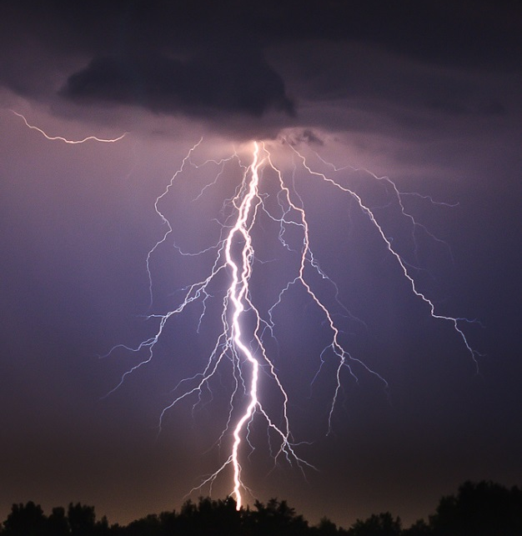
What is Electricity?
Definition:
When we refer to electricity, what we usually mean is electric current, which is the flow of electric charge.
Electricity occurs naturally. Some examples include:
Lightning
Static electricity
Bioelectricity is produced in living things, such as electric eels
Photo courtesy of skpy, Leszek.Leszczynski and desertdutchman (@flickr.com) - granted under creative commons licence - attribution

Slide 7
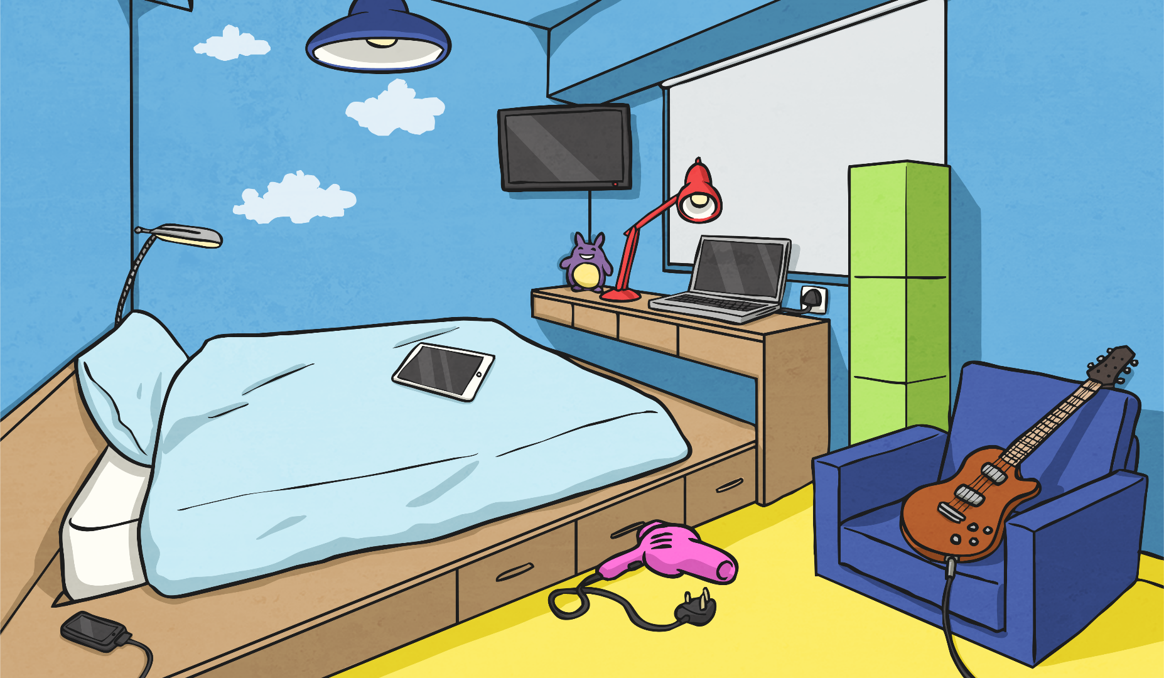
What is Electricity?
Electricity powers many of the things we use everyday - televisions, phones, computers, lights and microwaves. Electricity occurs naturally, such as in lightning, or even in your body to send messages from your brain to your organs!
Over time, scientists worked out how to use electricity to make things work. They also discovered ways to generate, or make, electricity. This meant that electricity was more readily available and things could be powered more easily. This sort of electricity is known as current electricity.
Current electricity is a flow of electrical charge through a material. Often it flows through wires to travel from a power source to an appliance.

Slide 8
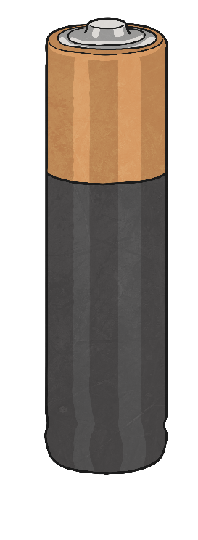
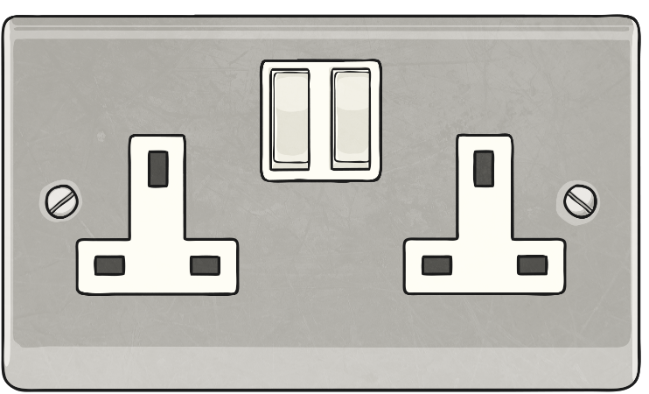
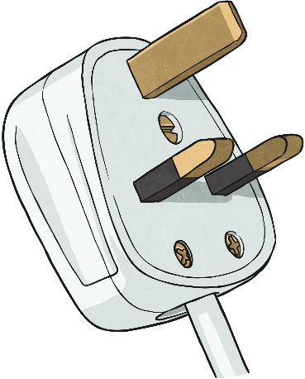
What is Electricity?
There are two types of electrical current that we use to power appliances:
Mains electricity: which is an alternating current (AC).
Batteries: which generate a direct current (DC).

Slide 9
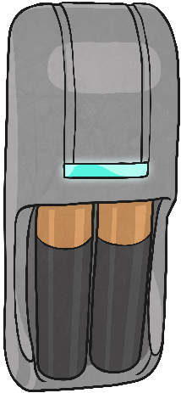
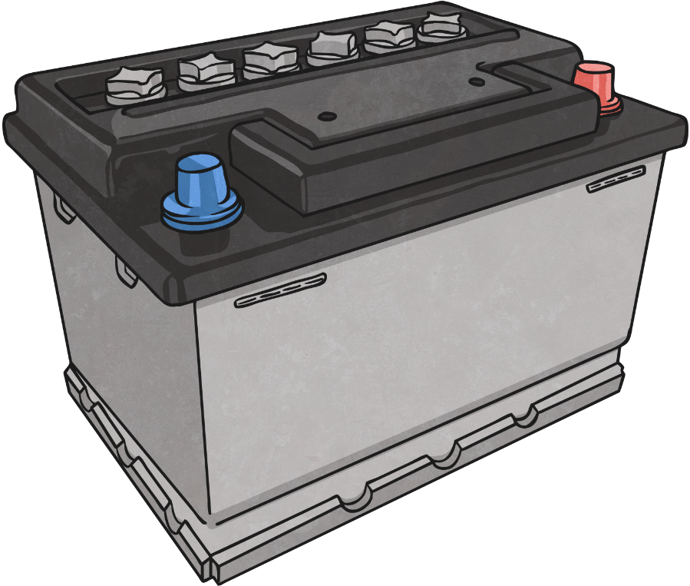
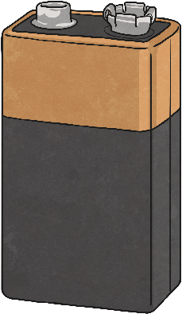
Where Does Electricity Come From?
An energy source is a way of powering something.
Electricity is a secondary energy source. This means it is made from primary sources of energy.
Some primary sources of energy include:
Coal
Oil
Natural gas
Wind power
Solar power

Slide 10
Where Does Electricity Come From?
Since electricity is a secondary source of energy, it needs to be generated, or made, from a primary source of energy.
Fossil Fuels
Hydro and Wind
Water is used in dams, and wind is used to turn windmills. These both generate electricity.
Coal, oil and natural gas are fossil fuels. Burning them produces heat, which generates electricity.
Solar
The sun's rays shine on special panels, which convert its energy into electricity.
Nuclear
This is the energy that is created when atoms are either combined or split, creating heat. This can be converted into electricity.
Geothermal
Geothermal energy is heat from the Earth, which can be converted into electricity.

Slide 11
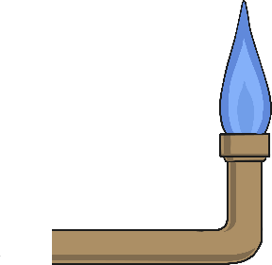
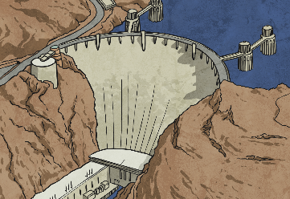
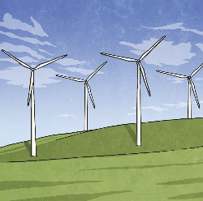
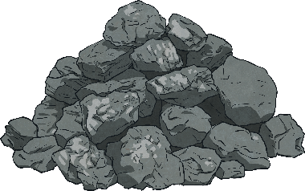
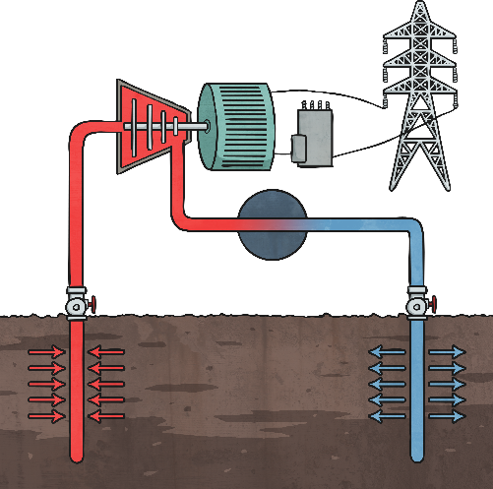
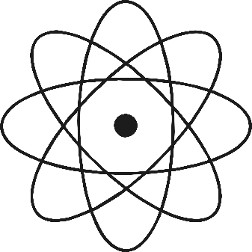
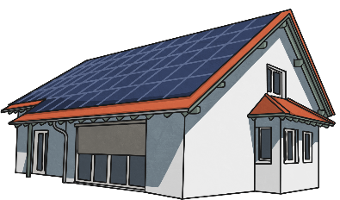
Where Does Electricity Come From?
Can you match the images of the primary energy sources with their names? Click each image to see which energy source it matches with.
Fossil Fuels
Geothermal
Hydro and Wind
Solar
Nuclear

Slide 12
Where Does Electricity Come From?
Did you match the images with the energy sources?
Hydro and Wind
Fossil Fuels
Geothermal
Nuclear
Solar

Slide 13
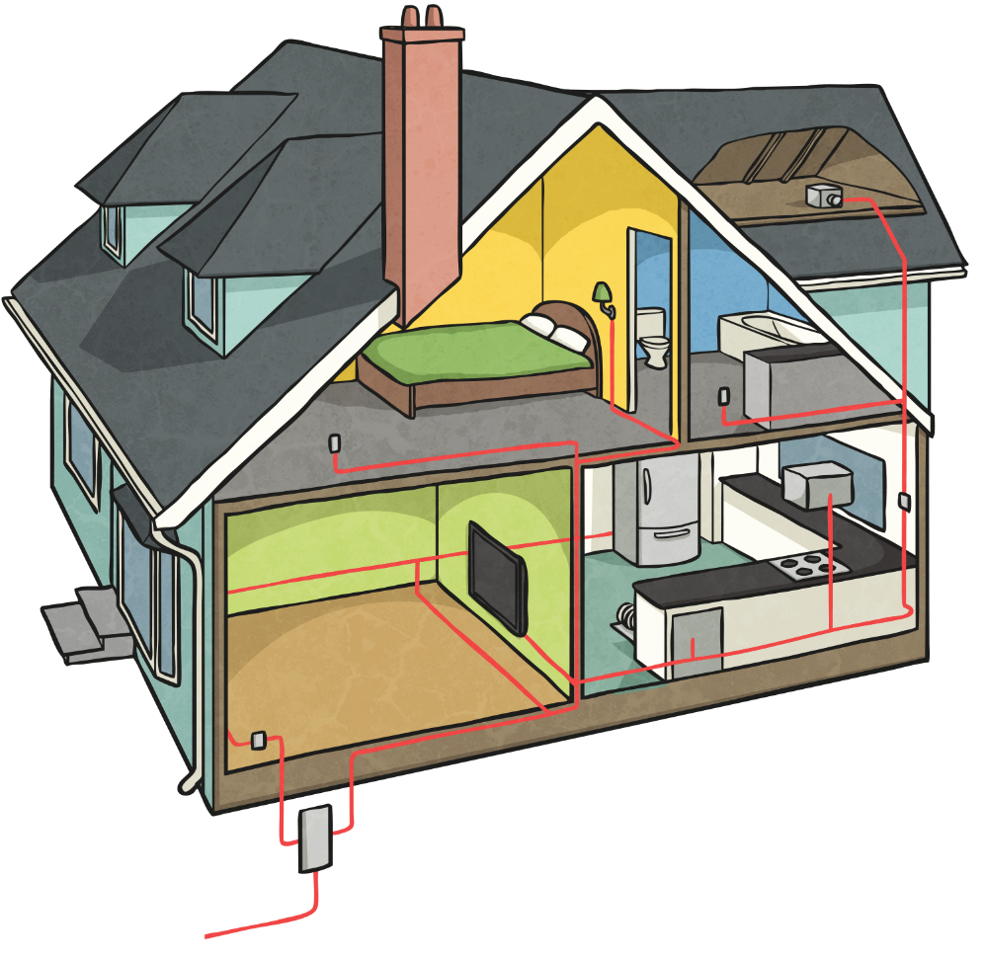
Where Does Electricity Come From?
So there are several different ways of generating electricity for us to use to power our appliances.
Some of these methods of generating electricity are renewable. This means they will never run out, so we can use them to generate electricity for ever.
However, some methods are non-renewable. This means that they will run out, and when they do we will not be able to use them to generate electricity.

Slide 14
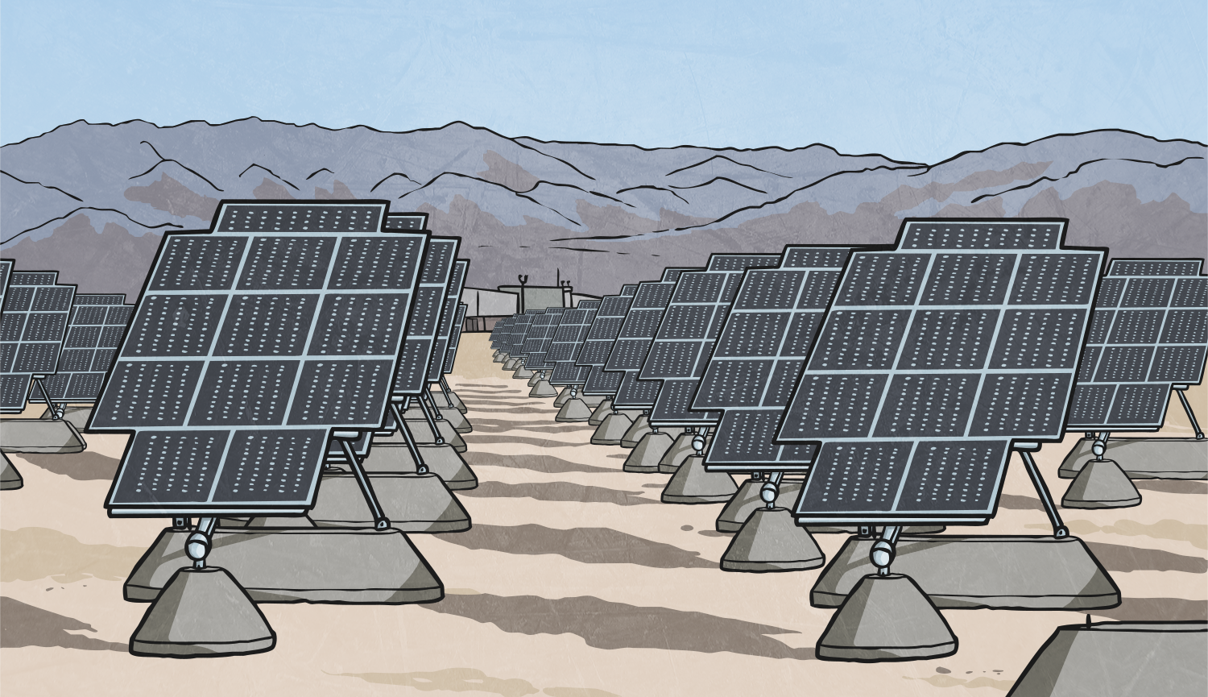
Where Does Electricity Come From?
Renewable | Non-renewable
Solar Nuclear Geothermal Hydro Wind | Fossil fuels

Slide 15
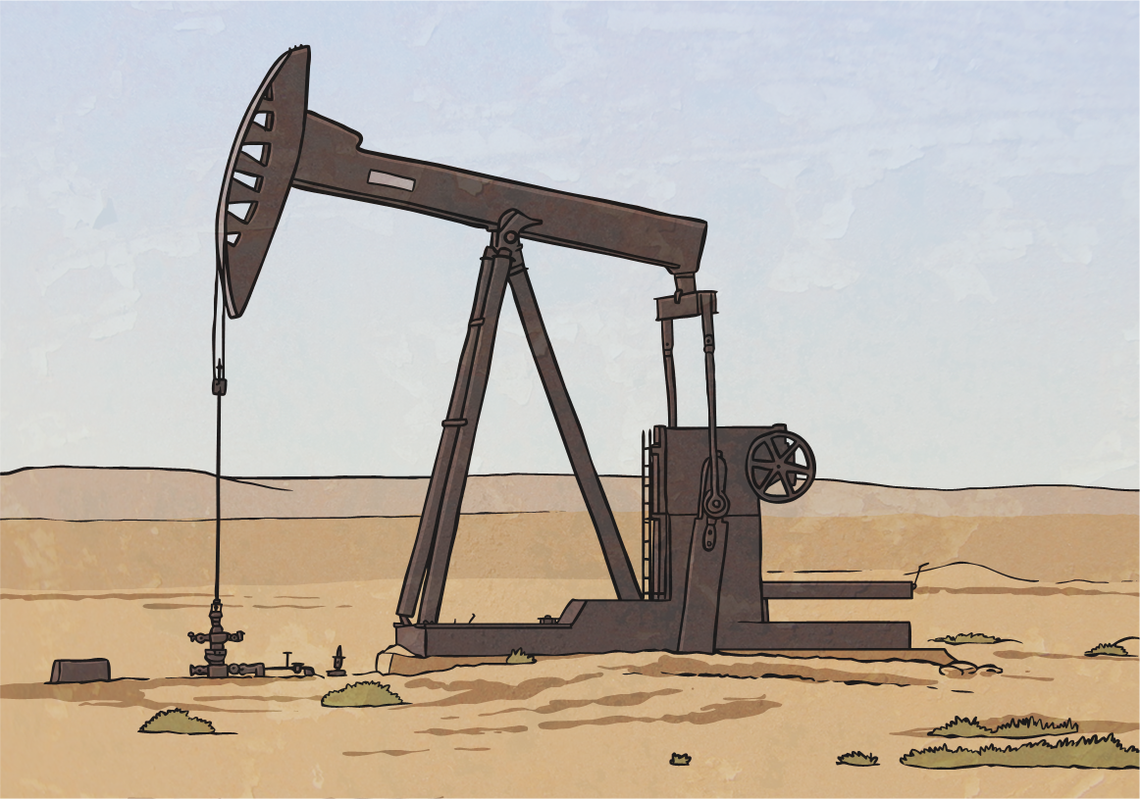
Where Does Electricity Come From?
Coal, oil and natural gas will all run out one day. When they do, we will not be able to burn these materials to generate electricity.
However, these materials are cheaper than the renewable sources. For this reason, most of our electricity is currently generated from fossil fuels.

Slide 16
Electricity Experts
Imagine you are electricity experts! Twinkl TV have asked you to narrate this film to teach children about where our electricity comes from.
You will provide the words to the film clip. You will not need to act it out, just narrate the images on screen.
You can use your Electricity Experts Activity Sheet to help you plan and write your narration.

Slide 17
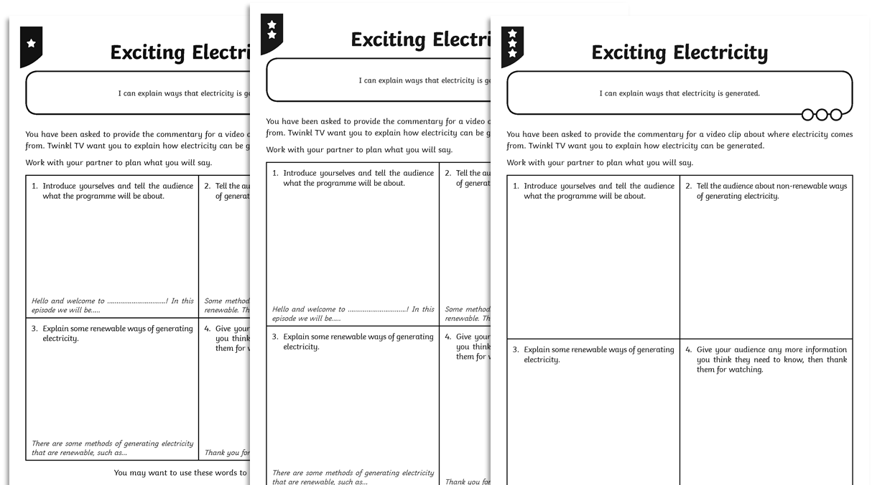
Electricity Experts

Slide 18
Electricity Experts

Slide 19
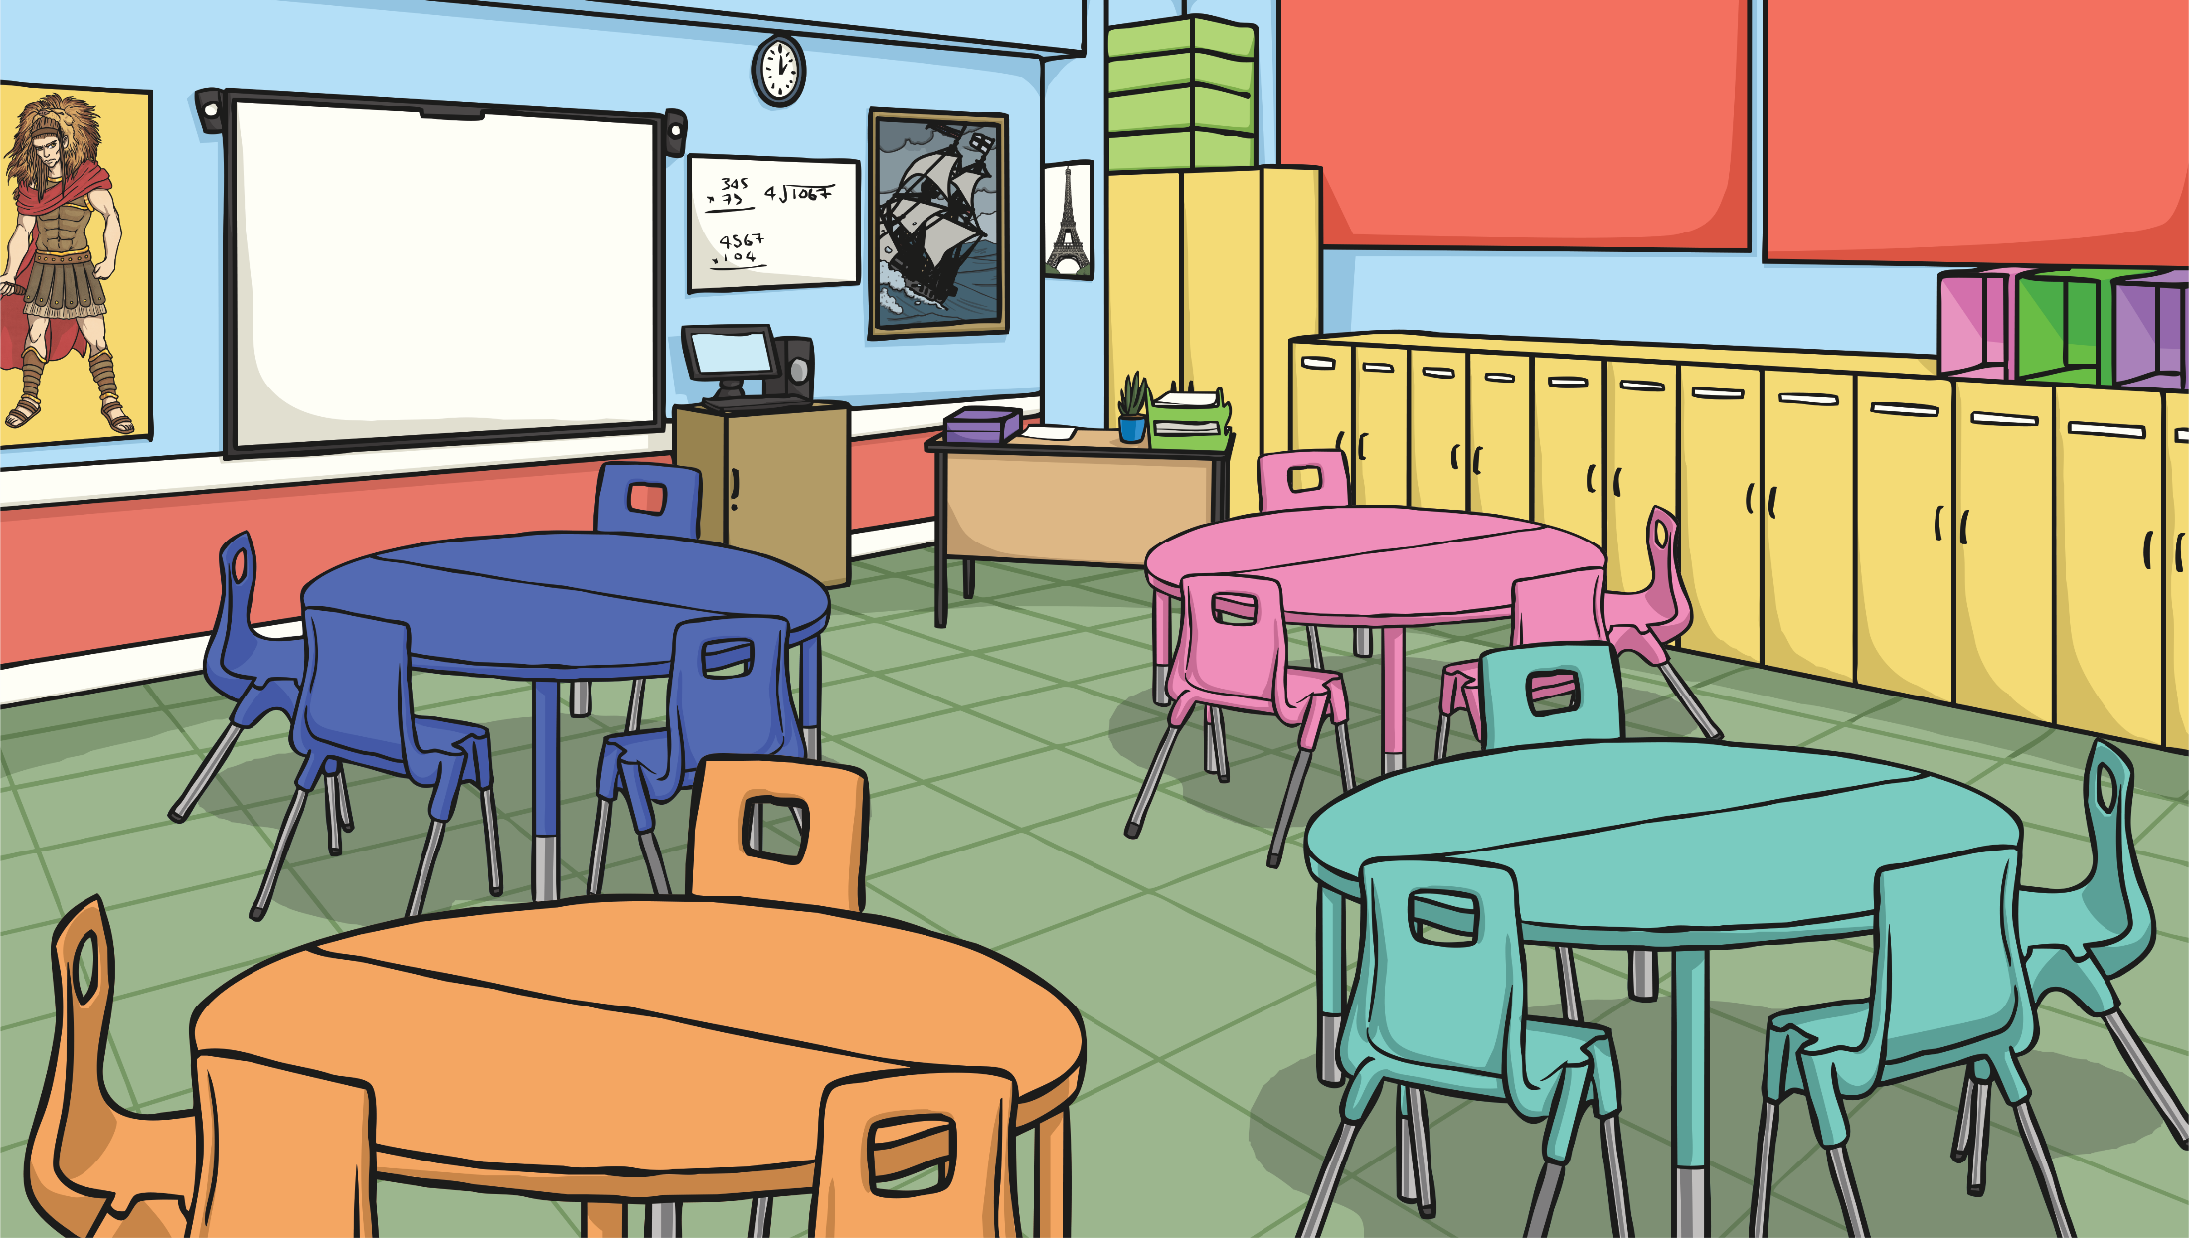
Life Without Electricity
Electricity is a flow of charge through a material. We use it to power appliances.
What would life be like without electricity?
Look around you. Discuss ways things would be different.
What would your classroom be like?
How would you learn?
What would your home be like?
How would people stay in touch?

