Slide 1
Date: Wednesday 11th November 2020
Squared and Cubed Numbers

Slide 2
Introduction
Use the time tables to complete the calculations below.
7 x 6 = |  |  | 6 x 5 =
9 x 8 = |  |  | 8 x 7 =
5 x 4 = |  |  | 11 x 10 =
11 x 12 = |  |  | 4 x 3 =
© Classroom Secrets Limited 2018

Slide 3
Introduction
Use the time tables to complete the calculations below.
7 x 6 = | 42 |  | 6 x 5 = | 30
9 x 8 = | 72 |  | 8 x 7 = | 56
5 x 4 = | 20 |  | 11 x 10 = | 110
11 x 12 = | 132 |  | 4 x 3 = | 12
© Classroom Secrets Limited 2018

Slide 4
Vocabulary
Indices – A number that indicates how many times to multiply by
Squared Number – A number that is the result of multiplying a number by itself
e.g. 7 x 7 = 49 so 49 is a squared number
Cubed Number – A number that is multiplied by itself three times
e.g. 5 x 5 x 5 = 125 so 125 is a cubed number

Slide 5
Indices
$$5^{2}$$
The indices above represents 5 squared.
As a number sentence this is 5 x 5
5 x 5 = 25
Why is a squared number called a square number?

Slide 6
Indices
$$4^{3}$$
The indices above represents 4 cubed.
As a number sentence this is 4 x 4 x 4
4 x 4 = 16
16 x 4 = 64
Why is a cubed number called a cube number?

Slide 7
Indices
$$5^{2}$$
The indices above represents 5 squared.
As a number sentence this is 5 x 5
5 x 5 = 25

Slide 8
Practice:
$$4^{2}$$
$$7^{2}$$
$${12}^{2}$$
Use a multiplication square to support you
Why are squared numbers generally easier to find than cubed numbers?

Slide 9
Indices
$$4^{3}$$
The indices above represents 4 cubed.
As a number sentence this is 4 x 4 x 4
4 x 4 = 16
16 x 4 = 64

Slide 10
Practice 2:
$$3^{3}$$
$$6^{3}$$
$$9^{3}$$
Use a multiplication square to support you as well as your written multiplication method
Why does finding cubed numbers often involve both mental and written methods?

Slide 11
Practice 2 Answers:
$$3^{3}$$
3x3x3 =27
6x6x6 = 216
9x9x9= 729
$$6^{3}$$
$$9^{3}$$
Use a multiplication square to support you as well as your written multiplication method
Why does finding cubed numbers often involve both mental and written methods?

Slide 12
Problem solving:
Complete the calculations

Slide 13
Problem solving answers:
Complete the calculations

Slide 14
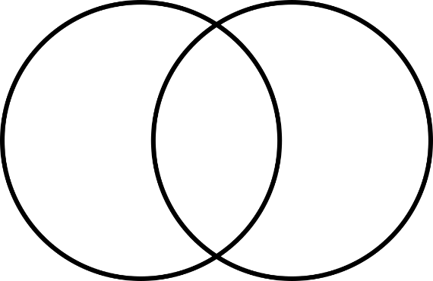
Problem Solving 1
Sort the square and cube numbers into the Venn diagram.
12² | 5³ | 6²
4³ | 6³ | 2²
More than 100
Even Number
© Classroom Secrets Limited 2018

Slide 15
Problem Solving 1
Sort the square and cube numbers into the Venn diagram.
12² | 5³ | 6²
4³ | 6³ | 2²
More than 100
Even Number
12²
5³
6²
6³
2²
4³
© Classroom Secrets Limited 2018

Slide 16
Reasoning 1
Match the square and cube numbers to the correct cards.
Which is the odd one out? Convince me.
7³
512
343
11²
216
121
6³
© Classroom Secrets Limited 2018

Slide 17
Reasoning 1
Match the square and cube numbers to the correct cards.
Which is the odd one out? Convince me.
512 is the odd one out because…
7³
512
343
11²
216
121
6³
© Classroom Secrets Limited 2018

Slide 18
Reasoning 1
Match the square and cube numbers to the correct cards.
Which is the odd one out? Convince me.
512 is the odd one out because it does not have a matching square or cube card.
7³
512
343
11²
216
121
6³
© Classroom Secrets Limited 2018

Slide 19
Problem Solving 2
Use the cards to complete the statements below.
Find 3 possibilities.
8³
300
10³
9²
100
>
<
© Classroom Secrets Limited 2018

Slide 20
Problem Solving 2
Use the cards to complete the statements below.
Find 3 possibilities.
Various answers, for example:
8³
300
10³
9²
100
10³
>
300
9²
<
100
© Classroom Secrets Limited 2018

Slide 21
Extension- Greater Depth

Slide 23
Square roots
A square root is the opposite of a square number.
You are basically doing the inverse of squaring!
It is a number which, when multiplied by itself, produces the given number
E.g √16
= 4
= 7
√49

Slide 24
Examples of square root

Slide 25
Cube roots
A cube root is the opposite of a cube number
It is a number which, when multiplied by itself three times, produces the given number
Example: √125
3
= 5
3
= 9
√729

Slide 26
Cube root examples

