Slide 1
Mixed Numbers

Slide 2
Keywords:
A mixed number is any whole number and fraction combination.
Eg. 3$\frac{3}{4}$
6$\frac{2}{3}$
An improper fraction is when the numerator is bigger than the denominator
Eg. $\frac{5}{4}$
This could be written as 1$\frac{1}{4}$ as a mixed number.

Slide 3
Let’s look at this question
$1\frac{3}{4}$ + $\frac{1}{4}$ =

Slide 4
Method:
You need to change the mixed number into an improper fraction before you can add them together
$1\frac{3}{4}$ + $\frac{3}{4}$ =
$\frac{7}{4}$ + $\frac{3}{4}$ =
$\frac{10}{4}$ =
CHECK!! Are the denominators the same?
When they are, add the numerators together.
2$\frac{2}{4}$
=2$\frac{1}{2}$
We can change the answer into a mixed number when the numerator is bigger than the denominator.

Slide 5
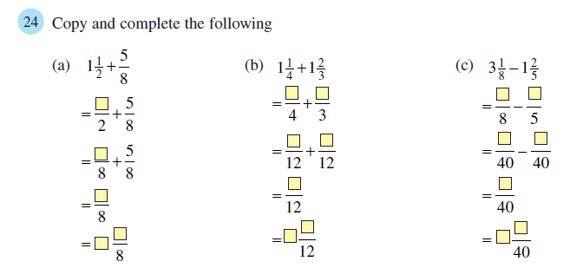
Choose one question that you feel comfortable with. copy and complete it in your book.

Slide 6
Answers:
5
5
25
7
3
15
20
125
56
12
35
69
17
1
11
29
2
1
2

Slide 7
Let’s see what you can do
Steps to Success:
1. Change any mixed numbers into improper fractions.
2. Make sure the denominators are THE SAME.
3. Add or subtract the numerators according to the question.
4. If your answer is an improper fraction, change it into a mixed number.
Work out in your books
1$\frac{5}{6}$ + $\frac{5}{6}$ =
3$\frac{1}{4}$ + 2$\frac{3}{4}$ =
5$\frac{2}{5} −$3$\frac{3}{10}$ =

Slide 8
You need to change the mixed numbers into Improper fractions
1$\frac{5}{6}$ + $\frac{5}{6}$ =
3$\frac{1}{4}$ + 2$\frac{3}{4}$ =
5$\frac{2}{5} −$ 3$\frac{3}{10}$ =
$\frac{11}{6}$ + $\frac{5}{6}$ =
$\frac{13}{4}$ + $\frac{11}{4}$ =
$\frac{27}{5} −$ $\frac{33}{10}$ =

Slide 9
You need to change the mixed numbers into top heavy fractions
$\frac{16}{6}$ =
$\frac{24}{4}$ =
2$\frac{4}{6}$
6
This can be simplified:
2$\frac{2}{3}$
$\frac{11}{6}$ + $\frac{5}{6}$ =
$\frac{13}{4}$ + $\frac{11}{4}$ =
$\frac{27}{5} −$ $\frac{33}{10}$ =
We have more work to do here!

Slide 10
Change the denominator
$\frac{27}{5} −$ $\frac{33}{10}$ =
You can’t add/subtract fractions whose denominators are different!
You must do the same to the top
Let’s change the $\frac{27}{5}$
$$\frac{54}{10}$$
x2 to get 10 as the denominator
$$\frac{54}{10} − \frac{33}{10}$$
= $\frac{21}{10}$
= 2$\frac{1}{10}$

Slide 11
Challenge yourself!
ANSWERS:
25) $2\frac{1}{12}$
26) $2\frac{7}{15}$
27) $1\frac{5}{8}$
28) 1$\frac{5}{12}$
29) $4\frac{7}{20}$
30) $1\frac{19}{24}$
31) $1\frac{7}{10}$
32) $3\frac{37}{40}$

