Slide 2
Aim
I can recognise and use fronted adverbials.
Success Criteria
I know that fronted adverbials are words, phrases or clauses that come before the main clause in a sentence.
I know that fronted adverbials modify the verb or the main clause by describing the time, frequency, manner, place or possibility.
I can use a comma after a fronted adverbial.
I can write my own fronted adverbials using the acronym ‘ISPACE’.

Slide 3
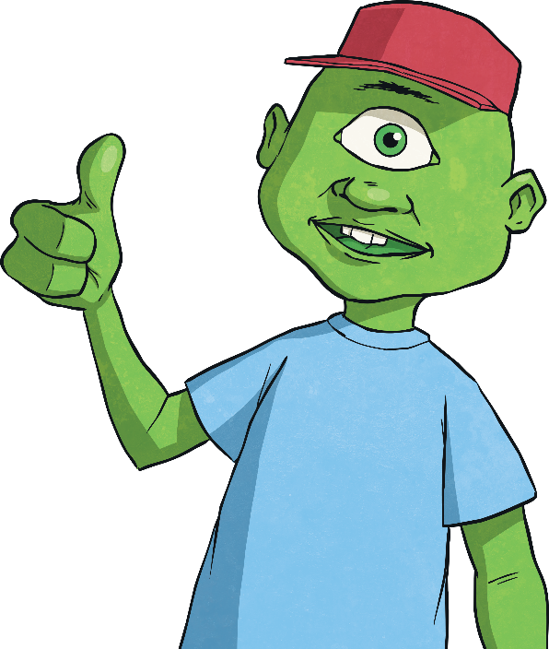
Fronted Adverbial Hunt
What is an adverbial?
An adverbial is a word, phrase or clause that is used, like an adverb, to modify a verb or a clause. Adverbs can be used as adverbials, but many other types of words, phrases and clauses can be used in this way, including prepositional phrases and subordinate clauses.
What is a fronted adverbial?
When an adverbial is used at the beginning of a sentence, they are often called ‘fronted adverbials’.

Slide 4
Next Steps: Types of Fronted Adverbial
Fronted adverbials are used to describe…
the time something happens,
e.g. Before sunrise, Darius crept into the beast’s cave.
the frequency (how often) something happens,
e.g. Every so often, Darius could hear the beast’s ferocious snore.
the place something happens,
e.g. At the back of the cave, the terrifying creature began to stir.
the manner something happens,
e.g. As quick as a flash, Darius bounded behind a nearby rock.
the possibility (how likely) something will/has happen(ed),
e.g. Almost certainly, the deadly beast would find Darius.
Did you notice how the fronted adverbials were punctuated?

Slide 5
Next Steps: Adding Commas
Every fronted adverbial word, phrase or clause needs to be followed by a comma to separate it from the main clause of the sentence. Where should the comma go in this fronted adverbial sentence?
Slowly and carefully they released the
juvenile badger back into the wild.
,
Does the fronted adverbial describe the time, frequency, manner, place or possibility of the action in the main clause?

Slide 6
Next Steps: Adding Commas
Where should the comma go in this fronted adverbial sentence?
On Tuesday Class 12 are visiting
The Imperial War Museum.
,
Does the fronted adverbial describe the time, frequency, manner, place or possibility of the action in the main clause?

Slide 7
Next Steps: Adding Commas
Where should the comma go in this fronted adverbial sentence?
Without a doubt Billy was going
to finish the race in first place.
,
Does the fronted adverbial describe the time, frequency, manner, place or possibility of the action in the main clause?

Slide 8
Next Steps: Adding Commas
Where should the comma go in this fronted adverbial sentence?
Out in the field the horse and
her new foal galloped.
,
Does the fronted adverbial describe the time, frequency, manner, place or possibility of the action in the main clause?

Slide 9
Fronted Adverbial Hunt
Can you spot the fronted adverbials in this piece of text? Do they describe the time, frequency, manner, place or possibility of the action in the main clause?
Against all the odds, Captain Curk got to his rocket before his oxygen supply ran out. Back in the safety of his shuttle, he removed his helmet and began to prepare for take-off. Suddenly, there was a loud crash at the shuttle door. The aliens must have caught up with him. Feeling intimidated, the captain quickly strapped himself into his seat as the door began to buckle. Almost certainly, the aliens would capture him if he didn’t leave this planet right away. With a trembling finger, he pressed
the launch button...10, 9, 8, 7, 6, 5, 4, 3, 2, 1...BLAST OFF!
Seconds later, Curk was in the air but something was wrong. The fuel
tank gauge showed a dangerously low level of fuel. The extra-terrestrial creatures must have caused it to leak. Sputtering noisily, the spacecraft started to stall. What was the captain going to do?
Against all the odds, Captain Curk got to his rocket before his oxygen supply ran out. Back in the safety of his shuttle, he removed his helmet and began to prepare for take-off. Suddenly, there was a loud crash at the shuttle door. The aliens must have caught up with him. Feeling intimidated, the captain quickly strapped himself into his seat as the door began to buckle. Almost certainly, the aliens would capture him if he didn’t leave this planet right away. With a trembling finger, he pressed
the launch button...10, 9, 8, 7, 6, 5, 4, 3, 2, 1...BLAST OFF!
Seconds later, Curk was in the air but something was wrong. The fuel
tank gauge showed a dangerously low level of fuel. The extra-terrestrial creatures must have caused it to leak. Sputtering noisily, the spacecraft started to stall. What was the captain going to do?

Slide 10






Writing Your Own Fronted Adverbials: ISPACE
Using ISPACE can help you remember six different ways to create fronted adverbials...
I
-Ing word
e.g. Shaking with fear, ...
S
Simile
e.g. Like a raging bull, ...
P
Preposition
e.g. Behind the clouds, ...
A
Adverb
e.g. Anxiously, ...
C
Conjunction
e.g. After he opened his eyes, ...
E
-Ed word
e.g. Exhausted, ...

Slide 11
Fronted Adverbial or
Subordinate Clause?
If you begin your fronted adverbial with a subordinating conjunction,
for example...
C
Conjunction
e.g. After he opened his eyes,
This could also be described as a subordinate clause as it contains a subject and a verb.
So, sometimes fronted adverbials can also be subordinate clauses.

Slide 12






Practise Your Skills
I
S
Now, it’s your turn.
Using the ISPACE acronym to help, can you invent a fronted adverbial to describe the time, frequency, manner, place or possibility of the action in this main clause?
P
A
C
E
, the jubilant winner of the talent contest celebrated.
Let’s hear some of your fronted adverbial ideas. How does changing the fronted adverbial affect the meaning of the whole sentence?

Slide 13
Practise Your Skills
I
S
Now, it’s your turn.
Using the ISPACE acronym to help, can you invent a fronted adverbial to describe the time, frequency, manner, place or possibility of the action in this main clause?
P
A
C
E
, the parachutist landed with a bump.
Let’s hear some of your fronted adverbial ideas. How does changing the fronted adverbial affect the meaning of the whole sentence?

Slide 14
Practise Your Skills
I
S
Now, it’s your turn.
Using the ISPACE acronym to help, can you invent a fronted adverbial to describe the time, frequency, manner, place or possibility of the action in this main clause?
P
A
C
E
, the trees were covered with a fine dusting of snow.
Let’s hear some of your fronted adverbial ideas. How does changing the fronted adverbial affect the meaning of the whole sentence?

Slide 15
Practise Your Skills
I
S
Now, it’s your turn.
Using the ISPACE acronym to help, can you invent a fronted adverbial to describe the time, frequency, manner, place or possibility of the action in this main clause?
P
A
C
E
, she began to cry.
Let’s hear some of your fronted adverbial ideas. How does changing the fronted adverbial affect the meaning of the whole sentence?

Slide 16
Practise Your Skills
I
S
Now, it’s your turn.
Using the ISPACE acronym to help, can you invent a fronted adverbial to describe the time, frequency, manner, place or possibility of the action in this main clause?
P
A
C
E
, the audience gasped.
Let’s hear some of your fronted adverbial ideas. How does changing the fronted adverbial affect the meaning of the whole sentence?

Slide 17


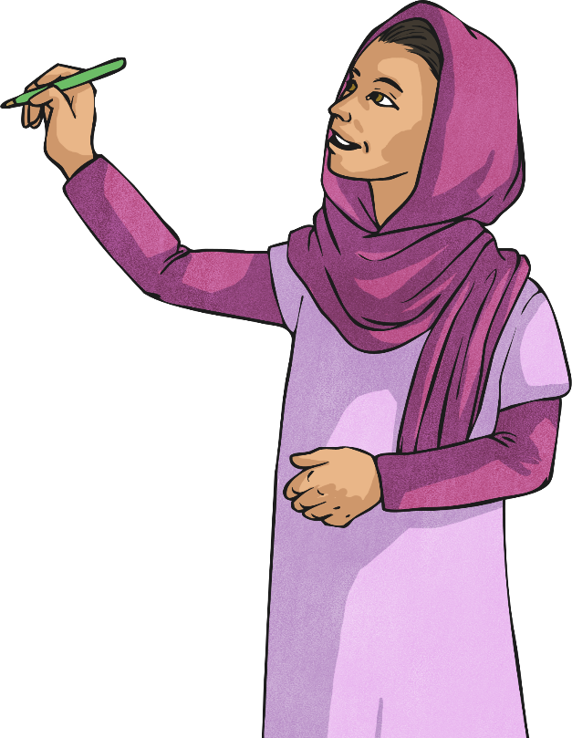
We are going to play ‘Fronted Adverbial Ten Strikes and You’re Out’.
Can you and your partner guess the letters within the
fronted adverbial before it’s too late?
_ _ _ a _ _
When an incorrect letter is chosen, press the ‘Oh no!’ button to make a pin disappear. Can you guess all of the missing letters before you strike out?
Oh no!

Slide 18

P
Preposition
This fronted adverbial uses a
_ _ _ _ _ _ _ _ _,
the children splashed happily.
I
n
t
h
e
p
o
o
l
Oh no!
a
b
c
d
e
f
g
h
i
j
k
l
m
n
o
p
q
r
s
t
u
v
w
x
y
z

Slide 19

C
Conjunction
This fronted adverbial uses a
_ _ _ _ _ _ _ _ _
_ _ _ _ _ _ _ _
_ _ _ _ _ _,
the pupils walked home.
A
f
t
e
r
t
h
e
y
f
i
n
i
s
h
e
d
s
c
h
o
o
l
Oh no!
a
b
c
d
e
f
g
h
i
j
k
l
m
n
o
p
q
r
s
t
u
v
w
x
y
z

Slide 20

I
-Ing verb
This fronted adverbial uses a
_ _ _ _ _ _ _ _ _ _
_ _ _ _ _ _ _,
the students discussed their
work in the library.
W
h
i
s
p
e
r
i
n
g
q
u
i
e
t
l
y
Oh no!
a
b
c
d
e
f
g
h
i
j
k
l
m
n
o
p
q
r
s
t
u
v
w
x
y
z

Slide 21

S
Simile
This fronted adverbial uses a
_ _ _ _ _
_ _ _ _ _ _ _ _
_ _ _ _ _ _ _,
Usain Bolt completed
the 100 metre sprint.
L
i
k
e
a
s
p
e
e
d
i
n
g
c
h
e
e
t
a
h
Oh no!
a
b
c
d
e
f
g
h
i
j
k
l
m
n
o
p
q
r
s
t
u
v
w
x
y
z

Slide 22
Quick Quiz: Question 1
Where should the commas be in these sentences to separate the fronted adverbials from the main clauses?
Clumsily the waitress dropped all of the plates on the restaurant floor.
Like an erupting volcano Mum suddenly lost her temper.
Although it was raining the children still went on the school trip.
,
,
,

Slide 23
Quick Quiz: Question 2
Can you think of appropriate fronted adverbials to describe the action in these main clauses?
the children bought Mum a bunch of flowers.
the witch stirred the potion.

Slide 24


Quick Quiz: Question 3
Can you remember all of the different ways that you could start a fronted adverbial using the ‘ISPACE’ acronym?
I
-Ing word
S
Simile
P
Preposition
A
Adverb
C
Conjunction
E
-Ed word

Slide 25
Aim
I can recognise and use fronted adverbials.
Success Criteria
I know that fronted adverbials are words, phrases or clauses that come before the main clause in a sentence.
I know that fronted adverbials modify the verb or the main clause by describing the time, frequency, manner, place or possibility.
I can use a comma after a fronted adverbial.
I can write my own fronted adverbials using the acronym ‘ISPACE’.

