Slide 1
Wednesday 10th February 2021
OLI: To write a character description

Slide 2
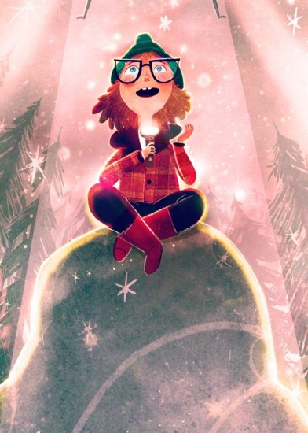
What do we know about Heather?

Slide 3
Appearance
Personality
Hobbies and Interests
Any other information

Slide 4
Think about the character of Heather. What words and phrases would you use to describe her? How is she similar / different to you?
Write a description of her. Think about what she looks like, her personality, her hobbies and interest and anything else you know about her from the story.

Slide 5
What do you need to remember in your writing?

