Slide 1
Science
Scientists and Inventors
Year One
Science | Year 4 | Scientists and Inventors | Thomas Edison | Lesson 7

Slide 2
Task - Research a famous scientist known for their work in electricity. Fill in fact file for that scientist.

Slide 4
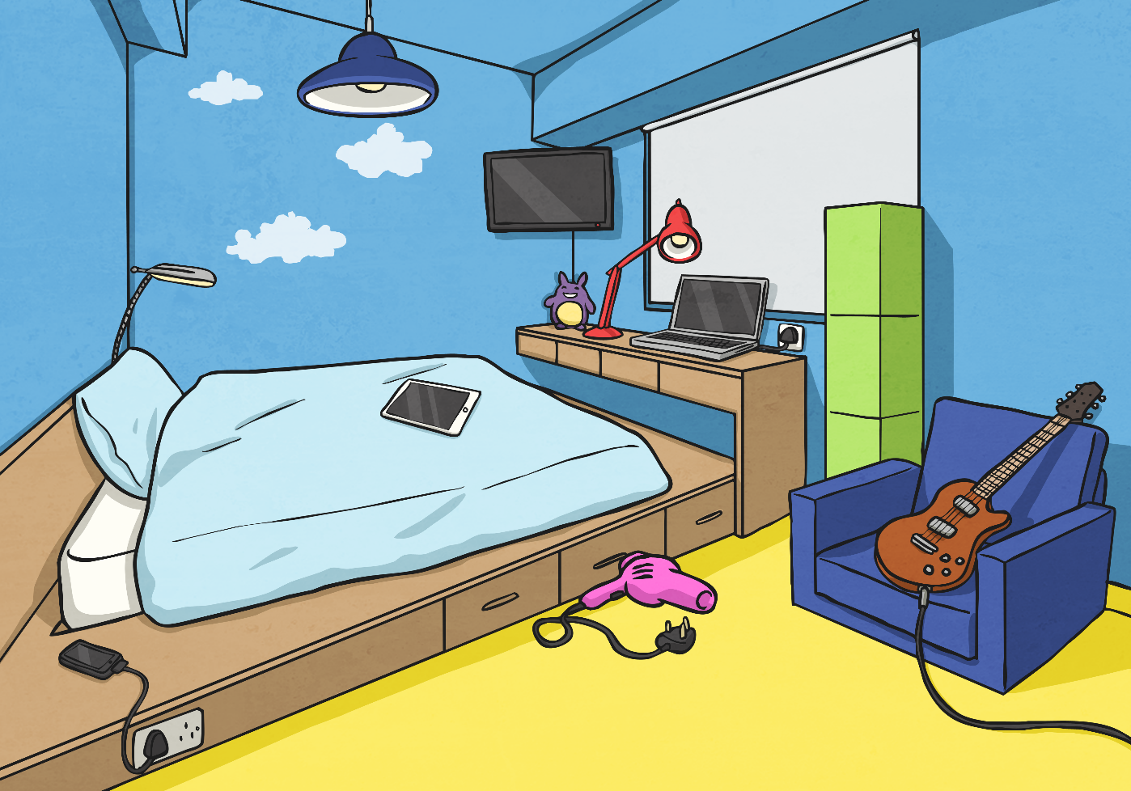
Electrical Appliances
Can you identify all the electrical appliances in this room?
Times up!

Slide 5
Electrical Appliances
How many electrical appliances did you spot?
pendant light
lamp
television
lamp
electric guitar
laptop
tablet
hair dryer
mobile phone
alarm clock

Slide 6
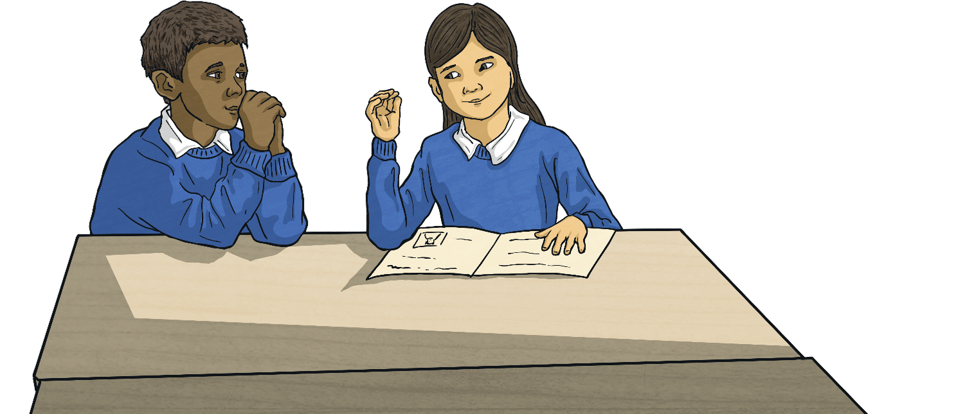
What If?
What if there was no electricity?
Discuss this question with your partner.
Though many scientists contributed to the discovery of electricity and the invention of electrical items, one scientist in particular made it possible for people like us to enjoy the benefits of electricity in our homes. That scientist was Thomas Edison. question with your partner.

Slide 7
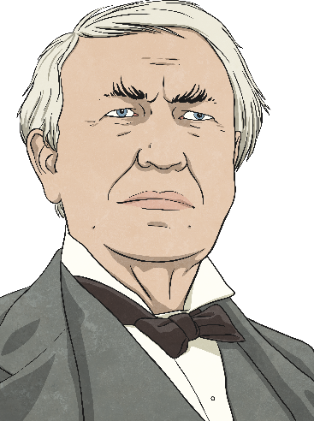
Thomas Edison
Thomas Edison was born in 1847 and died in 1931.
He was an American inventor and businessman.
Thomas didn't settle into school well because he was very easily distracted. He was too much of a daydreamer and was often in trouble with his teacher. After three months, his mother decided to home-school him instead.
At the age of twelve, Thomas began to work on a train, selling newspapers and snacks. He loved doing experiments and even conducted some while at work!

Slide 8
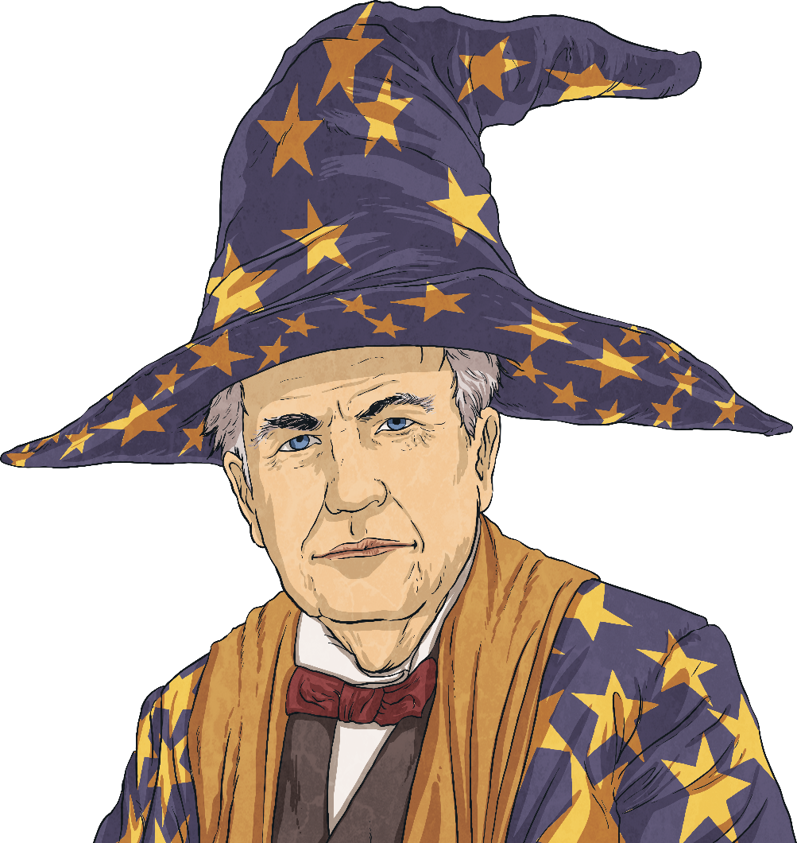
Thomas Edison
Edison made his first invention when he was 22.
Later in his life, he was known as 'The Wizard' because his inventions were so amazing.
Many of his inventions were not new, but he developed and improved other people's inventions.
For example, he invented a carbon
microphone for Alexander Graham Bell’s telephone, which meant that conversations over the telephone could be heard much better.

Slide 9
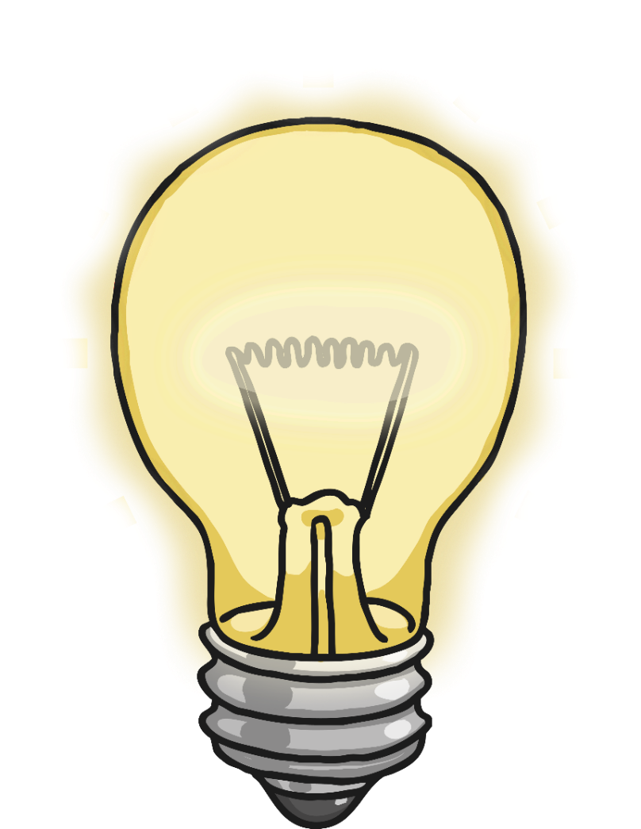
Lightbulbs and Lewis Latimer
Edison’s most famous invention was the light bulb. However, he did not actually invent it!
The lightbulb had already been invented, but Edison made improvements on its design and came up with a design for a practical incandescent lightbulb. Edison’s design had a paper filament initially which burnt out too quickly.
Edison and his team worked to find a better filament so that the lightbulb would stay lit for longer and be useful to people. They came up with various options which did last longer than the paper filament.

Slide 10
Lightbulbs and Lewis Latimer
However, the ground breaking discovery of using a carbon filament in lightbulbs was made by Lewis Howard Latimer.
Latimer’s design meant that a lightbulb would stay alight for a much longer time. Latimer’s lightbulb design was cheaper to produce than previous versions. As a result, Latimer not only made it possible for people to use lightbulbs that stayed alight for longer, but the price meant that more people could afford to light their homes in this way.

Slide 11
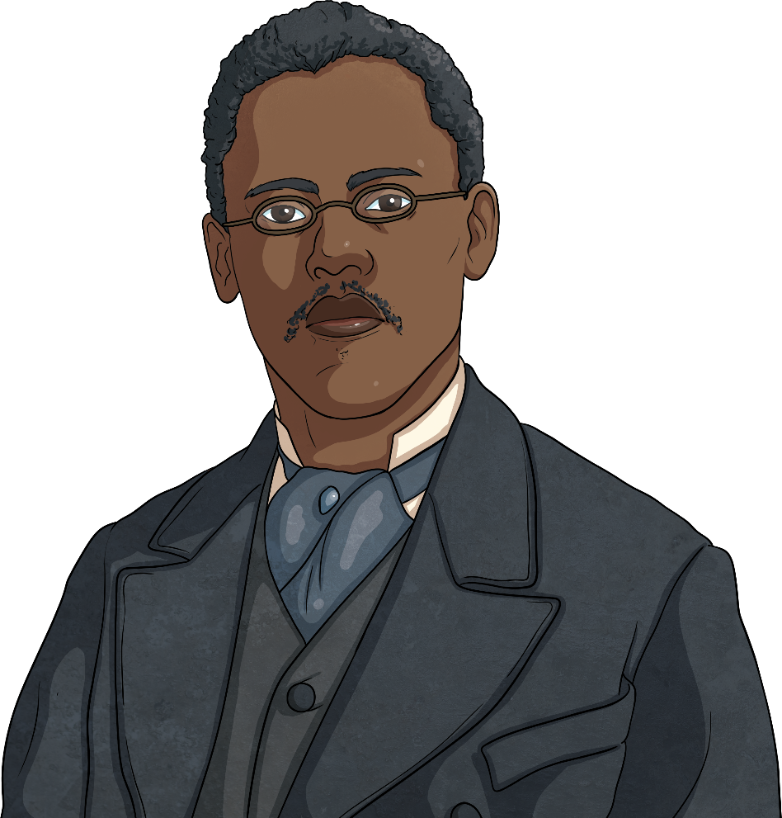
Lightbulbs and Lewis Latimer
Lewis Latimer's achievements were incredible, especially as he was mostly self-taught and lived in a time when there was even more racial discrimination than there is today.
Before Latimer was born, his parents had been enslaved people who managed to escape from their owners. Latimer received only a few years of schooling as a child and, after leaving the Navy, he secured a job at a company which provided patents for inventions.
(Patents are licences which give the owner the right to be the only one allowed to make and sell an invention.)

Slide 12
Lightbulbs and Lewis Latimer
Lewis Latimer taught himself mechanical drawing and, as well as helping those he worked for to secure patents, he also went on to invent things and patent them for himself.
Latimer’s biggest discovery was the carbon filament in the incandescent lightbulb but he also invented an early air conditioning unit and a toilet that could be used on a train.

Slide 13
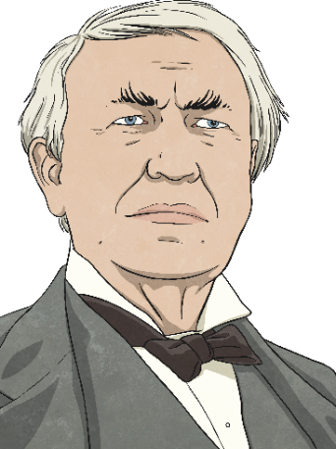
Edison and Electricity
Edison made what many consider to be his greatest achievement in the early 1880s. He introduced the world's first truly useful electric distribution system, which could distribute electric light, heat and power.
This invention made it possible for electricity to be used in people's homes for the first time and changed the world forever.

Slide 14
Mixed-Up Inventions
The names of some of Thomas Edison's inventions or improvements have been mixed up!
Can you rearrange the letters in each word to make the correct names?
norcab hopcormine
carbonmicrophone
ciletricety istonidritub mytess
electricity distribution system
light bulb
thilg lubb

Slide 15
Mixed-Up Inventions
Did you unscramble each invention?
Can you describe what each invention did?
carbon microphone
electricity distribution system
lightbulb

