Slide 1
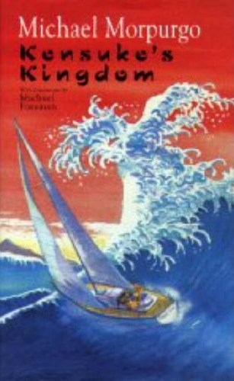
Read Chapter 4 of Kensuke‘s Kingdom

Slide 2
Today‘s objectives
OLI: To use evidence from the text effectively.
Success Criteria: By finding and understanding specific detail in chapter 4, I can draw and label and detailed picture of the island.

Slide 3
Starter: Look at the front covers of the book, what do they tell us?

Slide 4
OLI: To use evidence from the text effectively.
Carefully read the description of the island Michael is living on (page 53).
Jot down some descriptive bullet points about what he sees
IDEAS:

Slide 5
Your tasks-Describing the island
1) Write a short description of the island using Michael’s observations on page 53.
2) Then use this description to draw the island. Take your time with your drawing, think carefully about detail.

