Slide 1
THE FIVE PILLARS
Islam

Slide 2
The Five Pillars
These are five duties that every Muslim is obliged to perform. The five pillars of Islam help Muslims put their faith into action.
Read the following slides to find out more about each one.

Slide 3
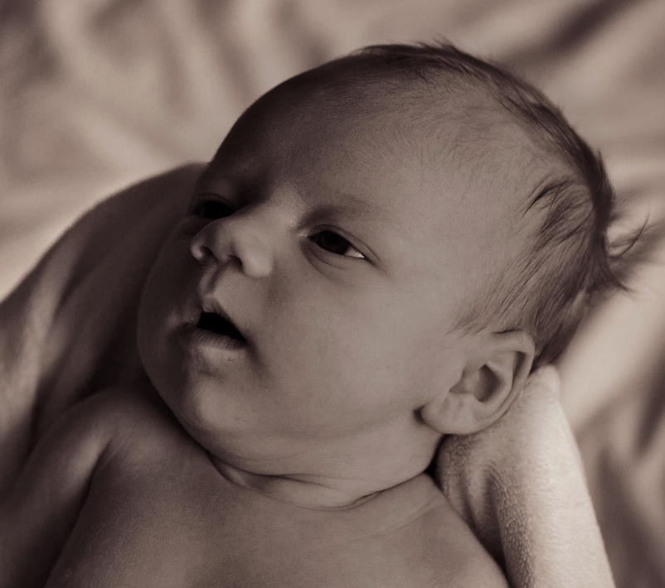
SHAHAD
This is at the heart of what Muslims believe and is the most important pillar.
It is summed up in one sentence; ‘There is no God but Allah and Muhammad is his messenger.’
These words are whispered into the ear of a Muslim baby when it is born. It is often written in works of art and jewellery.
Muslims pray this several times a day.

Slide 4
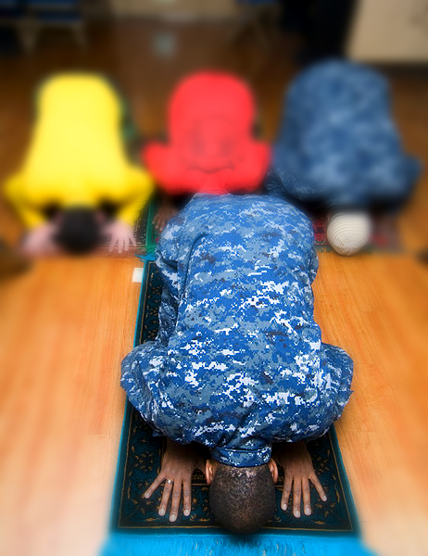
SALAH
This is the requirement of Muslims to pray five times a day.

Slide 5
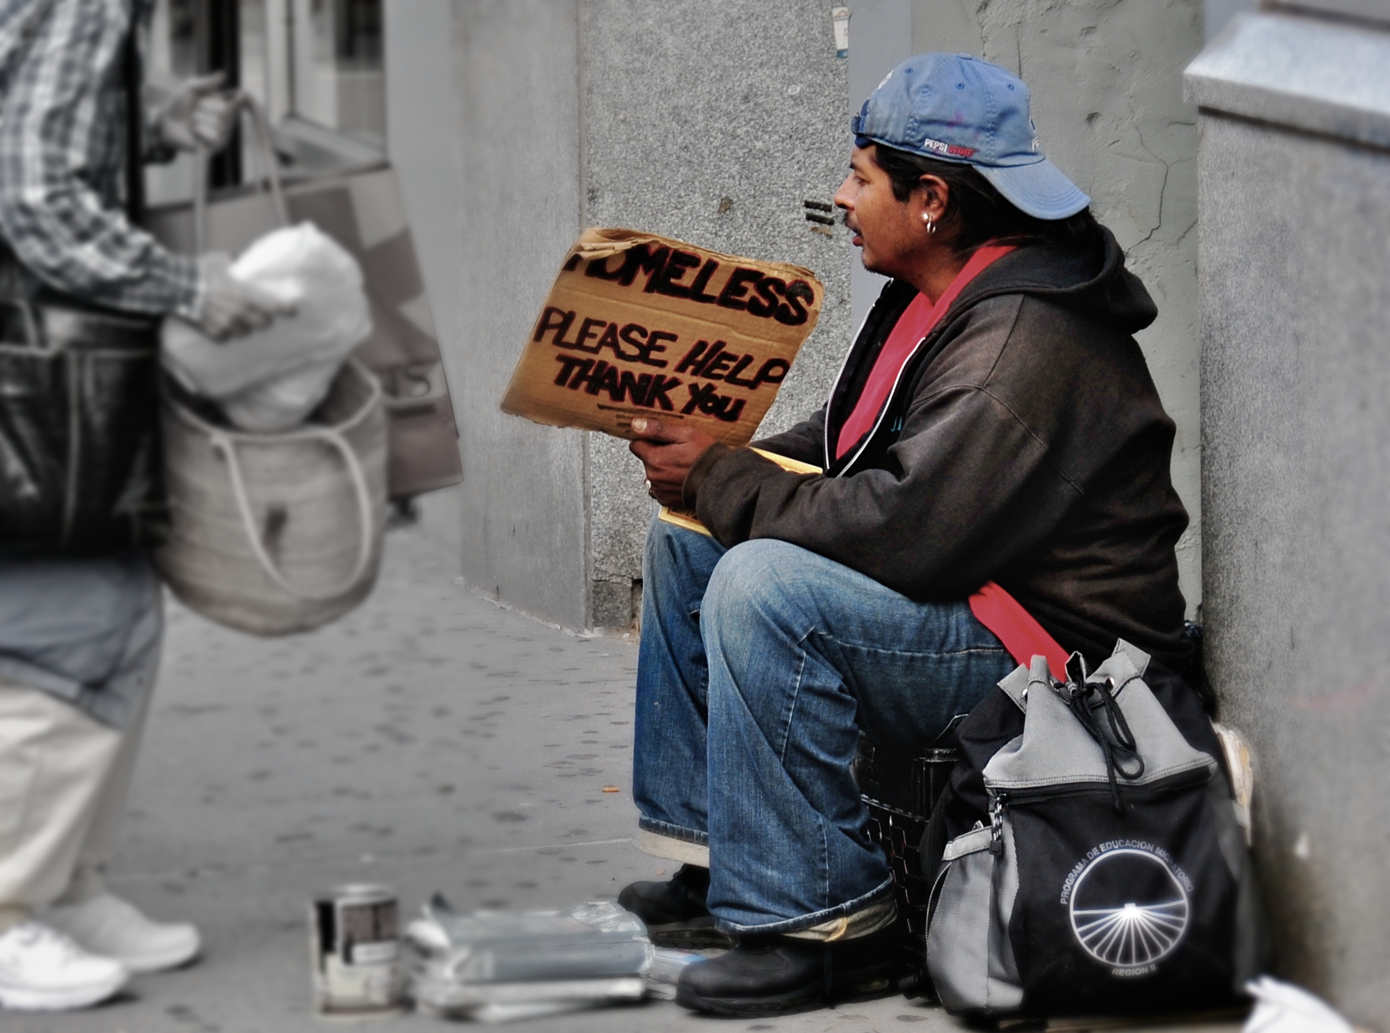
ZAKA
Muslims should give to the poor

Slide 6
SAWM
Fasting. During the months of Ramadan, Muslims go without eating and drinking during daylight hours

Slide 7
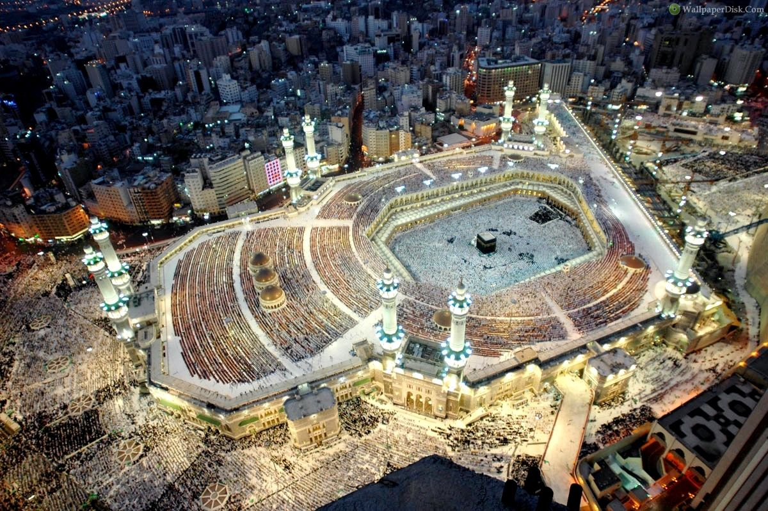
HAJJ
Once in a lifetime Muslims are required to make a pilgrimage to the holy places in Makkah.

Slide 8
Key questions
How do you think these Pillars give guidance to Muslims?
Which Pillars are about worship and which are about action for others?
Why do you think that Shahadah is the most important Pillar?

Slide 9
Activity
Create a poster explaining the Five Pillars of Islam to children who know nothing about them, using the internet and the information on this PowerPoint to help you.
Here are some useful sites:
http://www.primaryhomeworkhelp.co.uk/religion/Islam.htm
https://kids.kiddle.co/Five_Pillars_of_Islam
https://www.bbc.co.uk/teach/class-clips-video/religious-education-ks2-my-life-my-religion-what-is-islam/zbmrwty#:~:text=The%20Five%20Pillars%20are%20declaring,(also%20known%20as%20Makkah).

