Slide 1
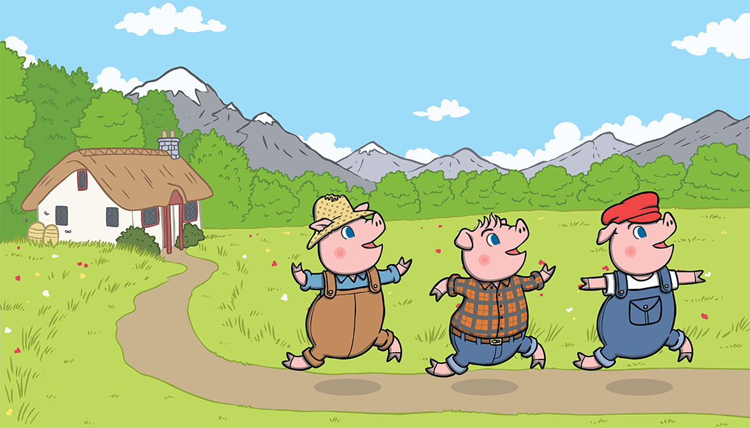
English The Three Little Pigs
Week 7
Week commencing Monday 22nd February 2021

Slide 2
Monday Lets read the story!
Put your own actions to the story to help you learn it off by heart!

Slide 4
Once upon a time, there lived three little pigs.

Slide 5
One day, they decided to leave home and build houses of their own.

Slide 6
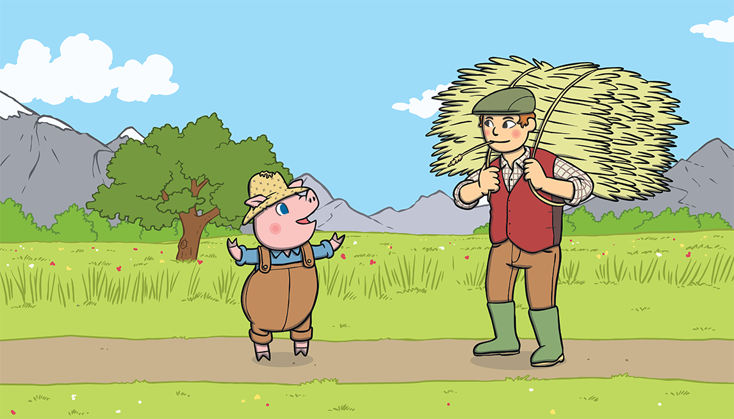
The first little pig thought that straw would make a good house.

Slide 7
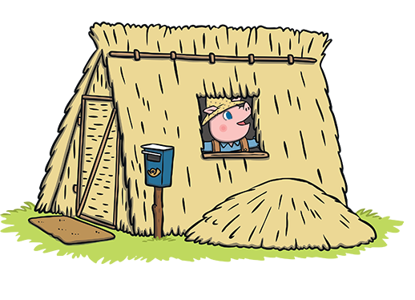
He built the house very quickly and he was very pleased with it.

Slide 8
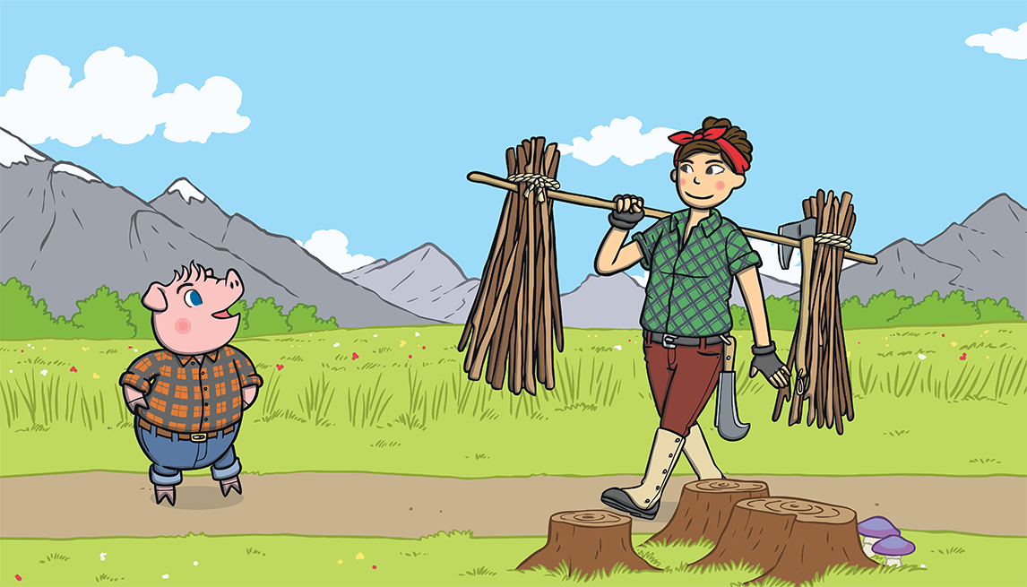
The second little pig thought that sticks would make a fine house.

Slide 9
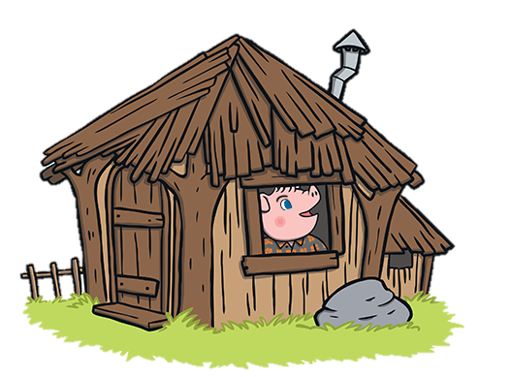
He built the house very quickly and he was very pleased with it.

Slide 10
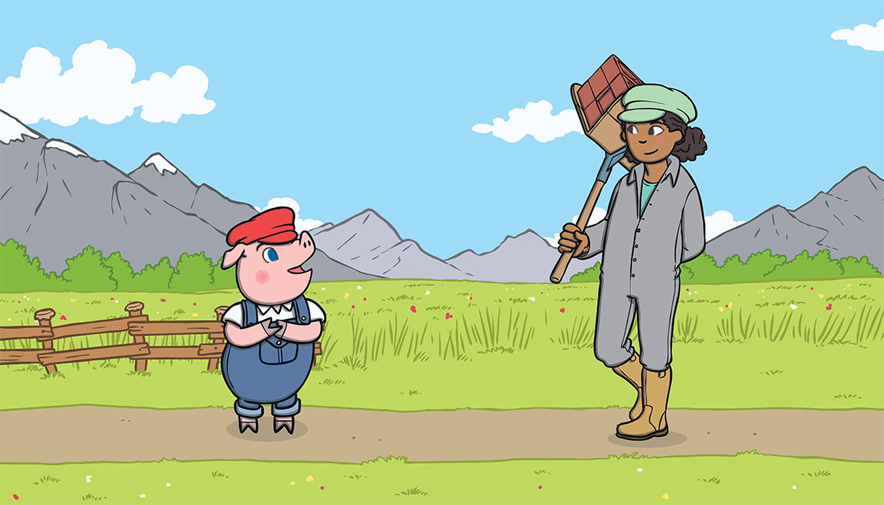
The third little pig thought that bricks would make a strong house.

Slide 11
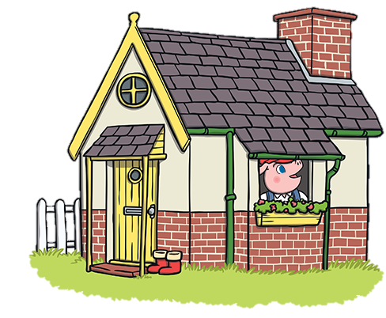
It took him a long time to build the house but he was very pleased with it.

Slide 12
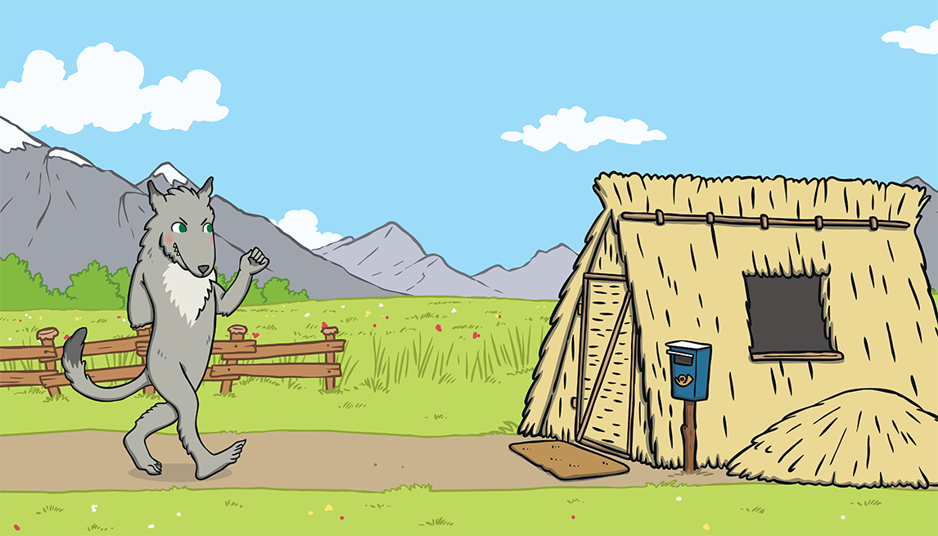
One day, a big bad wolf came along.

Slide 13
He saw the first little pig in his house of straw.

Slide 14
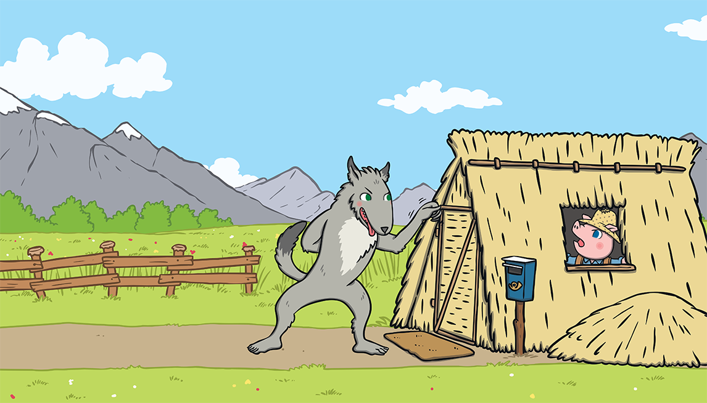
“Little pig, little pig, let me come in,” he snarled. “Not by the hair on my chinny, chin, chin!” cried the first little pig.

Slide 15
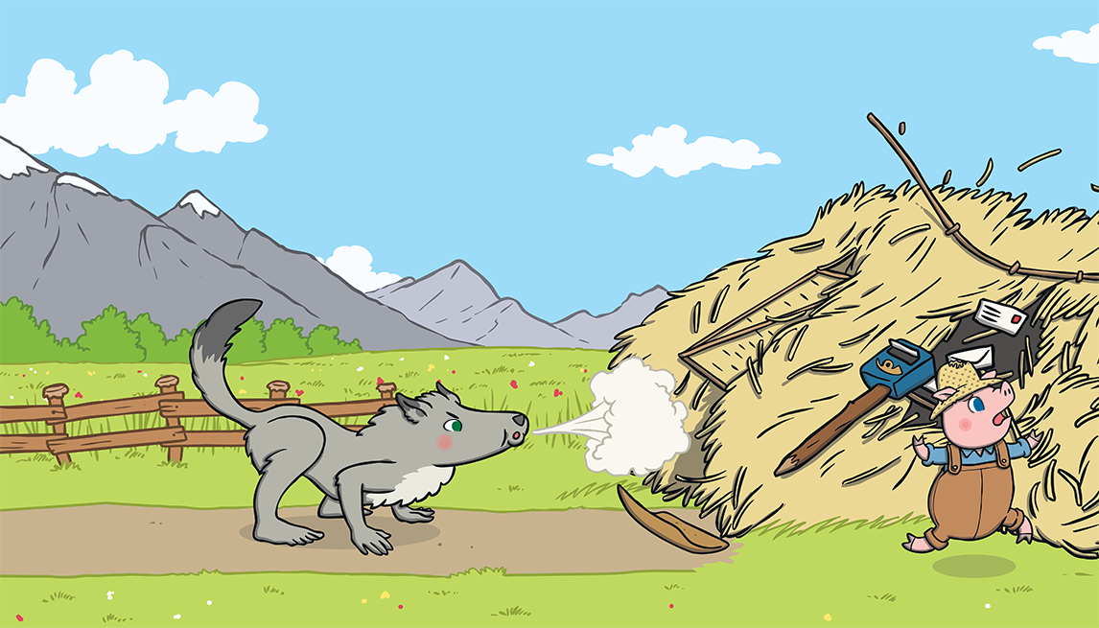
“Then I’ll huff and I’ll puff and I’ll blow your house down!” growled the big bad wolf.

Slide 16
So he huffed and he puffed and he blew the house down!

Slide 17
The first little pig escaped and ran to join his brother in the house made of sticks.

Slide 18
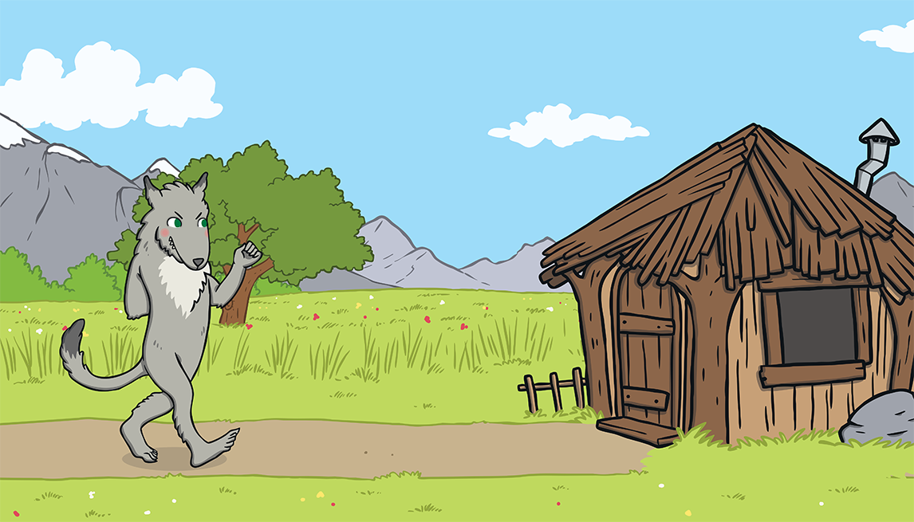
The big bad wolf followed the little pig to the house made of sticks.

Slide 19
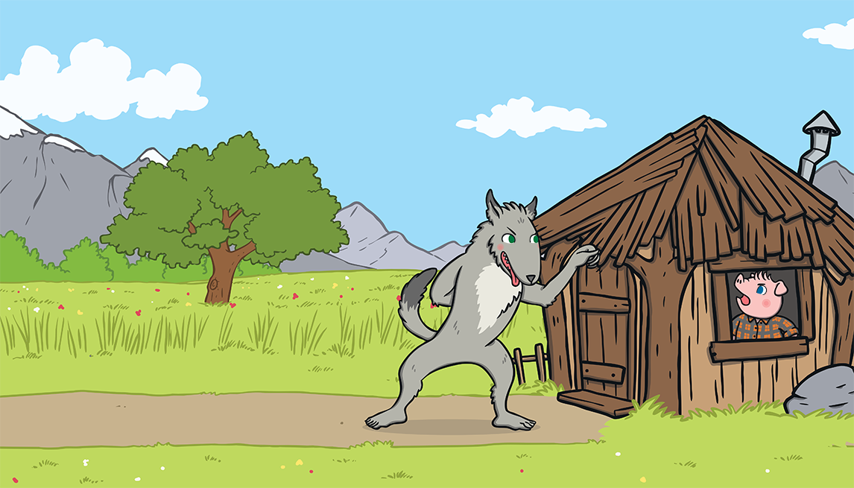
“Little pig, little pig, let me come in,” he snarled. “Not by the hair on my chinny, chin, chin!” cried the second little pig.

Slide 20
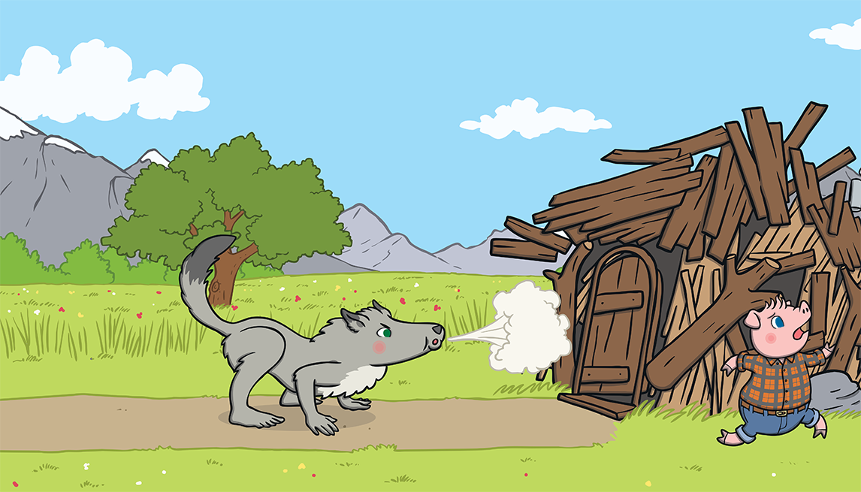
“Then I’ll huff and I’ll puff and I’ll blow your house down!” growled the big bad wolf.

Slide 21
So he huffed and he puffed and he blew the house down!

Slide 22
The two little pigs escaped and ran to join their brother in the house made of bricks.

Slide 23
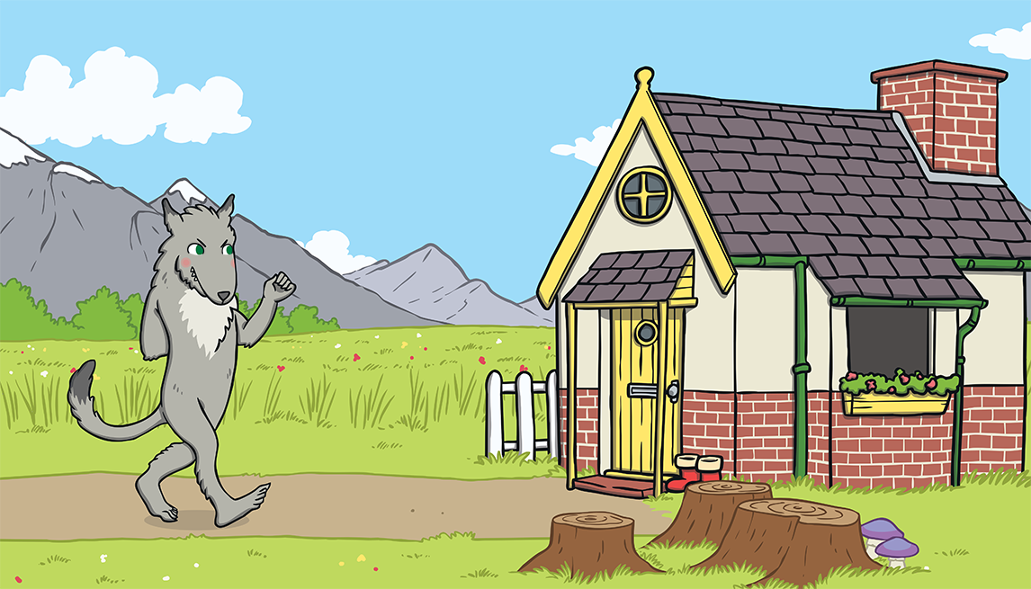
The big bad wolf followed the pigs to the house made of bricks.

Slide 24
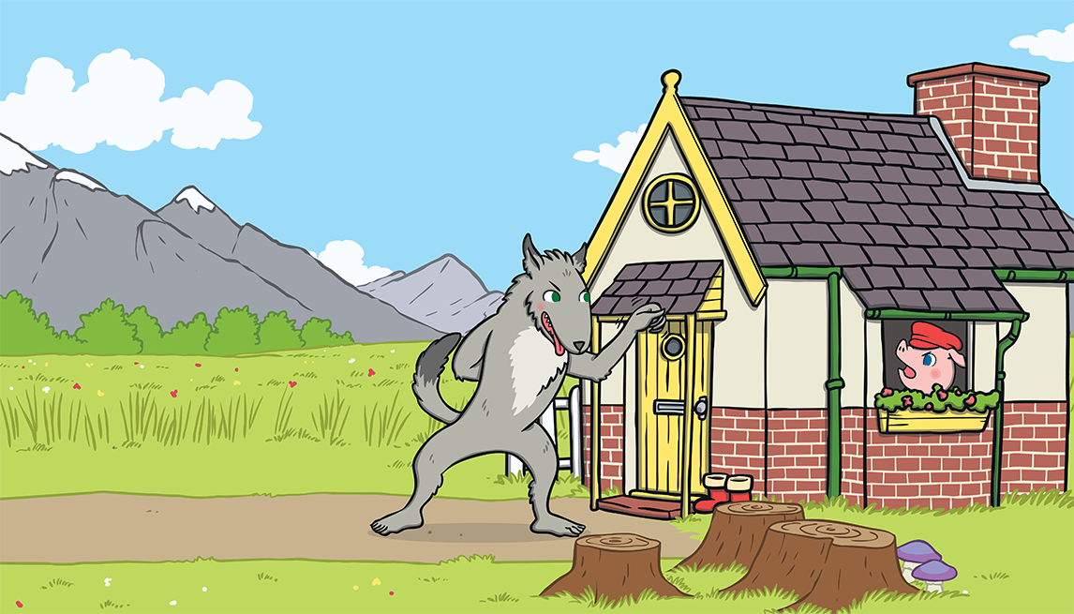
“Little pig, little pig, let me come in,” he snarled.
“Not by the hair on my chinny, chin, chin!” cried the third little pig.

Slide 25
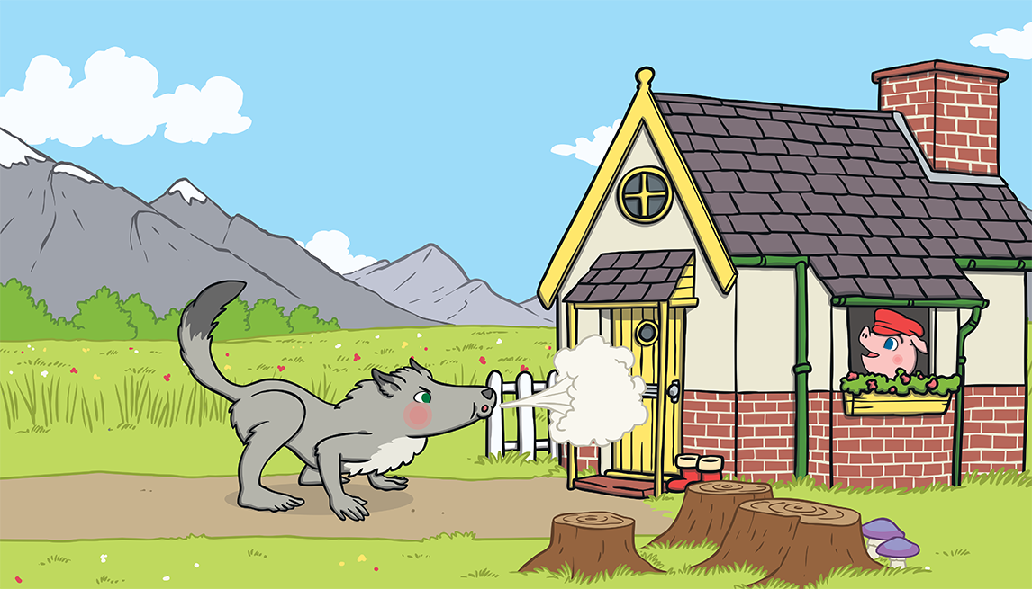
“Then I’ll huff and I’ll puff and I’ll blow your house down!” growled the big bad wolf.

Slide 26
He huffed and he puffed, but the house was too strong. He could not blow it down!

Slide 27
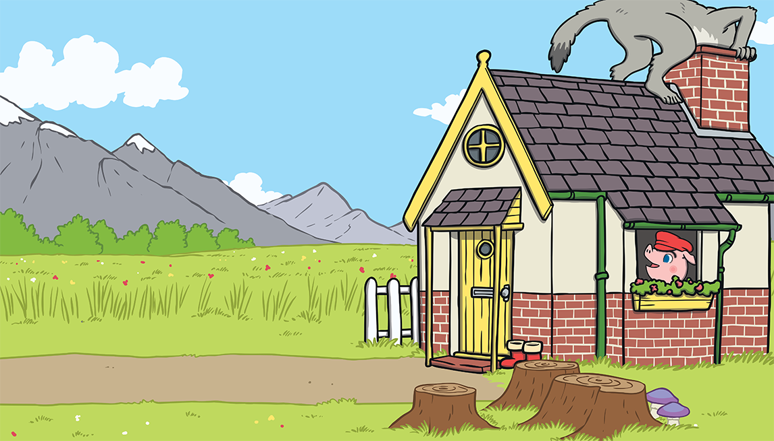
This made the big bad wolf very angry.
He climbed onto the roof of the house so he could crawl down the chimney.

Slide 28
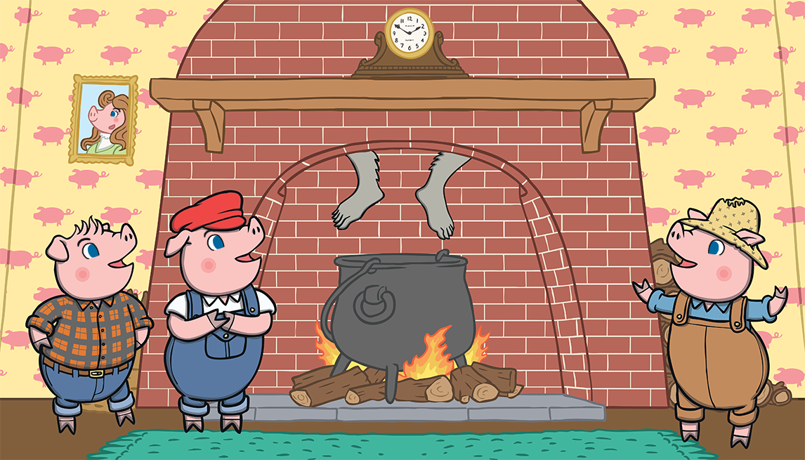
The big bad wolf was in for a big surprise!

Slide 29
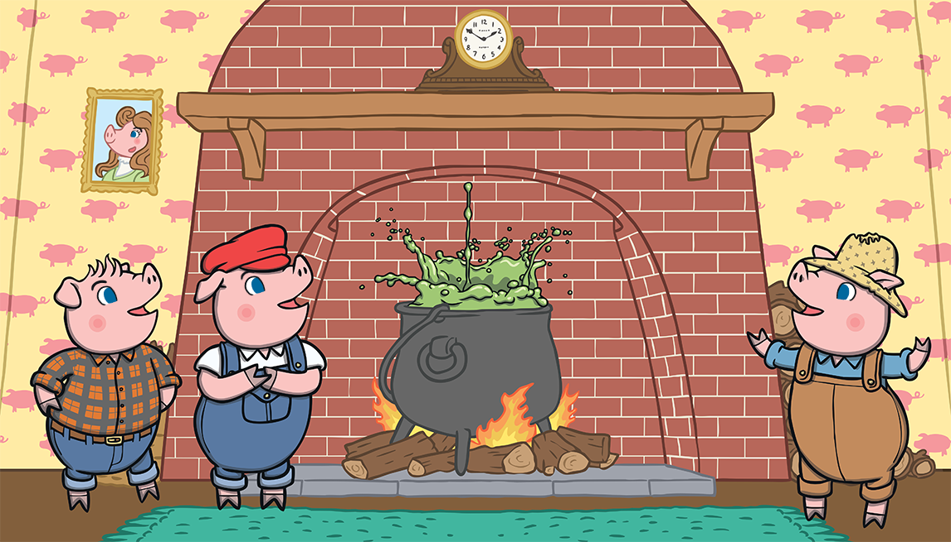
The third little pig had been cooking a big pot of stew and SPLASH! The wolf fell right into the pot!

Slide 30
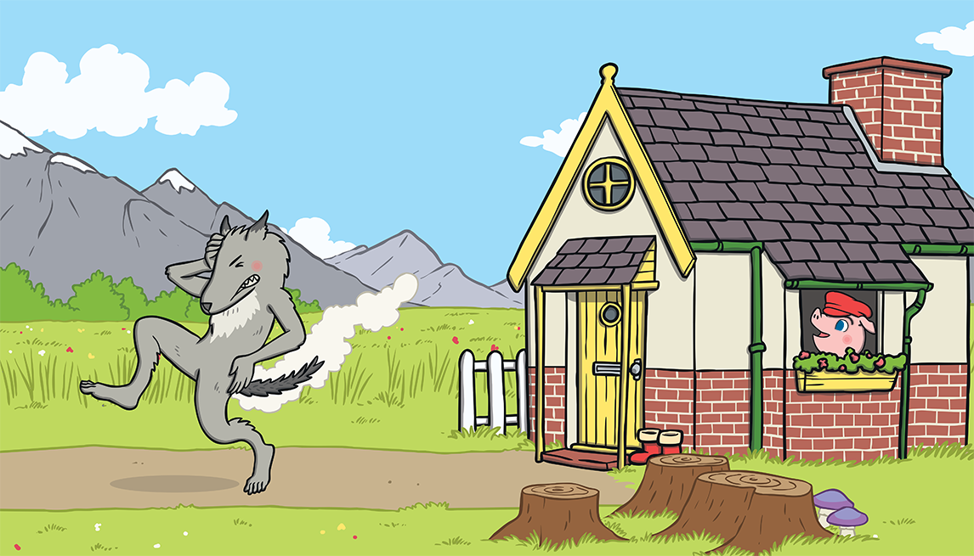
The wolf was very shocked. He jumped out of the pot and ran straight out of the house. He never came back again.

Slide 31
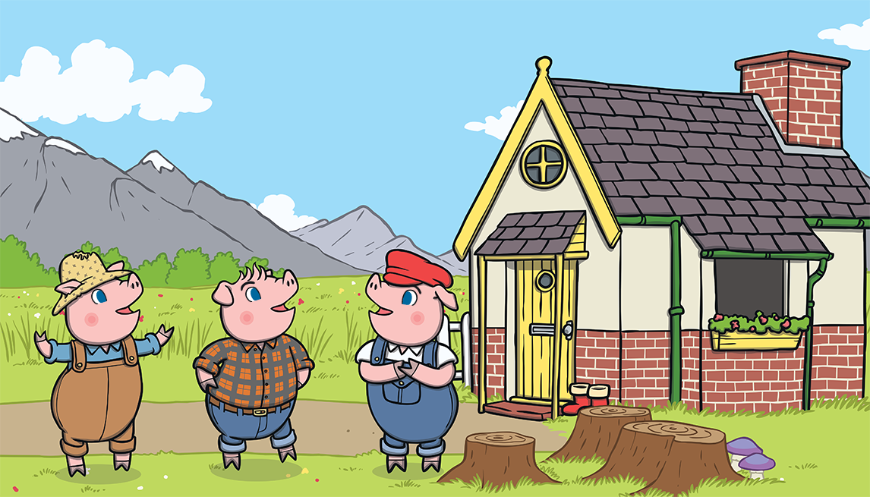
The little pigs lived happily ever after in the house made of bricks.

Slide 32
The end!

Slide 33
Monday OLI: To read the story and put actions with it. OLI: to write a wanted poster. Have a go a making a wanted poster for the big bad wolf. Remember to use adjectives to describe the wolf!

Slide 34
Monday OLI: to write a wanted poster. Have a go a making a wanted poster for the big bad wolf. Remember to use adjectives to describe the wolf!

Slide 35
Tuesday OLI: to write a letter. Imagine you are the wolf. Write a sorry letter to the 3 little pigs. Remember to start your letter with ‘To’ or ‘Dear’ and end your letter with ‘from Wolf’. Because you are pretending to be the wolf you will use ‘I’ through the letter when referencing the wolf (e.g. I am very sorry).

Slide 36
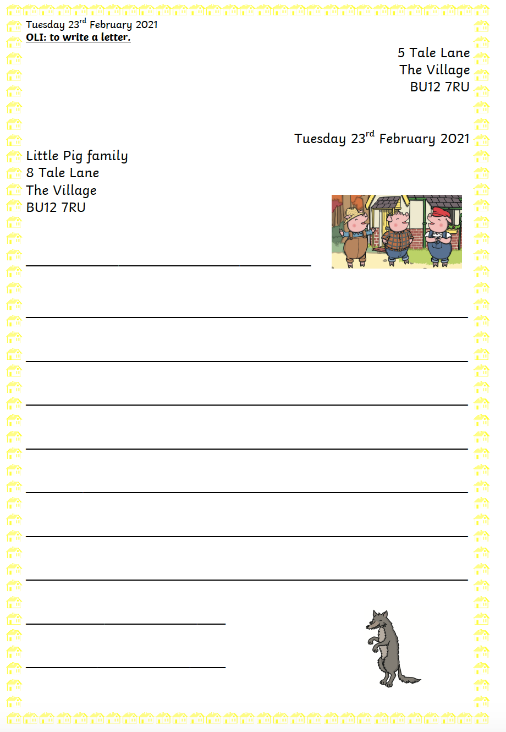
Tuesday OLI: to write a letter.

Slide 37
Wednesday OLI: to sequence the story using a story map template. To help children get ready to make their own story map tomorrow, today children will sequence the story using the pictures I have provided. This is a basic story map without key words or time words added. Once children have stuck the pictures in the right order, encourage them to orally retell the story, pointing to each part as they retell it.

Slide 38
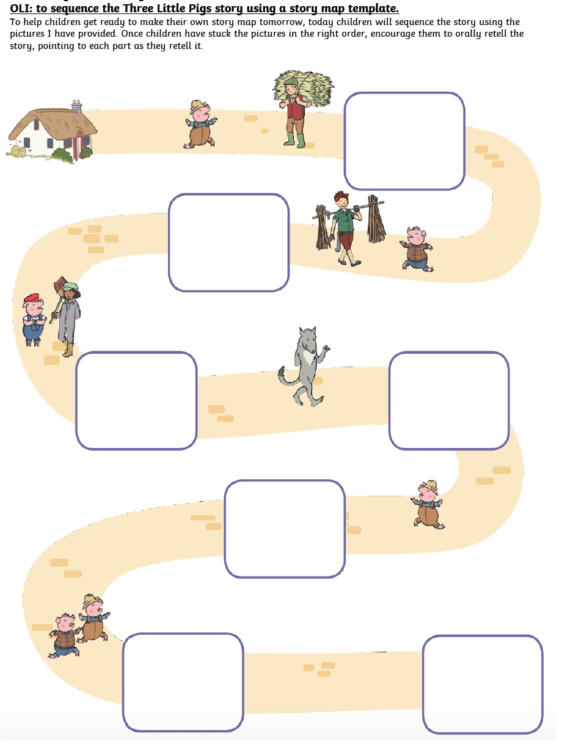
Wednesday OLI: to sequence the story using a story map template.

Slide 39
Thursday OLI: to make a story map. Please see the next few slides for example story maps. Feel free to use big paper. Steps to Success: - I can draw simple pictures to represent parts of the story. - I can put the pictures in the correct order. - I can add key words / sayings. - I can add time words (first, next, then, after that, finally etc.) You will use this story map to help you retell the story next week, so keep hold of it! I have also included puppets pictures you can pop onto lolly sticks and play out the story.

Slide 40
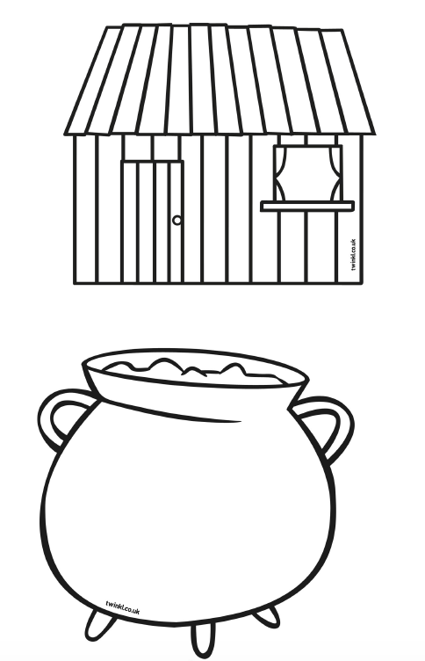
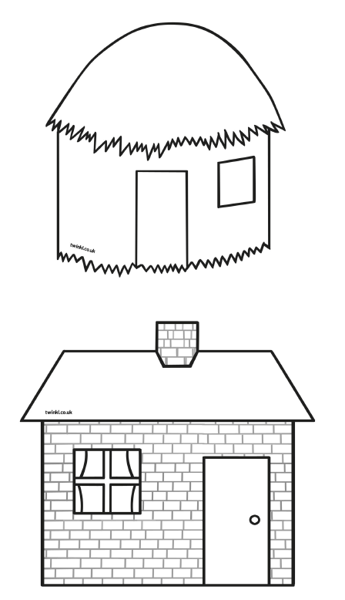
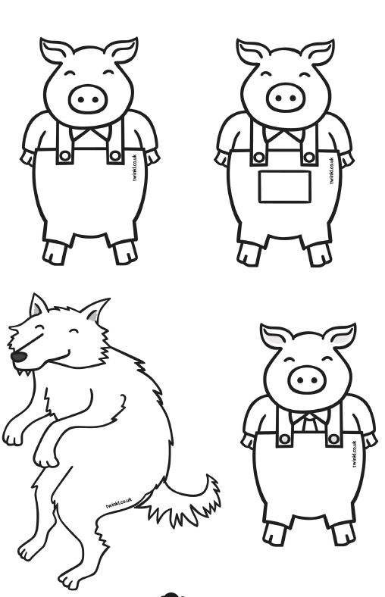
Thursday I have also included puppets pictures you can pop onto lolly sticks and play out the story. Please find them on Google Classroom and the website. This is just a little extra task should you want it!

Slide 41
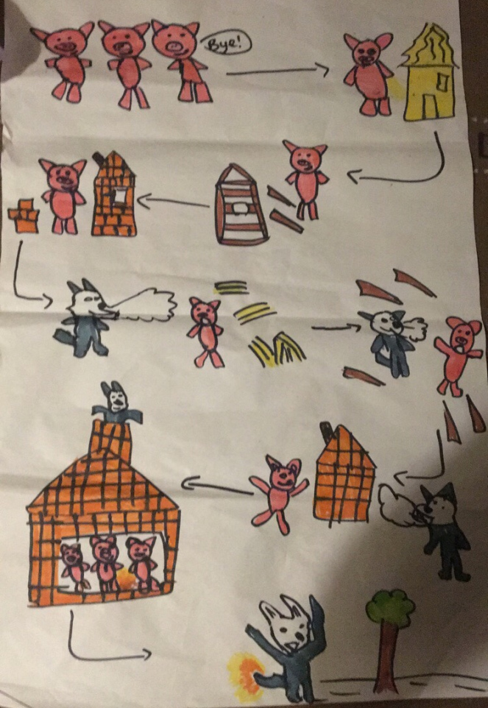
Example Story Map

Slide 42
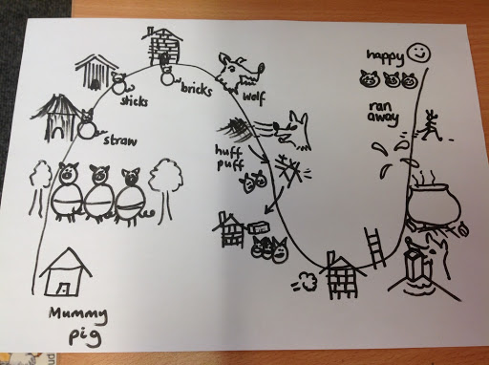
Example Story Map

Slide 43
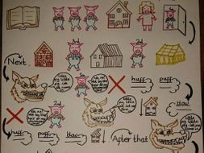
Example Story Map

Slide 44
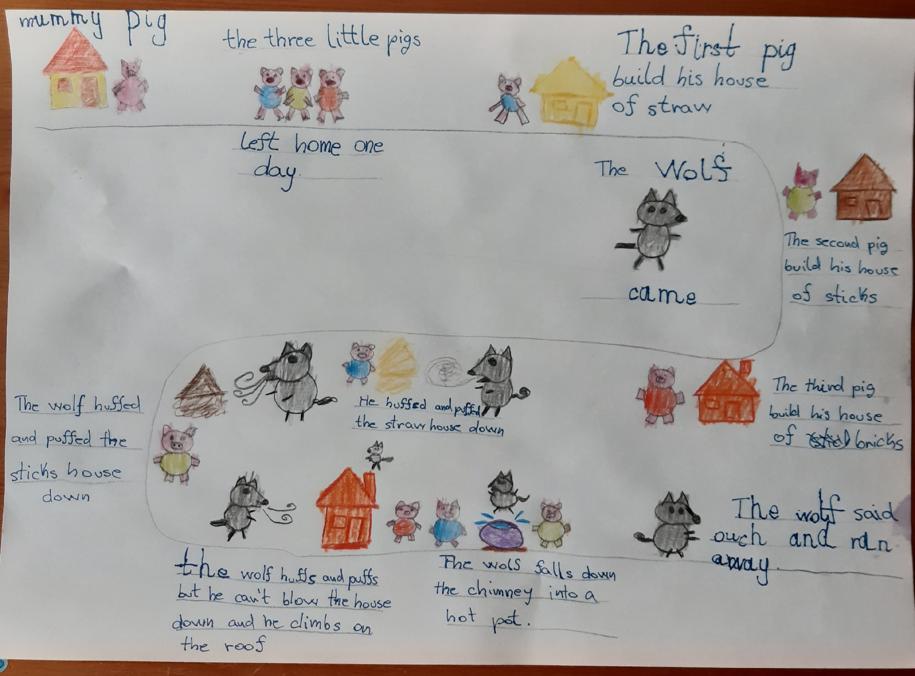
Example Story Map

Slide 45
Friday Spelling test day! We will carry on with ‘The Three Little Pigs’ next week. Well done!

