Slide 1
Science
Rocks
Year One
Science | Year 3 | Rocks | Investigating Soil Permeability | Lesson 6

Slide 3
Aim
I can observe carefully and systematically.
I can present my findings using scientific vocabulary.
Success Criteria
I can identify how to make careful observations.
I can observe how much water has filtered through different types of soil.
I can use the same equipment and length of time for each observation.
I can record my observations accurately in a table.
I can contribute to creating a group presentation.
I can use simple scientific language accurately in my presentation.

Slide 4
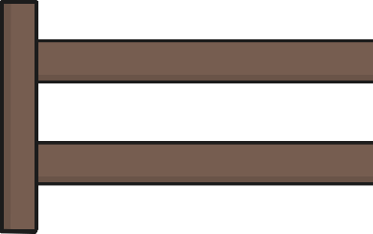
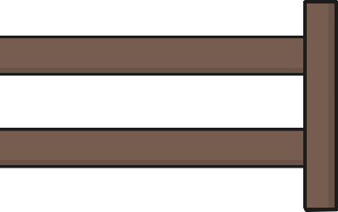
Rocks Quiz
What part do rocks play in forming soil?
How many types of soil do you think there are and why?
Correct Answer: There are hundreds of different types of soil, however there are 6 main types of soil that you will focus on in this lesson.
Why do you think there are hundreds of different types of soil?
Why might soil contain some types of rocks more than others?

Slide 5
Matching Rocks and Soils
In pairs, match soils and the rock(s) they are formed from.

Slide 6
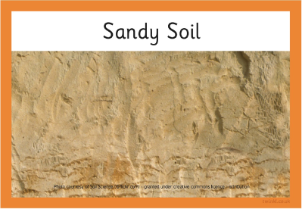
Matching Rocks and Soils

Slide 7
Matching Rocks and Soils

Slide 8
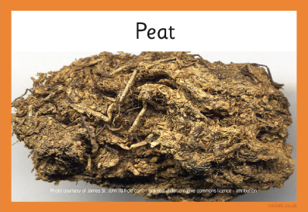
Matching Rocks and Soils

Slide 9
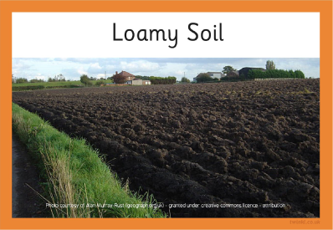
Matching Rocks and Soils

Slide 10
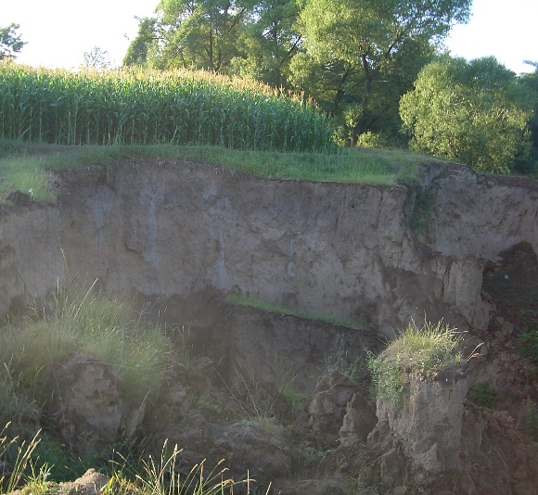
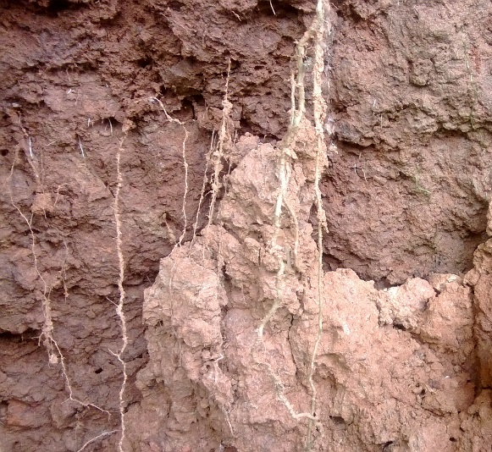
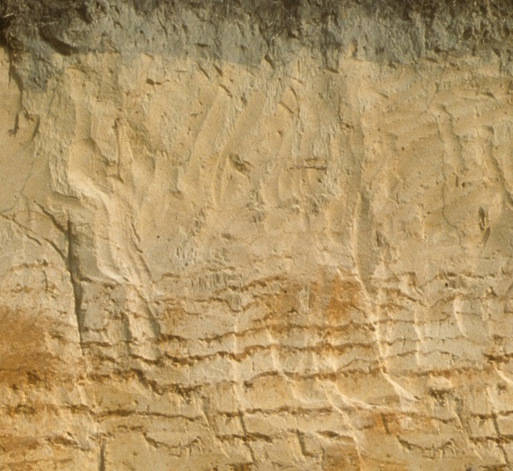
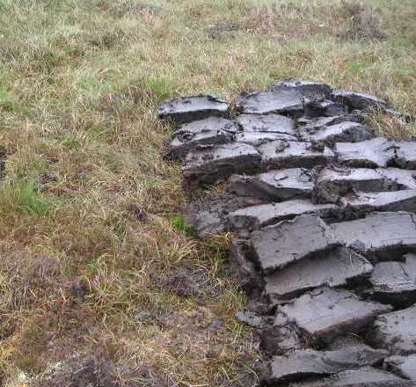
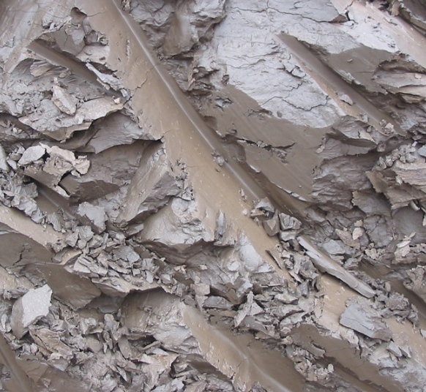
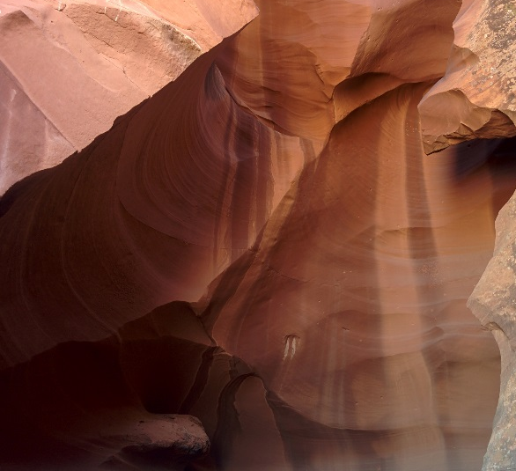
Comparing Soils
Click here to watch the Comparing Soils Video.
Photo courtesy of UserVmenkov, Krish Dulal, Wojsyl and Siim Sepp (@commonswikimedia.org) Soil Science and Cory Doctorow(@flickr.com) - granted under creative commons licence – attribution

Slide 11
Soil Permeability
Just like rocks, soils differ in terms of how permeable they are.
Why does it matter?
We grow much of our food in soil, including vegetables, fruit, wheat and rice. The permeability of soils affects which plants will grow and how well they grow in the particular soil.
When describing the permeability of a material… Permeable means that liquids flow through it. Semi-permeable means that some liquid manages to flow through it. Impermeable means that liquid cannot flow through it.

Slide 12
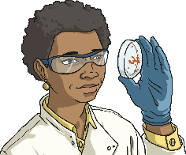
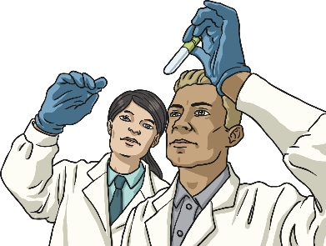
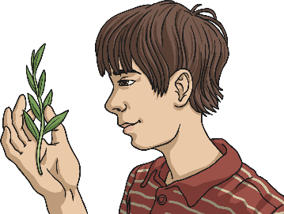
Making Careful Observations
In this investigation it is important that you make careful observations.
Seeing, looking and glancing are not the same as observing!
Scientists have to train themselves to observe carefully to know
and understand what they are observing.
Observation Checklist:
Focus your attention to what you are trying to find out
in your investigation (in this case the permeability of soil).
Make sure you have a clear view of what you are observing.
Avoid taking your attention away as you may miss something important happening. This would mean that what you think has happened and what actually happened is different.

Slide 13
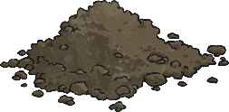
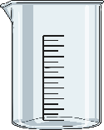
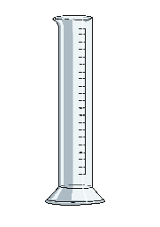
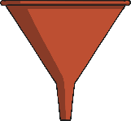
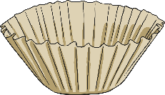
Testing Permeability
Question: What is the permeability of different types of soils?
Prediction: I predict that _________ soil will be the most permeable and ______ soil will be the least permeable. I think this because
Equipment:
Samples of soil Beakers
Measuring cylinder Water
Funnels Coffee filter papers
(use a different one for each type of soil)

Slide 14
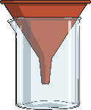
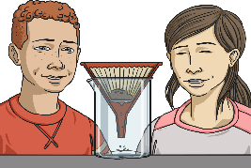
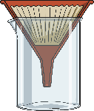
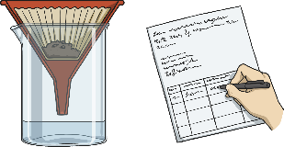
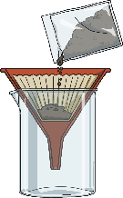
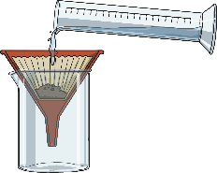
Testing Permeability
Method:
Place the funnel in the beaker.
Insert a coffee filter into the funnel.
Add the soil sample to the lined funnel.
4. Pour 300 ml of water into the soil.
5. Observe the water filtering through.
6. After 5 minutes check how much water has collected in the beaker and record this on your Soil Permeability Activity Sheet.
Repeat the instructions with each soil sample you are testing.

Slide 15
Oral Presentation
I can present my findings using scientific vocabulary.
I can record my observations accurately in a table.
I can contribute to creating a group presentation.
I can use simple specific language accurately in my presentation.

Slide 16
Presentation
Were the findings similar or different?
Why do you think that might be?
How can we know which results are accurate?
What conclusions can you draw about the permeability of different types of soil?

Slide 17
Aim
I can observe carefully and systematically.
I can present my findings using scientific vocabulary.
Success Criteria
I can identify how to make careful observations.
I can observe how much water has filtered through different types of soil.
I can use the same equipment and length of time for each observation.
I can record my observations accurately in a table.
I can contribute to creating a group presentation.
I can use simple scientific language accurately in my presentation.

