Slide 1
Week 6 English Week commencing Monday 8th February 2021
Make sure you read the watch the story on YouTube first. I have put two links up on Google Classroom and the Website. Watch it a few times first!

Slide 2
Monday OLI: to ask questions.

Slide 3
Monday OLI: to ask questions.
Ada Twist was very curious and LOVED to ask questions about the world.
Can you remember some of the questions she asked?
Go to the next slide to find out.

Slide 4
Monday OLI: to ask questions.
Some of her questions:
Why does it rick and why does it tock?
Why don’t we call it a grand daughter clock?
Why are there pointy things stuck to a rose?
Why are there hairs inside of our nose?
How does a nose know there is something to smell?

Slide 5
Monday OLI: to ask questions.
A question needs 2 important things:
Use a questioning word.
what why where how why who
2. A question mark at the end.
Can you practice forming a question mark?
?

Slide 6
Monday OLI: to ask questions.
Your task
Now it is your turn to write some questions that you have abut our world.
Don’t forget to use a questioning word and a question mark!

Slide 7
Tuesday OLI: to research new vocabulary and put them into sentences.
Your task
In Ada Twist, Scientist there are some complex words. Andrea Beaty uses big, fancy words in her story.
From my selection (or your own words from this book), find out what they mean then put the word into your own sentence. Pick at least 5 words!
Go to the next slide for some of the example words.

Slide 8
Tuesday OLI: to research new vocabulary and put them into sentences.

Slide 9
Tuesday OLI: to research new vocabulary and put them into sentences.

Slide 10
Tuesday OLI: to research new vocabulary and put them into sentences.

Slide 11
Tuesday OLI: to research new vocabulary and put them into sentences.
Your turn!

Slide 12
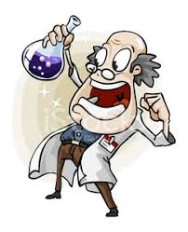
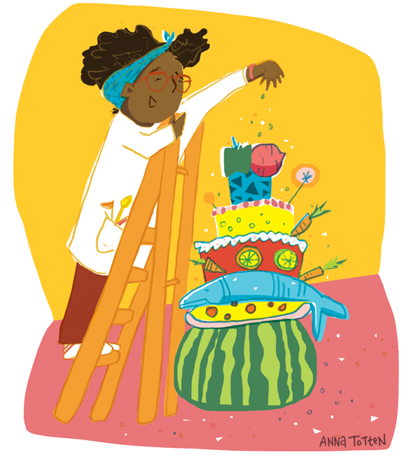
Wednesday OLI: to create and explain your invention.
Ada loves to experiment and make things. If you were a scientist or engineer what would you invent?
It could be anything from a flying car, a coat that makes you invisible, shoes that make your faster than a cheater, or a medicine to help people.
Draw, name and explain what your invention is / is for.

Slide 13
Thursday
OLI: Complete the Rising stars Reading Spring 1 Test.
The questions and answers of available on the website and Google Classroom.

Slide 14
Friday
OLI: Spelling test.
Complete your spelling test. Try your best, that is all that matters!
OLI: Complete the Rising stars Grammar, Punctuation and Vocabulary Spring 1 Test.
The questions and answers of available on the website and Google Classroom.

