Slide 2

OLI: Identify and use strategies to make writing more interesting.
Success Criteria: I can recognise techniques that make writing descriptive and I can write a descriptive account of a scary situation.

Slide 3


Starter:
What would you take with you on a journey like this?
What if you could only take 10 items?
List your items and reasons for these choices.

Slide 4
Scary situations in Chapter 4
A shadow under the trees moved
and came lumbering out into the
sunlight towards us. A monkey, a
giant monkey. Not a gibbon at all.
It moved slowly on all fours, and
was brown, ginger-brown. An
orang-utan, I was sure of it. He
sat down just a few feet from me
and considered me. I dared not
move. When he’d seen enough,
he scratched his neck casually,
turned and made his way on all
fours slowly back into the forest.
I was sitting under the trees when
I saw them standing there,
watching us. What were these
strange creatures? They did not
move, so I slowly went towards
them and sat down close by to
examine the two creatures. One
was standing upright. He looked
like a monkey, but did not have
any fur. The other had four legs
and a long face. I looked at them
for a while, but they did not more
or make a sound. What strange
creatures. I decided to return to
my friends in the forest.

Slide 5
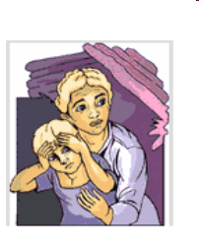



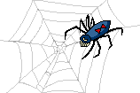
Read back over the scary situations Michael found himself in, in Chapter 4.
You are going to write about a scary situation you have found yourself in- you
can use your imagine and make it up!

Slide 6
Good features from the text
Ambitious vocabulary
Style of writing ‘it was brown, ginger brown.’
Varying length of sentences
Use of adverbs- casually, slowly

Slide 7
Success Criteria
Ambitious and descriptive vocabulary
A variety of types of clauses used
A variety of interesting sentence starters
Proof read and edit your work for grammatical sense and punctuation
Aim to write 3-4 paragraphs. Focus on quality and not quantity.
Remember this is a situation and not a whole story!

