Slide 2
The Big Questions

Slide 3

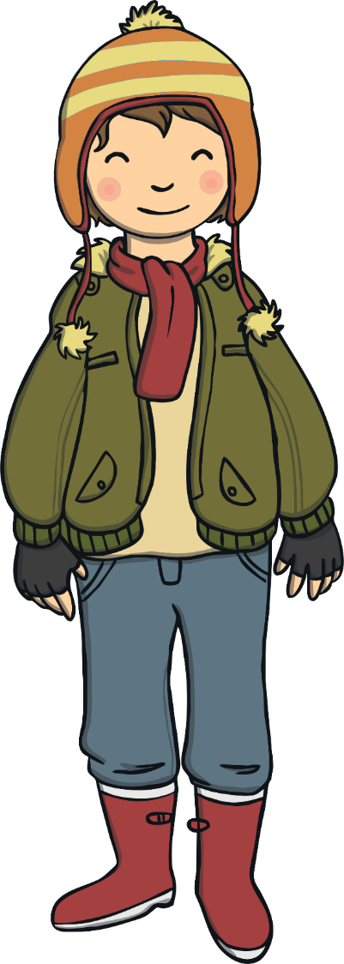
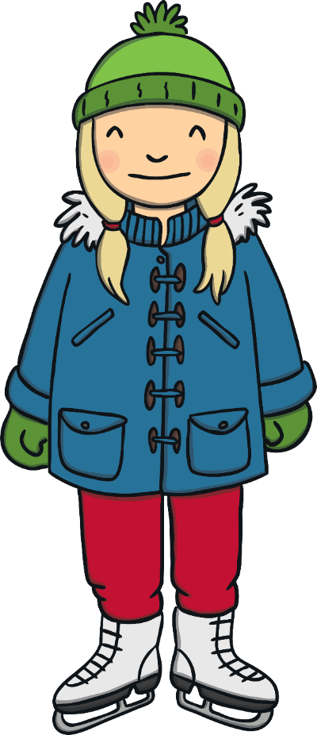
What makes
us special?
Why is it important to be kind to ourselves?

Slide 4

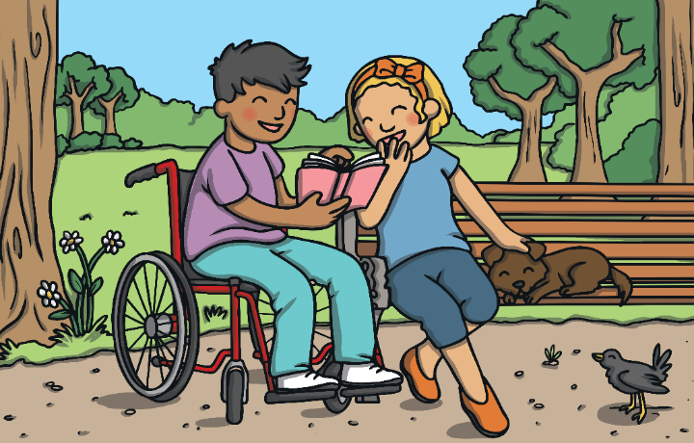
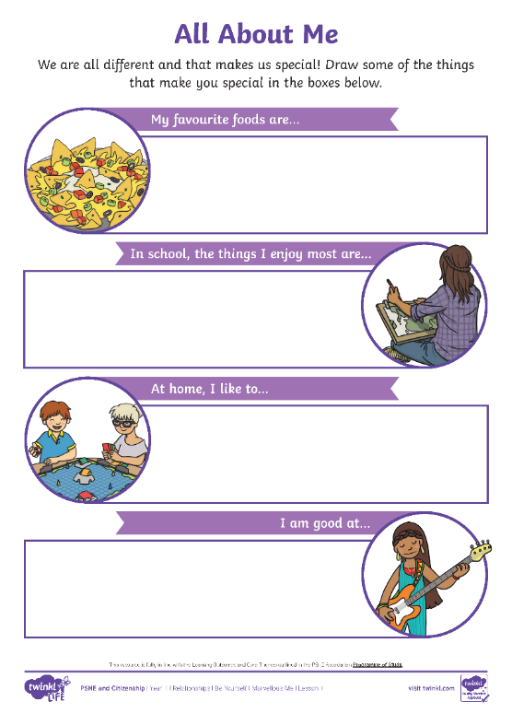
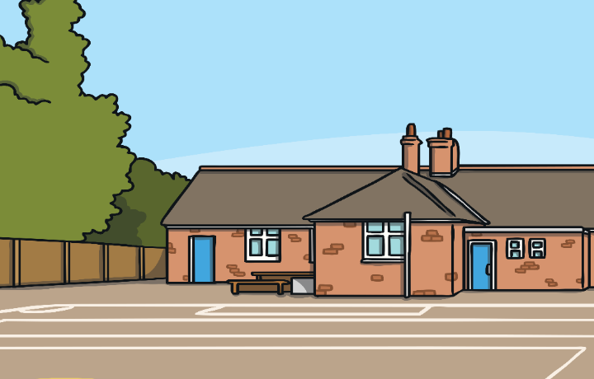
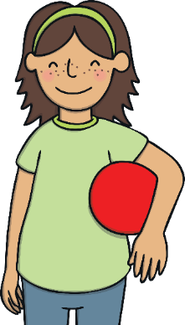
Task 1 - All About Me
We are all different.
This makes the world
an exciting place!
Use your All About Me Activity Sheet
to help you think of all of the
wonderful things about yourself.
We all like different things, we are all interested in different things and we are all good
at different things.
This makes us all special!

Slide 5


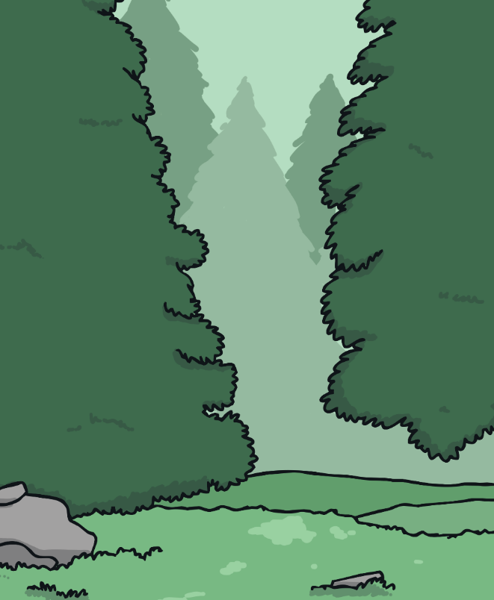
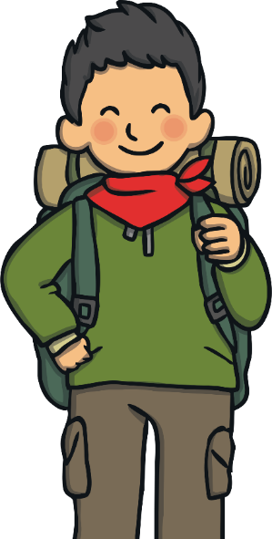
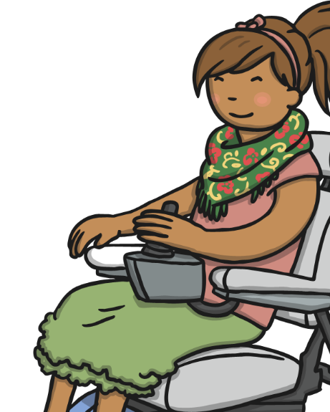

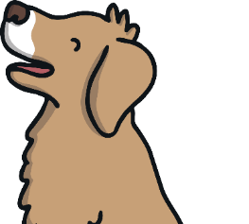
Only One Me
What a lot of fabulous things you like and are good at!
We are all individuals and this
is what makes us special.
There is only one you! This is very exciting – we can all
bring something different
and special to wherever
we are and whatever we
are doing.
None of us are exactly the same as anyone else.
We don’t need to be like anyone else, we just need to be ourselves.
Being ourselves can help us to feel happy inside.

Slide 6


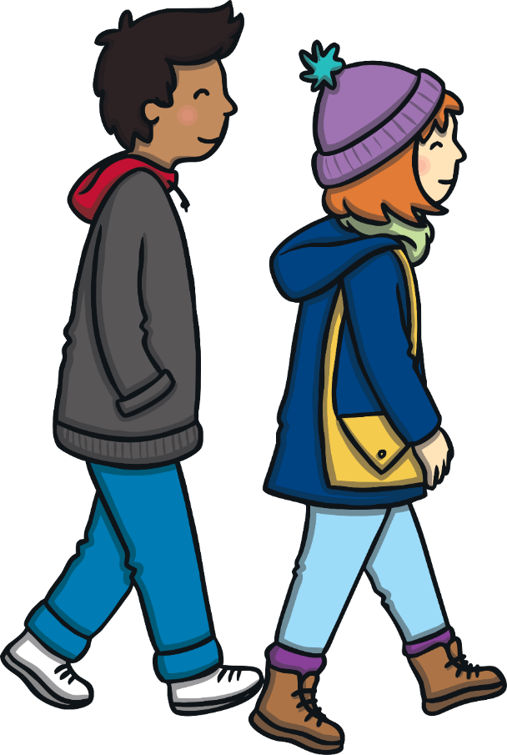


Helping Others to Feel Good
It can help others to feel
good when we make time to let them know what we think
is special about them.
How did it feel to hear what someone thinks is special about you?
How did it
feel to tell
someone what you
think is special
about them?
It can make
us feel good when we
make others feel good!
Tell someone at home or school what you think is special about them. It might be that they are kind, a good friend, that they know how to speak another language or many more things!
Let’s do all we can to help others feel happy to be themselves!

Slide 7

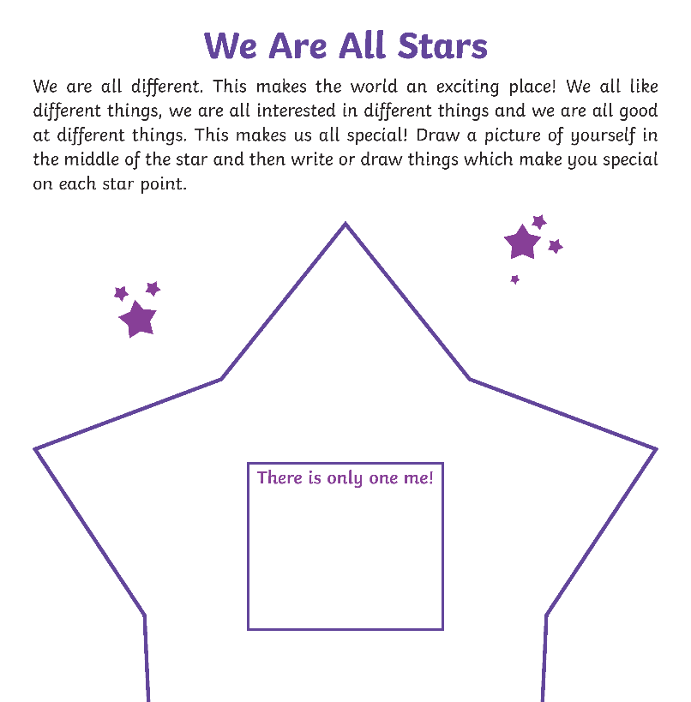

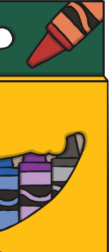

Task 2 - We Are All Stars
On the star on your We Are All Stars Activity Sheet, draw a picture
of yourself in the centre and on each star point write or draw something that makes you special.
Remember all of these things make you marvellous!
What makes you special?
Take a few moments to think about this.

Slide 8

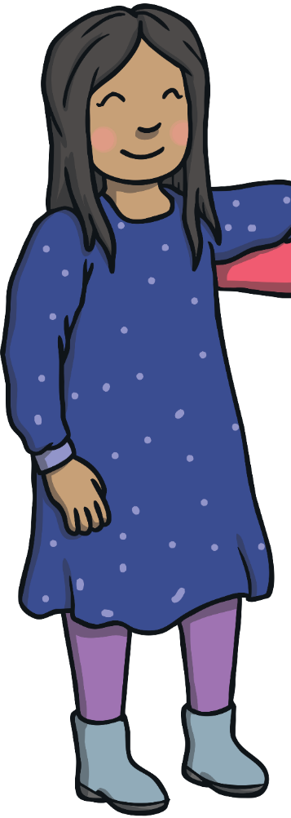
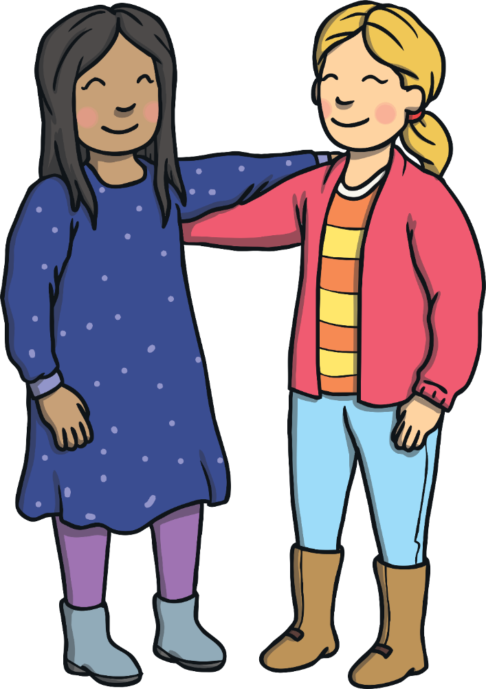
Being Kind to Ourselves
We are all special, we are all different and we are all unique!
Unique means being unlike anything or anyone else.
There can be times when we can feel different to our friends. This does not mean we need to change. Being happy to be ourselves is a way of being kind to ourselves. Not trying to be like anyone else can help us to feel happy inside.
Sit quietly and think of all the things that make you special. Nobody in this world is like you – you are totally unique!
How does that make you feel?
There are always ways for you to learn and grow but there
is so much that makes you marvellous – enjoy being you!

Slide 9
The Big Questions

Slide 10
What makes
us special?
Why is it important to be kind to ourselves?
What have you learnt today?

Slide 11
Don’t forget to take some time to complete your wellness journal today!

