Slide 1
Year 6 – Spring Block 3 – Algebra
Step 1: Find a Rule – One Step
© Classroom Secrets Limited 2019

Slide 2
Introduction
Match the starting number with the number that is 11 more.
3
73
622
118
89
35
84
14
633
100
129
46
© Classroom Secrets Limited 2019

Slide 3
Introduction
Match the starting number with the number that is 11 more.
3
73
622
118
89
35
84
14
633
100
129
46
© Classroom Secrets Limited 2019

Slide 4
Varied Fluency 1
Using the function below, match the inputs to the correct outputs.
Function:
÷ 7
Inputs:
Outputs:
119
20
140
15
105
17
© Classroom Secrets Limited 2019

Slide 5
Varied Fluency 1
Using the function below, match the inputs to the correct outputs.
Function:
÷ 7
Inputs:
Outputs:
119
20
140
15
105
17
© Classroom Secrets Limited 2019

Slide 6
Varied Fluency 2
Circle the function being used in the function machine below.
Inputs:
Outputs:
Function:
2.5
17.5
?
7
49
+ 15 |  | x 5 |  | x 7
© Classroom Secrets Limited 2019

Slide 7
Varied Fluency 2
Circle the function being used in the function machine below.
Inputs:
Outputs:
Function:
2.5
17.5
x 7
7
49
+ 15 |  | x 5 |  | x 7
© Classroom Secrets Limited 2019

Slide 8
Varied Fluency 3
Work out the missing inputs and outputs for the function machine below.
Inputs:
Outputs:
Function:
89
– 78
-15
© Classroom Secrets Limited 2019

Slide 9
Varied Fluency 3
Work out the missing inputs and outputs for the function machine below.
Inputs:
Outputs:
Function:
89
11
– 78
63
-15
© Classroom Secrets Limited 2019

Slide 10
Varied Fluency 4
Tick the incorrect outputs below.
Inputs:
Outputs:
Function:
17.5
74.5
+ 58
-13
45
49
106
© Classroom Secrets Limited 2019

Slide 11
Varied Fluency 4
Tick the incorrect outputs below.
Inputs:
Outputs:
Function:
17.5
74.5
✓
+ 58
-13
45
49
106
✓
© Classroom Secrets Limited 2019

Slide 12
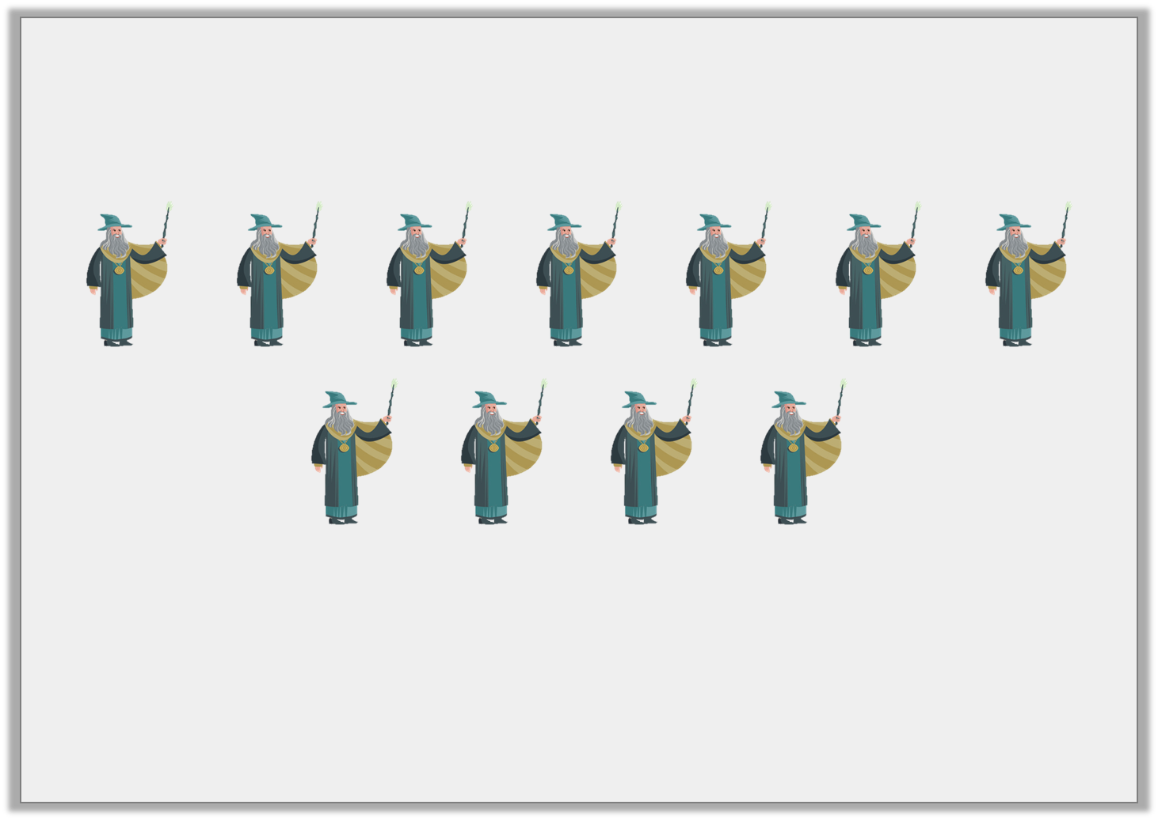
Reasoning 1
If the function for the number of goblins is the number of wizards x 3, how many goblins are there?
Explain your reasoning.
© Classroom Secrets Limited 2019

Slide 13
Reasoning 1
If the function for the number of goblins is the number of wizards x 3, how many goblins are there?
Explain your reasoning.
Various answers, for example:
There are 33 goblins…
© Classroom Secrets Limited 2019

Slide 14
Reasoning 1
If the function for the number of goblins is the number of wizards x 3, how many goblins are there?
Explain your reasoning.
Various answers, for example:
There are 33 goblins. This is because there are 11 wizards; if the function for the number of goblins is the number of wizards x 3, then the calculation to work this out is 11 x 3 = 33.
© Classroom Secrets Limited 2019

