Slide 1

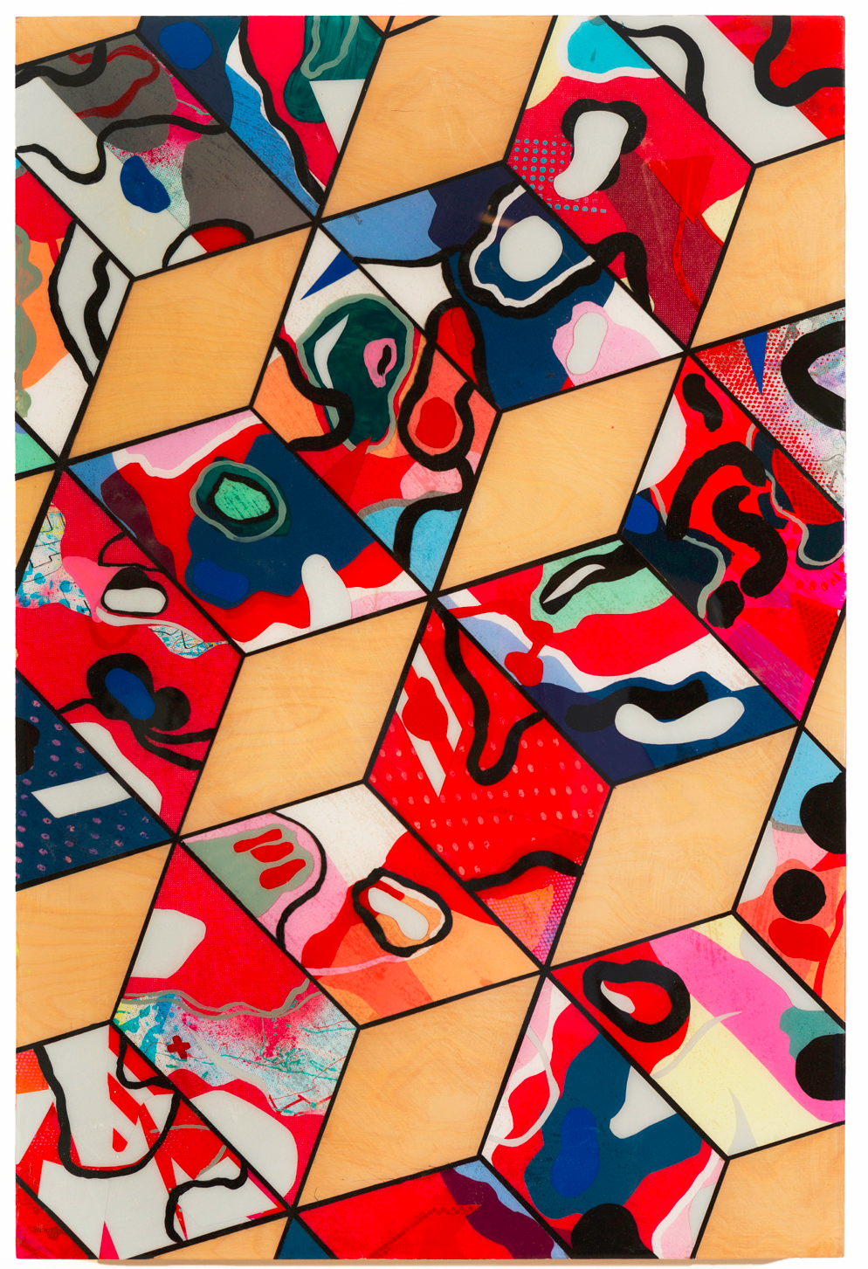
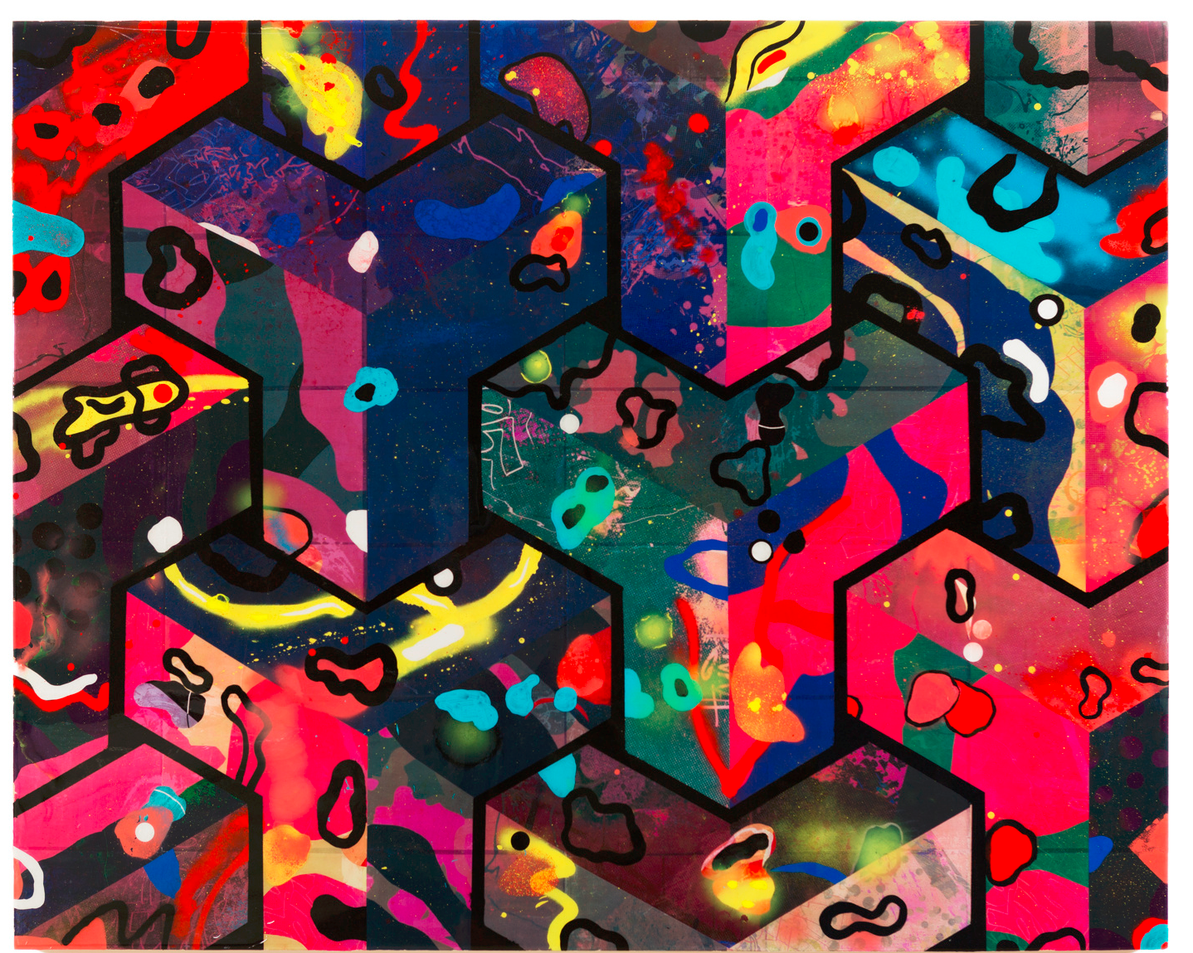

Slide 2
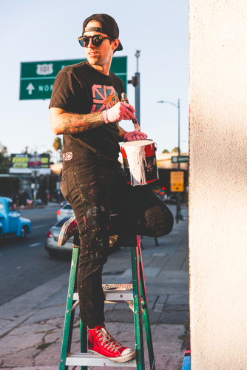
-Thank You x is an L.A. based street artist
-Thank You x is his alias, something that most street artists have
- An alias is a name used to protect someone’s true identity

Slide 3
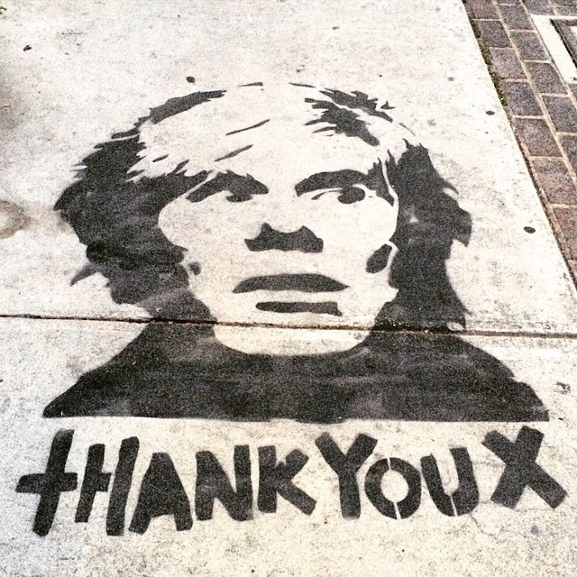
-The alias Thank You x was given to the artist accidently
-In 2009, Andy Warhol’s portrait was spotted created from a spray paint stencil with “Thank you x” underneath
-The artist added “Thank You x” as a gesture of gratitude to Warhol’s artwork
-Thank You x then became the artist’s identity

Slide 4
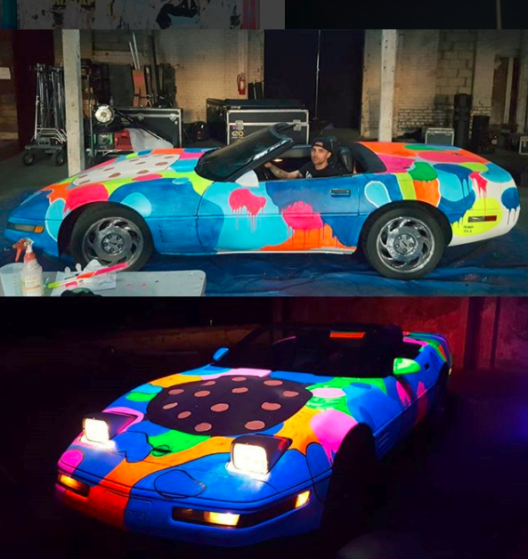

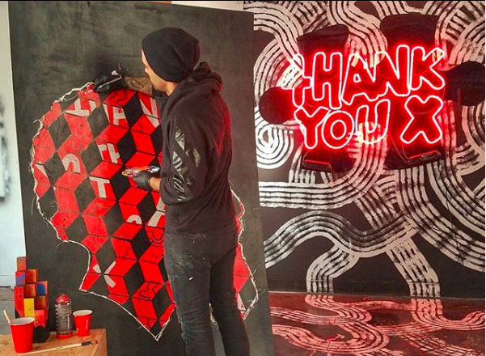
-More Thank You x artwork started popping up around L.A. and people were noticing
-Soon, businesses started commissioning him to paint murals and collaborations
-He is now a internationally recognized artist with murals and galleries all over the world

Slide 5
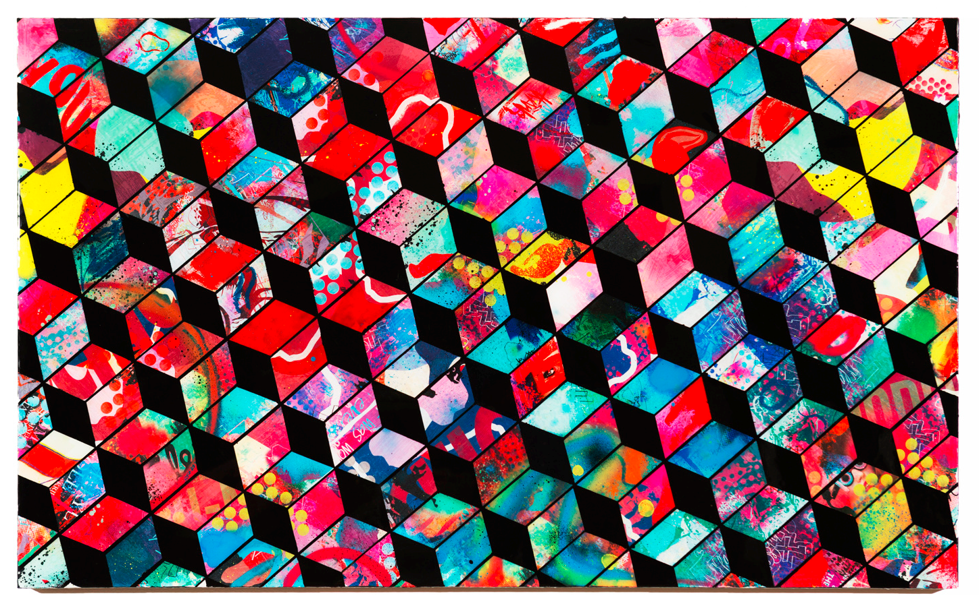
-Recently, Thank You x has been creating a more abstract style
-These “cube paintings” have been a huge success for the artist

Slide 6
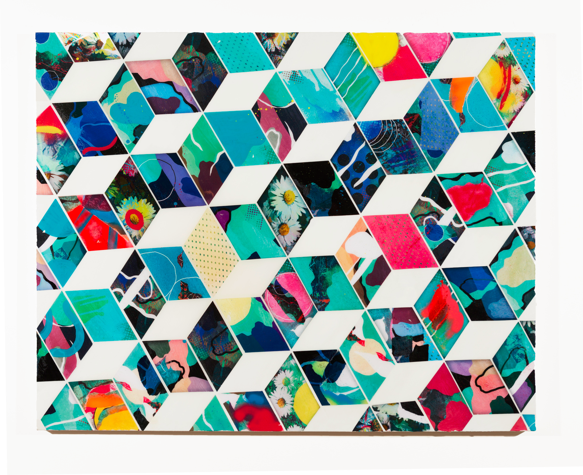



Slide 7

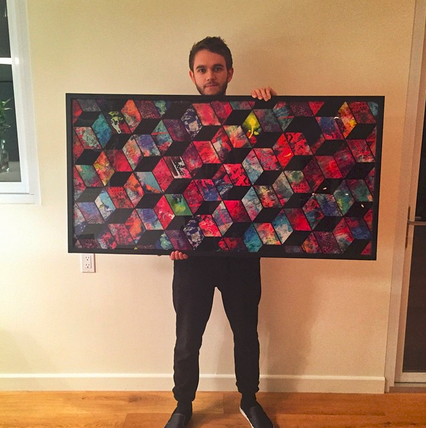

Slide 8
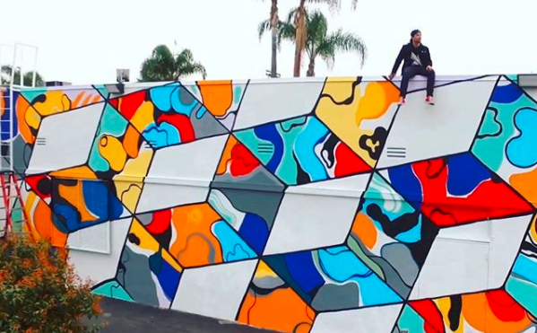
Let’s see what you can remember
-Who is Thank You x?
-What type of art does he create?
-Why is he known as Thank you x?
-How can I identify the theme in his artwork?
-How can I create something inspired by Thank You x, but make it unique to me?

Slide 9
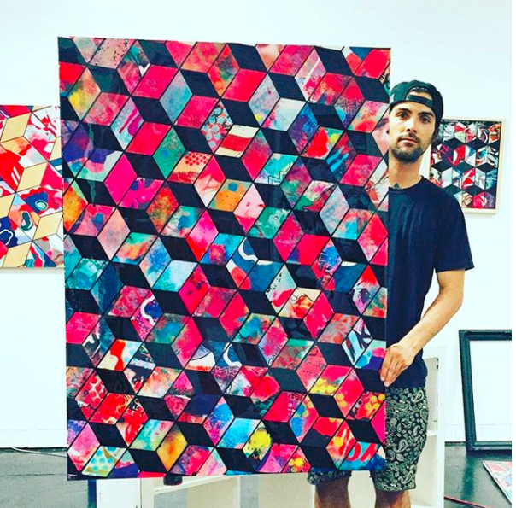
How can I create something inspired by Thank You x, but make it unique to me?
You and your family can create a collaborative cube drawing,
similar to Thank You x’s style
- Print off the cube template as many times as you like
- Each of you will create 3 sides of a cube
- One side of the cube will be an assigned solid color
-The other two sides of the cube will be any pattern or design that is unique to you
- Cut out carefully and glue onto a large piece of paper just like jigsaw pieces Create whatever pattern you like.

