Slide 2
Aim
To recognise the features of haiku poems.
Success Criteria
I know that a haiku contains only 3 lines;
I can count the syllables in each line to check the pattern matches the format 5-7-5;
I understand that haiku poems are often about nature or the seasons and how we feel about them.

Slide 3
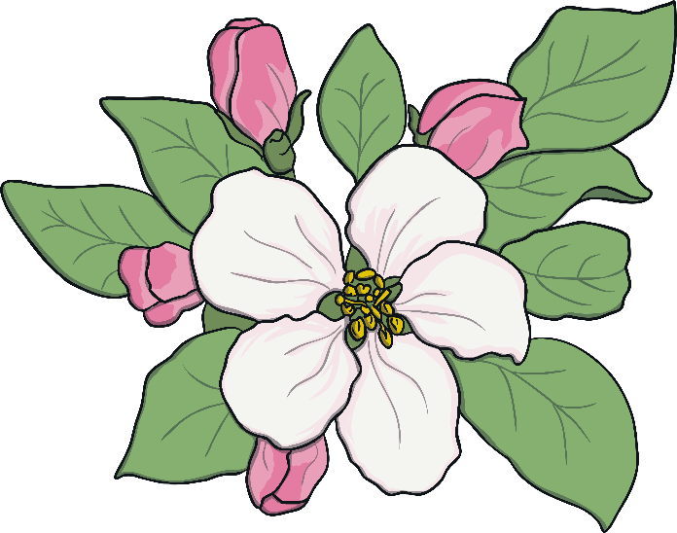
What is a Haiku?
Haiku poems are a traditional Japanese art form. Here’s one...
My two plum trees are
So gracious. See, they flower.
One now, one later.

Slide 4
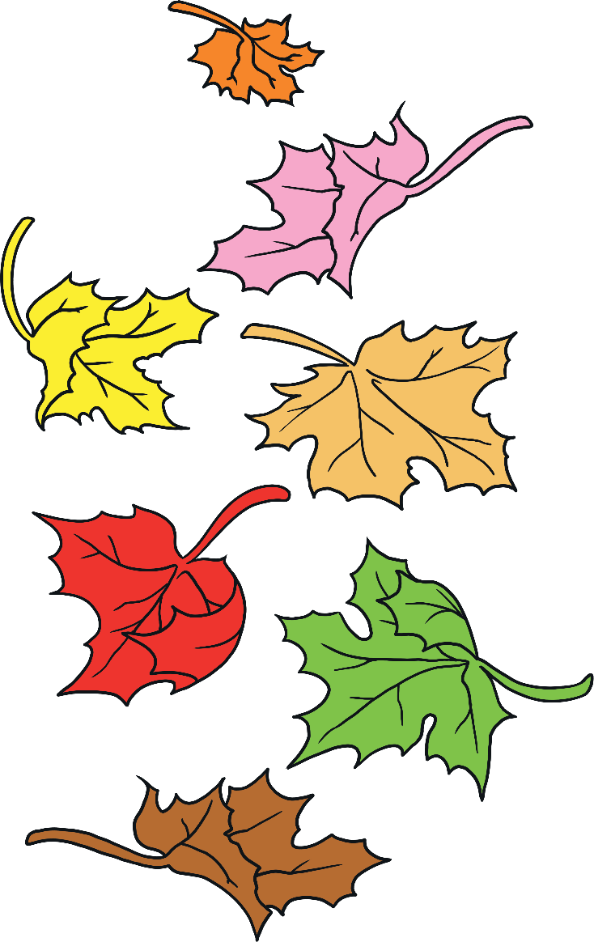
What is a Haiku?
Here’s another…
Winter is coming.
Snow will be arriving soon.
We should rake the leaves.

Slide 5
What is a Haiku?
What did you notice about the poems?
Think about:
the poem’s theme;
how many lines are in each poem;
how many syllables in each line.
Three lines in each poem.
My two plum trees are
So gracious. See, they flower.
One now, one later.
Winter is coming.
Snow will be arriving soon.
We should rake the leaves.
5 syllables in first line
7 syllables in middle line
5 syllables in final line
Final line is a comment or observation on the theme.
natural
theme

Slide 6
Let’s have a go!
How can we write a haiku?
First, we need to choose a theme. It doesn’t have to be about seasons or nature, but let’s be traditional.
Autumn
cold
playing
flowers
leaves
wind
crisp
halloween
red
dark
walks
fun
orange

Slide 7
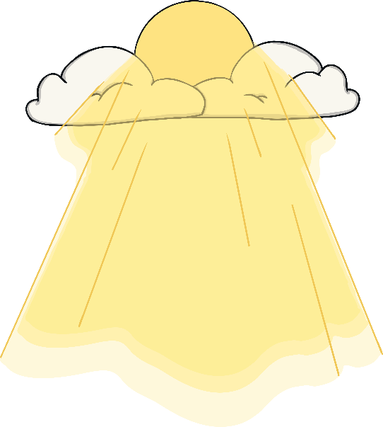
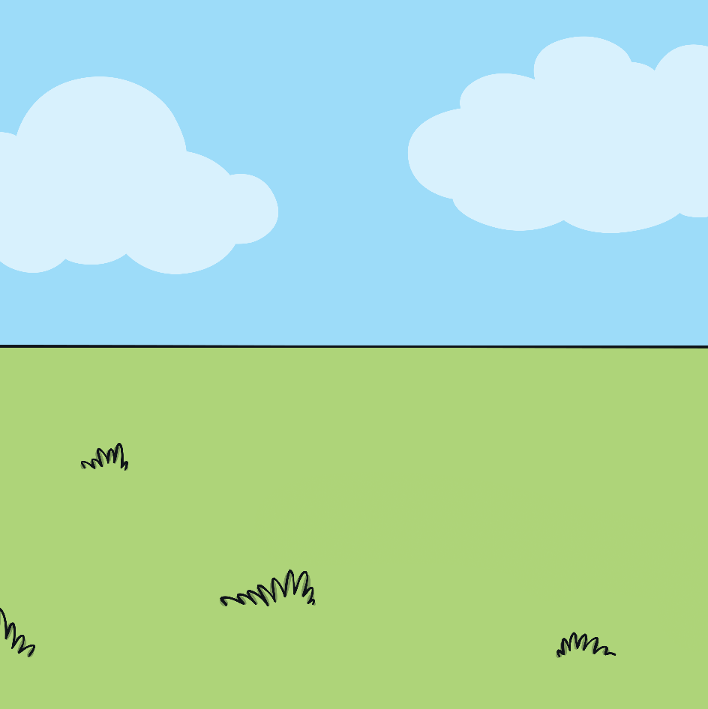
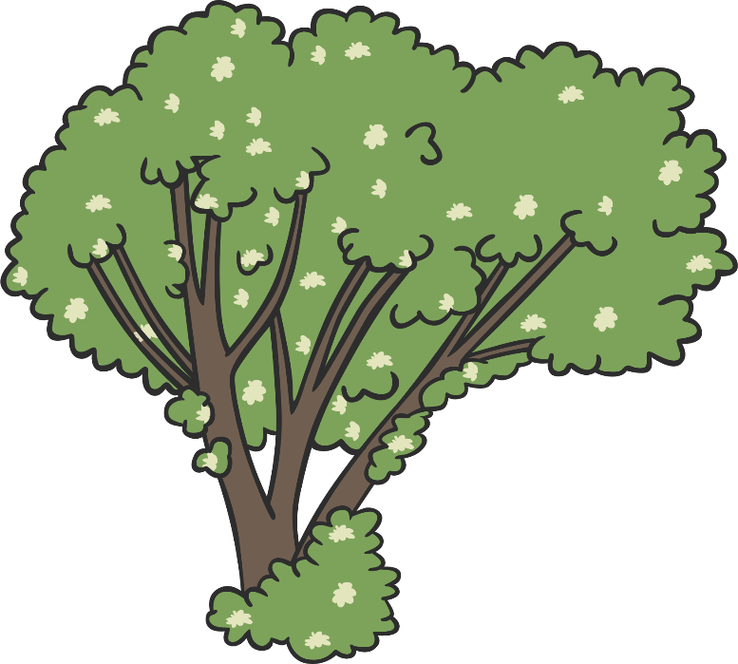
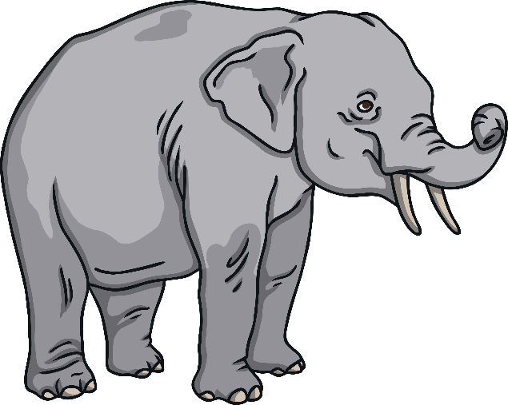
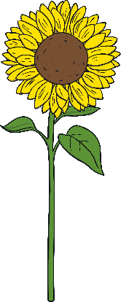
Let’s have a go!
You could write a haiku about the seasons, or about an animal or plant.
The choice is yours!

Slide 8
Aim
To recognise the features of haiku poems.
Success Criteria
I know that a haiku contains only 3 lines;
I can count the syllables in each line to check the pattern matches the format 5-7-5;
I understand that haiku poems are often about nature or the seasons and how we feel about them.

