Slide 1


Science
Forces
Year One
Science | Year 5 | Forces | Water Resistance | Lesson 4

Slide 3
Aim
To explore the effects of water resistance.
Success Criteria
I can explain the effects of water resistance.
I can identify streamlined shapes.
I can minimise the effects of water resistance on an object.

Slide 4







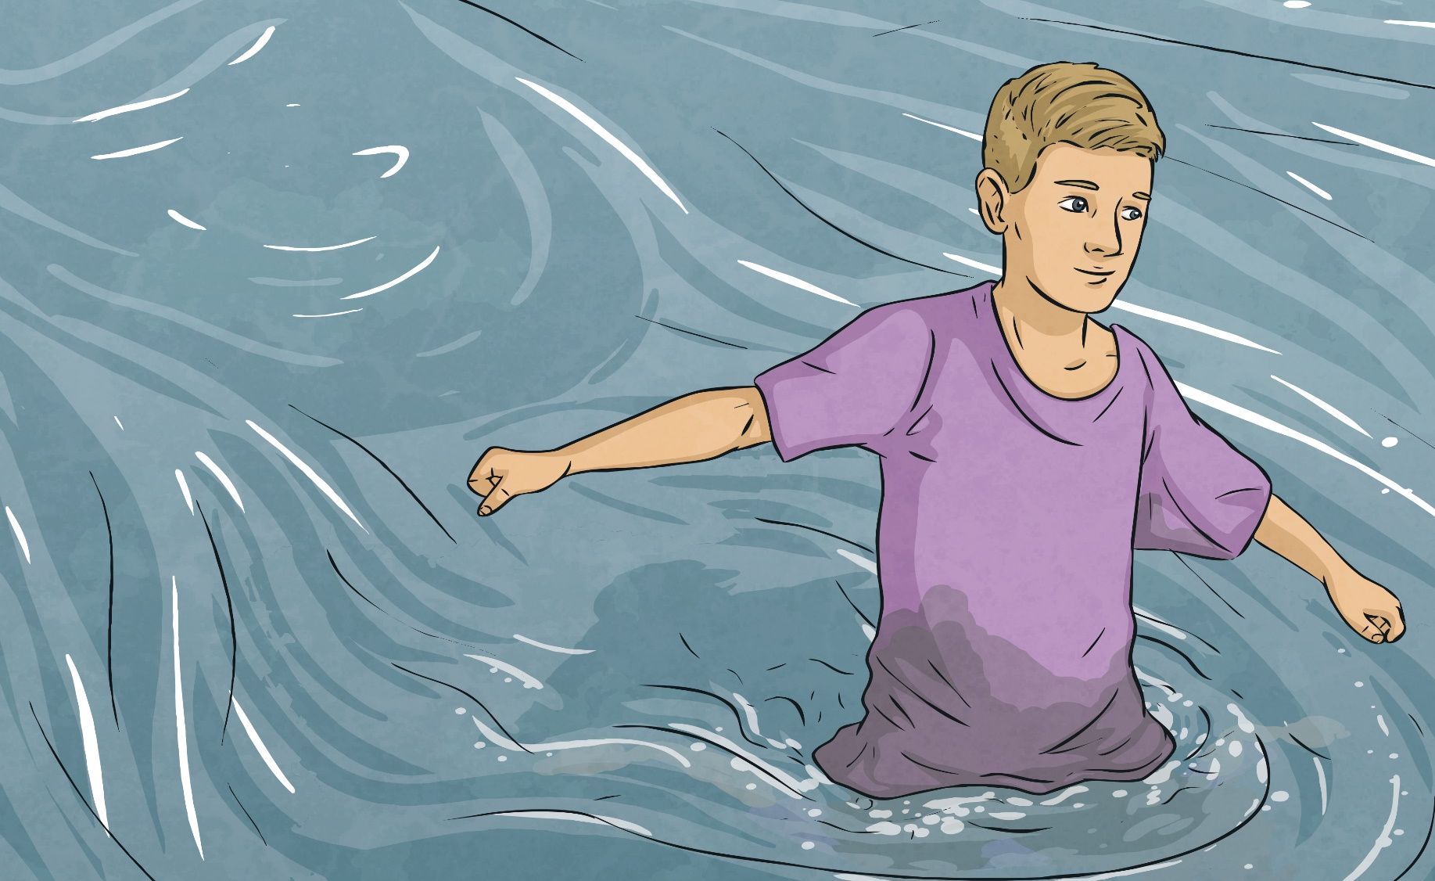
Water Resistance
How does it feel to walk through deep water?
Think of some words and phrases to describe the feeling.
Share your ideas with the class.

Slide 5
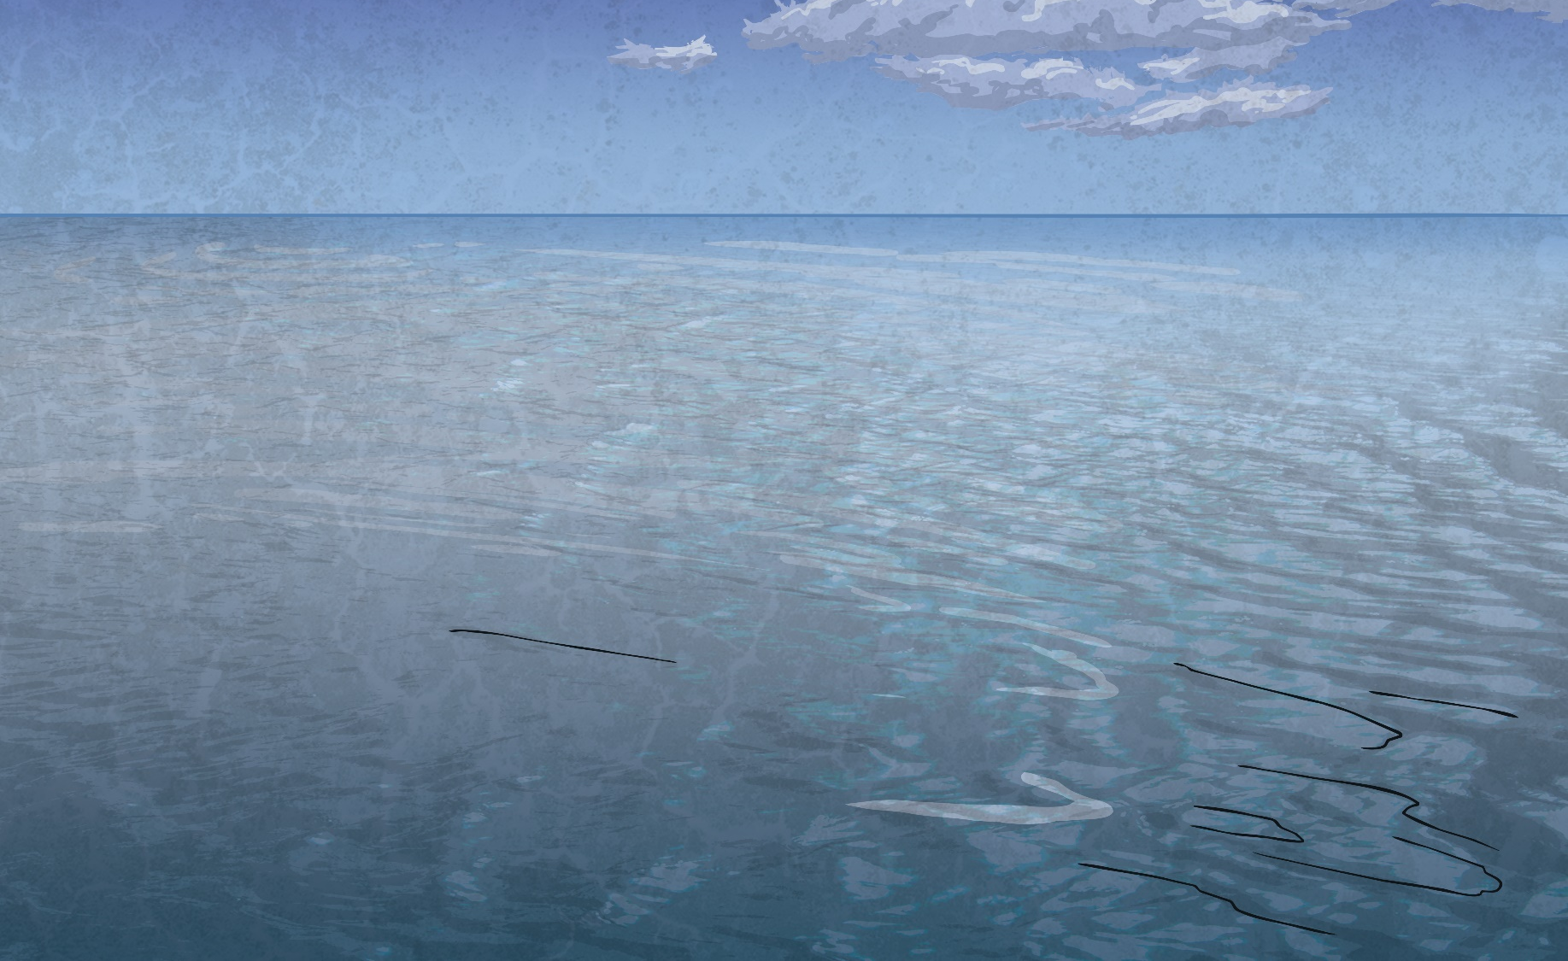
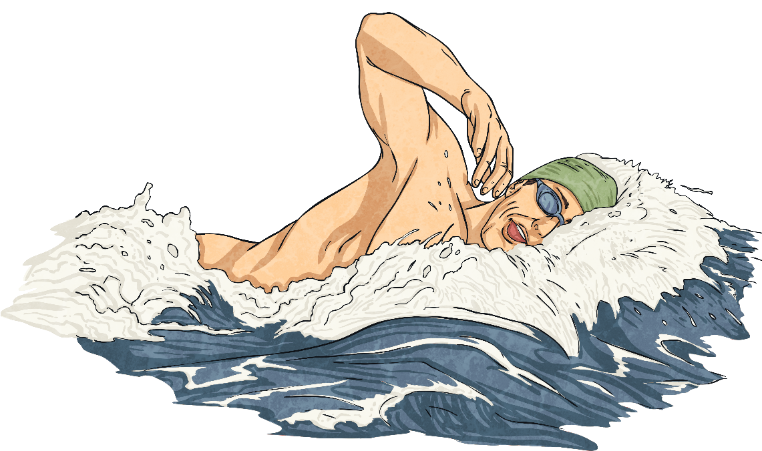
Water Resistance
If you have ever walked through water, you will have felt the effects of water resistance pushing against you.
However, this also helps you to swim, as when you push against the water with your hands, the water resistance pushes back and helps you to move forward, like using oars to push against the water to row a boat.
water resistance
Whenever an object moves through water, it experiences the force of water resistance. Water resistance pushes against objects, making it hard for them to move through water.
swimmer’s force

Slide 6
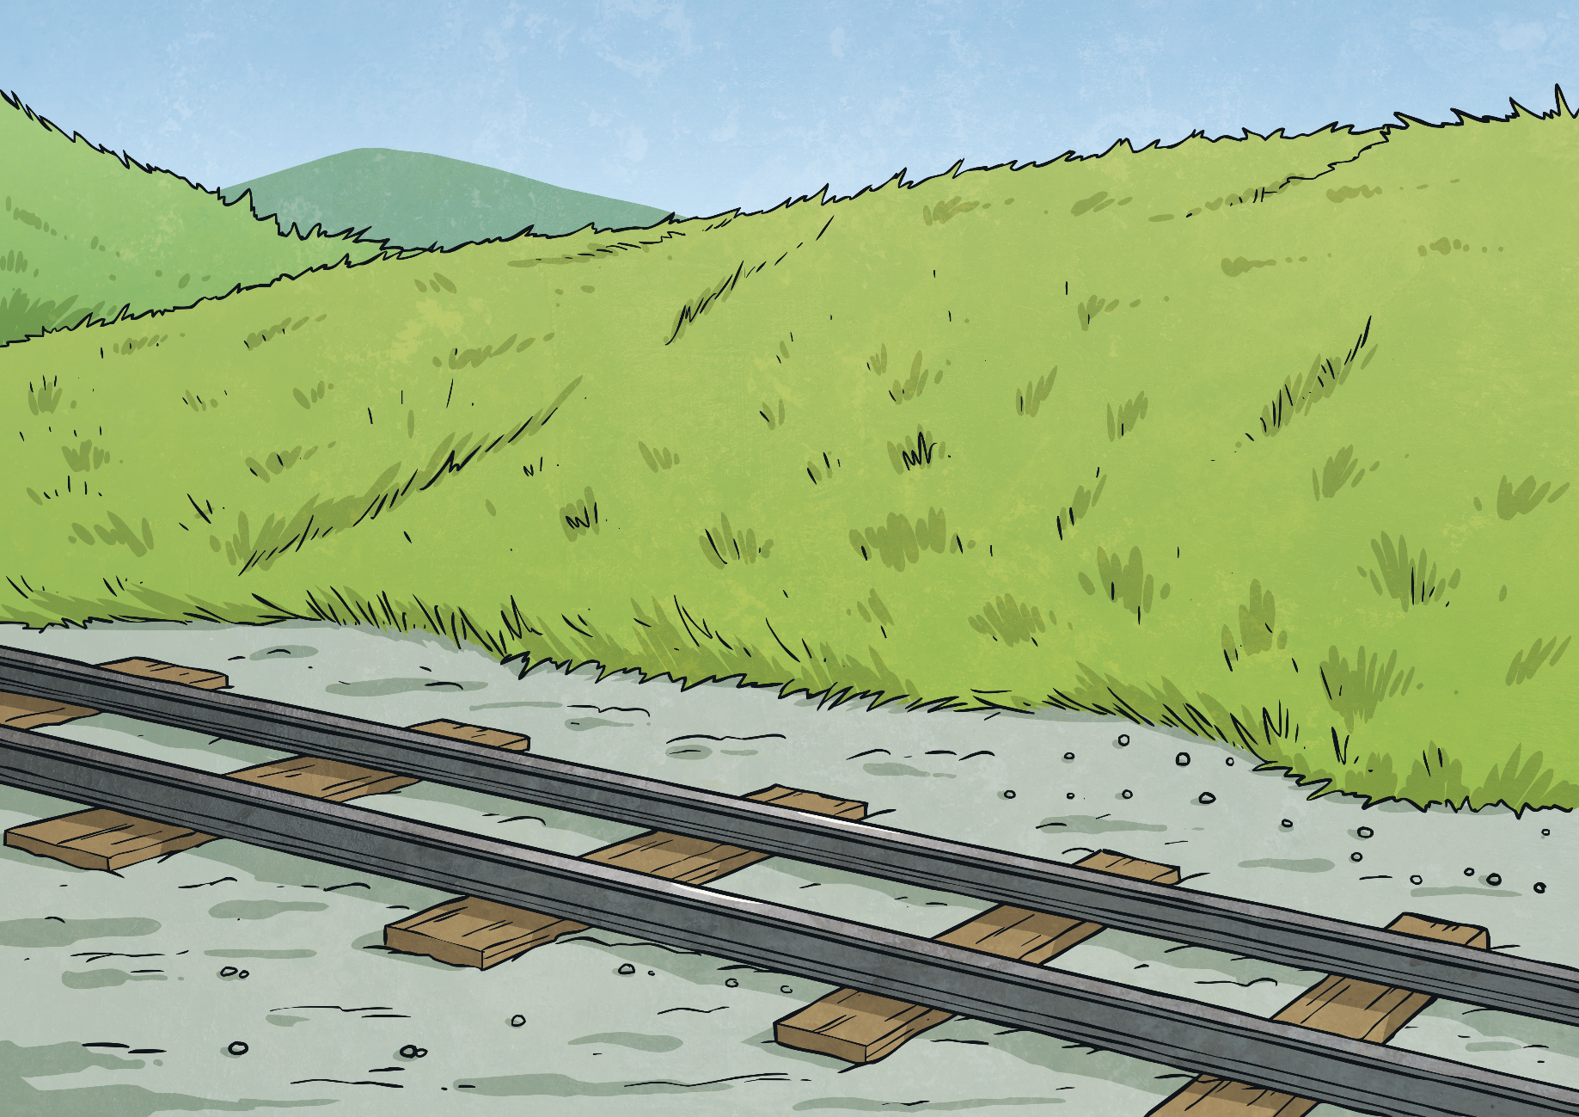
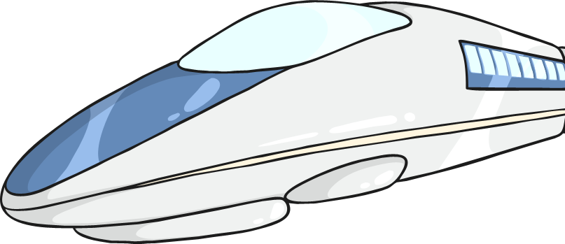
Streamlined Shapes
It is possible to reduce the effects of water and air resistance.
Objects that do not experience much water or air resistance are described as streamlined.

Slide 7

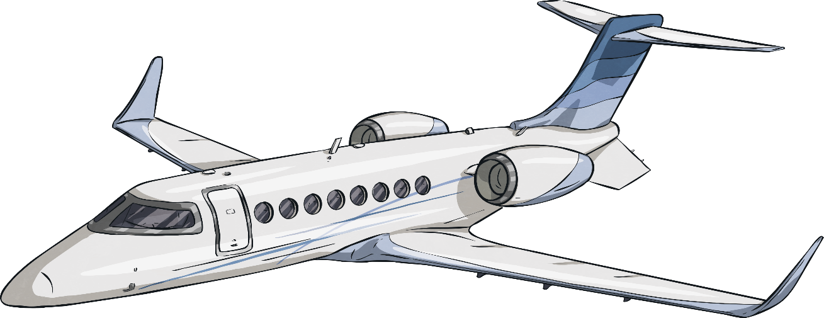
Streamlined Shapes
This aeroplane is streamlined.
Its nose is pointed so that it can cut through the air, and it has a smooth, low, curved back to allow the air to flow over and around it.
It does not create much air resistance so it can move through the air easily.

Slide 8
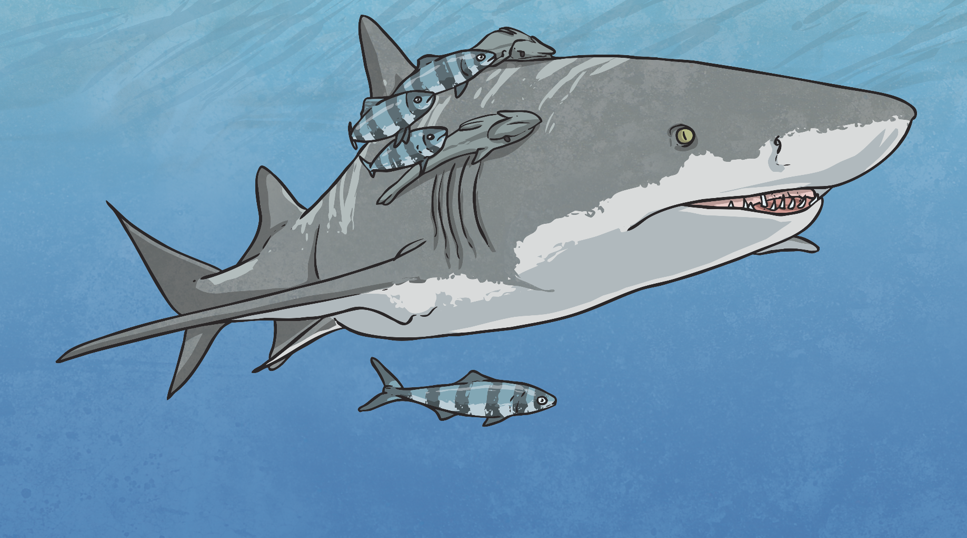
Streamlined Shapes
This shark is streamlined.
It has a pointed nose to cut through the water, and a smooth, low, curved back to allow the water to flow over and around it.
It does not create much water resistance so it can move through the water quickly.

Slide 9
Aim
To explore the effects of water resistance.
Success Criteria
I can explain the effects of water resistance.
I can identify streamlined shapes.
I can minimise the effects of water resistance on an object.

