Slide 1




Year 1 - Spring - Block 1
Addition & Subtraction

Slide 2

Use the diagram and counters to tell your own number story for these calculations:
0 $+$ 12 $=$ ____
7 $+$ 0 $=$ ____
14 $+$ ____ $=$17
First Then Now
F
F
F

Slide 3



Mo and Jack are working out 11 $+$ 7
Mo says,
Jack says,
Use a number line to show who is correct
11, 12, 13, 14, 15, 16, 17
12, 13, 14, 15, 16, 17, 18

Slide 4

Ron starts at 9 and adds on 5
Alex starts at 5 and adds on 9
Show their calculations on the number lines.
What do you notice? Does this always happen?
Which method do you like best? Why?

Slide 5
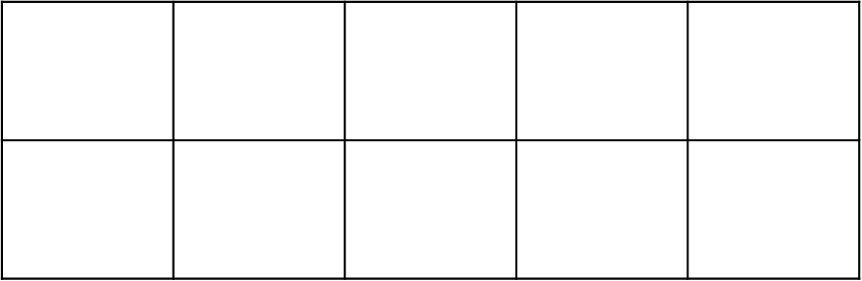


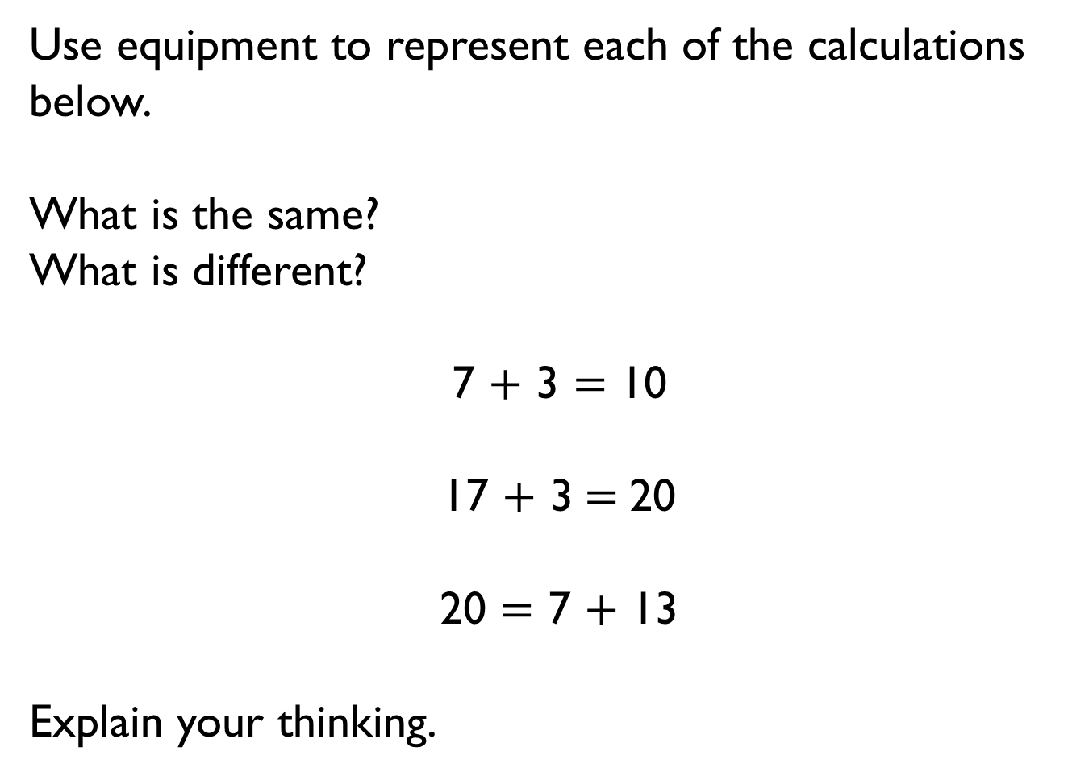
Use equipment to represent each of the calculations below.
What is the same?
What is different?
7 $+$ 3 $=$ 10
17 $+$ 3$=$20
20 $=$ 7 $+$ 13
Explain your thinking.

Slide 6

Jack represents a number bond to 20 in the part whole model.
Can you spot his mistake?
20
13
7

Slide 7
True or false?
There are double the amount of numbers bonds to 20 than there are number bonds to 10
Prove it – can you use a systematic approach?

Slide 8

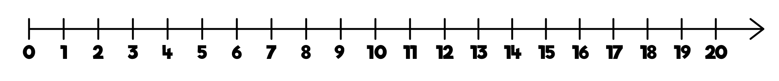


Teddy and Eva are adding together 7 and 8 using a number line.
Teddy shows it this way:
$+ 3 +5$
Eva shows it this way:
$$+ 2 +5$$
Who is correct? Explain your answer.

Slide 9

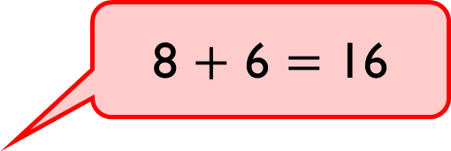
Dexter uses ten frames to calculate eight plus six.
He says,
Do you agree? Explain why.
8 $+$ 6 $=$ 16

Slide 10

Annie is calculating 8 $+$ 6
Which of these methods is most helpful?
Why?
8 $+$ 6 $=$
8 $+$ 6 $=$
8 $+$ 6 $=$
5
1
6
2
4
2

Slide 11





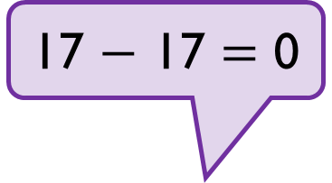
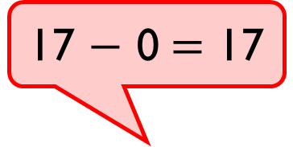
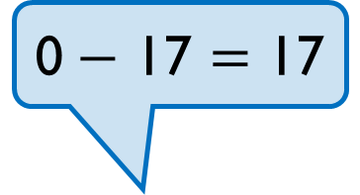
Annie, Tommy and Alex are working out which calculation is represented below.
Can you work out who is correct? Explain why.
First | Then | Now
17 $−$ 0$=$ 17
0$−$ 17 $=$ 17
17 $−$ 17 $=$ 0

Slide 12
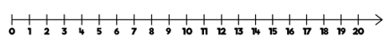

How many ways can you complete this number sentence?
Use the number line to help you.
$− =$ 11

Slide 13


Rosie is calculating 16 $−$ 7
Which of these methods is most helpful?
Why?
16 $−$7 16 $−$7
16 $−$ 7 16 $−$7
Could you find a way to partition 16 to help you
subtract 7?
8
8
3
4
6
1
10
6

Slide 14


Teddy works out 15 $–$ 6
This is Teddy’s working out:
15 $–$ 5 $=$ 10 $–$ 1 $=$ 9
Why is Teddy’s working out wrong?

Slide 15

Use $<$, $>$ or $=$ to make the statements correct.
17 $−$ 5 12 $−$ 5
14 $−$ 4 18 $−$ 8
11 $−$ 7 11 $−$ 4
Is Whitney correct? Explain how you know.

Slide 16
Which method would you use to solve each problem?
Max has 12 balloons.
5 of the balloons burst.
How many are left?
Max has 12 balloons.
5 of the balloons are red.
There rest are blue.
How many blue balloons does Max have?
Max has 12 blue balloons and 5 red balloons.
How many more blue balloons than red balloons does he have?
12
Blue
Red
?
12
5
5
?

Slide 17

Amir has 16 apples. Ron has none.
Amir gives Ron 9 apples.
Who has the most apples now?
Explain how you know.

Slide 18



Look at the following objects.
Teddy works out these calculations.
15 $−$ 4 $=$ ____
15 $−$ 11 $=$ ____
11 $−$ 4 $=$ ____
What question could he have asked each time?

Slide 19










Use the cards to write as many addition and subtraction sentences as you can.
nine
add
ten
subtract
nineteen
is equal to

Slide 20

Circle the addition and subtraction number sentences that match the ten frames.
15 $+$3 $=$18 15 $−$3 $=$18
3 $+$18 $=$15 18 $−$15 $=$3
18 $+$3 $=$15 18 $−$3 $=$15
18 $=$ 3 $+$ 15 15 $−$18 $=$3

Slide 21
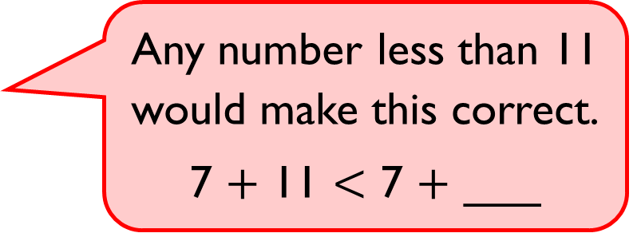
Any number less than 11 would make this correct.
7 $+$ 11 $<$ 7 $+$ ___
Alex
Do you agree with Alex?
Explain why.

Slide 22


Whitney has 16 sweets and eats 7 of them.
Mo has 17 sweets and eats 8 of them.
Who has more sweets left?
Explain how you know.

Slide 23



Dexter is working out which symbol to use to compare the number sentences.
14 $−$5 14 $+$5
Do you agree with Dexter?
Explain why.
The missing symbol must be $=$because all of the numbers are the same.

