Slide 1


Slide 3
Aim
To recognise the features of acrostic poems.
Success Criteria
I know that acrostics have a topic word hidden in the first letter of each line.
I can look for the poem’s theme by reading the first letters vertically.
I understand that acrostics don’t have to rhyme.

Slide 4

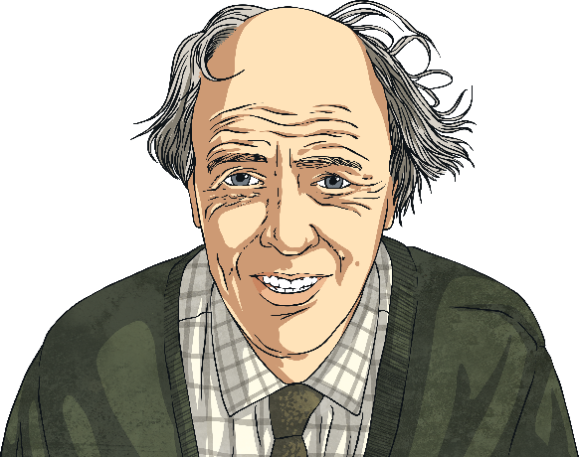
Acrostic Examples
What is each poem about?
R
O
A
L
D
D
A
H
L
Revolting rhymes
Oompa-Loompas
Angry farmers
Lazy aunts
Dangerous witches
Dream blower
Adventurous animals
Horrible headteacher
Lickable wallpaper
I
C
E
C
R
E
A
M
It’s my favourite food
Cold as the inside of a fridge
Every sunny day
Can’t wait
Running to the van
Empty out the money
‘Any sauce on that, love?’
Mmmmmm, yummy!

Slide 5
Acrostic Features
What did you notice?
Poetic devices may be used.
The first letter of each line spells out the poem’s theme vertically – what’s this one about?
alliteration
simile
I
C
E
C
R
E
A
M
It’s my favourite food
Cold as the inside of a fridge
Every sunny day
Can’t wait
Running to the van
Empty out the money
‘Any sauce on that, love?’
Mmmmmm, yummy!
Lines can be different lengths

Slide 6
Let’s Try It!
How can we write an acrostic poem?
First, we need to choose a theme. Today, you are going to write a poem about yourself!
Then, you need to think of lots of words or phrases about yourself. It might be your favourite hobbies, your talents and skills, your favourite food or subject at school. Make a list of some ideas.
art
walking
yoga
animals
travelling
cooking
camping
outdoors
diving
documentaries

Slide 7


Let’s Try It!
How can we write an acrostic poem?
Next, we write the letters of our theme word(s) vertically
down the page in CAPITAL LETTERS…
M
I
S
S
W
O
O
D
H
O
Miss Woodhouse

Slide 8
Let’s Try It!
How can we write an acrostic poem?
Finally, we use our list of words and phrases to create each line. Don’t worry if you can’t think of them in order – it’s fine to go back and add any missing lines afterwards.
M
I
S
S
W
O
O
D
H
y favourite food is spaghetti
love going for long walks
ometimes my hair is straight
ometimes my hair is curly!
hen I’m with my friends, we laugh a lot!
nce I went swimming with sharks!
utgoing and adventurous!
id you know, my favourite colour is blue?

Slide 9
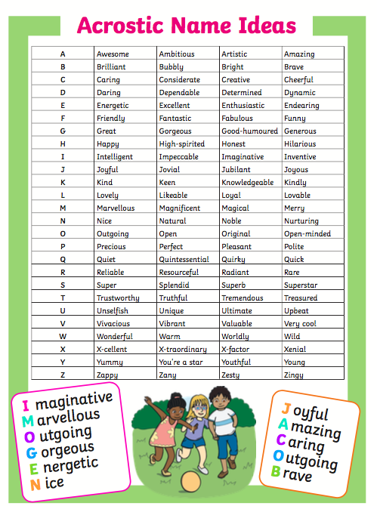
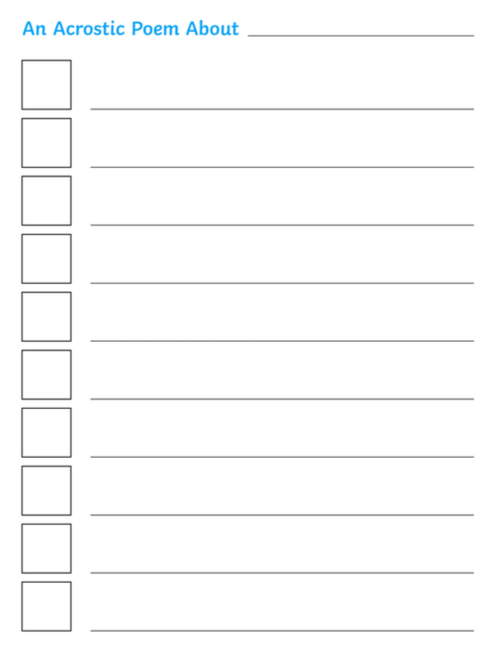
Your Turn!
Write an acrostic poem all about yourself. Celebrate the things that make you unique. Remember, start by writing your name in capital letters down the side of your page.
You can use the word mat to help if you get stuck!

