Slide 2
Diving into Mastery Guidance for Educators
Each activity sheet is split into three sections, diving, deeper and deepest, which are represented by the following icons:
These carefully designed activities take your children through a learning journey, initially ensuring they are fluent with the key concept being taught; then applying this to a range of reasoning and problem-solving activities.
These sheets might not necessarily be used in a linear way. Some children might begin at the ‘Deeper’ section and in fact, others may ‘dive straight in’ to the ‘Deepest’ section if they have already mastered the skill and are applying this to show their depth of understanding.
Diving
Deeper
Deepest

Slide 3
Aim
Find the area of rectilinear shapes by counting squares.

Slide 4
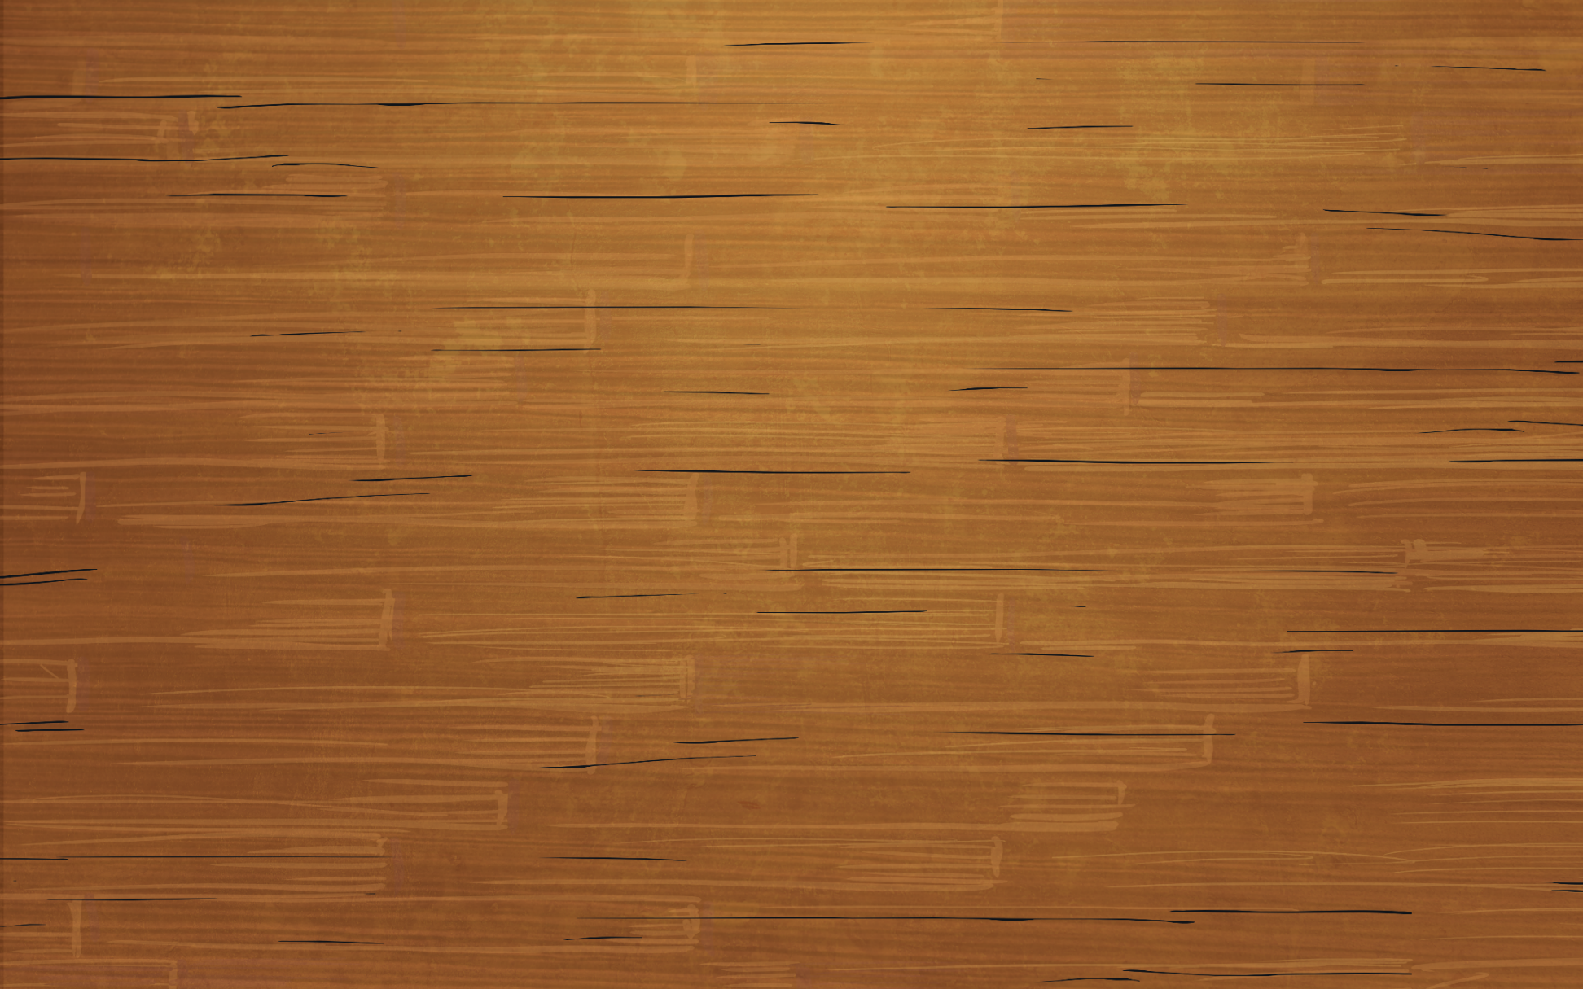
Making Shapes
Diving
Jed is exploring making rectilinear shapes using 6 squares. He is trying to work systematically, only moving 1 square at a time. Identify 3 more shapes that he could make by moving the same square.
Compare your rectilinear shapes with your partner’s. What did you notice?

Slide 5
Making Shapes
Diving
Here are some possible answers, but you may have found others.

Slide 6
Making Shapes
Diving
Here are some possible answers, but you may have found different rectilinear shapes.
Draw 3 rectilinear shapes with an area of 8 squares.

Slide 7
Making Shapes
Deeper
Correct or Incorrect
Alex has made a rectilinear shape using 10 squares. Decide if his work is correct or incorrect and give him some feedback.
Feedback You have created a rectilinear shape, but it has an area of 9 squares, not 10. You have not used enough squares so you need to add 1 more square to make this correct.

Slide 8
Making Shapes
Deeper
Look at this rectilinear shape. Using 4 more squares, can you turn this shape into a rectangle?
Here are the two possible answers.

Slide 9
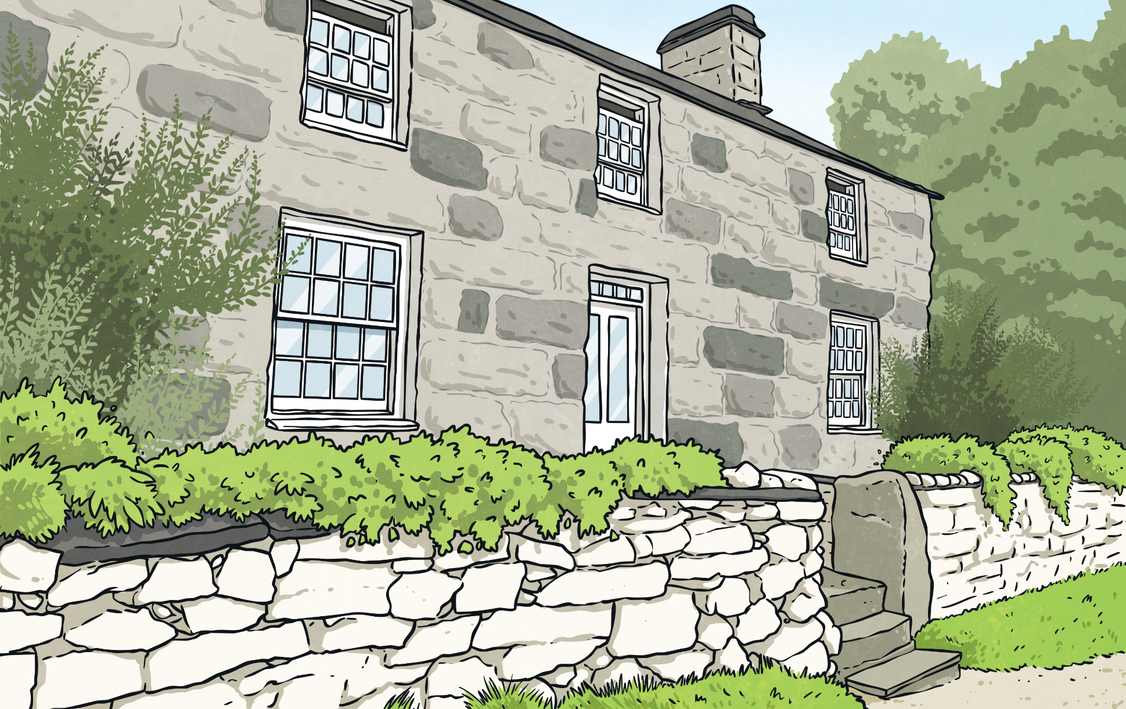
Making Shapes
Deepest
How many squares have been used to make each of the letters below?
9
12
7
11
13
Use the letters above to make your own word. Then, calculate the total area. Your answer will be dependent on the word you make.
Using only the letters above, make a word that has the largest area. You may use each letter more than once in a word.
Which letter has the greatest area?
Which letter has the smallest area?
B
T
Possible answers: attach = 58 squares batch = 52 squares
For example, for the word ‘cat’ the total area will be 9 + 12 + 7 = 28 squares.

Slide 10
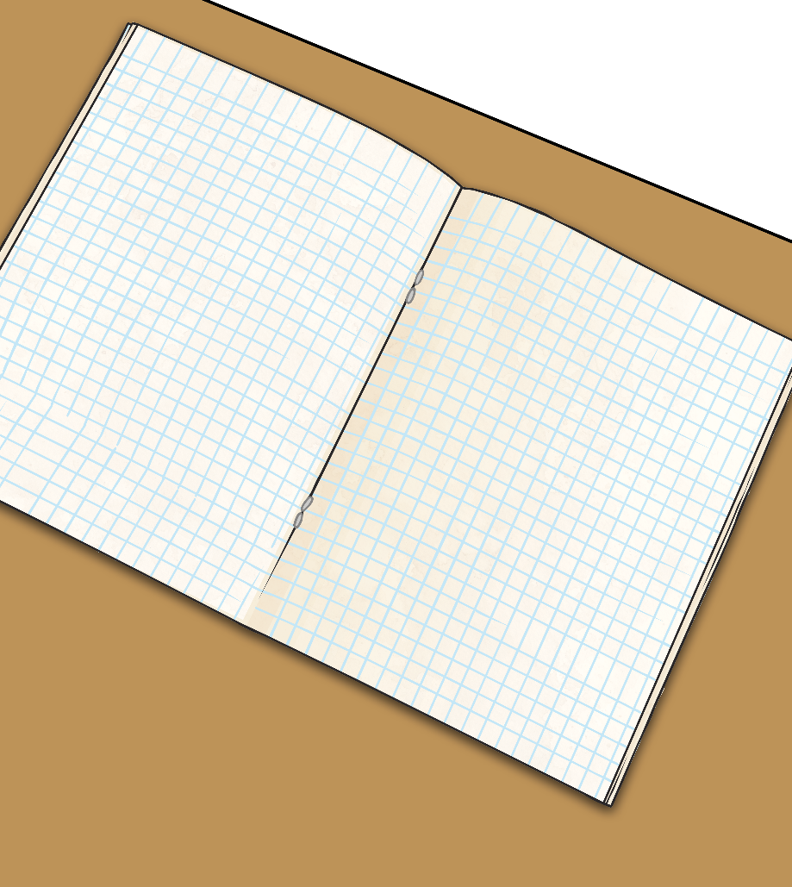
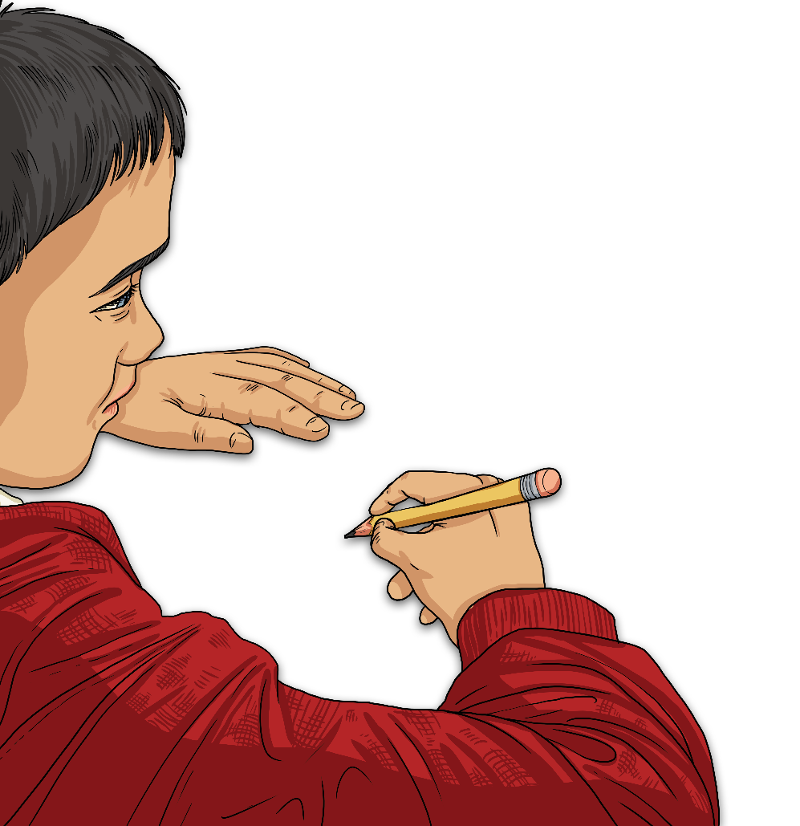
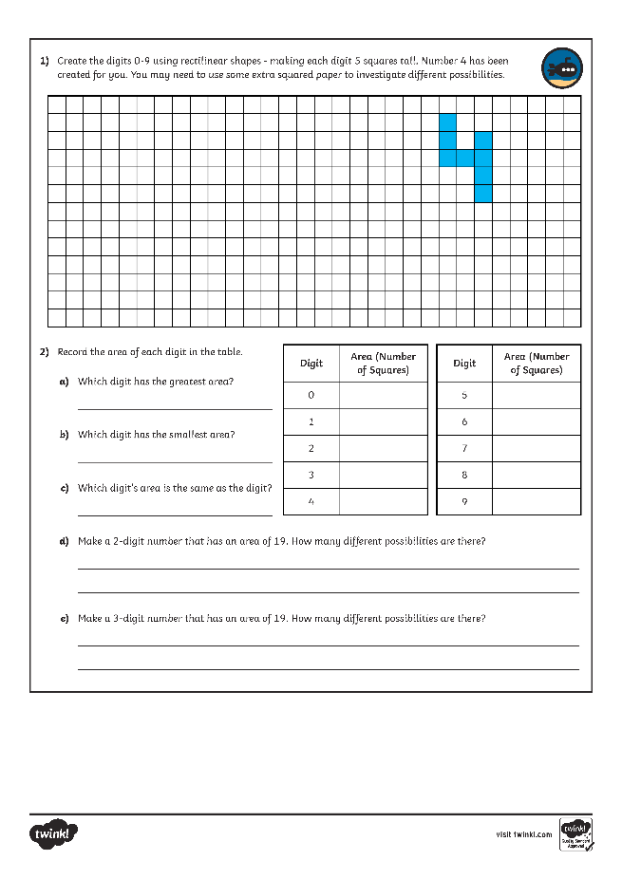
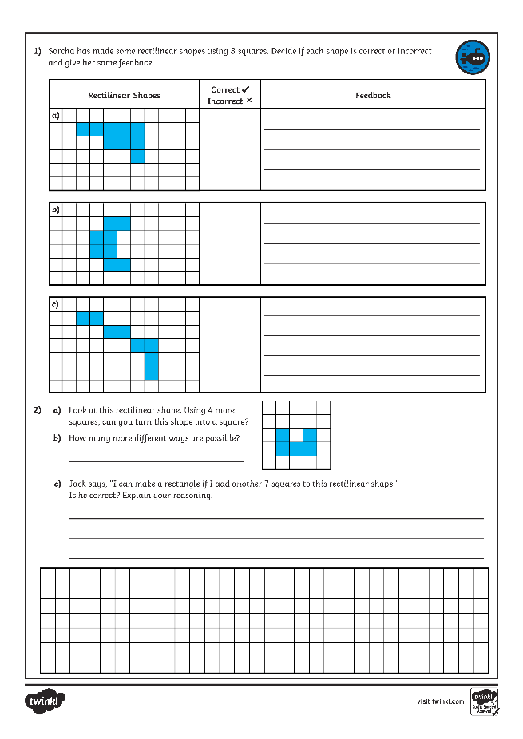
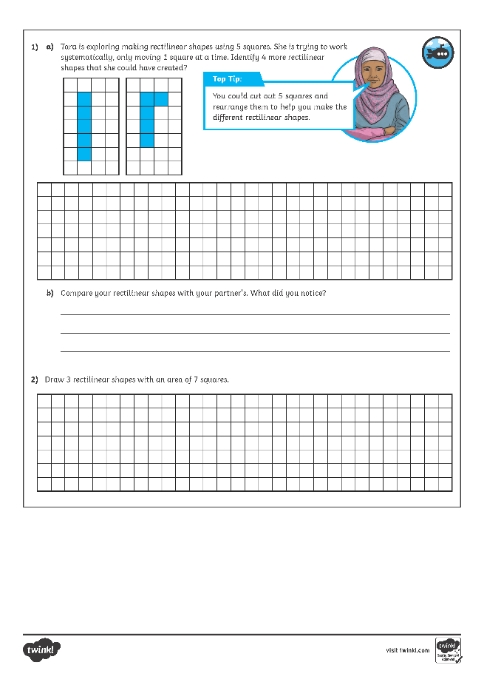
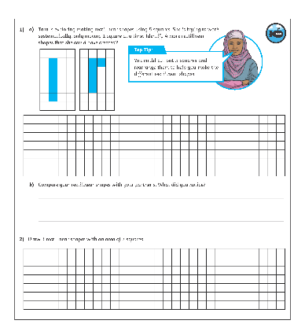
Making Shapes
Dive in by completing your own activity!

Slide 11
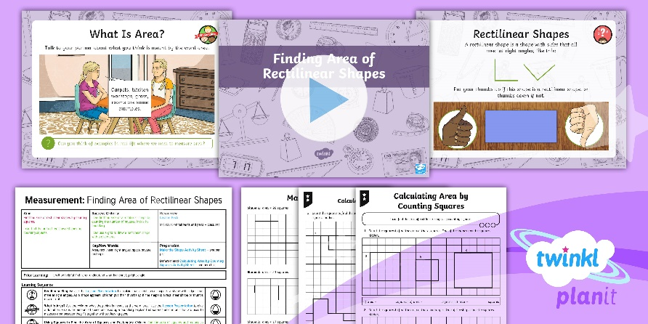
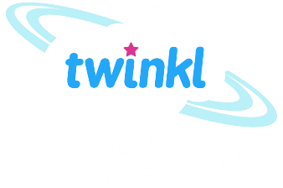
Need Planning to Complement this Resource?
National Curriculum Aim
Find the area of rectilinear shapes by counting squares.
For more planning resources to support this aim, click here.
Twinkl PlanIt is our award-winning scheme of work with over 4000 resources.

