Slide 1
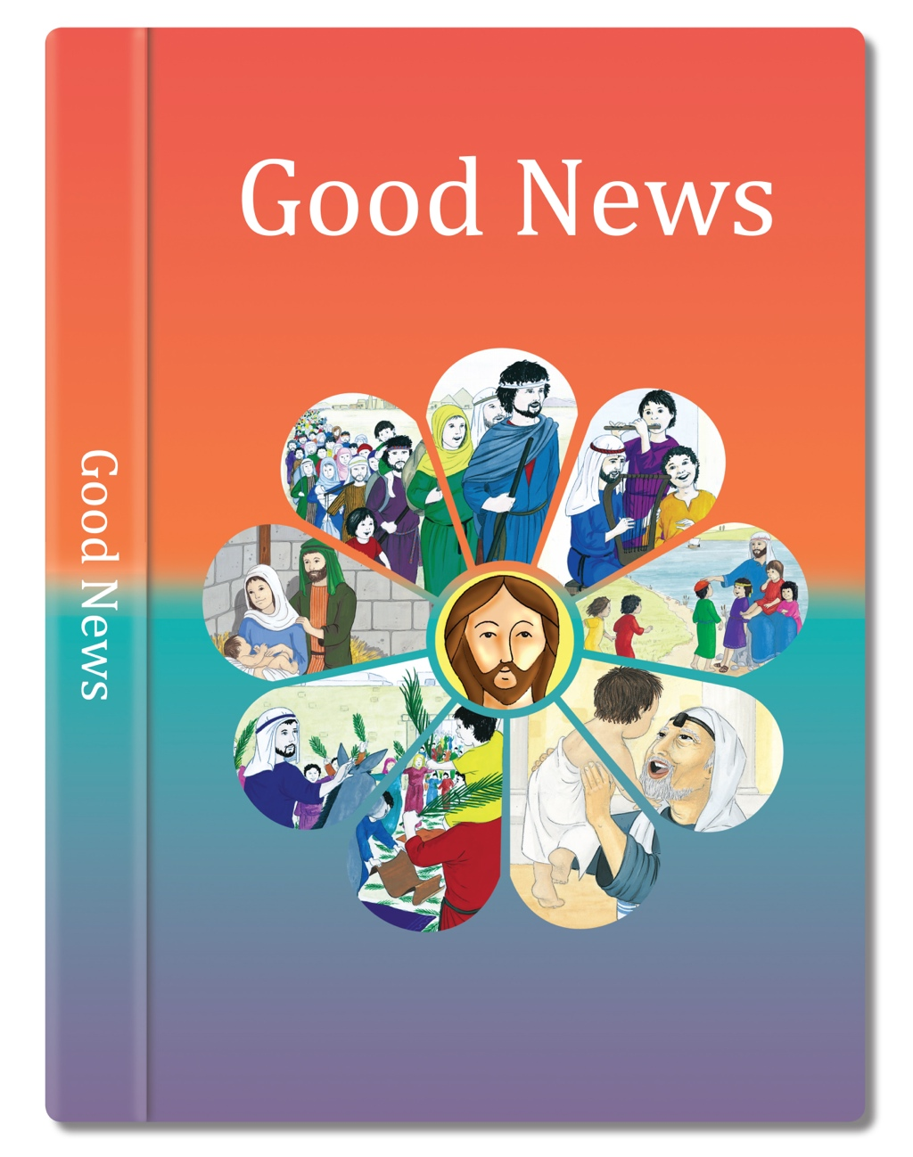

Slide 2

‘Christ is like a single body, which has many parts; it is still one body, even though it is made up of different parts.
In the same way, all of us, whether Jews or Gentiles, whether slaves or free, have been baptised into the one body by the same Spirit, and we have all been given the one Spirit to drink.
All of you are Christ’s body, and each one is a part of it.’
based on 1 Corinthians 12: 12-17, 21, 27
(Come & See)

Slide 3
Oli: to learn about different Christian denominations.
There are different Christian denominations which are not Catholic e.g. Methodist, Baptist, Anglicans and Pentecostal.
What can Christians do together to promote unity?
How could they be encouraged to get to know one another and their Churches?
Which Christian Churches do you know in your neighbourhood?

Slide 4
Take a virtual tour of the Highland Park Baptist Church. How is is different/similat to our church?
Explain what you see and how you know it is Christian?
https://www.fbhp.org/fbhp-360-virtual-tour/
If clicking the link doesn’t work copy and paste to the browser.

Slide 5
Research Baptist denomination and write about it. It should be at least one page long.
https://kids.britannica.com/kids/article/Baptists/443716
Finished?
Read about Methodist denomination.
https://kids.britannica.com/kids/article/Methodism/443427

Slide 6
Make sure your piece of writing includes the answers to the following questions:
When did this Christian denomination begin?
- Who is its leader? Who leads the worship?
- What do you notice that is special or different about it?
- How do people worship?
- What do they believe?
- What is the same?

Slide 7


