Slide 1


Science
Forces
Year One
Science | Year 5 | Forces | Gravity | Lesson 2

Slide 3
Aim
To explore the effect that gravity has on objects and how the first theory of gravity was developed.
Success Criteria
I can explain the effect of gravity on unsupported objects.
I can explain Isaac Newton’s role in developing a theory of gravity.
I can accurately measure the force of gravity pulling on objects.

Slide 4
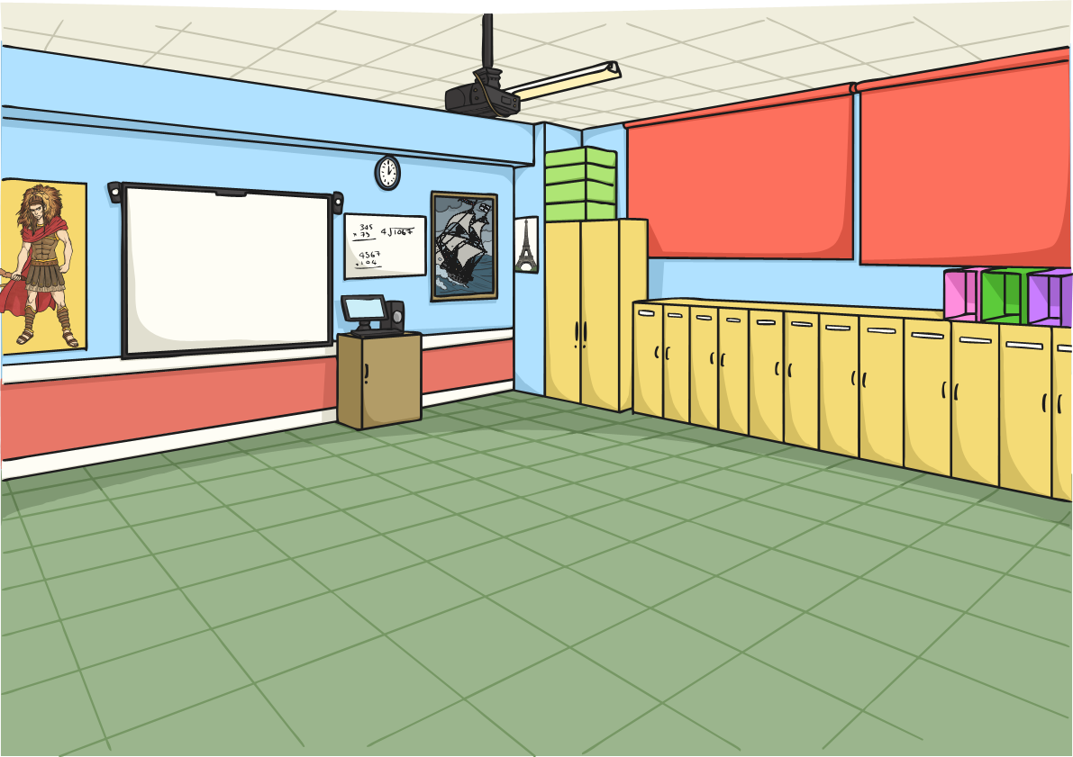










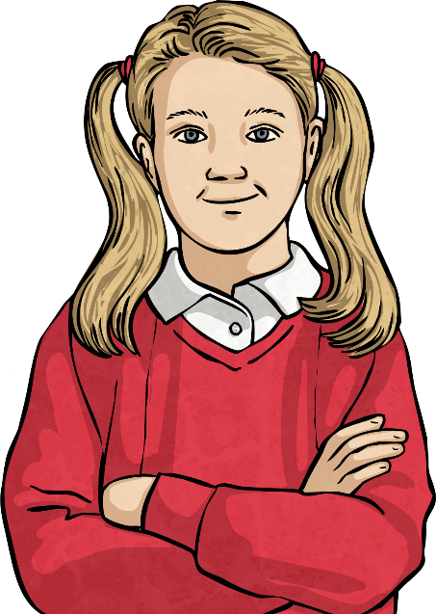
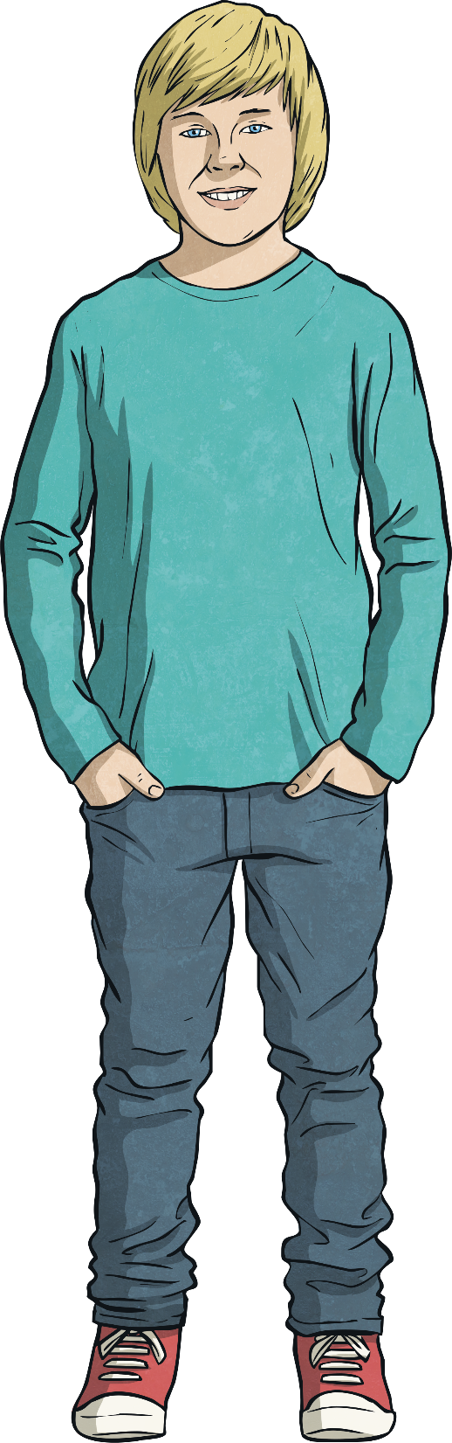

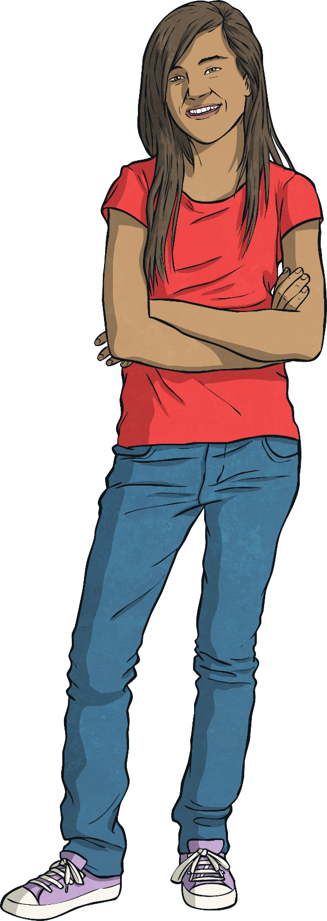
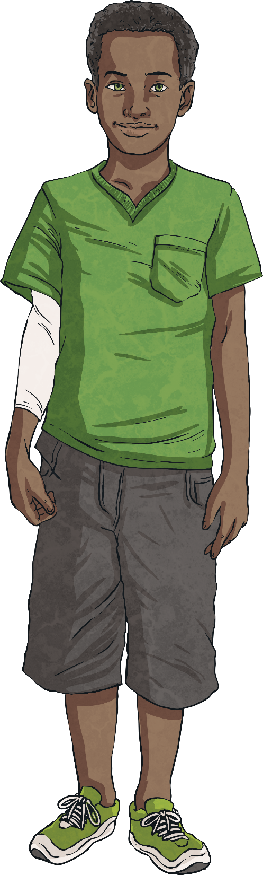
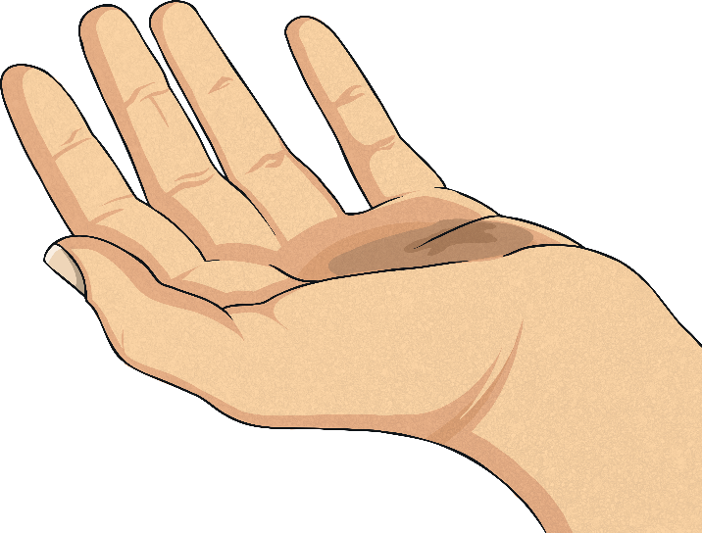
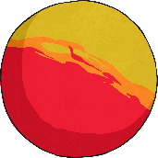
Falling Down
Watch your teacher let go of a bouncy ball. What does it do?
These children are discussing why the bouncy ball falls down rather than falling up, sideways or staying still.
Which child or children do you agree with?
There is no air resistance acting on the ball, so it can go straight down.
The ground exerts a force on the ball so the ball is magnetically attracted to the ground.
The ball falls downwards because gravity is pulling it down.
The bouncy ball falls downwards because it is heavy. If it were lighter, it would float away.

Slide 5

Falling Down
Did you agree with this boy?
Gravity is the force that means that objects are pulled towards the centre of the Earth.
All objects exert a gravitational pull. However, the strength of an object's gravitational pull depends on its mass. The Earth is a huge object with an extremely high mass, so its gravitational pull is very strong.
The force of gravity keeps us on the ground. Gravity also causes objects to fall down if they are dropped.
Gravity pulls the bouncy ball downwards so it falls down.

Slide 6
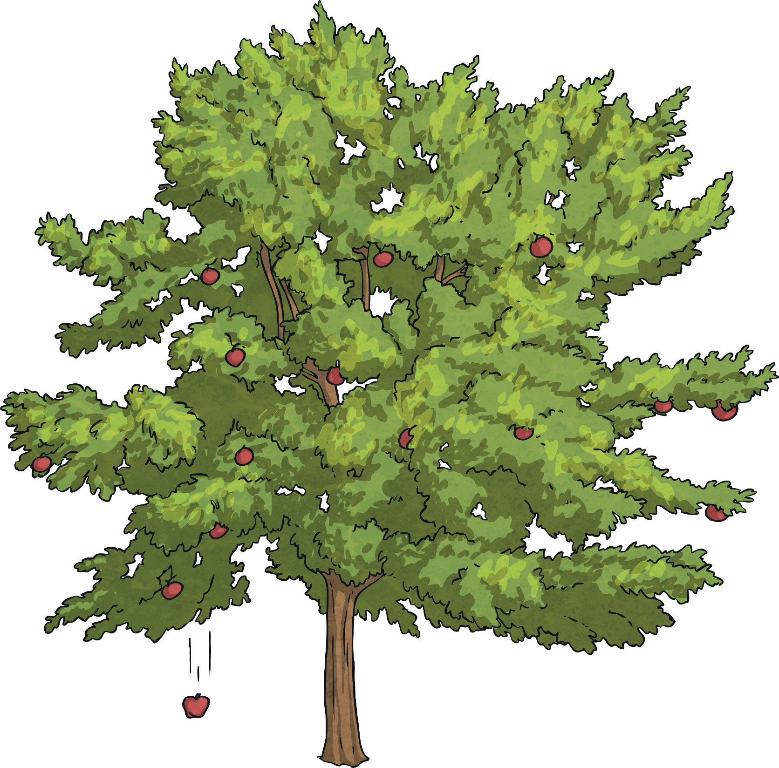
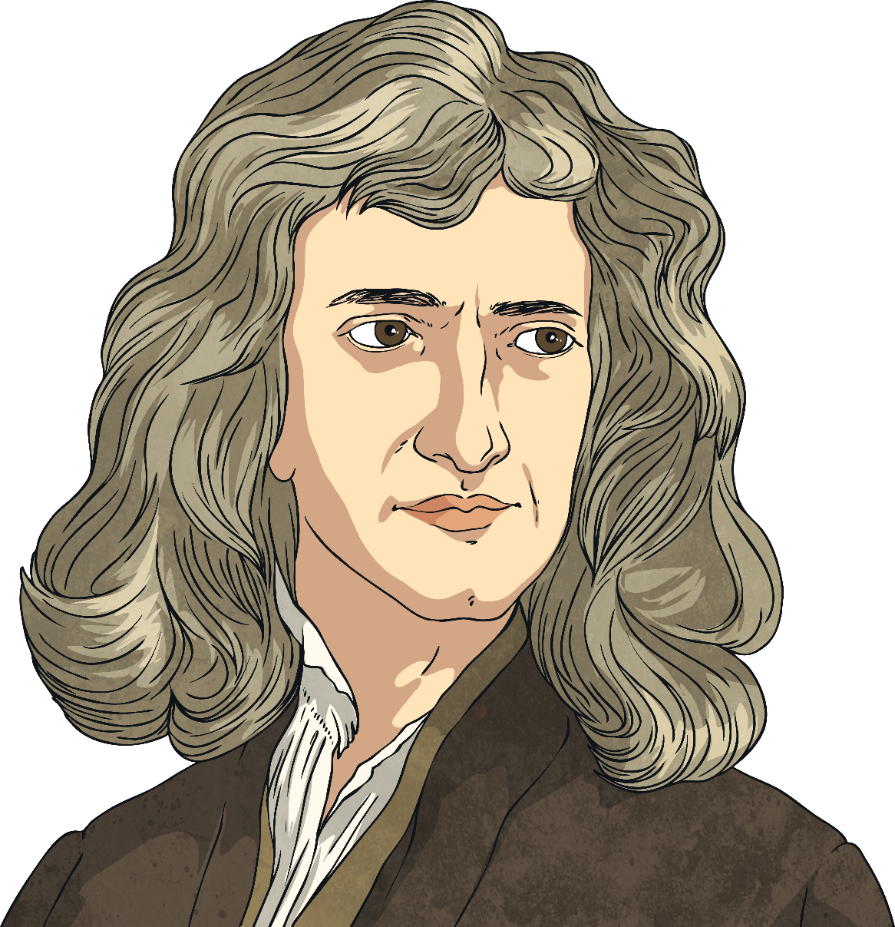
Discovering Gravity
This is Isaac Newton. Do you have any idea why he is pictured next to an apple tree?

Slide 7
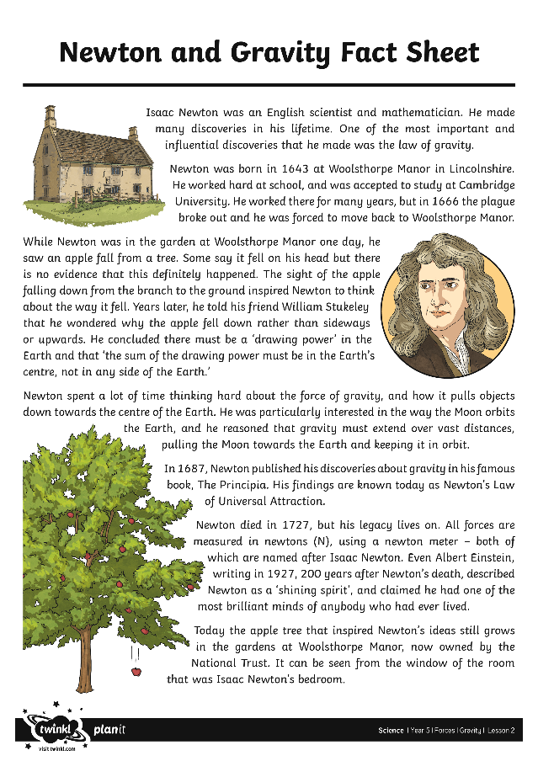

Discovering Gravity
Isaac Newton famously developed his
theory of gravity when he
saw an apple fall to the
ground from an apple tree.
Read your Newton and Gravity Fact Sheet about his life and his theory. Then answer the questions on the Newton and Gravity Activity Sheet.

Slide 8
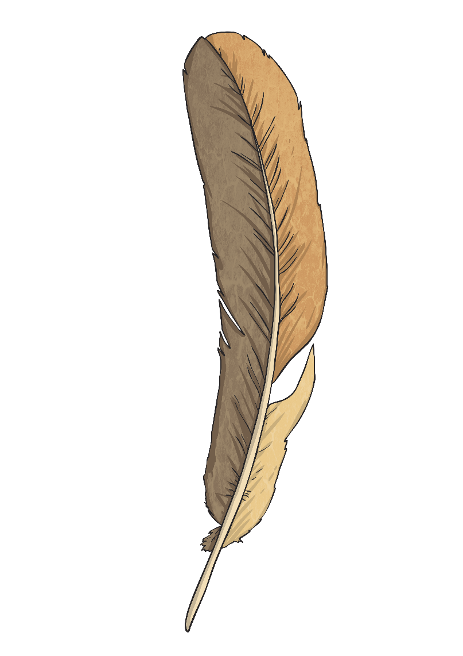
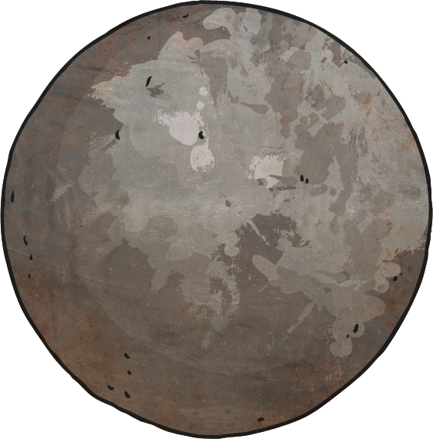
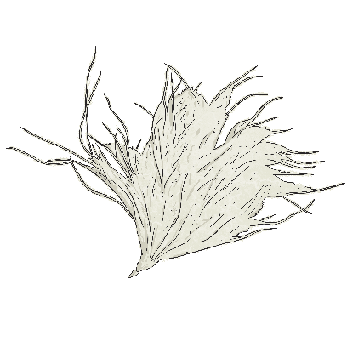
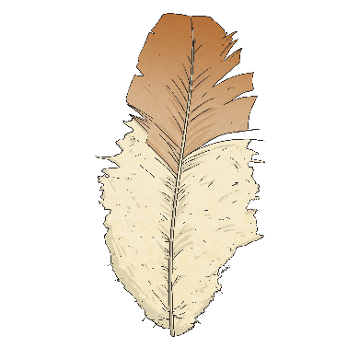
Weight and Mass
People often use the words weight and mass to mean the same thing.
Mass is a measure of the amount of ‘stuff’ inside an object, and is measured in kilograms (kg).
Weight is actually a measure of the strength of gravity acting on an object. It is measured in newtons (N).
The weight of an object is caused by gravity pulling it down. Objects with more mass have a greater weight, as the force of gravity pulls them down more strongly.

Slide 9

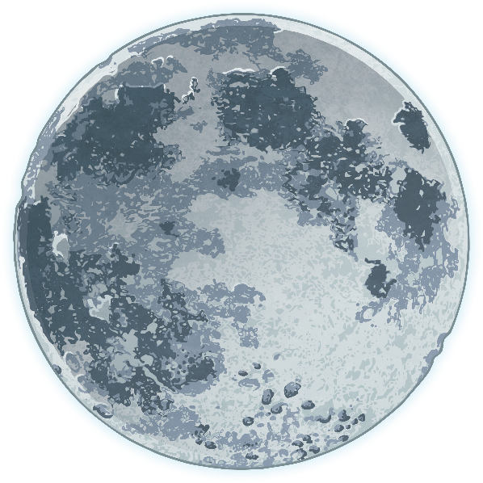
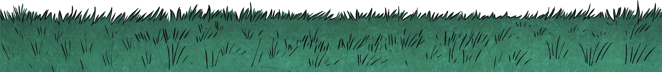
Weight and Mass
An object's mass will stay the same even if it is in a place with weaker gravity, like the Moon.
However, an object’s weight can change! If the object were on the Moon, although it would have the same mass, it would weigh much less as the gravity would not be pulling it down as strongly. The Moon’s gravity is much weaker than the Earth’s.

Slide 10
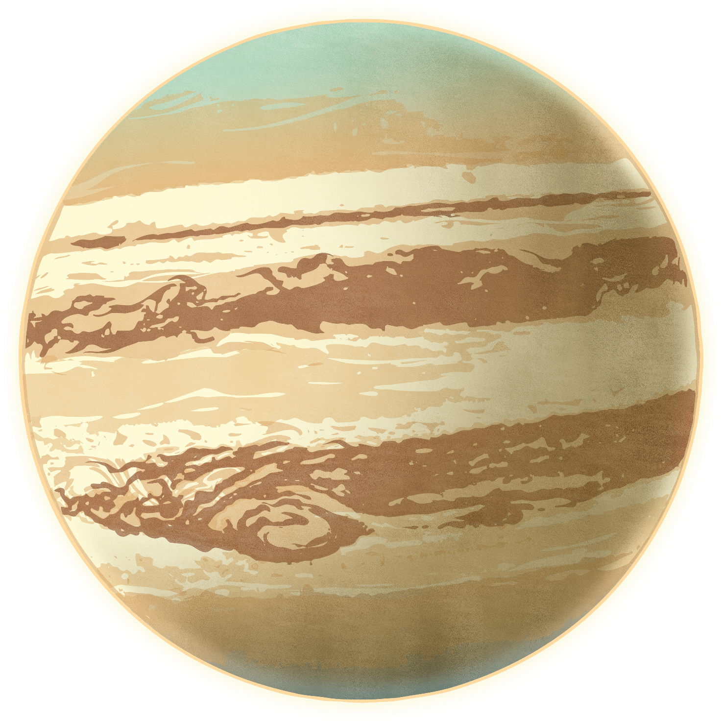
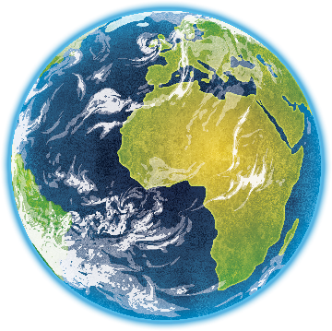
Weight and Mass
Jupiter is a much bigger planet than Earth so it has a stronger gravitational pull. Although an object would have the same mass on Jupiter as anywhere else, it would weigh much more due to the gravity pulling it more strongly.

Slide 11
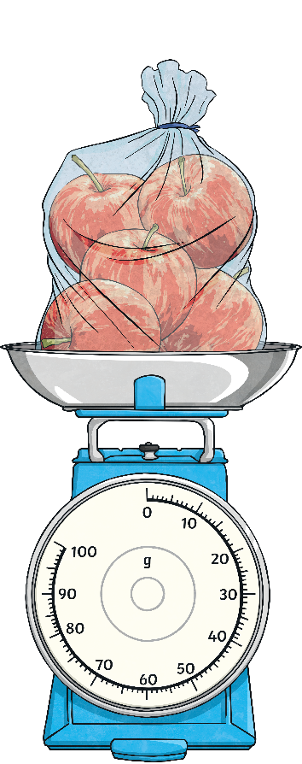
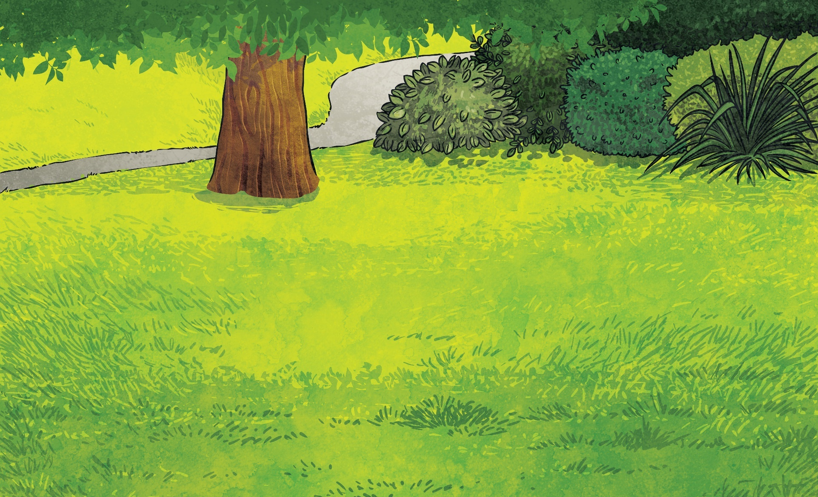
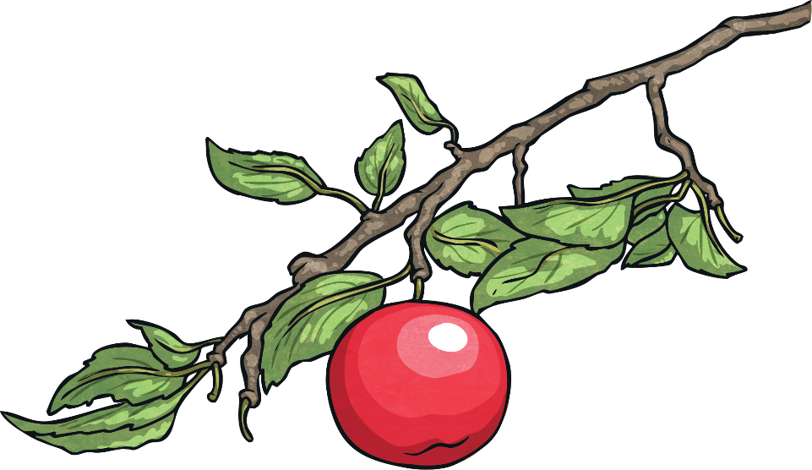

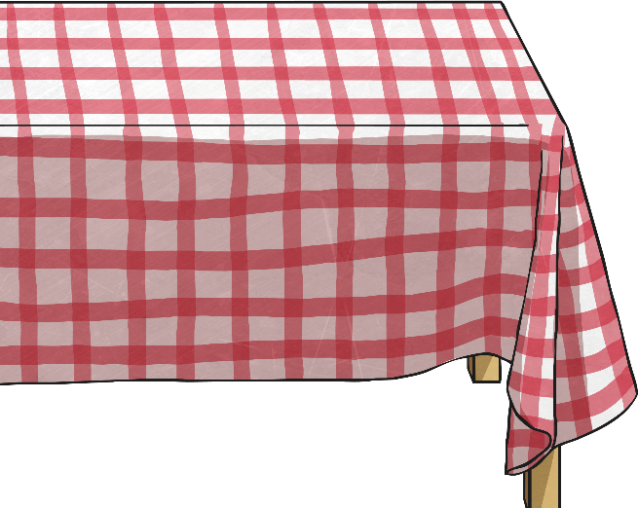
Weight and Mass
Remember
Mass is how much matter (or ‘stuff’) is inside an object. It is measured in kilograms (kg).
Weight is how strongly gravity is pulling an object down. It is measured in newtons (N).

Slide 12
Aim
To explore the effect that gravity has on objects and how the first theory of gravity was developed.
Success Criteria
I can explain the effect of gravity on unsupported objects.
I can explain Isaac Newton’s role in developing a theory of gravity.
I can accurately measure the force of gravity pulling on objects.

