Slide 1
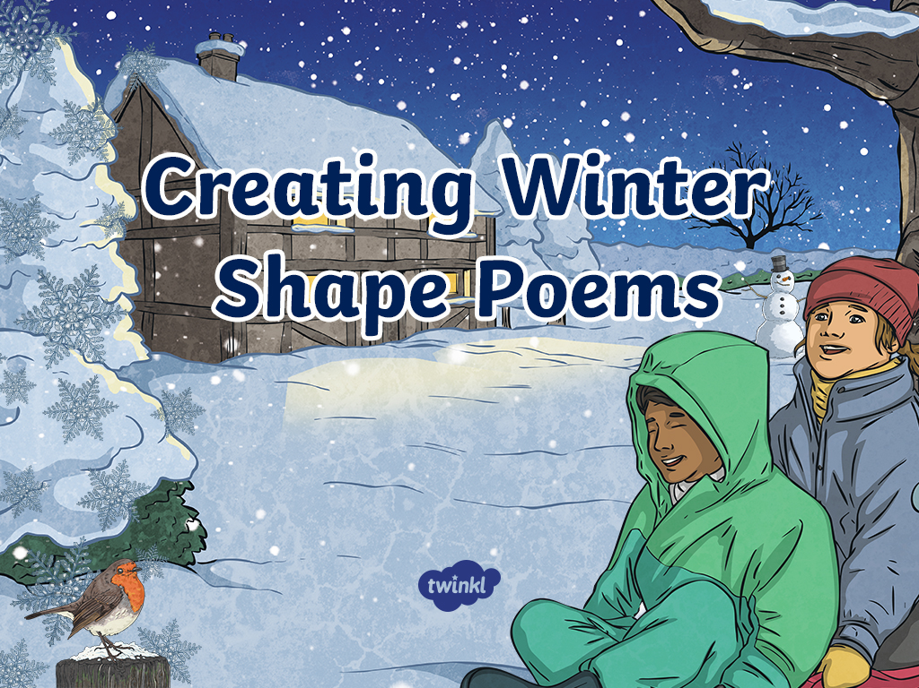

Slide 2
Aim
To understand the features of shape poetry
Success Criteria
I know that a shape poem describes an object, person or animal and the words of the poem form the shape of the object, person or animal being described.
I understand that shape poetry doesn’t have to rhyme.
I can try to include alliteration and similes in my poem.
I can create my own winter themed shape poem.

Slide 3

Shape Poems
Can you and a partner guess what these poems are describing?
Hint: You can use the words and the shape of the words to help you.
They glide across
the golden grass
gathering goblins and
gathering grasshoppers.
They giggle as they
glide above
the ground.
Reveal a Hint

Slide 4

Shape Poems
Can you and a partner guess what these poems are describing?
Softly, it falls silently from the sky.
It is so silvery, small and sudden.
Slowly you slip and slide as you sled
your way through its silky secrets.
Hint: You can use the words and the shape of the words to help you
Reveal a Hint

Slide 5
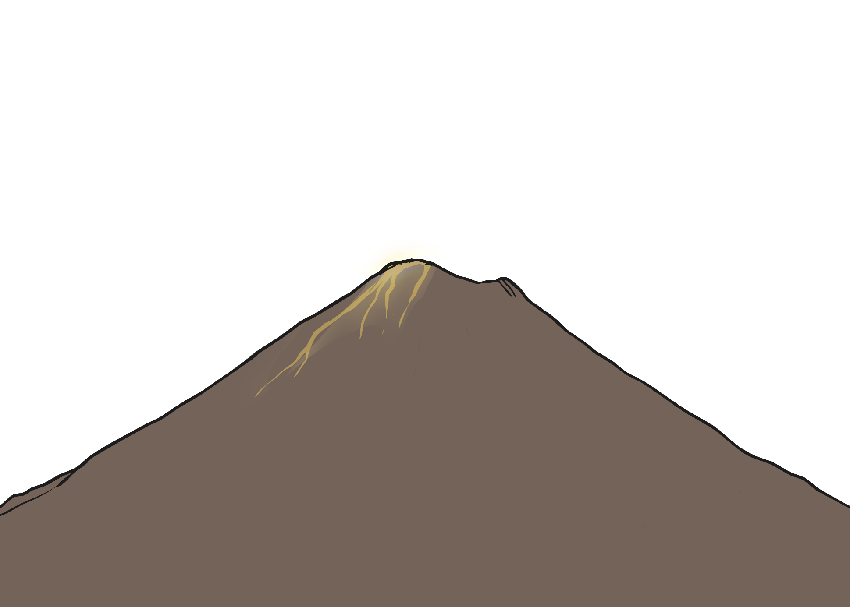
Shape Poems
Can you and a partner guess what these poems are describing?
Hint: You can use the words and the shape of the words to help you
Reveal a Hint
A huge rock that
rumbles and roars, wrecking the
ground all around it. It shoots sizzling,
steaming, scorching lava like a monster spitting
out hot liquid into the air. Like a smoking dragon, it finally
starts to calm down. The chaos stops and it goes back to being a
deadly and dangerous rock.

Slide 6

What is a Shape Poem?
A shape poem is a poem that describes an object, person or animal.
The special thing about a shape poem is that the
words of the poem form the shape of the object,
person or animal being described.
Shape poems don’t have to rhyme!
Shape poems can use full stops and capital
letters like sentences.
Shape poems often use alliteration
or similes.

Slide 7

Let’s Try it!
Sweet, steamy and smooth
Lick the soft, delicious whipped cream
As it sits upon a rich, chocolatey bath.
Sip the comforting liquid,
which is as hot as
lava, carefully
Sweet, steamy and smooth
As it slowly cools
Gulp it down
Down, down
Mmmm
Mmm
Mm
m
As it cools, gulp it
down, down, down
Here are some lines written using the adjectives and phrases that we brainstormed.
Oh no, they’re all mixed up! Can you put them into the right order to make the shape of a glass of hot chocolate?
Use the length of the lines and the punctuation to help you.
Mmmmmmm.
as it sits upon a rich, chocolatey bath.
which is as hot as lava carefully
Sip the comforting liquid
Lick the soft, delicious whipped cream

Slide 8
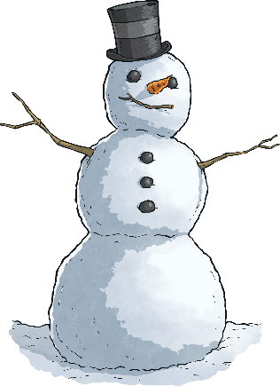

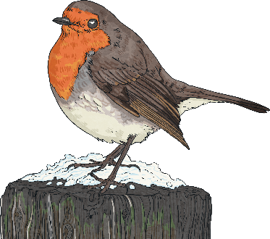
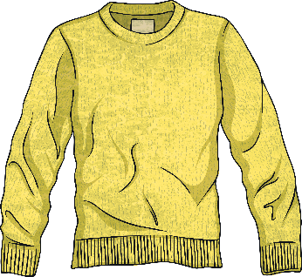
It’s Your Turn to Brainstorm
Let’s make a shape poems describing winter objects, animals or themes! As a group, choose 2 or 3 of these winter objects and brainstorm some words or phrases to describe them
cold
roly-poly friendly
eyes made of coal
blazing
spectacular
crackling
with a breast as red as cherries
small
beautiful
cosy
as soft as cotton
fluffy comforting like a hug

Slide 9
It’s Your Turn to Write a Shape Poem
Now, start writing your Wilbur poem. Using the ideas you have brainstormed and an outline of the object or animal you have chosen, create your own shape poem
Remember to stay inside the lines of the picture, starting a new line when you get close to the edge.
Don’t forget to use full stops and capital letters.
Try to use alliteration or similes if you can. This will make your shape poem more exciting and descriptive.

Slide 10

Plenary
Tellme a fantastic adjective that you have used in your shape poem.
Who can read out an example of where they have used alliteration?
Who has used a simile? What have you compared?

Slide 11
