Slide 1
Islam week OLI: to recognise a Mosque is an Islamic place of worship. 1. Watch the video on the website and Google Classroom 2. Read today’s story ‘Rameena’s Ramadan’ available on the website and Google Classroom 3. Go through this PowerPoint to help you understand the task. 4. complete the artwork.

Slide 2
In the story provided on the other PowerPoint, Rameena and her family went to their local mosque on the first day of Eid. A mosque is where Muslims go to worship and pray. You will be making a silhouette of a mosque with a sunrise in the background.

Slide 3
Mosque at Sunrise
Rameena and her family went to their local mosque on the first day of Eid.
mosque – a Muslim place of worship
Eid – a Muslim festival

Slide 4
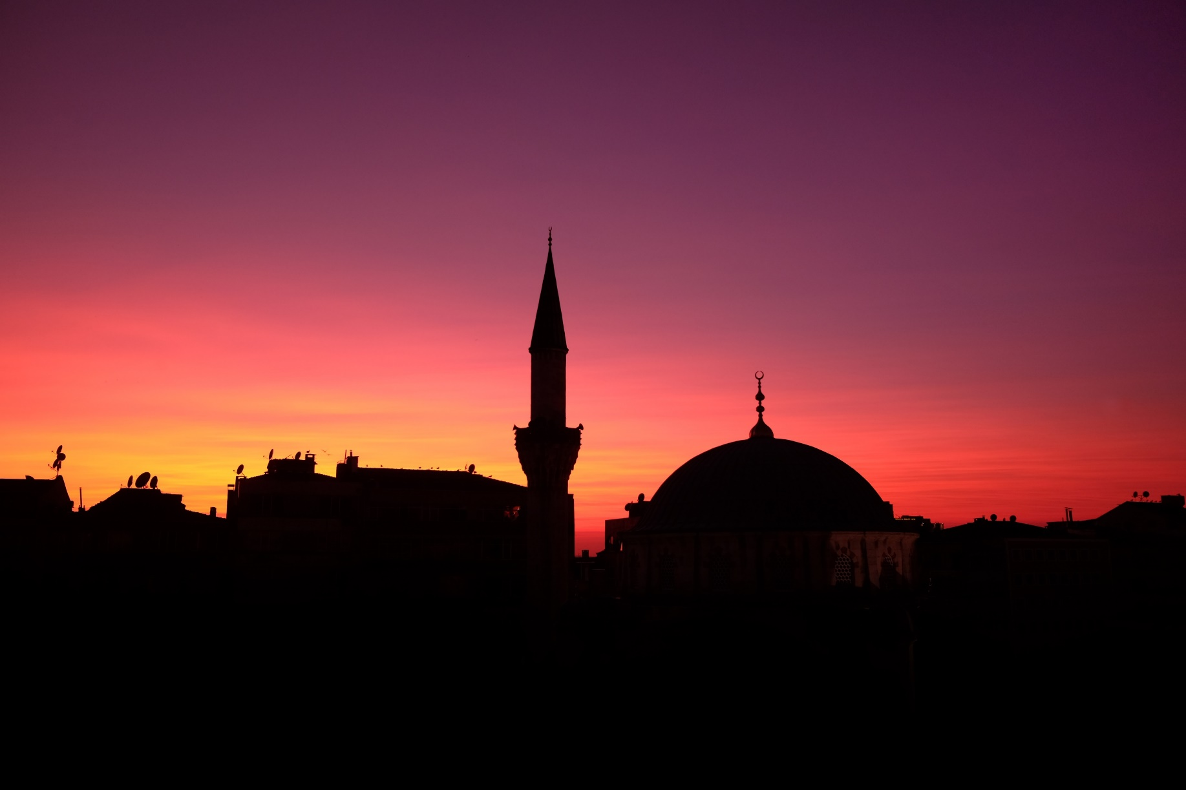
Mosque at Sunrise
It was very early in the morning. The sun was rising and the sky was full of colours.

Slide 5
Mosque at Sunrise
Today, we are going to make our own beautiful pictures of a mosque at sunrise.
We are going to use mixed media to create our artworks.
We will use paint to make our colourful sky.
We will use collage to create a silhouette of a mosque.
silhouette – a dark shape and outline of something

Slide 6
Mosque at Sunrise
Look carefully at the image of skies at sunrise that you have. What colours can you see in the sky?
These are the colours that you will use in your painting of the sky.
“Unnamed Sky 3” by [Yazuu] is licensed under CC BY 2.0

Slide 7
Watercolour Wash
To make the colourful sky, you can use watercolour paints, or normal paint if you don’t have watercolours.

Slide 8
Watercolour Wash
Dip your brush into the water so it is very wet.
Then, dip your brush into your first colour.

Slide 9
Watercolour Wash
Sweep your brush from one side of your paper, all the way across to the other.
The brush should sweep smoothly along the page. If not, add more water to your brush.

Slide 10
Watercolour Wash
Dip your brush back into water to remove any paint and make the brush wet again.
Then, dip the brush into your second colour.

Slide 11
Watercolour Wash
Sweep your brush across the page again, underneath the first colour.

Slide 12
Watercolour Wash
Dip your brush back into water to remove any paint and make the brush wet again.
Then, dip the brush into your third colour.

Slide 13
Watercolour Wash
Sweep your brush across the page again, underneath the second colour.
If your page is full, stop there. If not, continue until the page is covered.
Then, wait for you sunrise sky to dry.

Slide 14
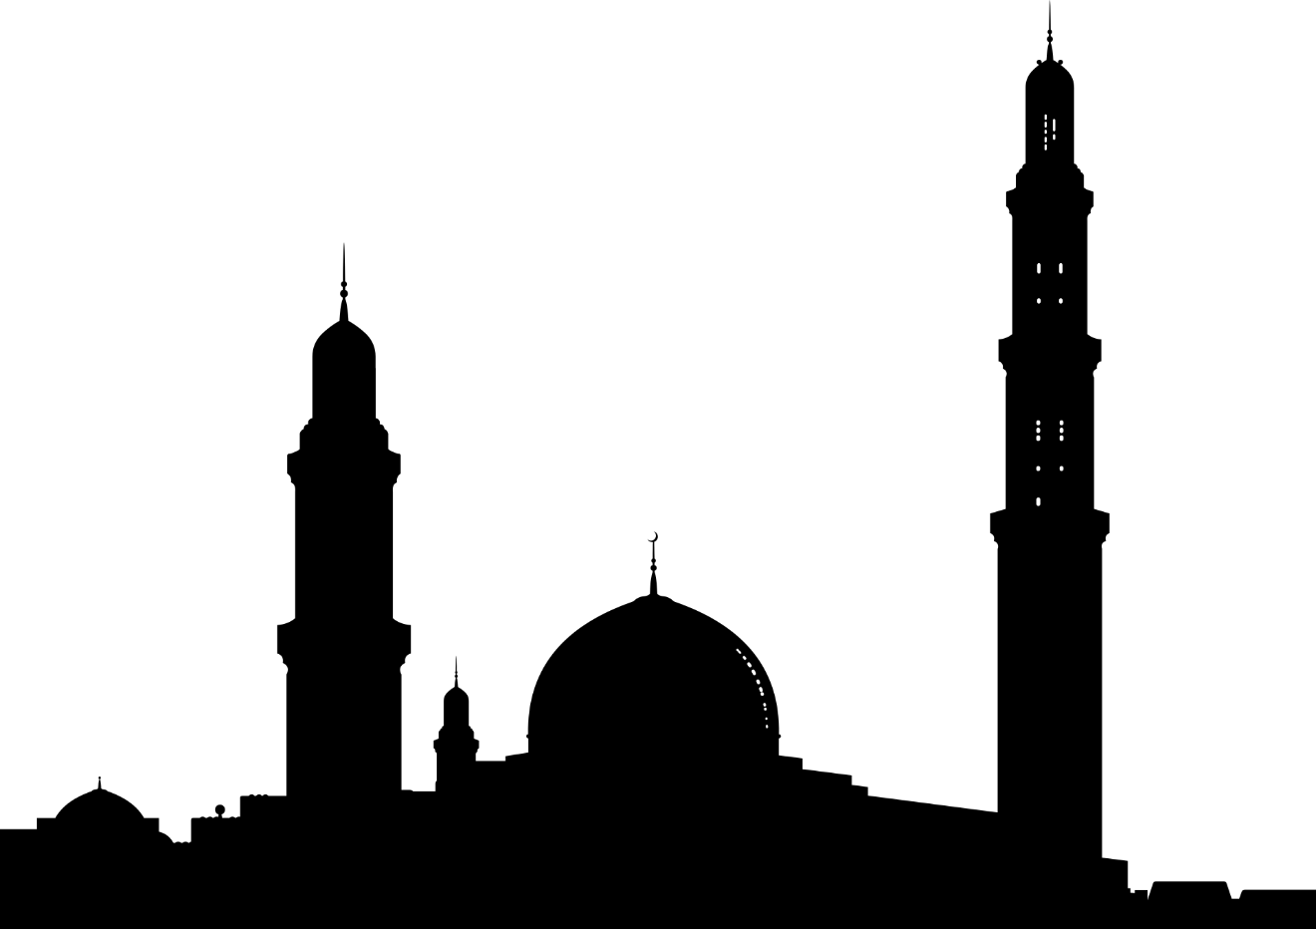
Mosque Silhouette
Next, you need to make your mosque silhouette to add to the scene.
Look carefully at the mosques in the photos.
Your silhouette should include the key features of a mosque.

Slide 15
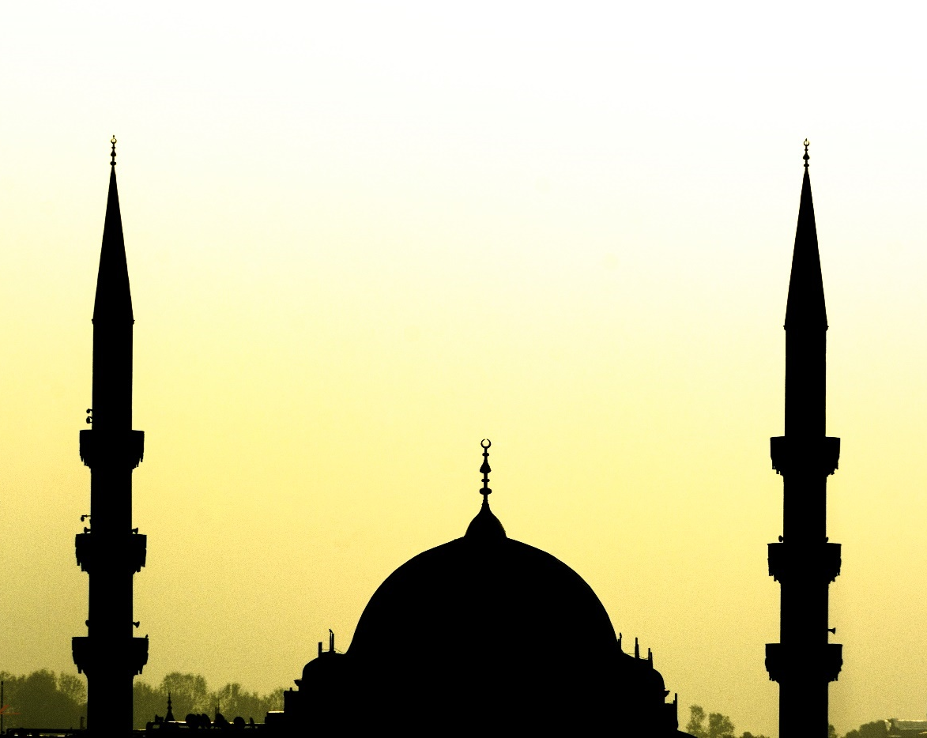
Mosque Silhouette
Features of a Mosque
minaret
This is a thin tower. A muezzin, or crier, calls from the minaret to tell people that it is time to pray.
dome
Most mosques feature a dome, also called a qubba. The dome usually covers the main hall in which people pray.
“Peace” by [Sedat ONAT] is licensed under CC BY 2.0

Slide 16
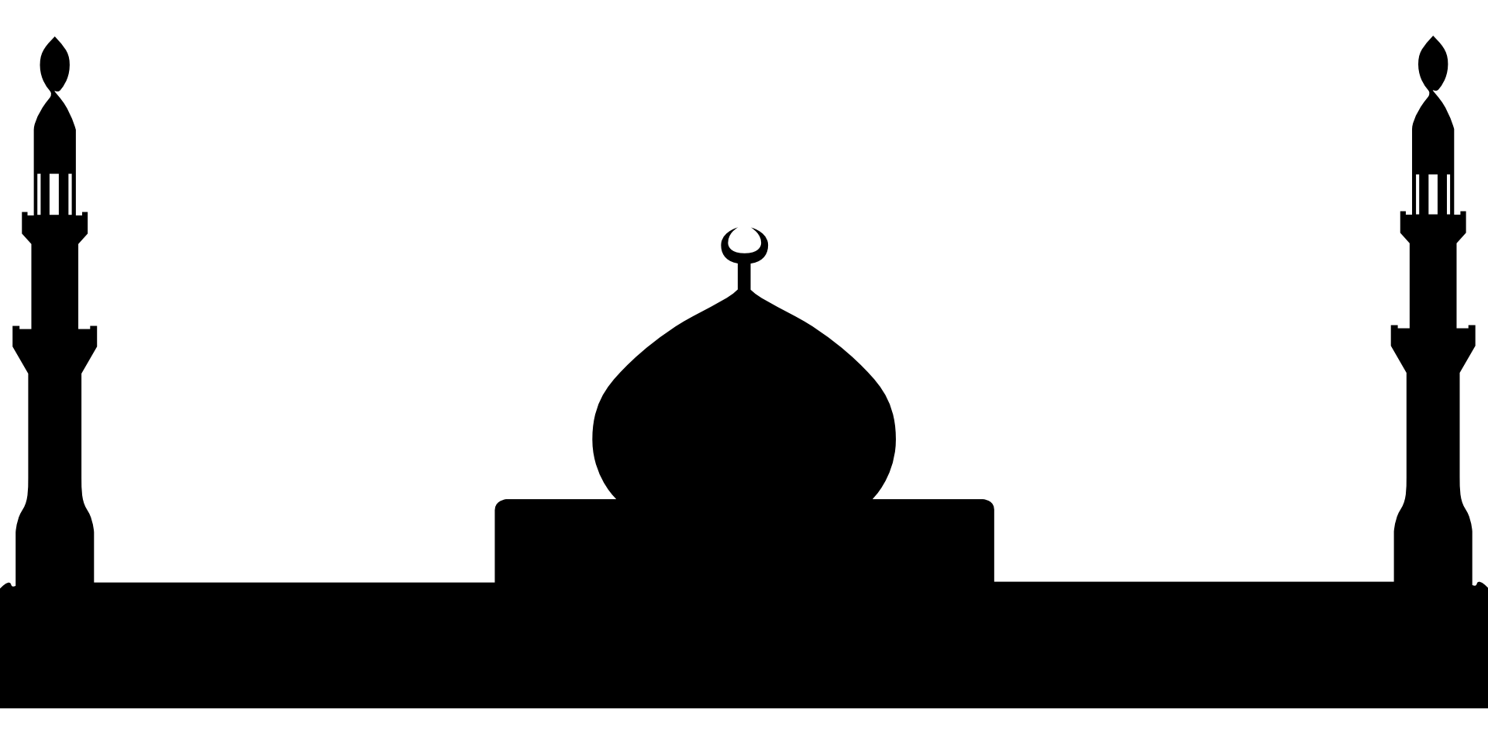
Mosque Silhouette
Draw your mosque silhouette in pencil onto your black paper (or use my template as a stencil/ paint it black.
If you make your own, try and include the key features: a dome and at least one minaret.
Try to keep your design simple, rather than very detailed, so that you are able to cut it out later.
You can use my template and paint it black f you would prefer.

Slide 17
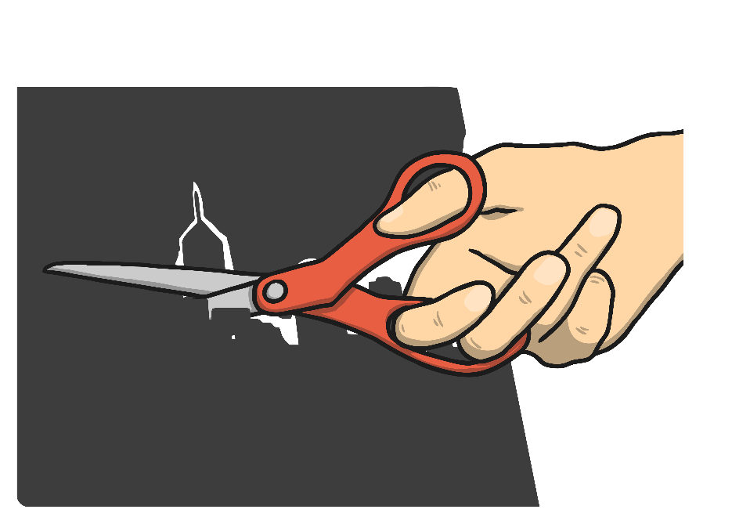
Mosque Silhouette
When your mosque shape is ready, cut it out very carefully to make sure you include all of the details.
For an extra challenge, try cutting out a door or windows.

Slide 18
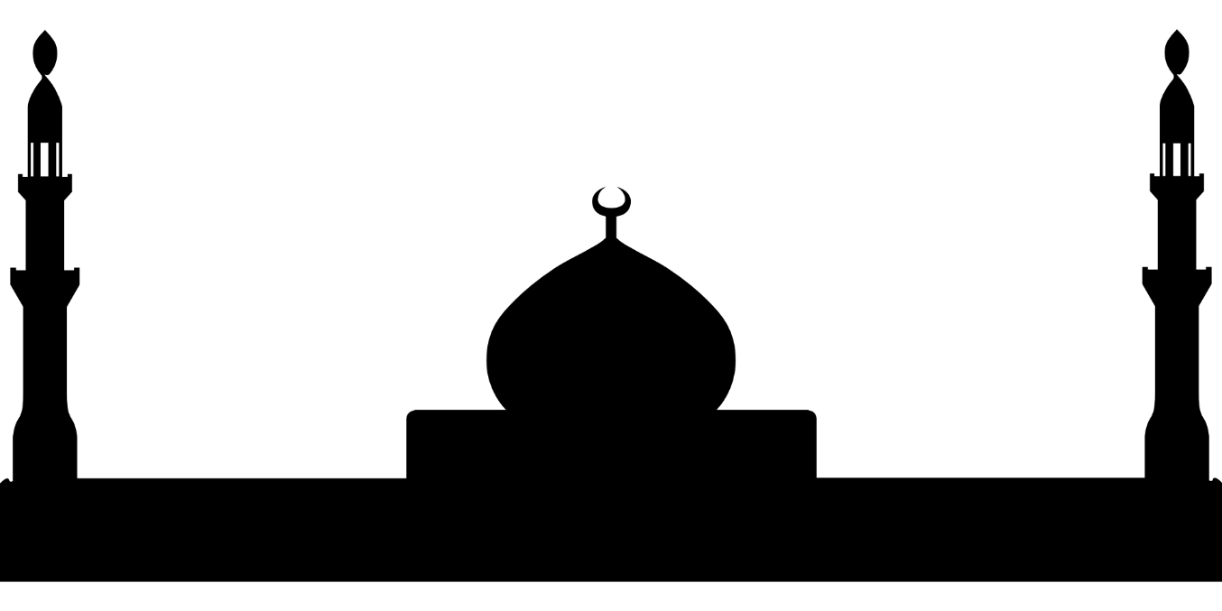
Your Unique Artwork
Then, stick your mosque silhouette onto your dry sunrise background.
You will now have your own unique picture of a mosque at sunrise!

